Slide 1
A Taste
4 English
Newspapers

Slide 2
We distinguish newspapers according to:
A. Frequency of publication
① daily
② weekly
B. Size / type of newspaper
① tabloids – popular papers
② broadsheets – quality papers
C. Expansion
① Local newspapers
② National newspapers

Slide 3
Types of Newspapers
Tabloids
Quality Papers
➲ smaller in size
➲ larger in size
➲ smaller pictures
➲ bigger pictures, most in colour
➲ more pictures
➲ less pictures
➲ shorter articles
➲ more detailed articles
➲ bigger, sensationalistic headlines
➲ less ‘sensational’ headlines
➲ informal language
➲ formal language
➲ details about private lives of famous
people
➲ wider coverage of national and international events
➲ bigger print
➲ more accurate, factual reporting

Slide 4

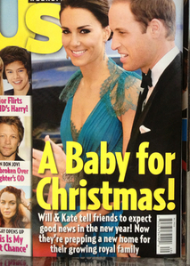
Examples of Tabloids = popular press

Slide 5



Examples of daily quality papers

Slide 6
Sections of a newspaper
advertisements
(ads)
home (national) news
editorial
sports news
foreign (international) news
weather forecast
entertainment and gossip
TV listings
horoscope
business news

Slide 7




