Slide 1
A Taste
4 English
Teenage Tribes

Slide 2
Tel: tale signs
 Mono-syllabic grunts replace normal speech
 When they do speak it's in American ̶ ‘Totally rad’, and ‘That sucks’
 Their head disappears under a back-to-front cap
 Cracks appear in the ceiling below their stereo…
 They are in a band, and toying with names like 'Kryptonite'

Slide 3
Where to find them
 In a ‘mosh pit’ ̶ the crush zone at the front of a gig (the more shoved about you get the more ‘rad’ the experience is)
 Skateboarding on any concrete surfaces they can find
 Car parks
 Outside train stations

Slide 4
They're listening to
 American bands like Linkin Park, Korn, Slipknot, Limp Bizkit
Which sounds like
 Think industrial strength Sex Pistols put through a cement mixer with Iron Maiden and blasted with hip hop (music born out of the Bronx in the late 70s).
 LOUD guitars, LOUD and SHOUTY vocalist and heavy but rhythmic drums. LOUD, LOUD, LOUD.

Slide 5
Love
 Skateboarding
 Ross Robinson (uber producer)
 Baggy oversized t-shirts sporting rock band logos
Hate
 Britney Spears and her pop pals
 Anything played at less than pain threshold
 Smiling

Slide 6
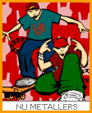
WHO
ARE
THEY?
NU METALLERS

Slide 7
Tel: tale signs
 Any colours but pink, silver and baby blue have been banished from their wardrobe. Yes, it's a girl thing!
 Their bedroom becomes a shrine to pop and soap idols. You can no longer remember what colour the walls are underneath their poster collection
 Fickle: you just can't keep up with their favourites
 They start to look like Britney Spears Mini-Mes
 They dream of marriage to Gareth Gates

Slide 8
Where to find them
 In Claire's Accessories buying more pink things
 In Woolworth’s handing over their pocket money for the latest pop sensation
 Drooling over a poster of Gareth Gates in their shiny new, much coveted Top of The Pops magazine

Slide 9
They're listening to
 Britney Spears, S Club, Gareth Gates, Will Young, Atomic Kitten
Which sounds like
 Squeaky clean, fresh pop fun sung through glistening white teeth!

Slide 10
Love
 Pink
 Britney
 Prince William
 Powerpuff Girls
 Gossiping about who wants to snog who
 Most male pop stars
Hate
 Roller Skates
 ‘All that Nu Metal noise’ Spots

Slide 11

WHO
ARE
THEY?
POP PRINCESSES

Slide 12
Tel: tale signs
 Girls: turquoise and white clothing
 Boys: Ben Sherman shirt, black shoes, and hair gel a go-go
 18 can't come fast enough ̶ so they can dance the night away in ‘super clubs’ like Gatecrasher and Renaissance
 You find brochures for their ‘paradise island’ Ibiza in their bedroom
 All sentences preceded by ‘wicked’

Slide 13
Where to find them
 At the under-18s club, sipping cola
 At the hairdresser’s
 Doing Saturday jobs to save for their Ibiza holiday
 McDonald's

Slide 14
They're listening to
 Basement Jaxx, Faithless, Ministry of Sound compilations or the latest Ibiza club classic
Which sounds like
 Repetitive beats and heavily treated vocals. A bit: Bam Bam Bam, Boooo, Urrrrr, Bam Bam

Slide 15
Love
 Decks
 12" white label (first pressings)
 Vinyl
 Rare grooves
Hate
 Having to be home by 11pm
 Dancing to anything less than 130bpm

Slide 16

WHO
ARE
THEY?
CLUBBERS

Slide 17
Tel: tale signs
 Are they straight outta Compton or straight outta Croydon? They seem more than a little confused about their origins
 They speak in tongues ̶ ‘Dr Dre was really blowing up the house’ (roughly translates as, ‘That was a jolly good performance by good old Dr Dre’)
 They have a new found love of Bling, Bling (jewellery) Mobile phone (the smaller the better) constantly glued to their ear
 Resemble a walking advert for a sportswear shop

Slide 18
Where to find them
 In a sports shop drooling over the latest Nikes
 Surfing the net for Wu Wear (hip hop posse Wu Tang Clan's range of clothes)
 ‘Freestyling’ (making up rhymes) with their homeys (‘homeboys’, friends from their neighbourhood). Admiring the latest 'tags' (personalised graffiti) on the train track walls
 In the record shop checking out CDs with Parental Advisory stickers

Slide 19
They're listening to
 Dr Dre, Eminem/ D12, DMX, Busta Rhymes, Wu Tang Clan, old Hip Hop classics like NWA, Mobb Deep, Public Enemy, and the Hip Hop ladies: Missy Elliot and Lil' Kim
Which sounds like
 A DJ spinning a track, and mixing it in with other beats and sounds while an MC (Master of Ceremonies) sings or shouts over the top, like a poet with lots of attitude

Slide 20
Love
 Ali G
 High-rise Calvins (Calvin Klein underwear) under low-slung baggies (trousers)
 Sportswear
 Mobile Phones
Hate
 Skaters/Nu Metal
 Pop
 When the pre-paid card in their mobile runs out

Slide 21
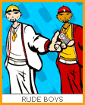
WHO
ARE
THEY?
RUDE BOYS

Slide 22
Tel: tale signs
 They have traded in their school rucksack for a Louis Vuitton-style holdall
 They want to be the fourth member of Destiny's Child
 It's all about being a glamorous Diva, sweetie!
 They are a foot smaller without their high heels on
 They use, and understand, terms like ‘Shake your booty’
 Aspire to having a boyfriend with a four-wheel drive convertible
 Want to live in California!

Slide 23
Where to find them
 Getting their nail extensions put on
 Shaking their booty at their local R&B night spot
 Updating their mobile phones
 Drooling over luxury leather goods at their local department store

Slide 24
They're listening to
 R&B and hip hop stars Missy Elliot, Tweet, Destiny's Child
Which sounds like
 Soul mixed with pop, with slightly provocative lady lyrics

Slide 25
Love
 Designer gear: D&G, Moschino… the more it costs the better!
 Sunglasses: only the best will do
 Gold Jewellery
Hate
 Nu Metal
 Mess or dirt
 When their nail extensions fall off in public

Slide 26

WHO
ARE
THEY?
SOULSTRELS

Slide 27
Tel: tale signs
 Their room is painted black
 Panda eyes and white face
 Like shy woodland creatures they adopt a protective shell-like disguise to save them from predators
 Seem to have misplaced their smile
 They aspire to be an individual… but share a uniform

Slide 28
Where to find them
 In their black bedroom being misunderstood and writing poetry
 Posing dramatically on the ‘dance’ floor
 Buying more black items of clothing
 Being misunderstood with their fellow misunderstood friends
 Goth Mecca, Camden in London

Slide 29
They're listening to
 Cradle of Filth, Fear Factory, old Goth classics Siouxsie and The Banshees, The Mission, The Cure and The Damned, Sisters of Mercy
Which sounds like
 Dark and full of doom and a tad spooky. Swelling guitars, feedback and dramatic vocals - a sonic cathedral of sound

Slide 30
Love
 Black clothes
 Cats
 When they scare people by just looking at them
 People not understanding them
Hate
 Band names with ‘fear’ in them
 Hairspray
 Black platform shoes
 Pop
 Daylight
 Colour, except for red
 Confrontation
 Being told they will 'grow out of it'

Slide 31
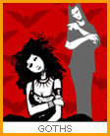
WHO
ARE
THEY?
GOTHS

Slide 32
Tel: tale signs
 Demands for you to hand over your 70s drainpipe cords
 Clothes from Oxfam
 Eyes have disappeared under a floppy fringe and that 'just fallen out of bed' look

Slide 33
They're listening to
 Independent 'Alternative' Music, from small independent labels in pressings of say 100 straight out of Reykjavik
 Garage Rock like The Strokes, The White Stripes, Yeah Yeah Yeahs
 Old indie classics ̶ The Velvet Underground, The Smiths, Nirvana, The Pixies
Which sounds like
 Guitars and drums and rock and roll

Slide 34
Love
Hate
 7" vinyl
 70s badges
 John Peel
 Anything popular
 Obscure independent record labels
 Boy Bands, especially if they are trying to look a bit ‘indie’
 R&B
 Not being working class
 When their favourite band jumps from obscurity on a cool independent to a major label
 When someone knows a more obscure band than they do

Slide 35

WHO
ARE
THEY?
INDIE KIDS

Slide 36
AND NOW …
LET´S MEET SOME OF
THE ‘OLDIES’
(I MEAN… OLD TEEN TRIBES)

Slide 37
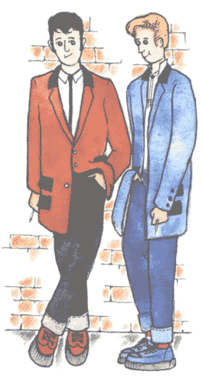
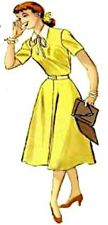
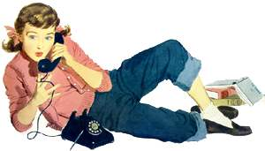

WHO
ARE
THEY?

Slide 38
Teddy Boys and
Teddy Girls

Slide 39
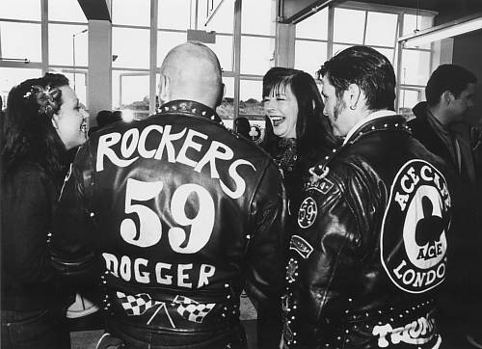
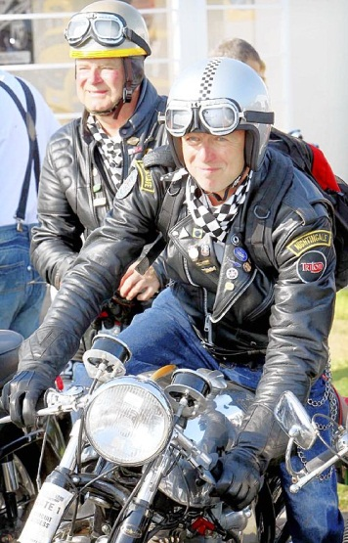
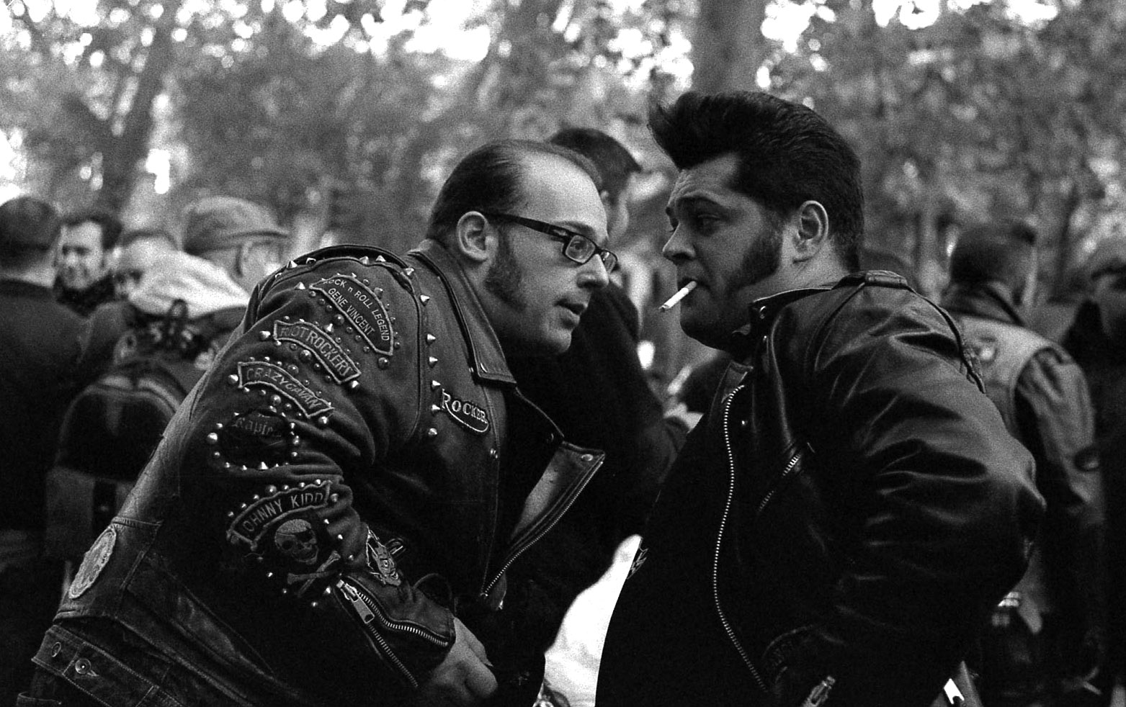
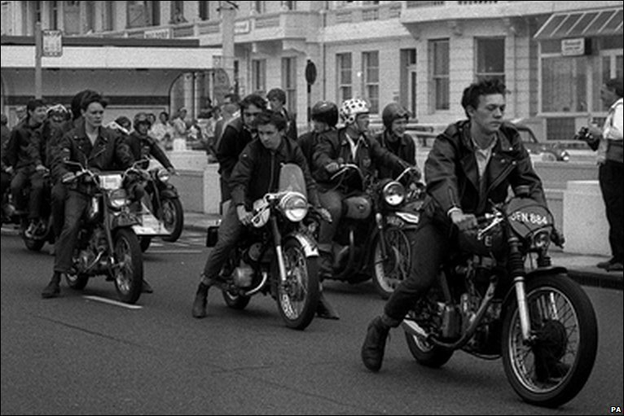
WHO
ARE
THEY?

Slide 40
Rockers

Slide 41
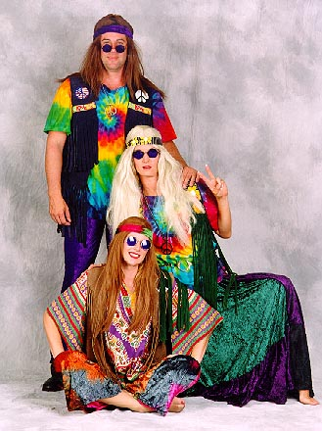
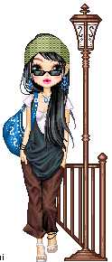

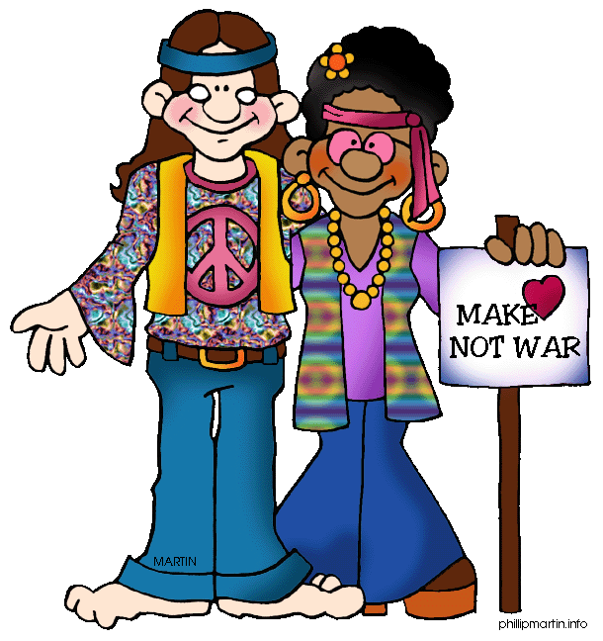
WHO
ARE
THEY?

Slide 42
Hippies

Slide 43
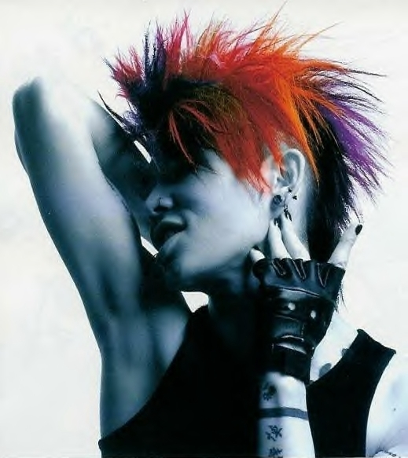
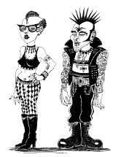
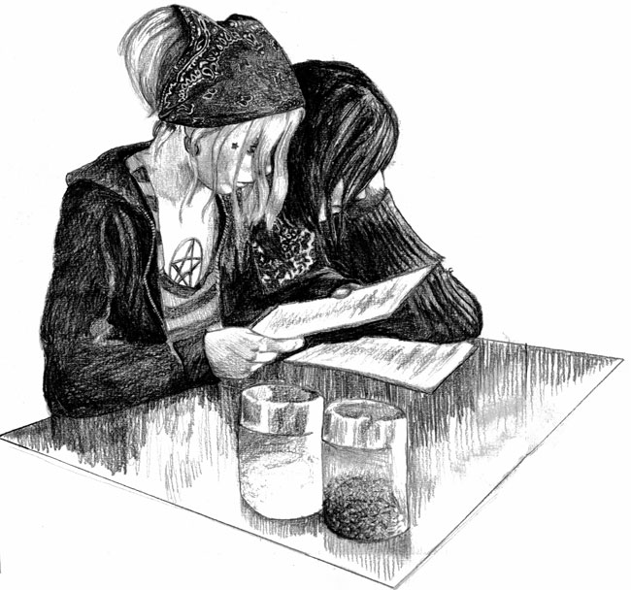
WHO
ARE
THEY?

Slide 44
Punks

Slide 45
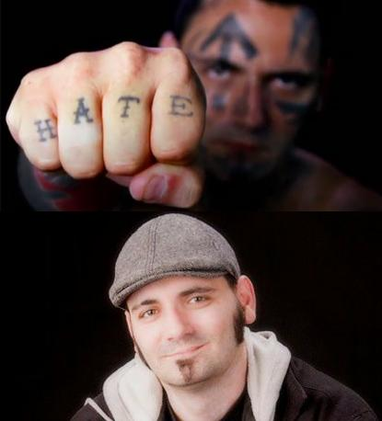
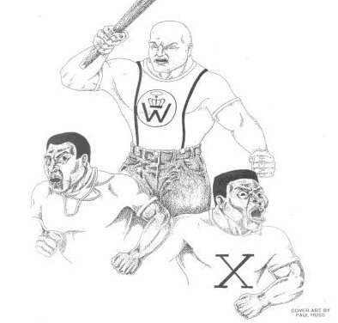
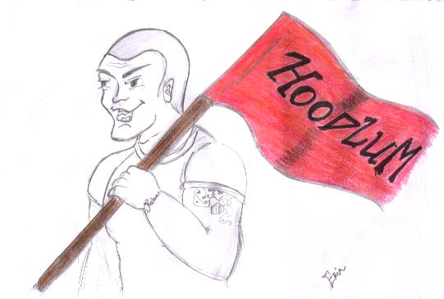
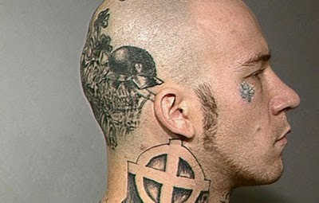
WHO
ARE
THEY?

Slide 46
Skinheads

Slide 47




