Slide 1


Adjective order

Slide 2
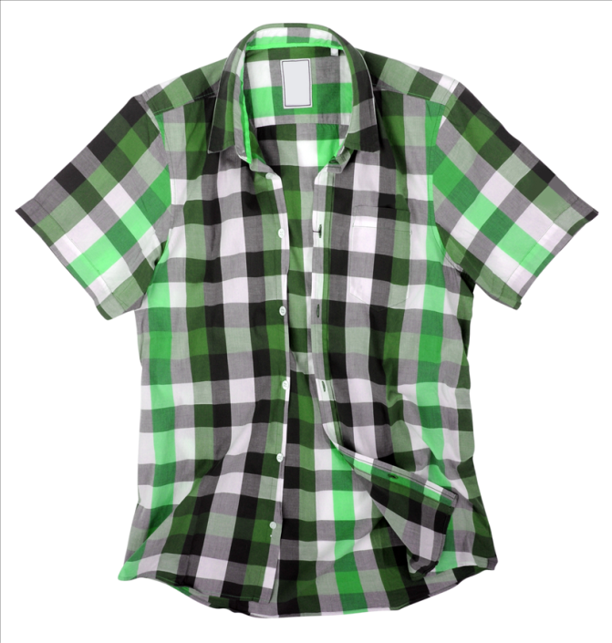
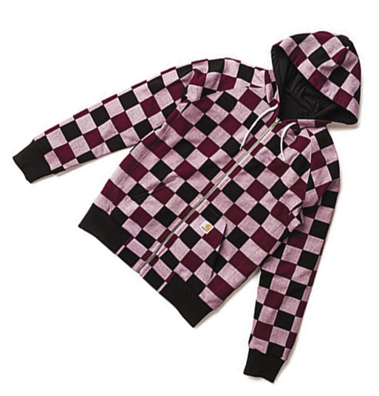
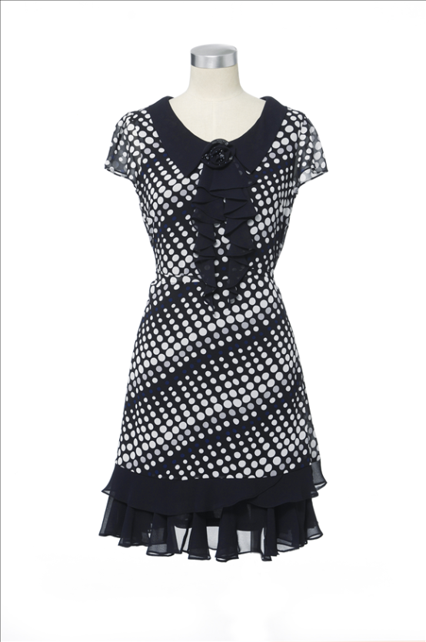
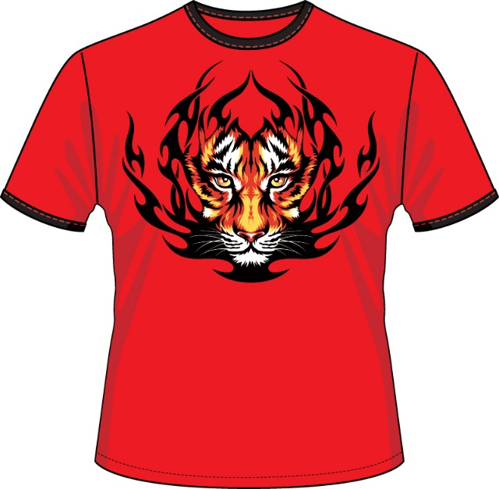
Describe each item.

Slide 3

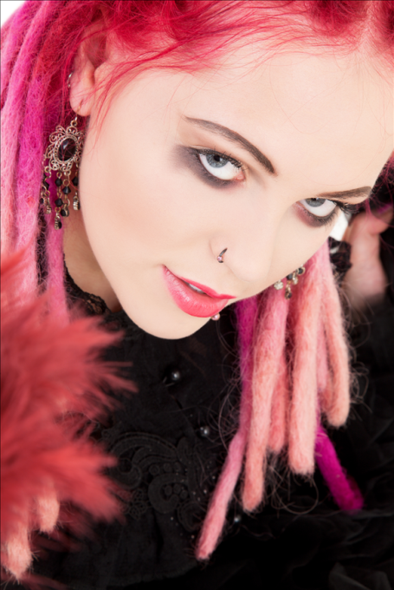

Describe the following teens.

Slide 4
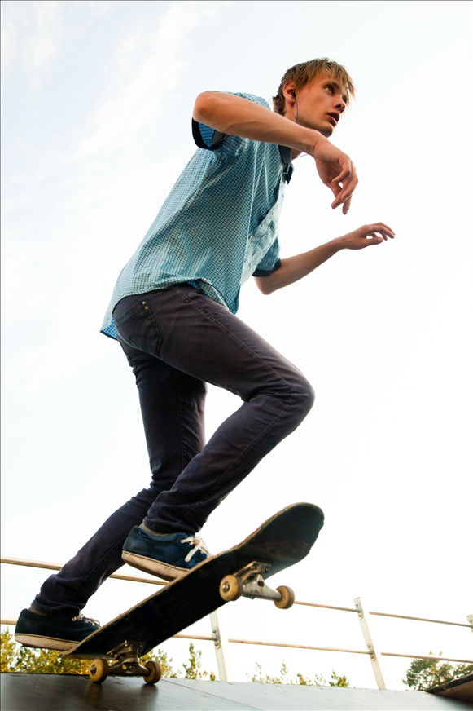
Look at Damon. We can say he has short blonde hair and he’s wearing a new blue skater’s t-shirt. We can’t say he has blonde hair, short and he’s wearing a skater’s, blue, new t-shirt.
Why?

Slide 5
blonde, short, new are adjectives.
They tell us something about Damon’s hair and his t-shirt.
When we have more than one adjective before a noun, they usually come in a fixed order.
If we take one adjective of each type, they would normally occur in the following order:

Slide 6
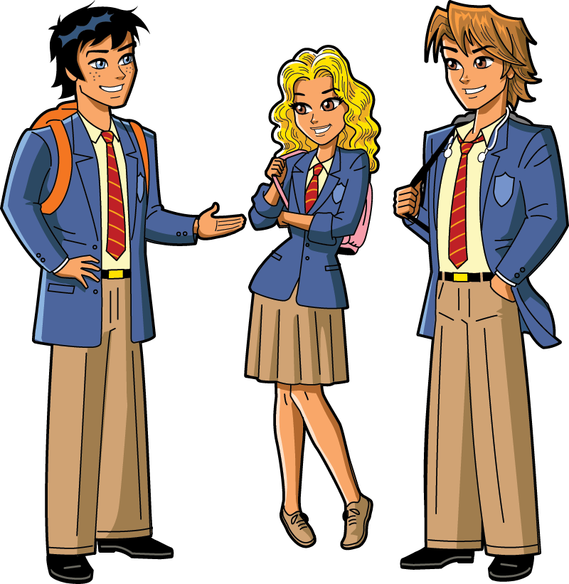
Describe one of your classmates using as many adjectives as possible. Don’t forget to put them in the correct order!!!
Opinion
Size
Shape
Condition
Age
Temperature
Colour
Origin
Type/material

Slide 7
The words in each phrase below have been mixed up.
Rewrite them in the correct order.
small pot a flower brown
and towel white a bath check red
book blue grammar a thin
white bag large a carrier
big engine a fire red
table old dining long a/an
tie a and school blue striped white
train a passenger grey modern
motorcycle helmet and striped black a red
enormous stadium football white a/an

Slide 8
Adjective order

