Slide 1
Adjectives
Comparative and Superlative

Slide 2
Adjectives are words that modify
other words.
The comparative form of an adjective is used to compare a thing/person/event with another thing/person/event.
The superlative form of an adjective is used to compare something/somebody with the whole group it/he/she belongs to.

Slide 3
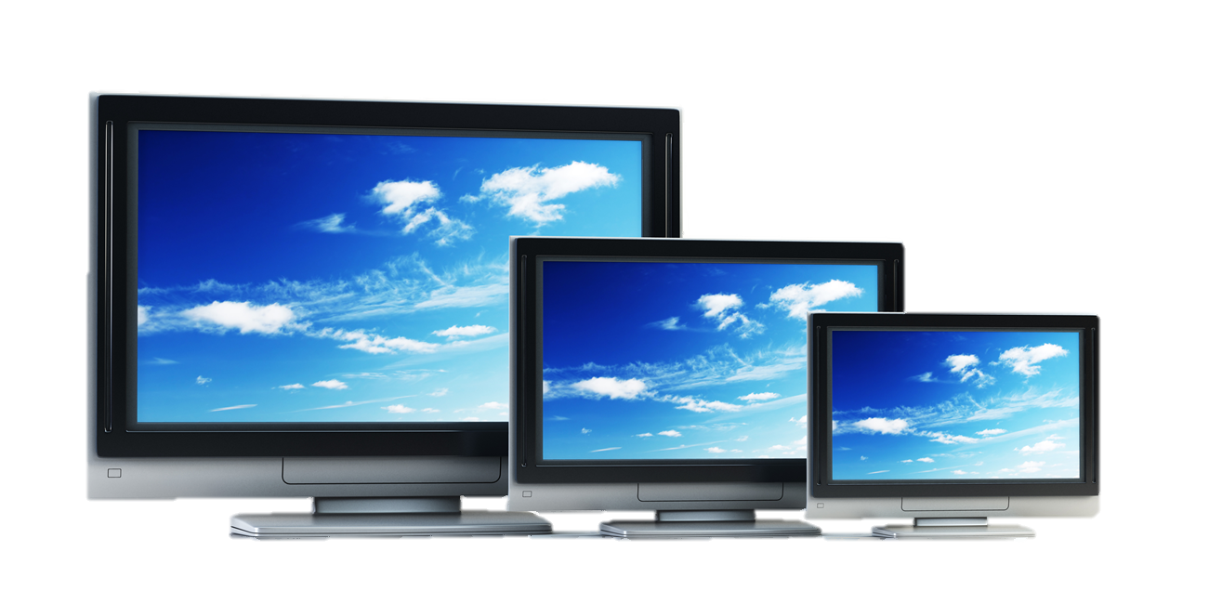
Examples Adjectives
the largest larger than large
The TV on the right is large.
The TV in the middle is larger than the one on the right.
The TV on the left is the largest of the three.

Slide 4
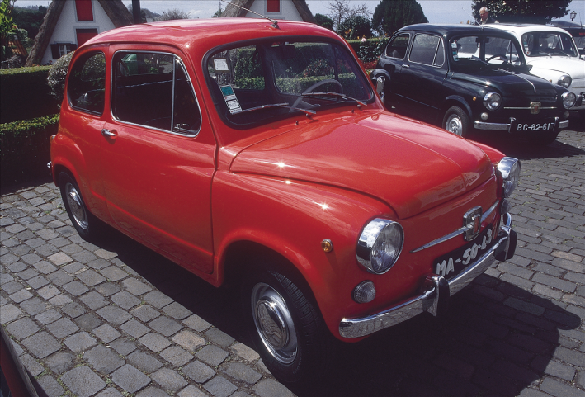
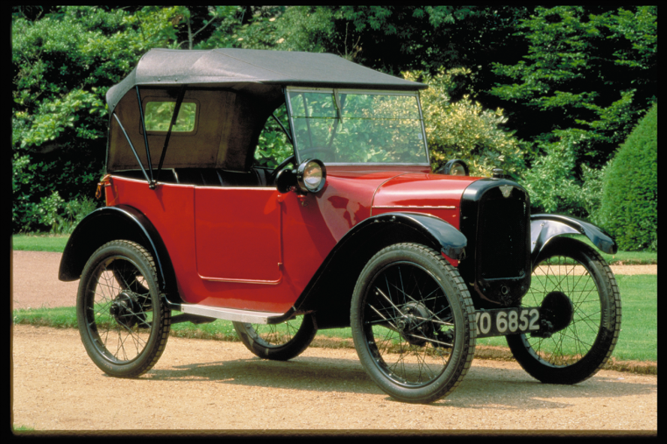
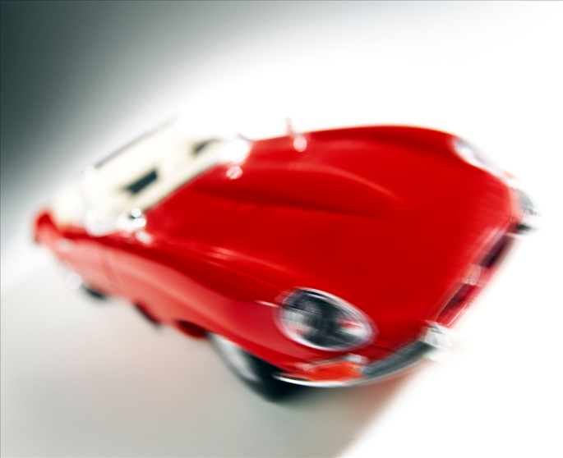
The car on the left is slow.
The car in the middle is faster than the first one.
The one on the right is the fastest car.

Slide 5
Short adjectives
To make the comparative or superlative forms of one-syllable adjectives with more than one vowel OR ending in more than one consonant, add -er (comparative) OR -est (superlative).
tall | taller than | the tallest
neat | neater than | the neatest
deep | deeper than | the deepest

Slide 6
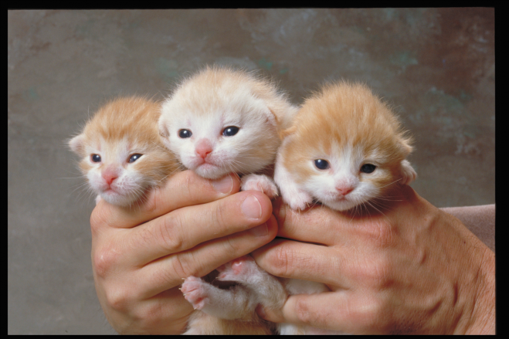
Short adjectives
To make the comparative or superlative forms of a one-syllable adjective ending in –e, add -r (comparative) OR –st (superlative).
wide | wider than | the widest
fine | finer than | the finest
cute | cuter than | the cutest

Slide 7
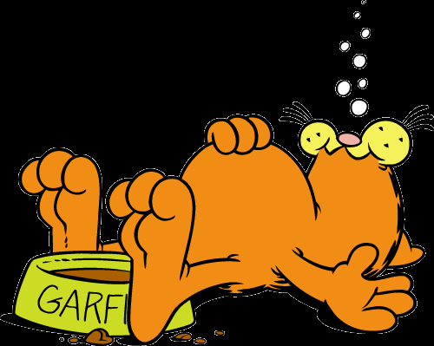
Short adjectives
To make the comparative or superlative forms of a one-syllable adjective ending in one vowel and one consonant, double the consonant, and add -er (comparative) OR –est (superlative).
sad | sadder than | the saddest
big | bigger than | the biggest
fat | fatter than | the fattest

Slide 8
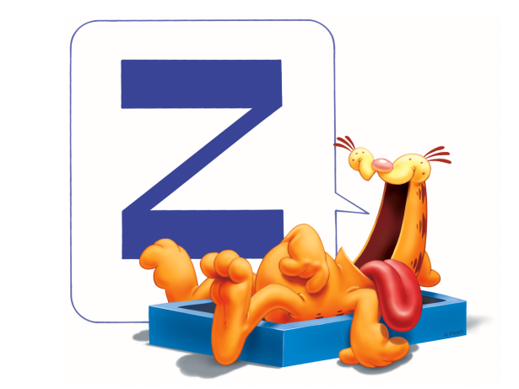
Longer adjectives
To make the comparative or superlative forms of a two-syllable adjective ending in consonant + -y, change the -y to -i, then add -er (comparative) OR -est (superlative).
happy | happier than | the happiest
jolly | jollier than | the jolliest
lazy | lazier than | the laziest

Slide 9
Longer adjectives
To make the comparative or superlative forms of a two-syllable adjective ending a vowel-sound that is not stressed, add –er (comparative) OR
-est (superlative).
Adjectives ending in -le, -ow, er frequently take
-er and -est.
narrow | narrower than | the narrowest
gentle | gentler than | the gentlest
clever | cleverer than | the cleverest

Slide 10
Longer adjectives
To make the comparative or superlative forms of two or more syllable adjectives, add more + adjective (comparative) and most + adjective (superlative).
intelligent | more intelligent than | the most intelligent
handsome | more handsome than | the most handsome
talkative | more talkative than | the most talkative

Slide 11
Adjective | Comparative | Superlative
Only one syllable, with more than one vowel or more than one consonant at the end. Examples: light, neat, fast, tall, neat, deep | Add -er: lighter, neater, faster, taller, neater, deeper | Add -est: lightest, neatest, fastest, tallest. neatest, deepest
Only one syllable, ending in -e. Examples: wide, fine, cute | Add -r: wider, finer, cuter | Add -st: widest, finest, cutest
Only one syllable, with one vowel and one consonant at the end. Examples: hot, big, fat, sad | Double the consonant, and add -er: hotter, bigger, fatter, sadder | Double the consonant, and add -est: hottest, biggest, fattest, saddest
Two syllables, ending in consonant + -y. Examples: happy, silly, lonely, jolly | Change -y to -i, then add -er: happier, sillier, lonelier, jollier | Change -y to -i, then add -est: happiest, silliest, loneliest, jolliest
Two syllables or more, not ending in -y. Examples: modern, interesting, beautiful | Use more before the adjective: more modern, more interesting, more beautiful | Use most before the adjective: most modern, most interesting, most beautiful

Slide 12
Irregular adjectives
Adjective | Comparative | Superlative
good | better than | the best
bad | worse than | the worst
much | more than | the most
little | less than | the least
far | farther than | the farthest
old | older than | the oldest
 | elder than | the eldest

Slide 13
Fill in the correct form of the adjectives in brackets (comparative or superlative).
My house is (big) __________ than yours.
This flower is (beautiful) _______ than that one.
This is the (good) ______ book I have ever read.
Non-smokers are usually (healthy) _______ than smokers.
Which is the (dangerous) _______ animal in the world?

Slide 14
Fill in the correct form of the adjectives in brackets (comparative or superlative).
A holiday by the sea is (good) ______ than a holiday in the mountains.
It is strange, but often a coke is (expensive) ________ than a fruit juice.
Who is the (rich) _________ woman on earth?
The weather this summer is even (bad) _______ than last summer.
He was the (intelligent) _________ student of all.

Slide 15
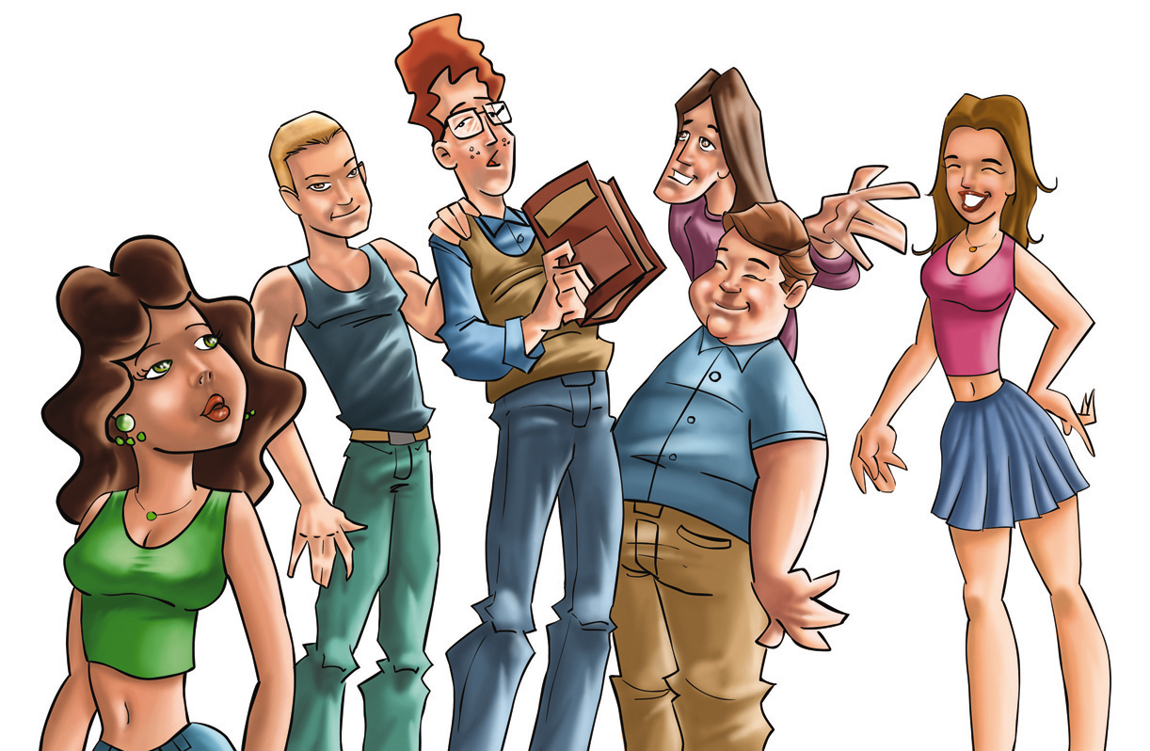
Describe this image, using comparatives and superlatives.

Slide 16
Adjectives
Comparative and Superlative

