Slide 1

THE INTERNET
advantages and disadvantages
Powerpoint Templates

Slide 2

Dangers of the Internet

Slide 3

Dangers of the Internet

Slide 4
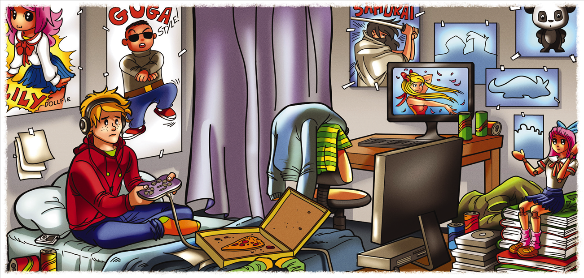
Dangers of the Internet
Hikikimori

Slide 5

Dangers of the Internet

Slide 6

Dangers of the Internet

Slide 7

Dangers of the Internet

Slide 8

Advantages of the Internet

Slide 9

Advantages of the Internet

Slide 10

Advantages of the Internet

Slide 11
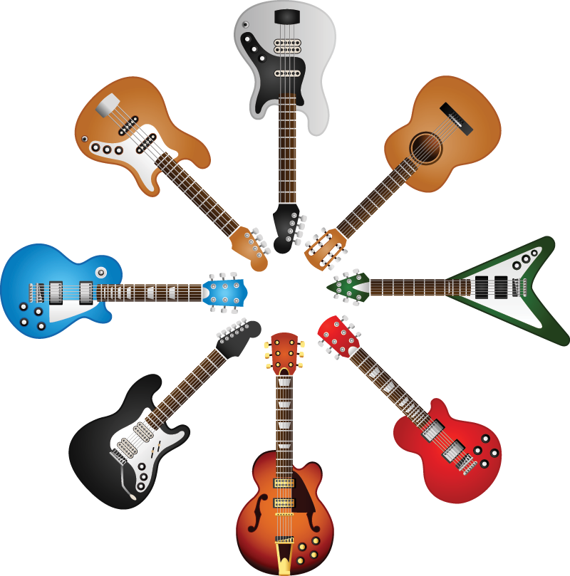
Advantages of the Internet

Slide 12
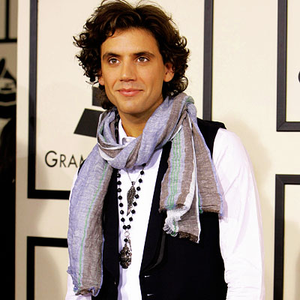
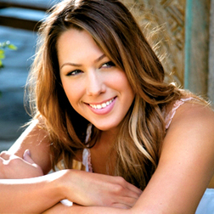
Advantages of the Internet
Pop stars who started off their music career on the internet – Mika and Colbie Caillat

Slide 13
THE INTERNET
advantages and disadvantages
Powerpoint Templates

