Slide 1
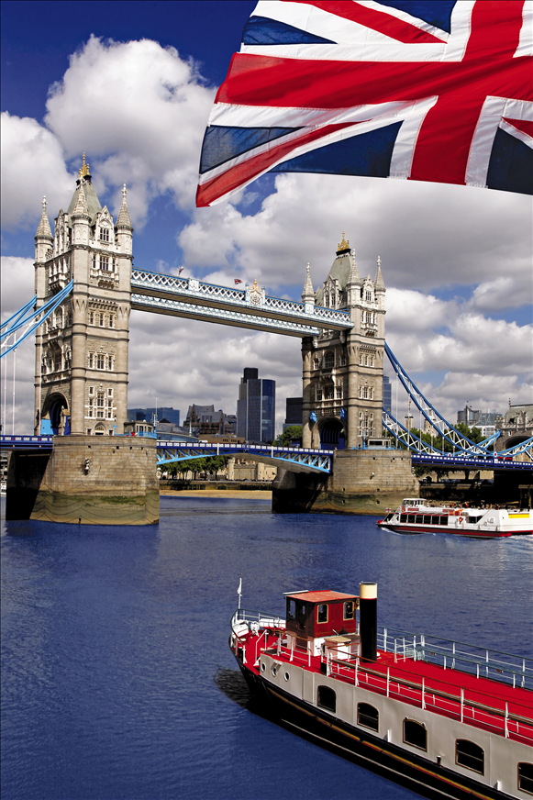
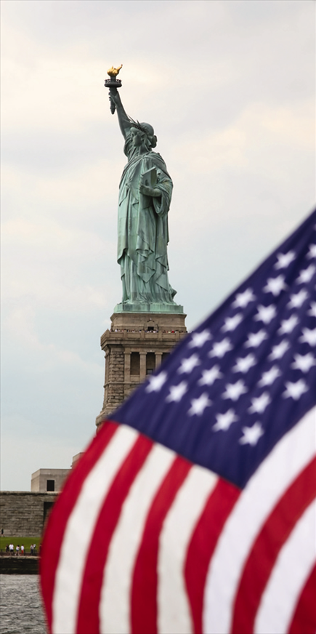
British & American

Slide 2


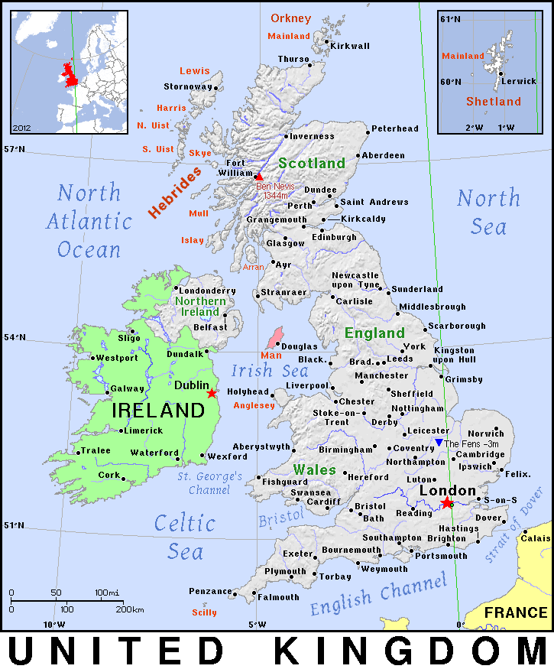
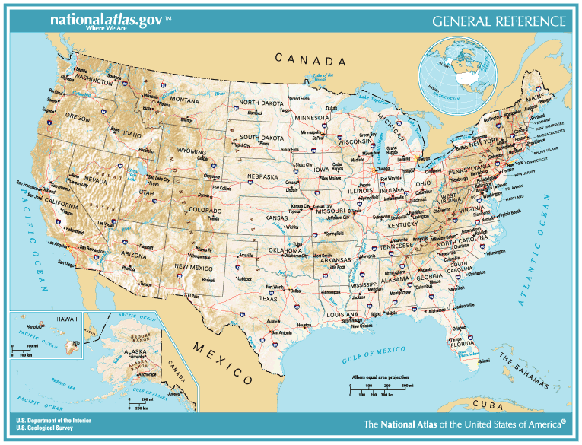
The United Kingdom of Great Britain and Northern Ireland
Scotland
England
Wales
Northern Ireland
British overseas territories
The United States of America
50 states
Alabama, Alaska, Arizona, Arkansas, California, Colorado, Connecticut, Delaware, Florida, Georgia, Hawaii, Idaho, Illinois, Indiana, Iowa, Kansas, Kentucky, Louisiana, Maine, Maryland, Massachusetts, Michigan, Minnesota, Mississippi, Missouri, Montana, Nebraska, Nevada, New Hampshire, New Jersey, New Mexico, New York, North Carolina, Ohio, Oklahoma, Oregon, Pennsylvania, Rhode Island, South Carolina, South Dakota, Tennessee, Texas, Utah, Vermont, Virginia, Washington, West Virginia, Wisconsin, Wyoming
+
American Samoa, District of Columbia (seat of the Federal Government – Washington D.C.), Guam, Northern Mariana Islands, Puerto Rico, Virgin Islands
British political system
Constitutional monarchy
Parliament
House of Commons
House of Lords
Prime Minister
Queen – head of state (not of government)
American political system
Federal republic
Congress
House of Representatives
Senate
President
Supreme Court

Slide 3
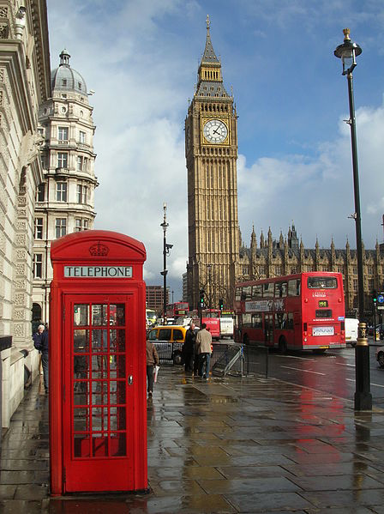
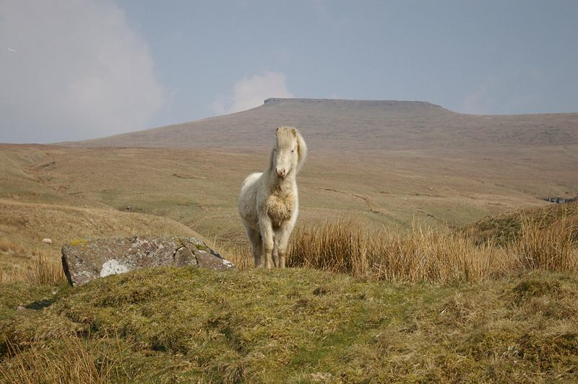
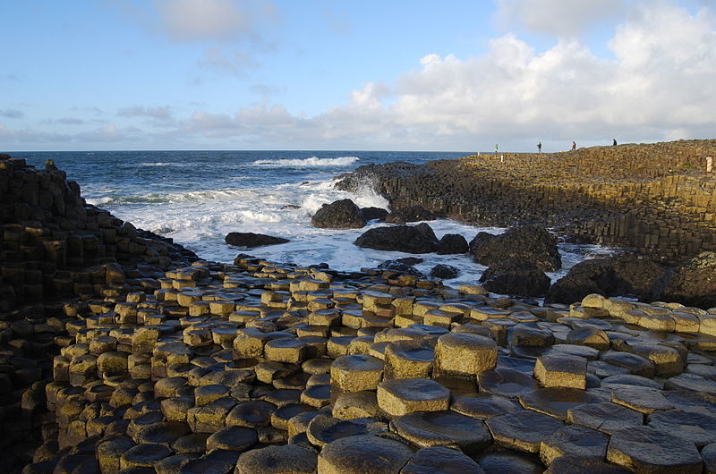
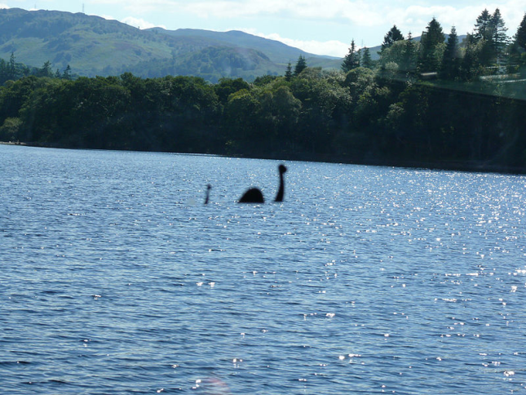
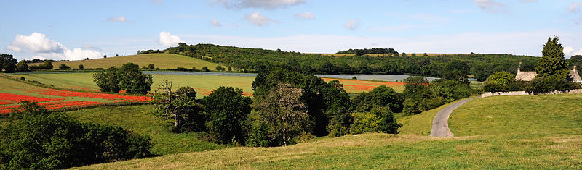
Locations
Cotswolds countryside, England
Brecon Beacons, Wales
London, England
Giant’s Causeway, Northern Ireland
Loch Ness, Scotland

Slide 4
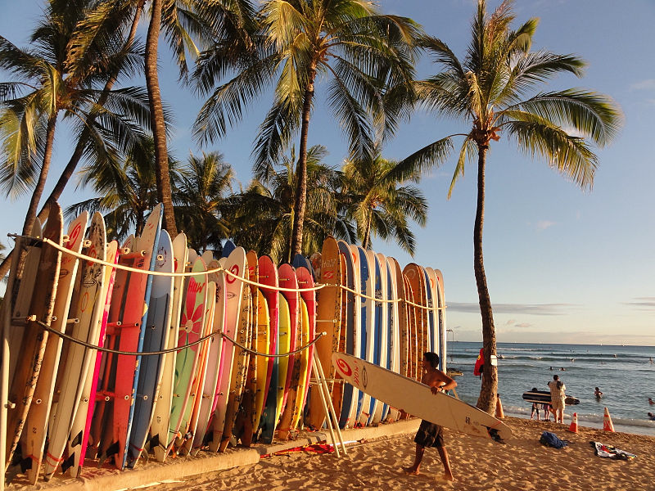
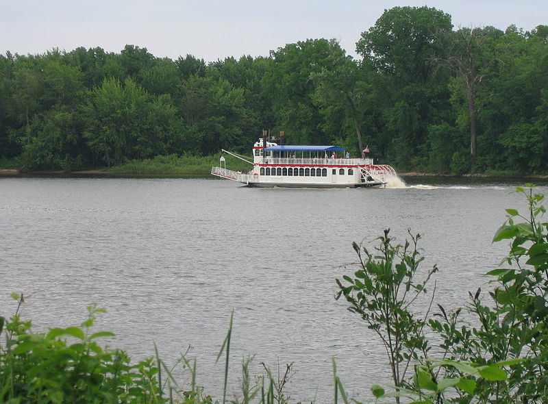
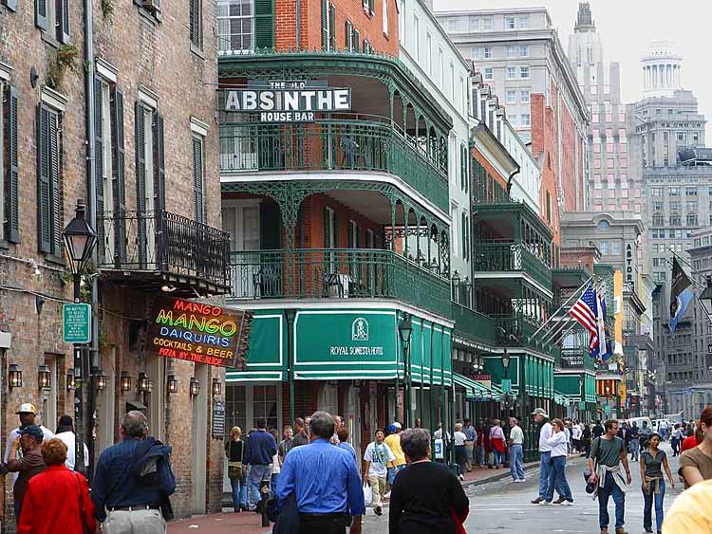
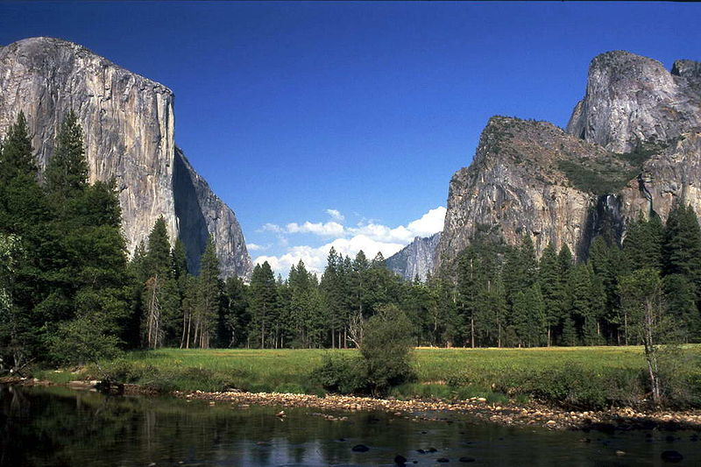
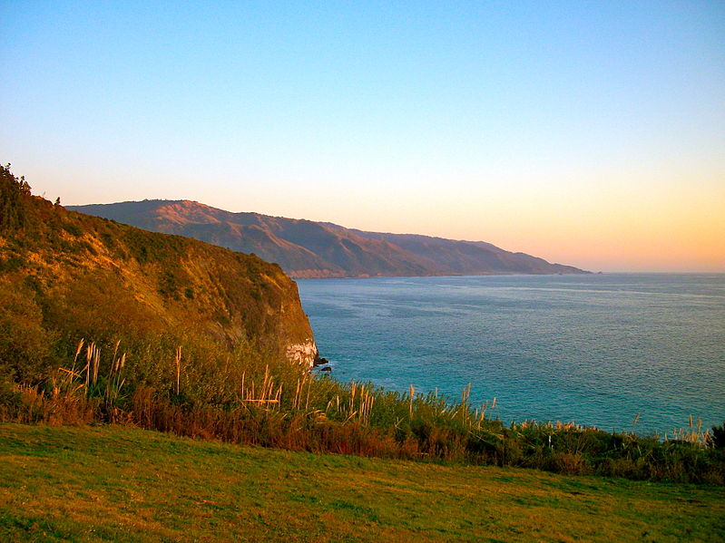
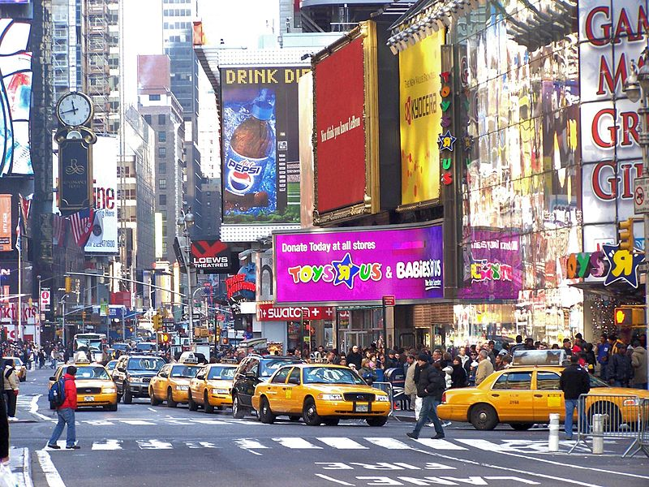
Locations
Waikiki, Hawaii
Mississippi river
New Orleans, Louisiana
Yosemite Park,
California Coast
Times Square, New York

Slide 5
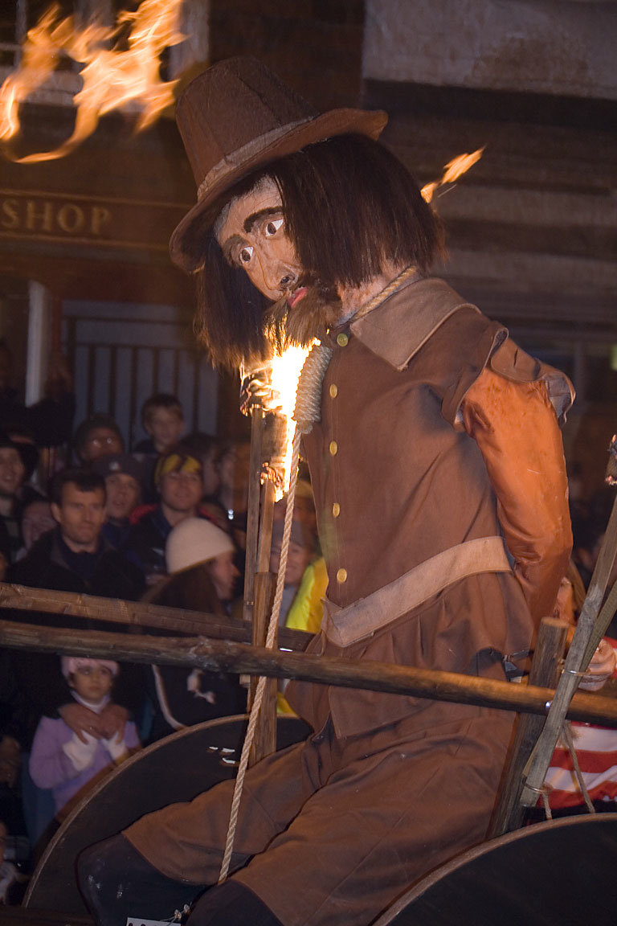
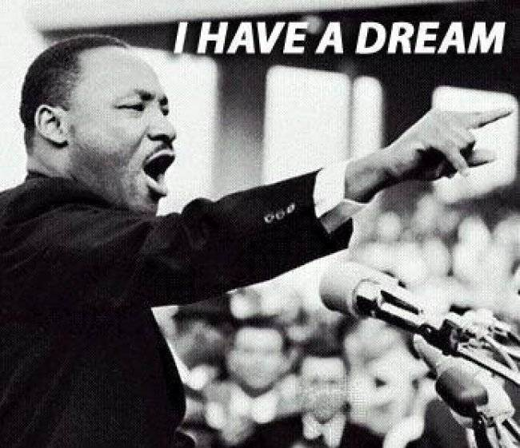
Holidays
Trooping the Colour
Remembrance Day
Poppy Day
Bonfire Night
4th July
Thanksgiving
Martin Luther King Day

Slide 6
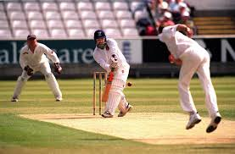
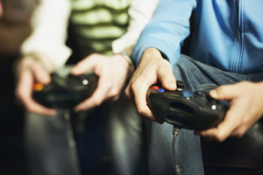
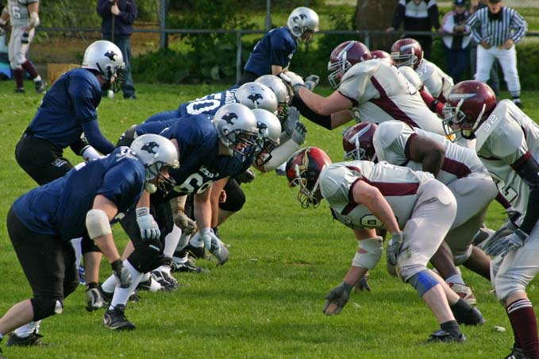
Free time
Watching TV
Listening to music
Playing video games
Using the Internet
Tennis
Football
Rugby
Cricket
Baseball
Basketball
American football

Slide 7
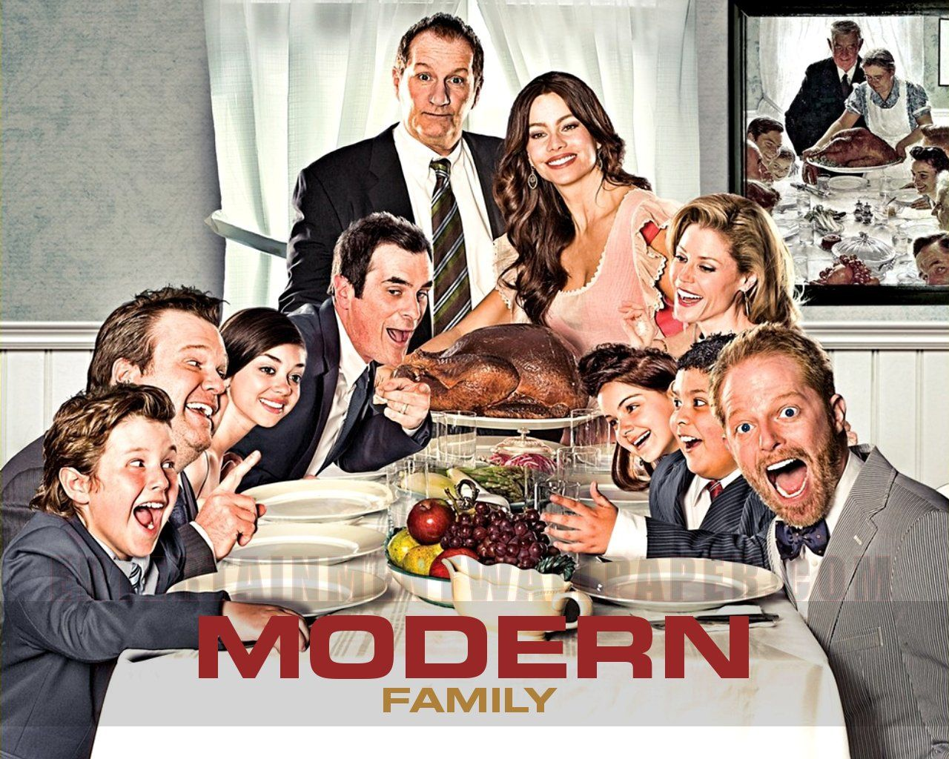
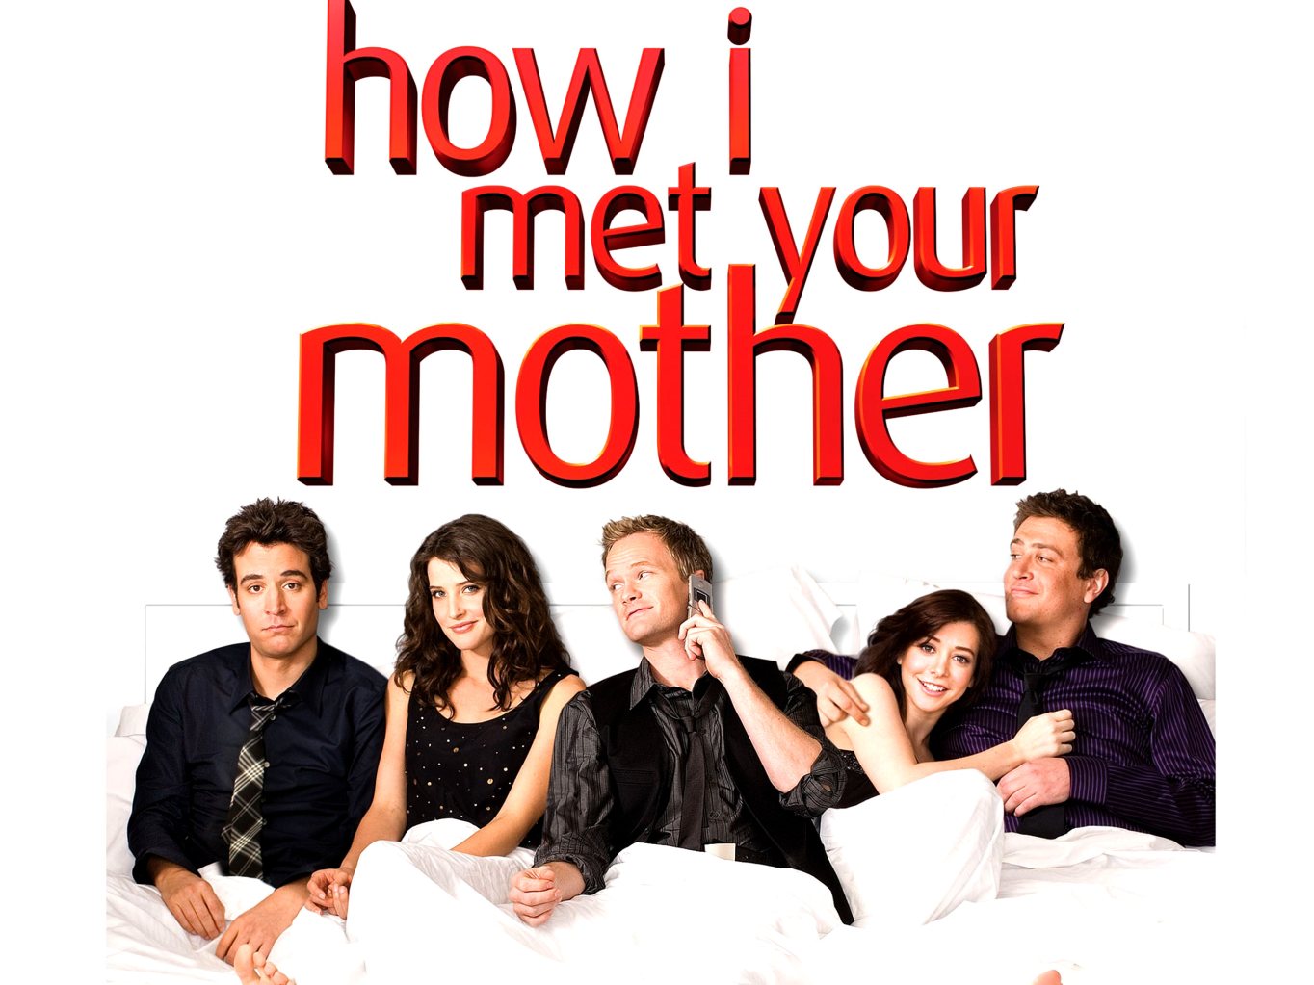
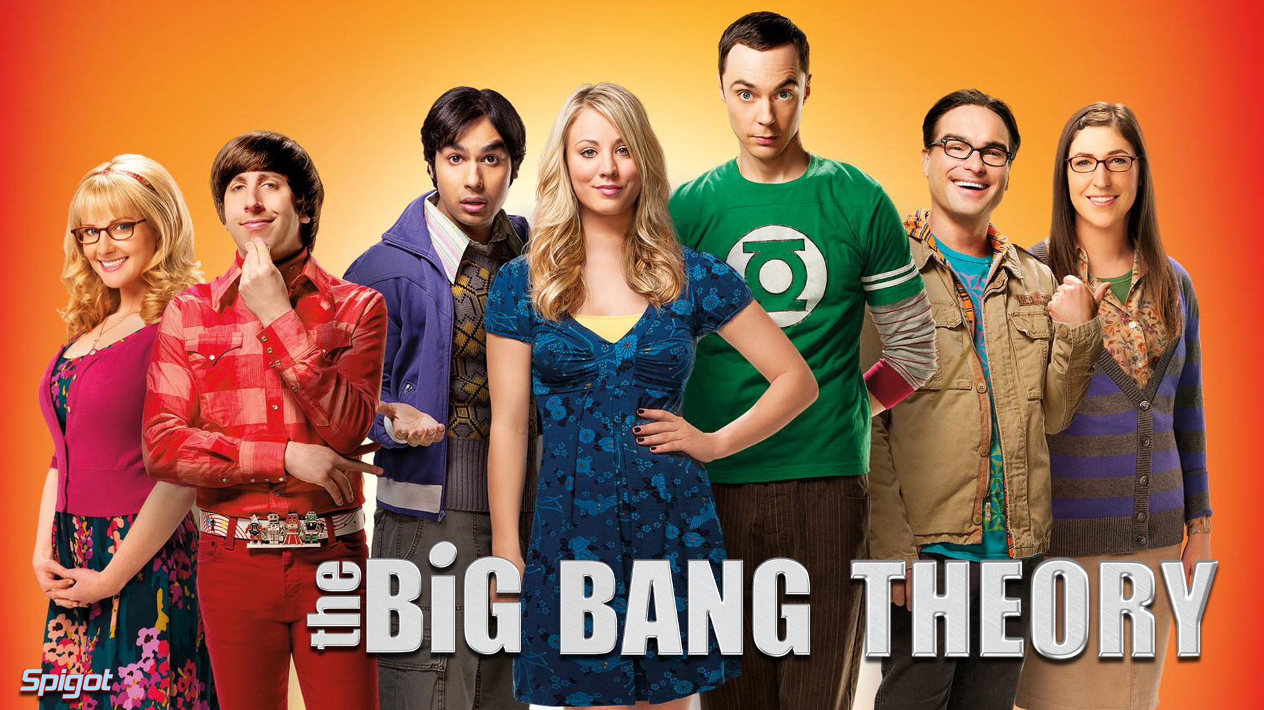
Humour

Slide 8
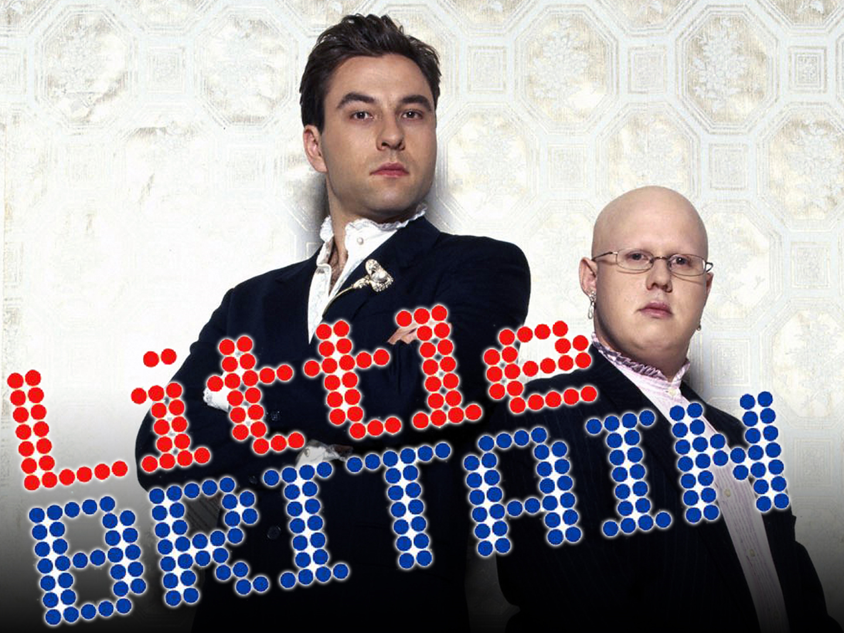
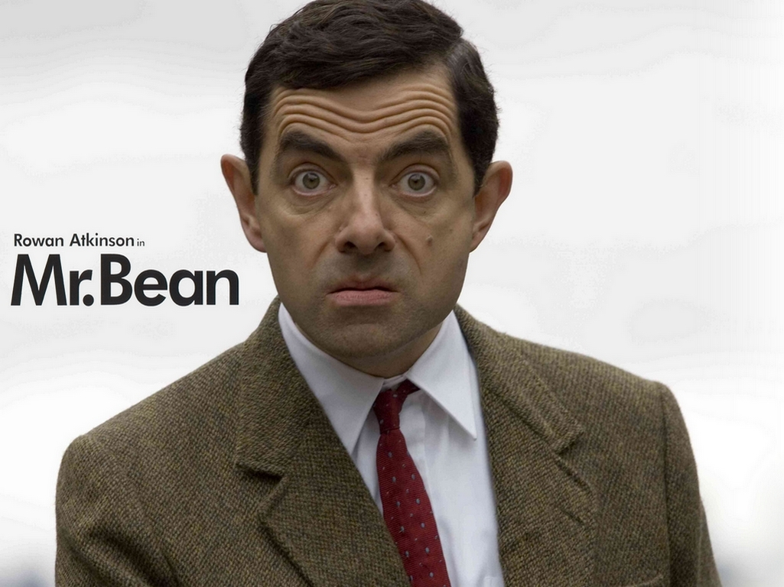
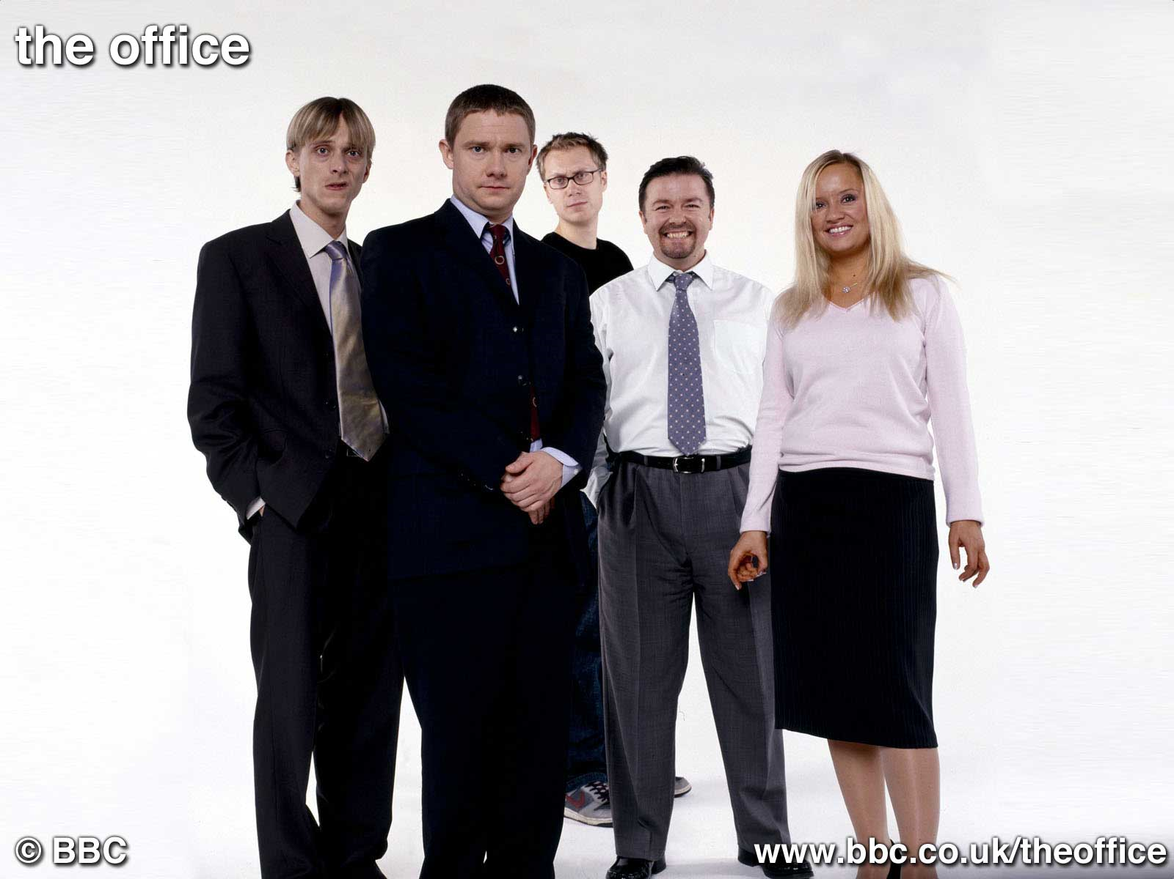
Humour

Slide 9
British English & American English
Spelling
centre | center
colour | color
apologise | apologize
travelled | traveled
defence | defense
dialogue | dialog or dialogue

Slide 10
British English & American English
Vocabulary
biscuit | cookie
flat | apartment
car park | parking lot
chips | French fries
holiday | vacation
jumper | sweater
queue | line
underground | subway

