Slide 1

CONDITIONALS
Types 1, 2 and 3

Slide 2

1st CONDITIONAL
If it’s sunny...
Work in groups of three. Take turns to continue one of these sequences. After each sentence the members of the group should ask what will happen next.
e.g.
A - If it’s sunny, I’ll go to the beach.
Group - What will you do if you go to the beach?
A - If I go to the beach, I’ll go to the sea and I’ll swim.
Group - What will you do if the waves are too rough?
A - If the waves are too rough, I’ll lie on my towel and catch a suntan.

Slide 3
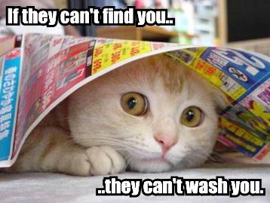
If it rains tomorrow...
If I study hard...
If he/she rings...
If we win the game...
If we save enough...
If I learn German...

Slide 4
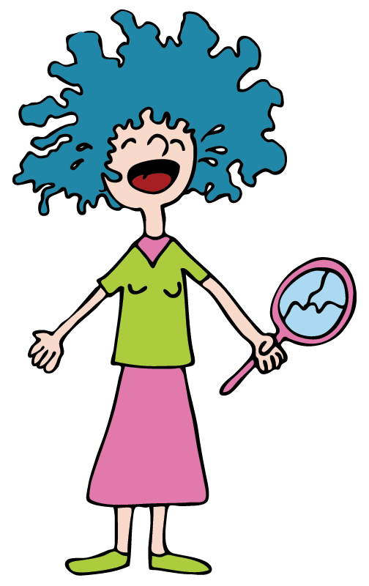
Superstitions
Are people where you live very superstitious?
What are they superstitious about?
What about you?
e.g. If you break a mirror, you’ll have seven years of bad luck.

Slide 5
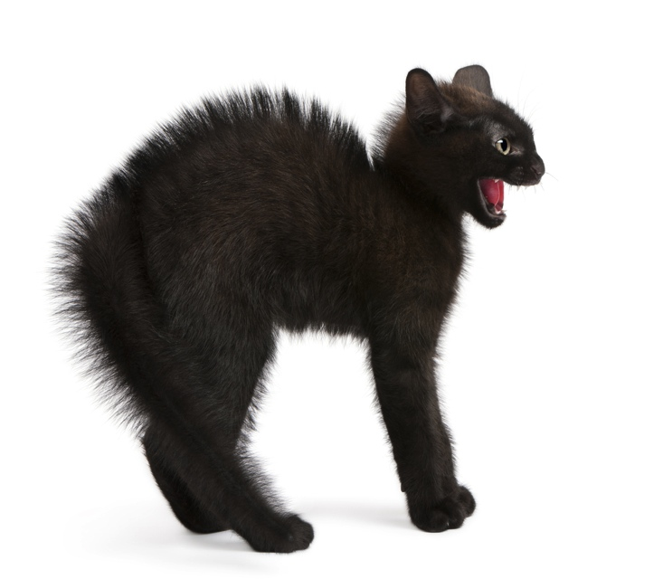
In pairs write superstitions for some of these words:
What other superstitions
can you think of?
black cat
mirror
ladder
itchy hand
itchy ear
number
spider
salt
thirteen

Slide 6
2nd CONDITIONAL
If...
Work in pairs. Read the following situations and say what would happen if the situation were different.
e.g. It’s raining so we’ll have to cancel the football match.
If it weren’t raining, we’d beat you.

Slide 7
I don’t know the answer so I can’t tell you.
He gets headaches because he studies so hard.
We don’t have enough space for the piano.
She’s ill. She can’t come to the party.
He’s not tall enough to be a model.
I can’t give you a lift because I haven’t got my scooter.

Slide 8
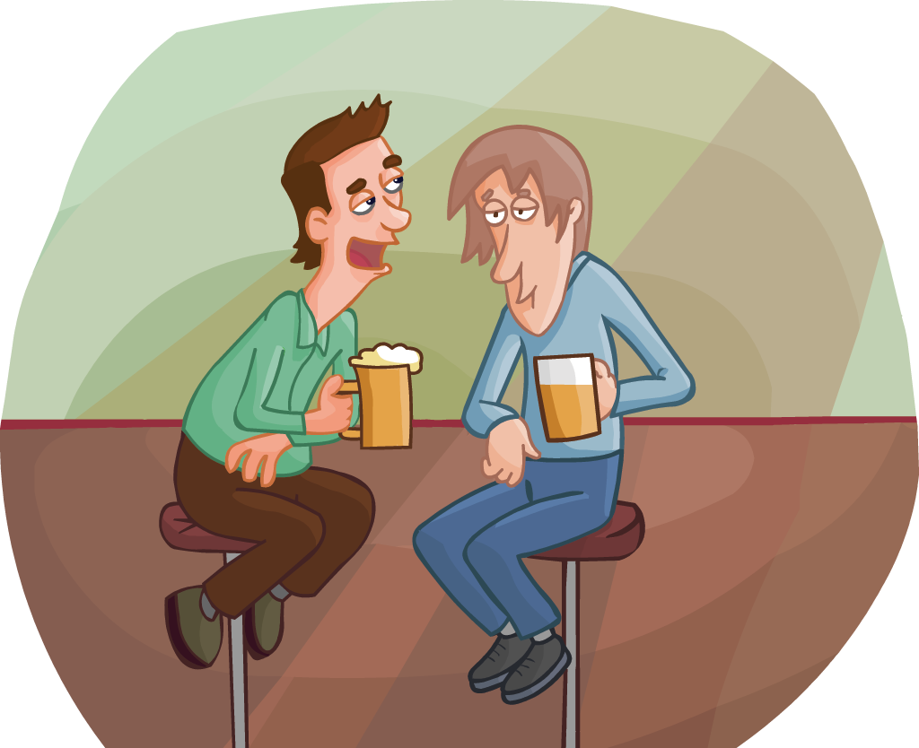
Giving advice
In pairs, give each other advice for these problems, beginning with:
If I were you...., I’d....
You’re trying to find yourself? – No offense, but if I were you, I’d look for somebody else.

Slide 9
I want to give up smoking.
I love him/her but she never texts me.
I keep dropping things.
I keep getting bad marks in my tests.
I’m always tired in the morning.
English grammar is so hard.
My hair won’t stay flat.

Slide 10
3rd CONDITIONAL
Complete the sentences.
I wouldn't have been angry if you…
If he had known you were in hospital,...
We wouldn’t have come by taxi if…
We would have visited Madame Tussaud’s if…
If you hadn't been asking me questions all the time, I…
If I … your number, I would have phoned.

Slide 11
If just one person had remembered my birthday, I…
I would have understood the film if it…
They… to see you if they hadn't been away.
If she… on a double yellow line, she wouldn't have got a fine.
If I'd known you were coming, I…
If she… the shed unlocked, her bike wouldn't have been stolen.

Slide 12
CONDITIONALS
Types 1, 2 and 3

