Slide 1


Slide 2

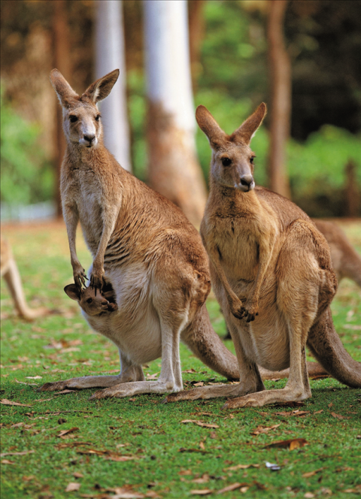
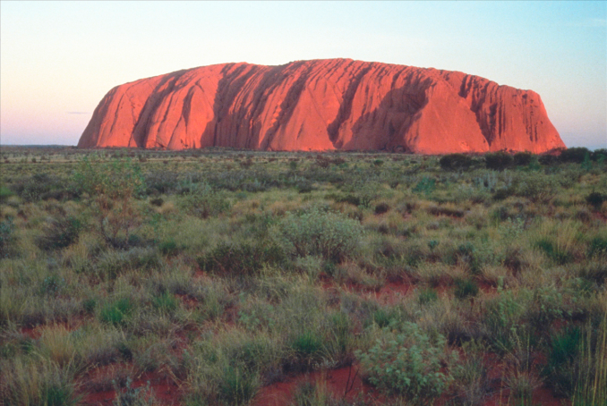
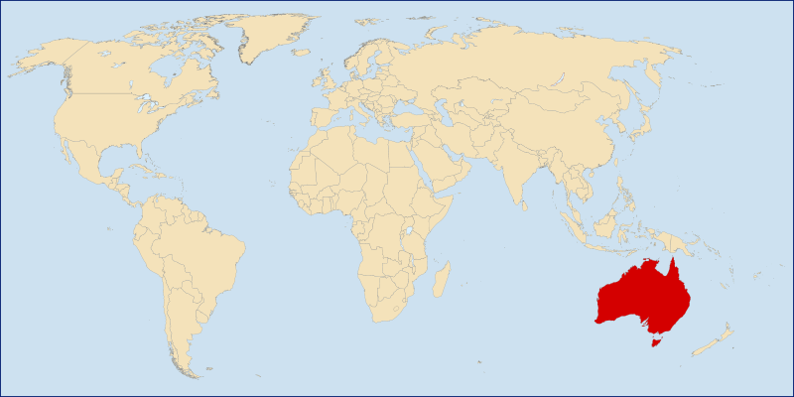
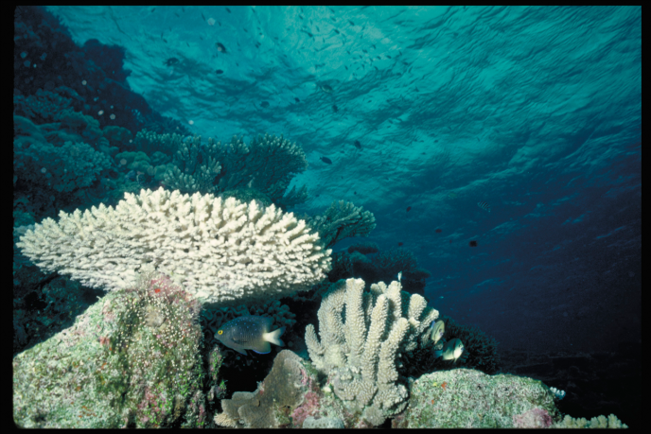
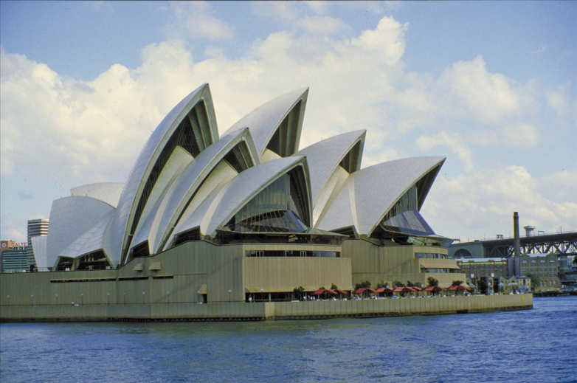
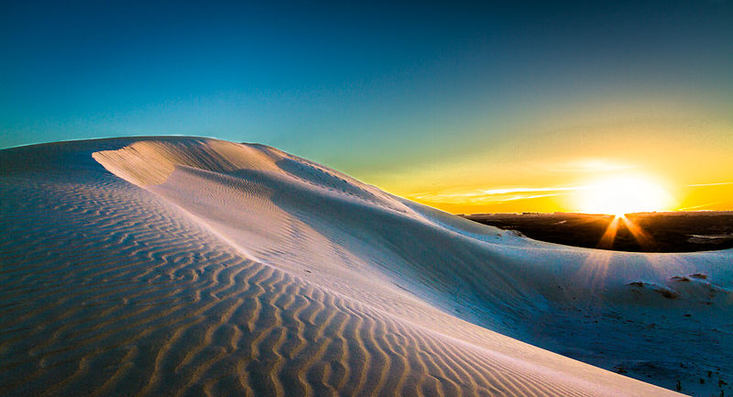
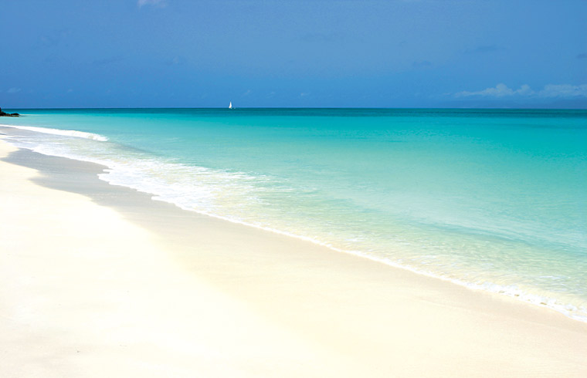
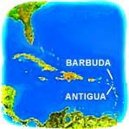
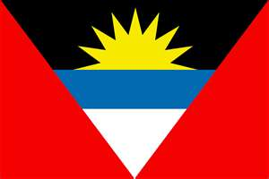
Antigua and Barbuda
Australia

Slide 3


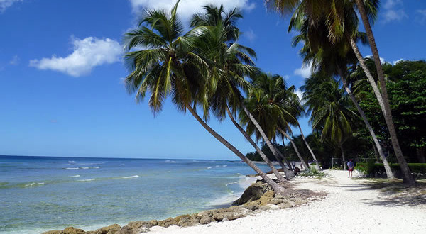
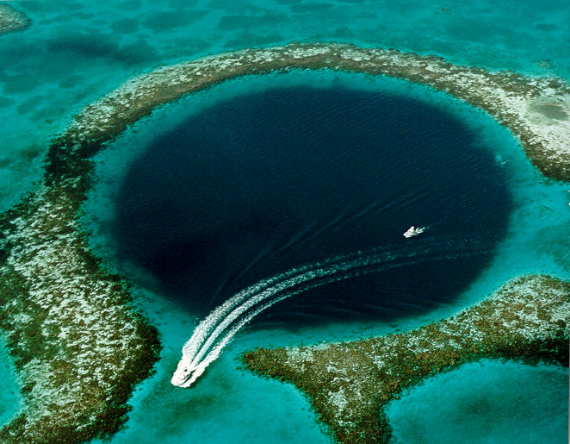
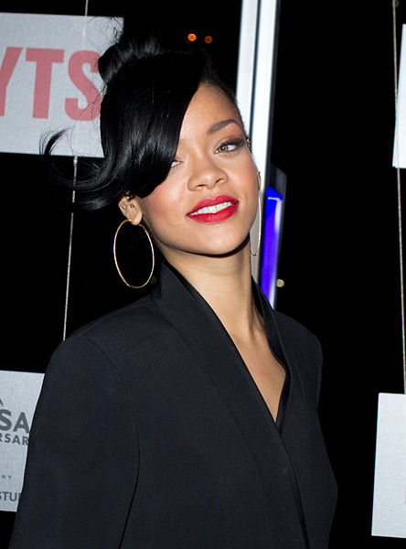
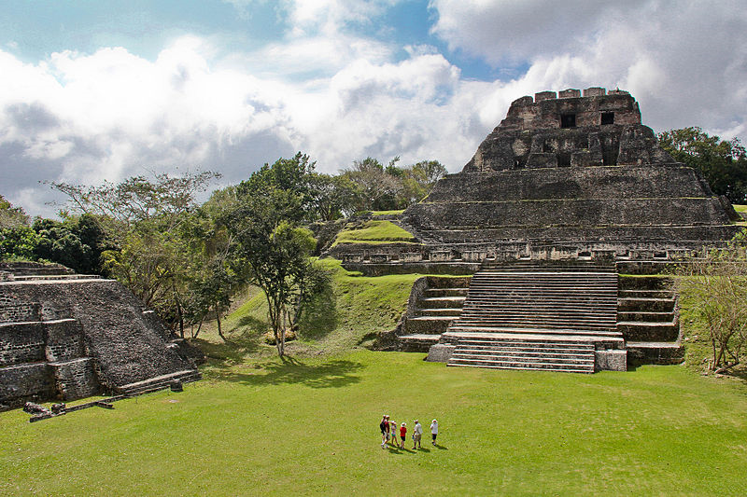
BARBADOS
BELIZE
Notes:
Barbados: Singer Rhianna is from Barbados.
Belize: The Great Blue Hole; El Castillo, Mayan ruins of Xunantunich.

Slide 4

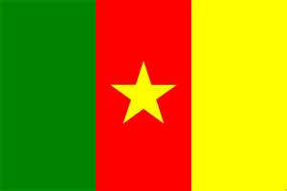
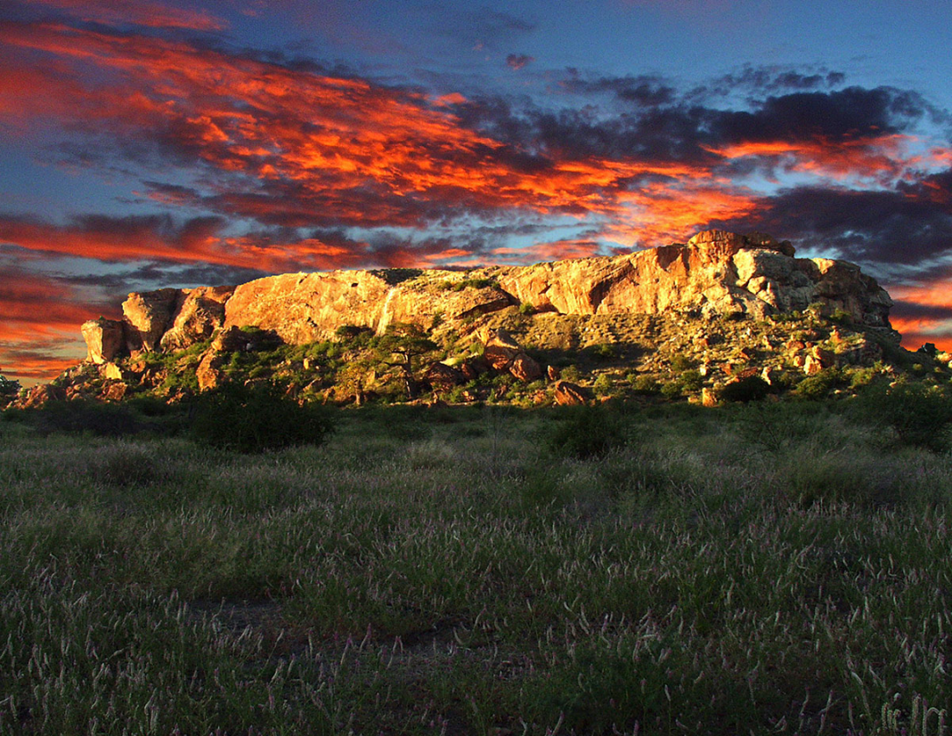
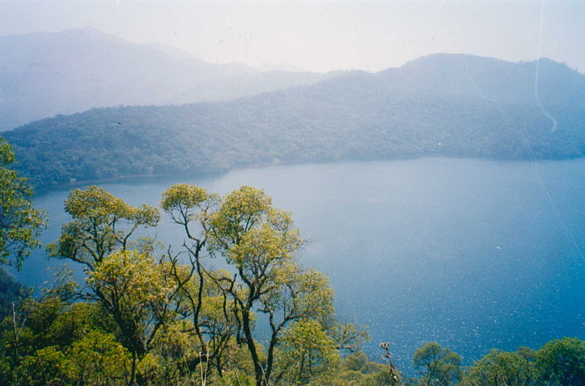
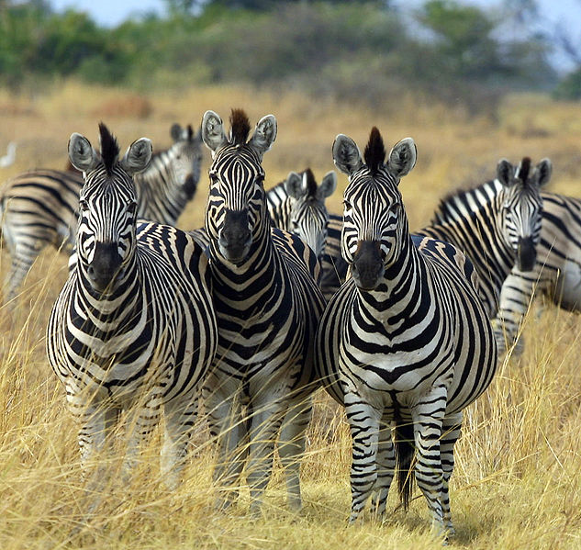
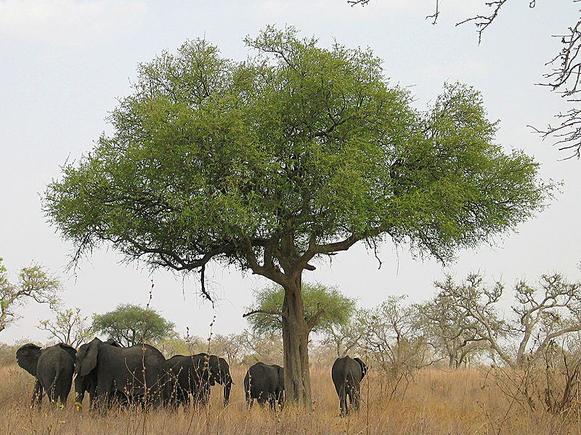
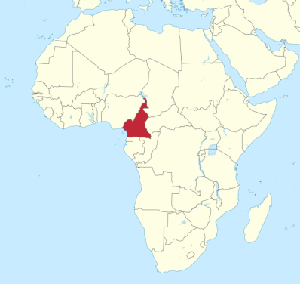
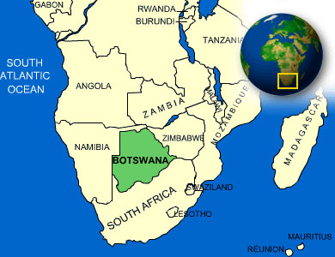
BOTSWANA
CAMEROON
Notes:
Cameroon: Lake Oku

Slide 5
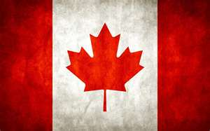
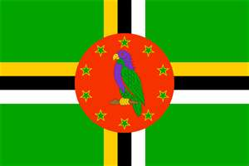
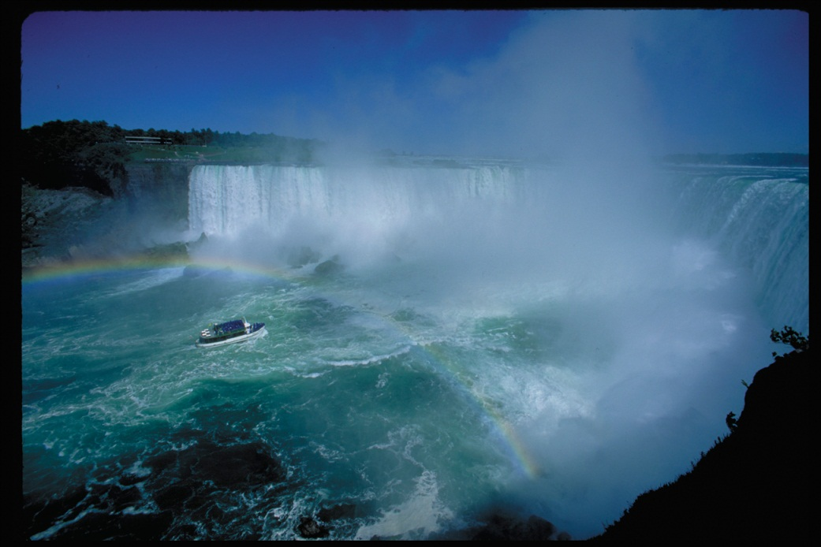
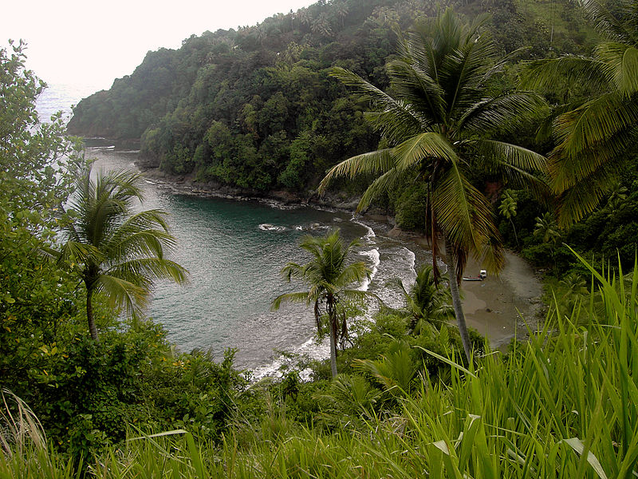
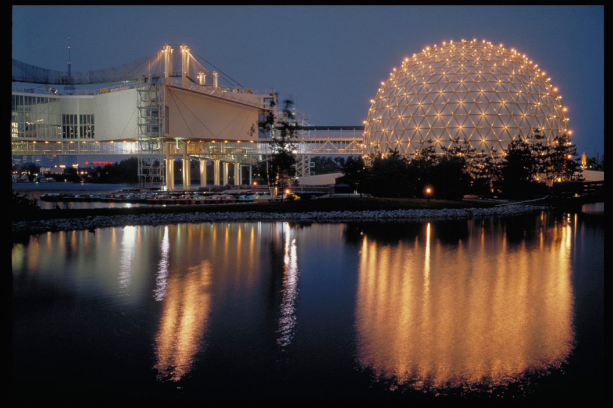
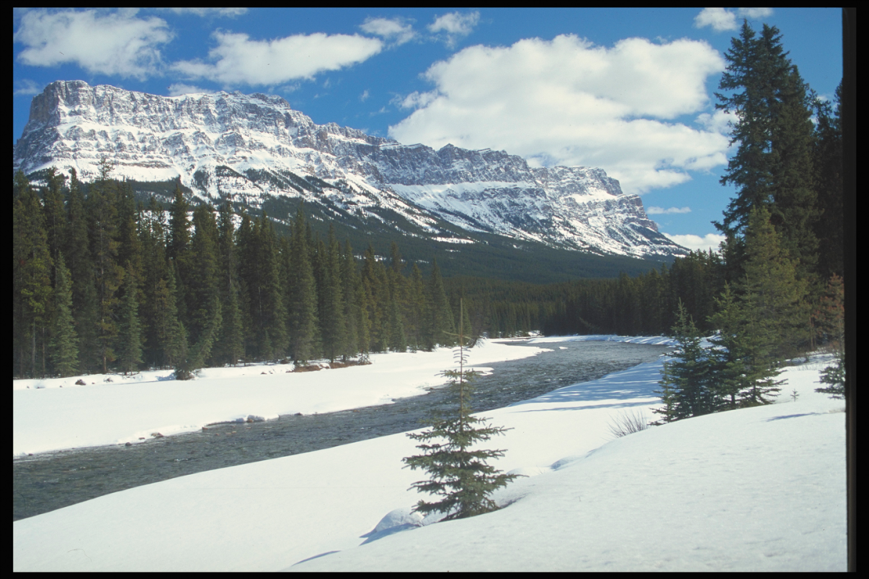
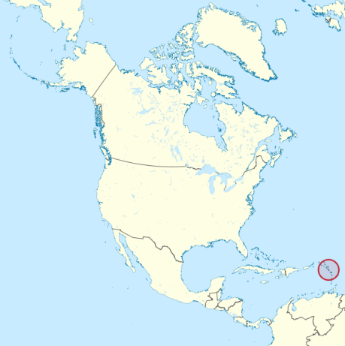
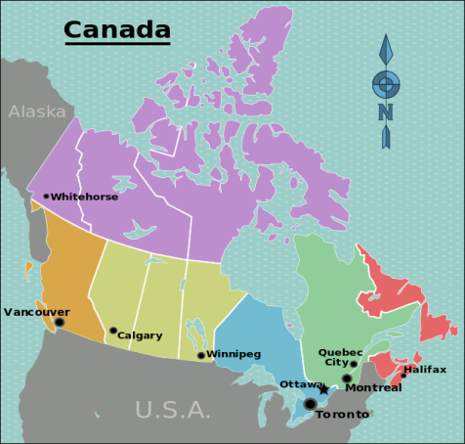
CANADA
DOMINICA
Notes:
Canada: Niagara Falls; Toronto; Rocky Mountain river.

Slide 6

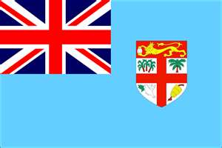
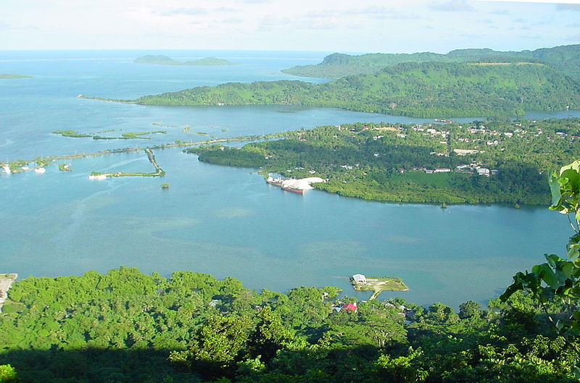
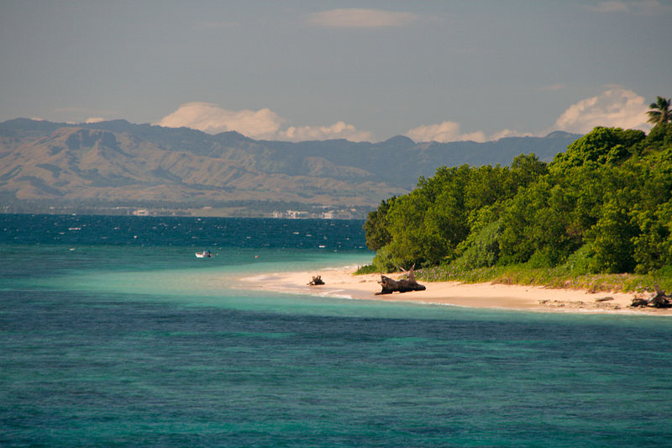
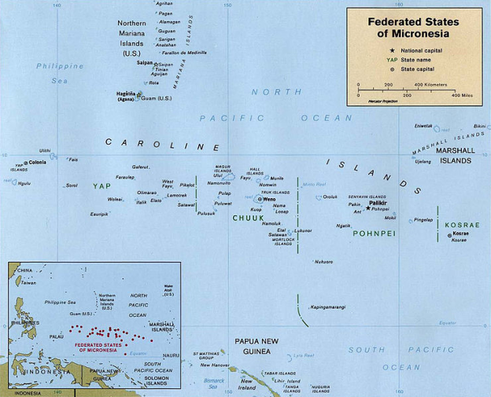
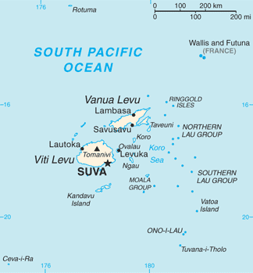
FEDERATED STATES
OF MICRONESIA
FIJI
ISLANDS

Slide 7
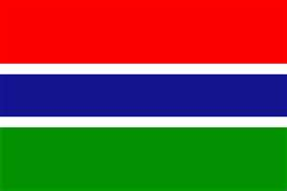

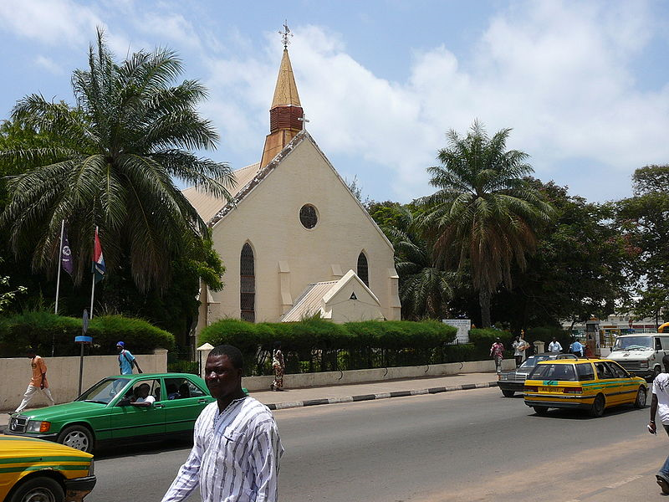
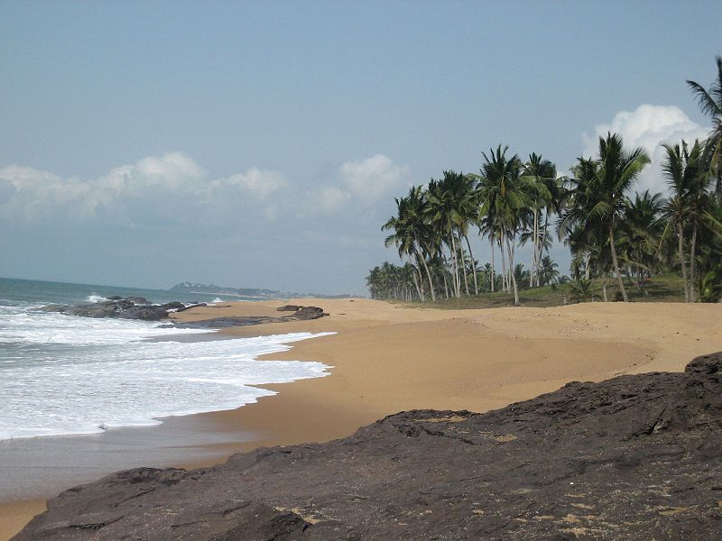
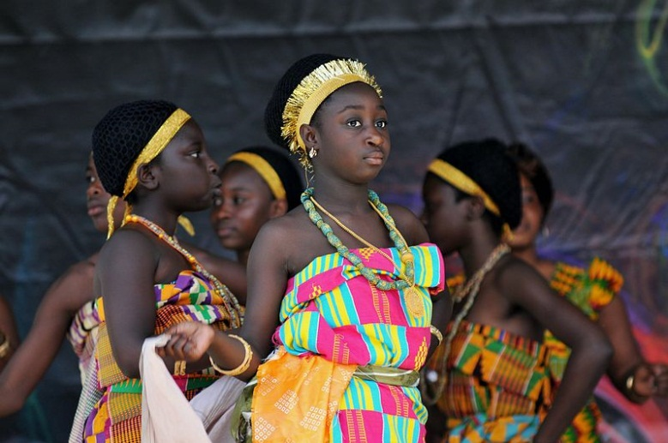
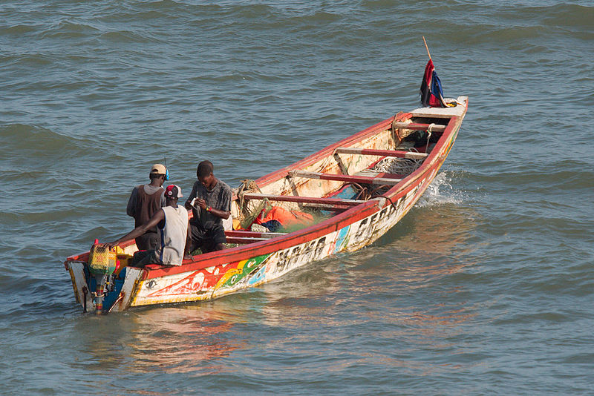
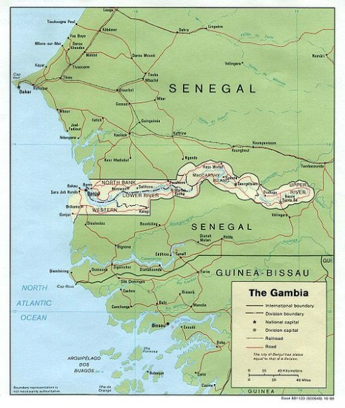
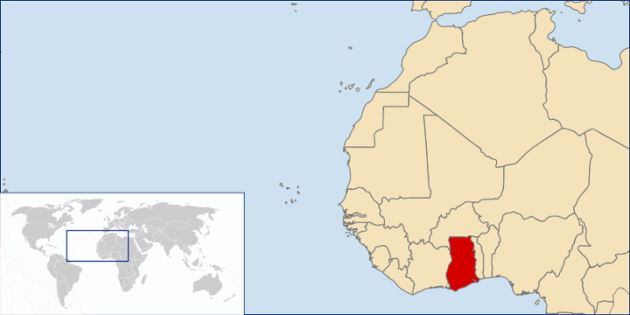
GAMBIA
GHANA
Photo: Brandan Lally

Slide 8

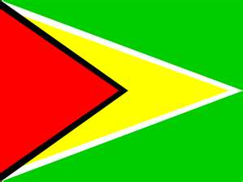
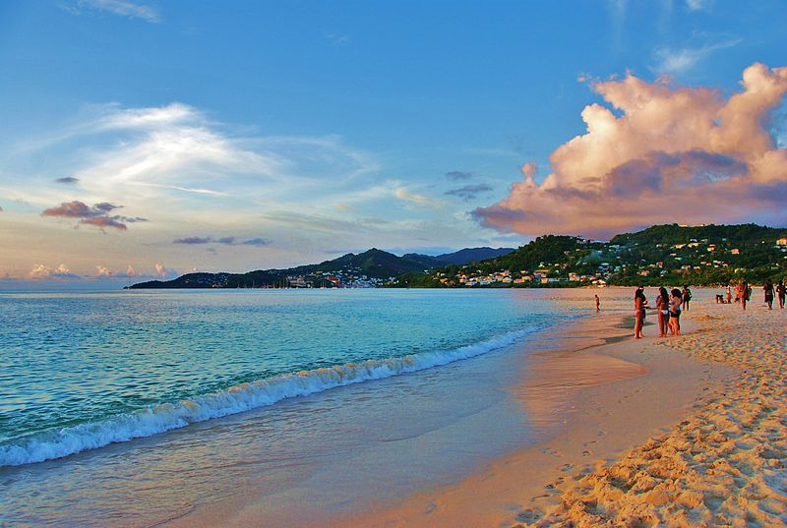
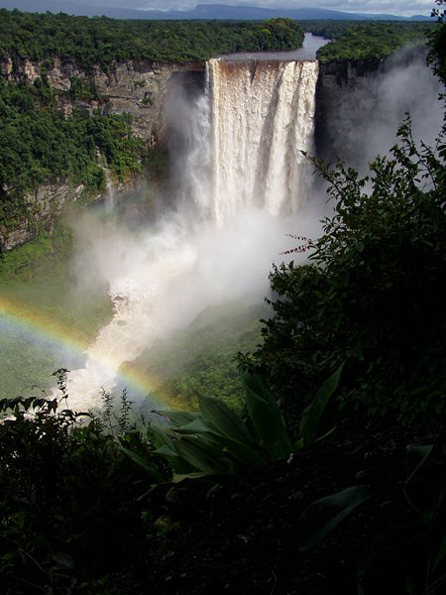
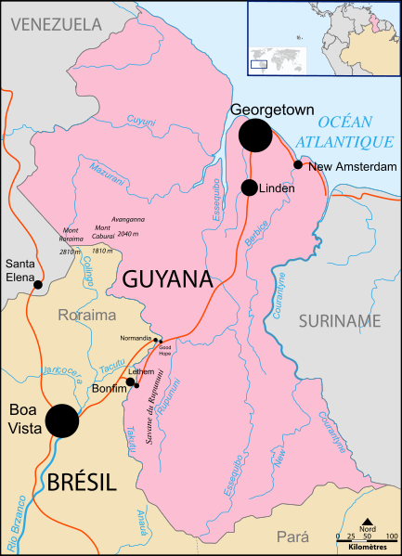
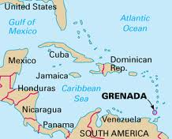
GRENADA
GUYANA

Slide 9
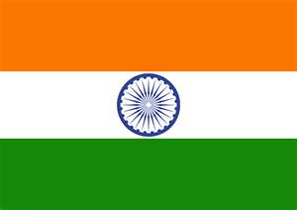
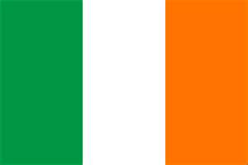
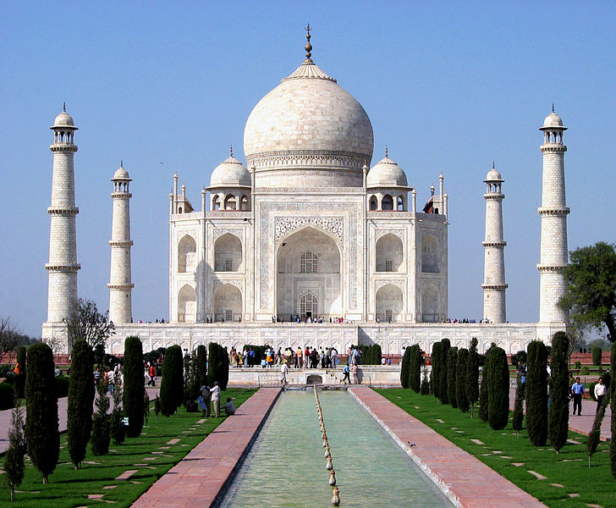
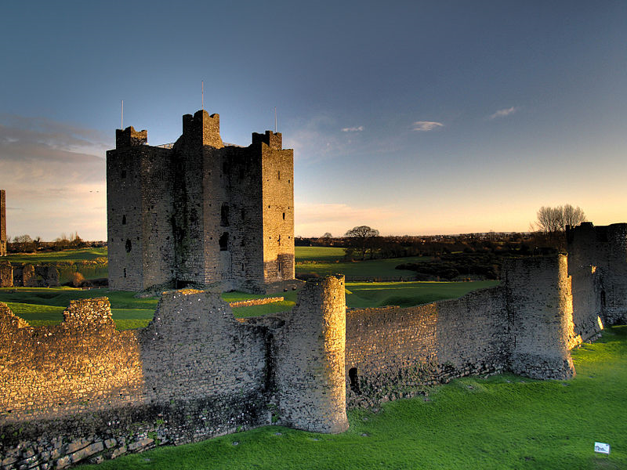
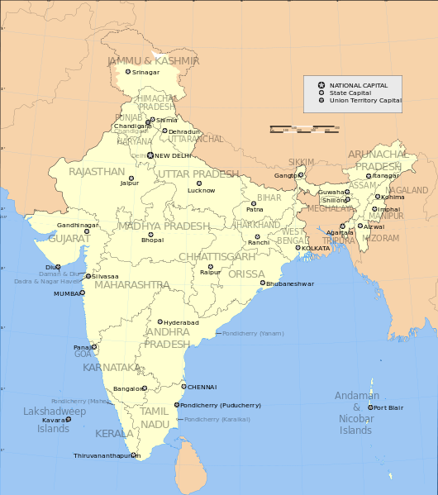


INDIA
REPUBLIC
OF IRELAND
Photo taken 25 June 2003 copyright Richard Gallagher.
Notes:
India: Taj Mahal
Ireland: Trim Castle, Co Meath;

Slide 10







JAMAICA
KENYA

Slide 11






KIRIBATI
LESOTHO

Slide 12






LIBERIA
MALAWI
Photo by John Atherton
Photo by Stefan Kraft

Slide 13






MALTA
MARSHALL
ISLANDS
Photo by Kristoferb
Photo by Stefan Lins

Slide 14






MAURITIUS
Photo by Hansueli Krapf
NAMIBIA
Photo by Rubend Nazario

Slide 15







NEW ZEALAND
NIGERIA
Photo by Mrogex
Kwa Falls
Photo by Shiraz Chakera
Photo by Jorge Royan

Slide 16






PALAU
PAPUA
NEW GUINEA
Mount Tavurvur, photo by Taro Taylor
Rock Islands

Slide 17






PHILIPPINES
RWANDA
Photo by Nic Palmer
Outrigger Camiguin Philippines, photo by chjab

Slide 18






SAINT LUCIA
Marigot Bay, St. Lucia, Photo by Matt Wade
SAMOA
Falefa Valley, Photo by Kronocide

Slide 19






SIERRA
LEONE
SINGAPORE
Road from Kenema to Kailahun District, photo by Lindsay Stark
Photo by Jecco

Slide 20








SOLOMON
ISLANDS
SOUTH
AFRICA
Photo by Jim Lounsbury
Drakensberg mountains, photo by PZFun
Kruger National Park, photo by D. Gordon Robertson
Coffee Bay, photo by Jon Rawlinson

Slide 21





ST KITTS
AND NEVIS
ST VINCENT AND
THE GRENADINES
Photo by Rjkoolj
Photo by Kayokayo

Slide 22






SWAZILAND
TANZANIA
Photo by Eckhard Pecher
Photo by William Warby

Slide 23






THE BAHAMAS
TONGA
Photo by Njackson7
Nuku Island, photo by Msdstefan

Slide 24






TRINIDAD
AND TOBAGO
TUVALU
Parlatuvier Bay, photo by cheesy42
Photo by INABA Tomoaki

Slide 25





UGANDA
ZAMBIA
Queen Elizabeth National Park, photo by Cody Pope
Victoria Falls, Zambian side, photo by DoctorJoeE

Slide 26







United Kingdom
Stonehenge, photo by Teacher13
Balmoral Castle, Scotland, photo by BK59
Belfast, Northern Ireland, photo by Thardas
Barafundle Bay, Wales, photo by Sarah and Iain
Big Ben, London, photo by Mstyslav Chernov

Slide 27








UNITED STATES OF AMERICA
Times Square, New York, photo by Terabass
Grand Canyon, Arizona, photo by Realbrvhrt
White House, Washington D.C., photo by Daniel Schwen
Red carpet, Academy Awards, L.A., photo by Greg Hernandez
Kauai, Hawaii, photo by Daderot
Byron Glacier, Alaska, photo by Ianaré Sévi

Slide 28








VANUATU
ZIMBABWE
Photo by Graham Crumb
Victoria Falls, Zimbabwe side, photo by Steve Evans
Harare, Photo by Gary Bembridge
Photo by Philip Capper

