Slide 1
Future Tenses

Slide 2

Future Tenses
In English we don’t have ONE future tense.
We use several forms to talk about different ideas about the future.

Slide 3
Future simple “will”
  e.g. I think that boy will be a great actor one day.
“be + going to”
  e.g. Their house has been burgled 3 times, so they are going to get a dog.
Present Continuous
    e.g. He’s flying to Rome tomorrow at 6 am.

Slide 4
Future Simple - will
The future simple implies there is no plan or decision before we speak. We use the future simple to:
express a spontaneous decision at the time of speaking.
e. g. Maybe we'll stay in and watch television tonight.
make a prediction about the future.
e. g. People won't go to Jupiter before the 22nd century.
express an intention or a promise.
e.g. I’ll clean up my room, mum, I will!
make a request or an offer.
e.g. I’ll give you ten euros for that.
Will you pass me the butter, please?

Slide 5
be + going to
We use be + going to + infinitive without to:
to express intentions and plans for the future
e. g. I’m going to go camping in the Summer.
to express a prediction based on something you can observe now
e. g. I think I’m going to fall asleep.
You should apologise, otherwise I think she’s going to be upset.

Slide 6

Present Continuous with a future meaning
We sometimes also use the present continuous to express planned, scheduled events in the near future.
e. g. I’m going to the cinema tonight.
We’re having our first Mandarin lesson on May 6th.

Slide 7

Key words for Future Tenses
Next week/Friday/year…
Tomorrow
In three months/an hour…
On Sunday/my birthday…
At 3 o’clock this afternoon…
FUTURE

Slide 8
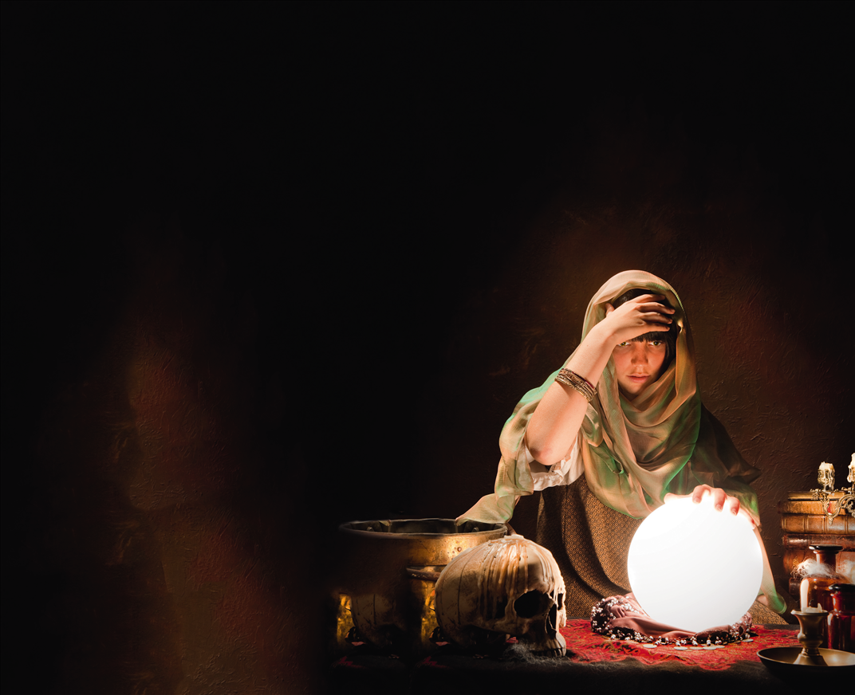
Answer the following questions.
What are your predictions for the future?

Slide 9
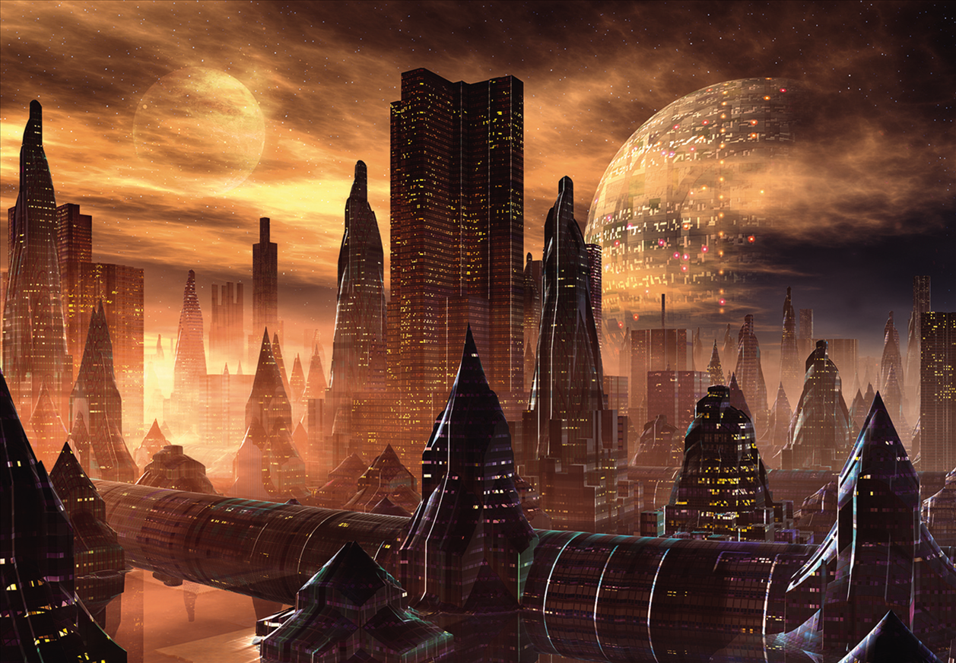
Will we all live in outer space one day?

Slide 10

Where will you be twenty years from now?

Slide 11

What are you going to do tomorrow?

