Slide 1


Infinitive and
GERUND

Slide 2
To-Infinitive or Gerund
The to-Infinitive after certain verbs often describes a future event.
After hope, expect, promise, want, the to- Infinitive comes after the activity or thought in the main verb:
  e.g. I hope to see you next week.
The Gerund is often used after verbs expressing likes and dislikes.
  e.g. We enjoyed seeing you last weekend.

Slide 3
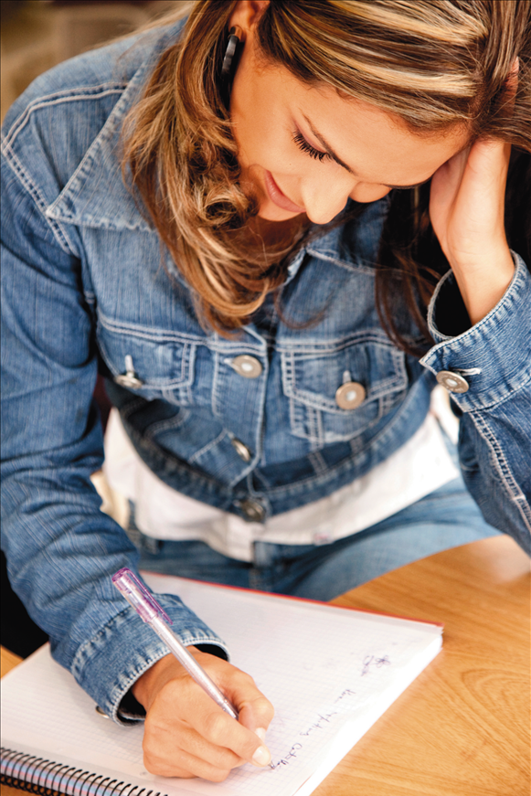
Gerund or Infinitive?
afford / agree
learn / need
ask / decide
promise / refuse
expect / fail
tell / want
hope / wish
want / decide

Slide 4
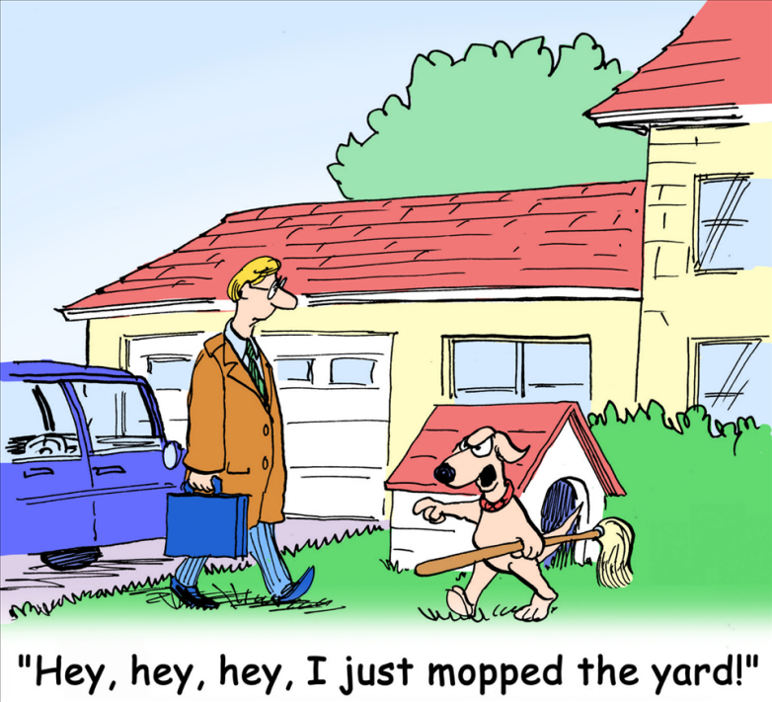
afford / agree
I agree to go with you this summer holiday.
I can afford to buy this
mp3 player.
learn / need
We should learn to do some housework.
Humans need to drink a lot of water.

Slide 5
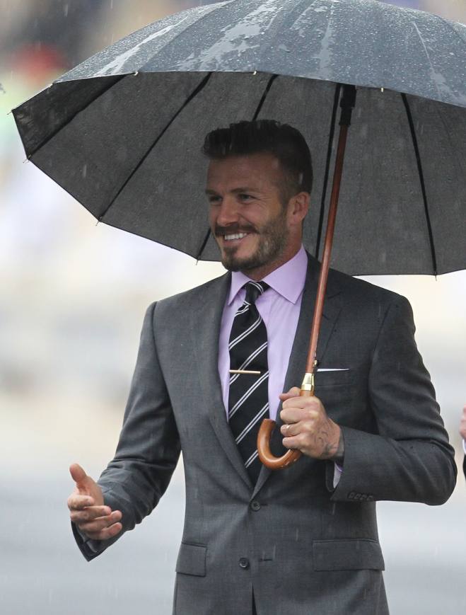
hope / wish
I hope to meet Beckham in England.
I wish to fly up high in the sky.
want / decide
I want to do my homework today.
I decided to buy this book.

Slide 6

expect / fail
We expect to pass the English exam.
They failed to do their homework.
tell / want
He wanted to tell her about his feelings.

Slide 7
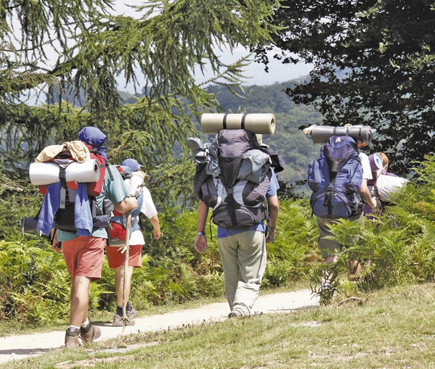
ask / decide
I asked my mum to go shopping with me.
I decided to go hiking this Sunday.
promise / refuse
I promised my mother to finish my homework by 6pm.
I refuse to invite Tiffany to my party.

Slide 8
No major difference in meaning
Some verbs can be followed by either the to-
infinitive or the gerund without any major
difference in meaning:
begin continue start intend
e.g.
Mother Teresa started to live/living in the slums of Calcutta from 1948.
Though she faced many problems, Mother Teresa continued to work/working for the poor.

Slide 9

Gerund (general)
To-Infinitive (particular situation)
e.g.
I like swimming but I don’t like to swim on cold days.
Some verbs are generally followed by the gerund when used in a general sense.
The to-infinitive is often used for a particular situation.
love | like | hate | prefer

Slide 10
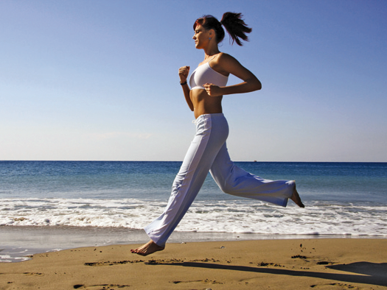
The Gerund is formed by adding ‘-ing’ to the base form of a verb.
swim → swimming
eat → eating
run → running

Slide 11
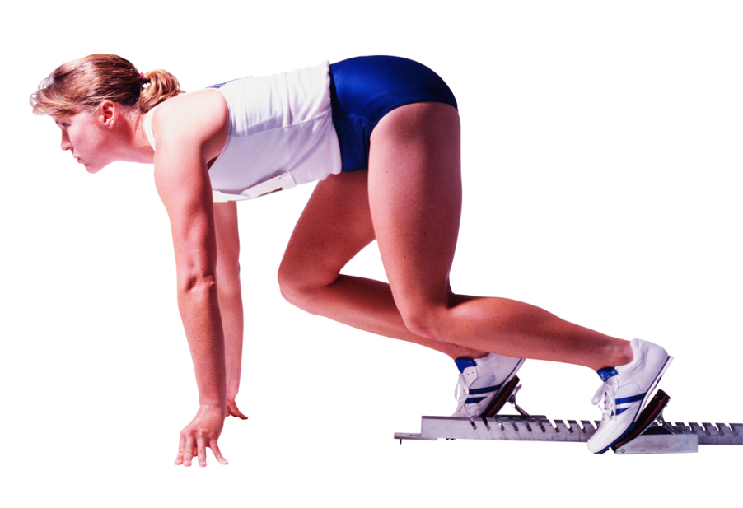
The Gerund can be used:
As a noun
e.g.
  Running is my favourite sport. (subject)
  He tried running faster. (object)
  She was afraid of losing. (object of a preposition)

Slide 12

Exercises
(swim) _________is a very good form of exercise.
I have some (shop) ______to do this afternoon.
(learn) ________ English takes a long time.

Slide 13
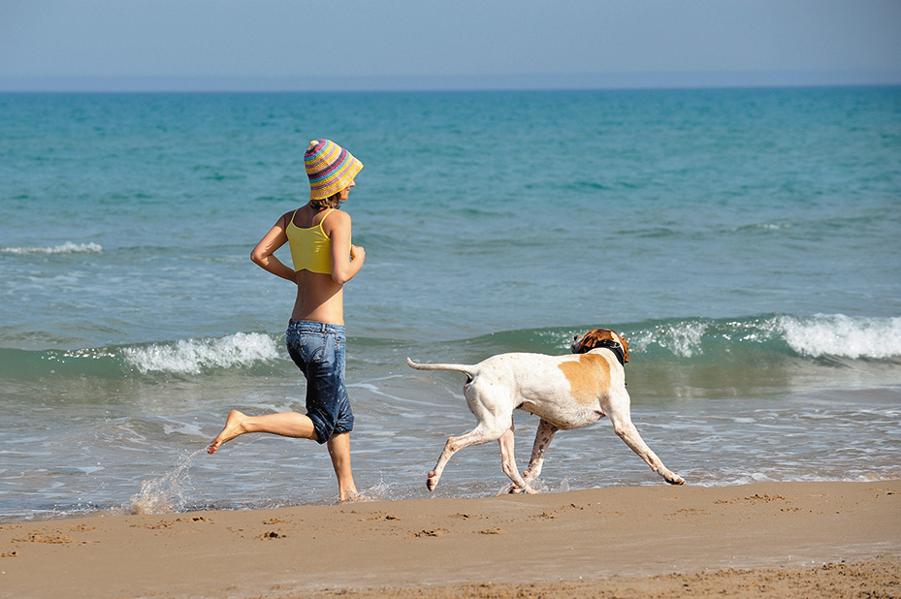
After adjectives + preposition
The Gerund can be used:
accustomed to capable of fond of afraid of | successful in good at tired of interested in
e.g.
She is accustomed to training for many hours.
He is good at running the 200 meters race.

Slide 14
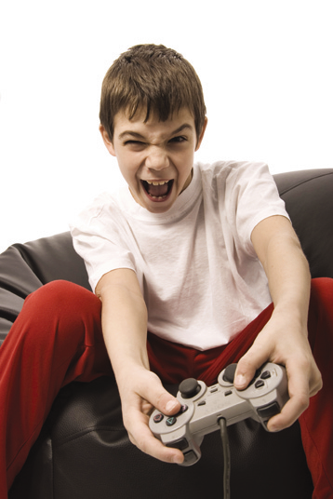
Exercises
Mary is fond of _______ (sing).
The boy soon became accustomed to _______ (work) hard.
Are you afraid of _______ (play) video games against me?
She is never tired of _______ (talk) about her clever son.

Slide 15
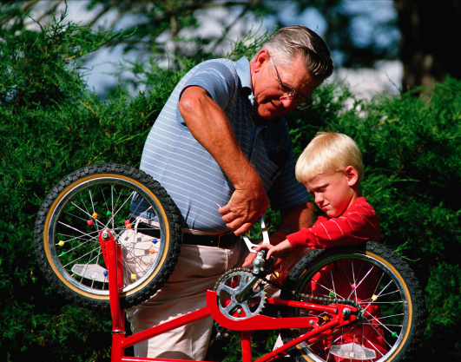
After certain verbs
The Gerund can be used:
admit can’t help dislike keep try | finish advise enjoy avoid suggest | appreciate understand mind keep forgive
e.g.
John has finished repairing his bicycle.
They enjoy walking in the evening.
Mary dislikes swimming in winter.

Slide 16

Exercises
He kept ________ (run) till the end.
She enjoys _______ (run) for competitions.
They dislike _______ (drive) small cars.
He avoided ________ (answer) my question.
Would you mind ________ (open) the window?

Slide 17
Bare Infinitive
The Infinitive form without “to” is used:
After modal verbs (should, could, must, etc.), had better and would rather.
e.g.
    We should respect people who are generous and kind.
    You’d better prepare for the interview as you’ll be asked lots of questions.
    I’d rather go for a walk.

Slide 18
After let and make
  e.g.
  Let me get you a glass of water.
  The teacher made him stay behind after school.
After the verbs:
e.g.
feel | see | watch | notice | hear | listen to
She saw a man enter the room.
I heard the boys fight with each other.

Slide 19
Infinitive and
GERUND

