Slide 1
LOST ON A DESERTED ISLAND

Slide 2
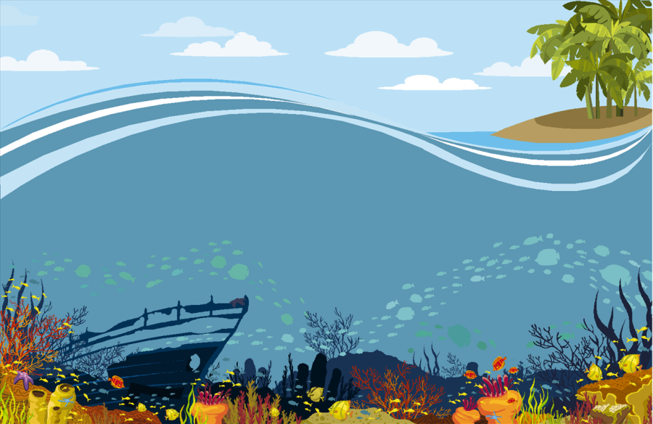
Imagine there was a shipwreck, everyone
has been stranded on a deserted island!
Each person is allowed to bring one object to the island - ideally something that represents them or something that they enjoy.

Slide 3





Each person must describe what they would bring and why. This need not be realistic; if someone loves music, he or she might choose to bring a guitar, or an animal lover might choose to bring a dog, a fast food lover might choose to bring a hamburger, and so on.
Be creative!

Slide 4
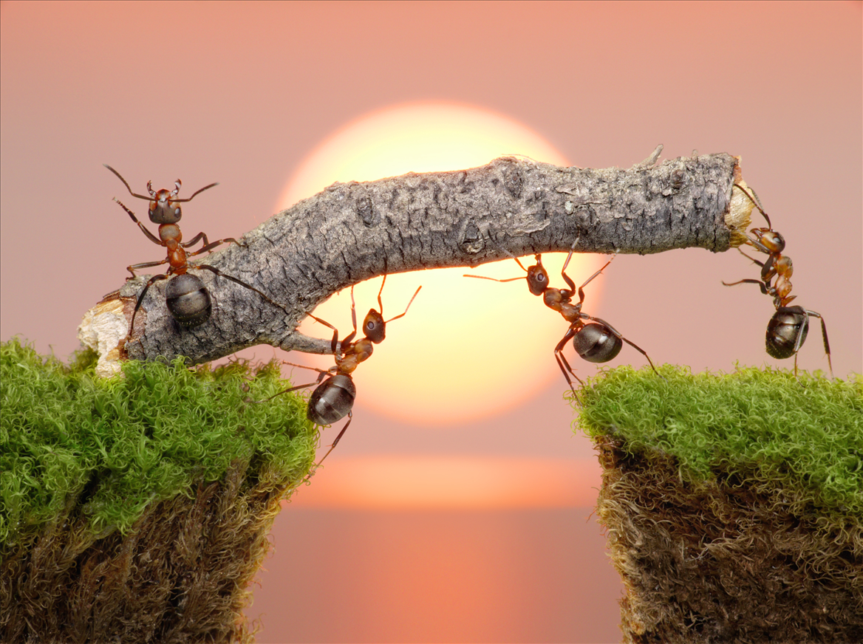
After everyone has introduced their object and stated why they have chosen that object, the teambuilding portion begins.

Slide 5
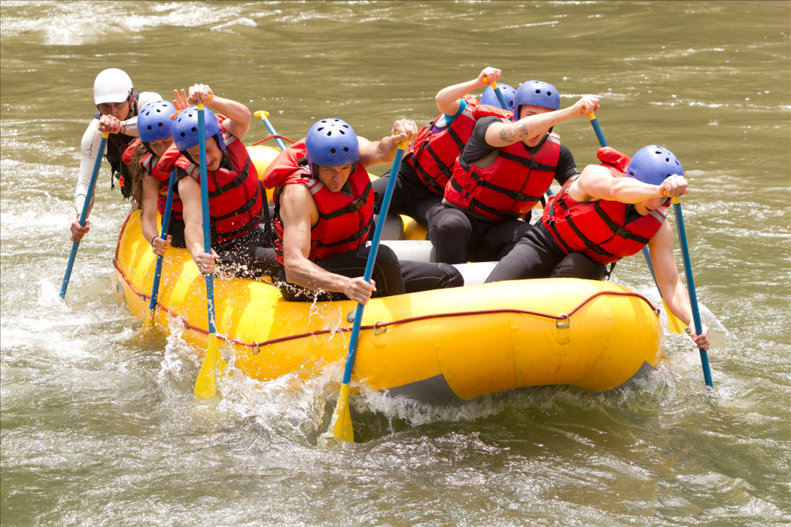
Get together in smaller groups and work together to improve your team’s chances of survival by combining the various objects that your mates introduced. If necessary, you can add more objects, but be sure to use all the objects that everyone mentioned.

Slide 6
LOST ON A DESERTED ISLAND

