Slide 1
Past Perfect and Past Perfect Continuous

Slide 2
There are two past tenses used to describe things that happened before another point in time in the past.
Past Perfect
I had been to Japan twice by the time I was 10 years old.
Past Perfect Continuous
Tom was tired, because he had been studying for hours.

Slide 3
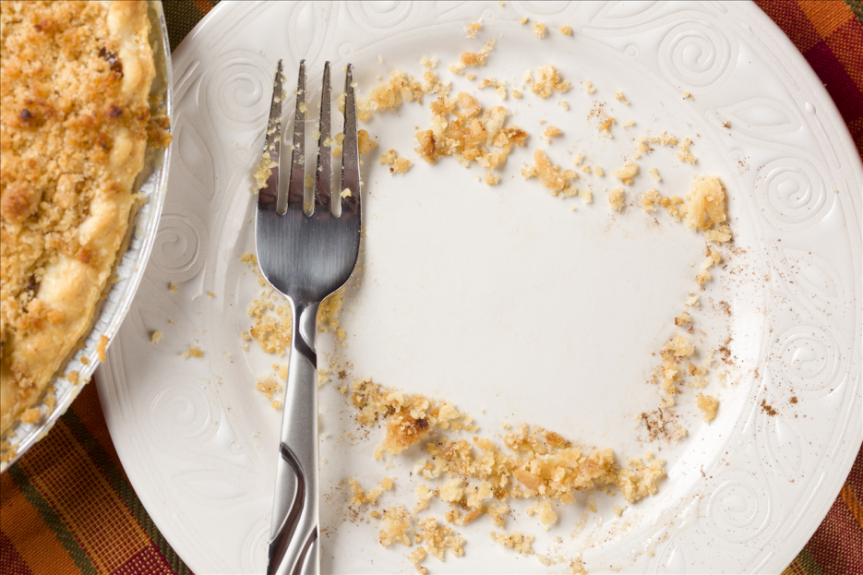
Past Perfect
We use the past perfect to talk about an event which had happened at some point in time before another action in the past.
She had already eaten by the time they arrived.

Slide 4

Past Perfect
USE
Something that had happened before something else took place.
I had eaten lunch before they arrived.
Susan had already finished the project when he asked for her help.

Slide 5
Past Perfect
USE
Something that had happened over a period of time in the past before another point in the past.
I had lived abroad for twenty years when I decided to move back home.
Jane had studied in England before she did her master's at Harvard.
Past Perfect
Present
Future
Simple Past

Slide 6

Past Perfect
USE
In the third conditional to express imagined conditions.
If I had known that, I would have acted differently.
He would have come to the party if he had been invited.

Slide 7

Past Perfect
USE
With wish to express a desire about the past.
I wish you had told me.
She wishes she had known about his problems.

Slide 8

Past Perfect
Common time expressions used with the past perfect:
already | just | before | when
I thought I had already sent you an email.
He had just come through the front door when the door bell rang.
Before I had tried yoga, I thought I wouldn’t like it.
When he had done his homework, he played video games.

Slide 9
Past Perfect Continuous
USE
The past perfect continuous is used to express how long something had been going on before something else happened in the past.
Jane had been studying for four hours when he came home.

Slide 10

Past Perfect Continuous
USE
Something that had been happening before something else took place.
I had been working for three hours when you arrived.
Susan had been thinking about the idea for a while when he made the suggestion.

Slide 11
Past Perfect Continuous
USE
Something that had been happening over a period of time in the past up until a later point in the past.
I had been playing tennis for two hours when I sprained my ankle.
Jane had been studying for two years when she got a job as an actress.
Past Perfect Continuous
Simple Past
Present
Future

Slide 12

Past Perfect Continuous
USE
Something that had been happening in preparation for something else.
I had been practicing for three days and was ready for the concert.
Tom had been studying hard and felt good about the test he was about to take.

Slide 13

Past Perfect Continuous
USE
Something that had been happening over a period of time in the past up until a later point in the past.
I had been playing tennis for two hours when I sprained my ankle.
Jane had been studying for two years when she decided to join the army.

Slide 14

Past Perfect Continuous
USE
In the third conditional to express imagined conditions.
If I had been working on that project, we would have got a good final mark.
She would have been ready for the test if she had been preparing diligently.

Slide 15
Past Perfect or Past Perfect Continuous?
I_________ (try) to get tickets for that play for months before my friend finally got them.
When I arrived at the theatre, my friend ___________ (pick, already) up the tickets.
He was really angry because he __________(wait) for more than half an hour when I arrived.
When the film started, I___________ (already, apologise) to my friend.
We______________ (watch) the film for about 20 minutes when the lights went off.
He ______________ (marry) her two years before we met.

Slide 16
Past Perfect or Past Perfect Continuous?
I ________________ (want / always) to travel, so I was delighted to go abroad with them.
She was no stranger to him. They_____________ (be introduced) to each other a few days before.
We ________________(stay) at that B&B since 1999.
I__________________ (stay / never) in London before.
Did I tell you that when I saw you, I realised that we___________ (meet / already)?
James told me your parents____________ (buy) the old cottage two years before you were born.
I wish we_____________________ (buy) it before.

Slide 17
Past Perfect and Past Perfect Continuous

