Slide 1

Plural form of nouns

Slide 2
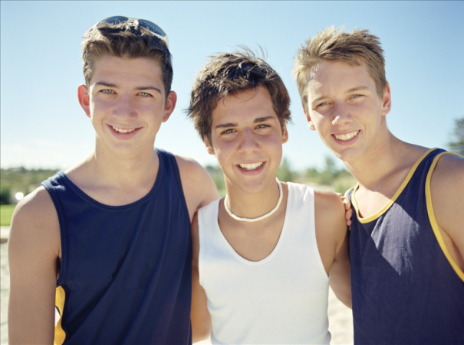
Rule #1: Plural nouns are usually formed by simply adding “-s” to the singular noun.
Boy boys
Video videos
Song songs
Computer computers
Cell phone cell phones

Slide 3
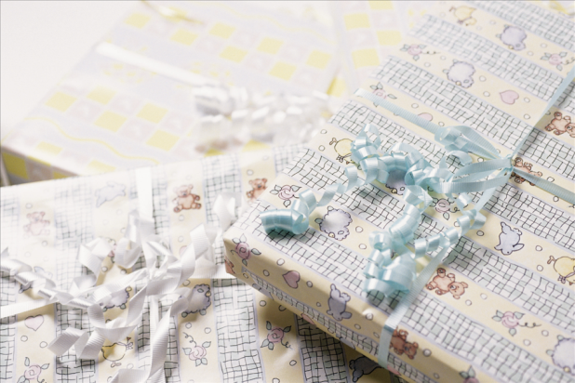
Rule #2: Nouns ending in “-s” “-z” “-x” or “-sh” take “-es” in the plural form.
Wish wishes
Buzz buzzes
Box boxes
Dress dresses
Brush brushes
Tax taxes

Slide 4


Rule #3: Most nouns that end in “-y” are made plural by changing the “-y” to “-i” and adding “-es”.
Sky skies
Theory theories
Injury injuries
Cherry cherries
Lady ladies
Family families

Slide 5
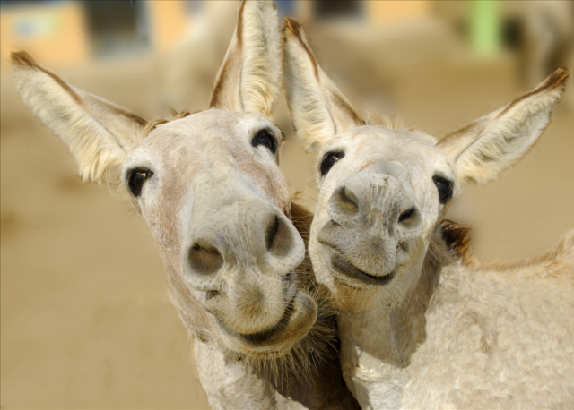
Nouns that have a vowel before “-y” are made plural by simply adding “-s” at the end.
Toy toys
Essay essays
Turkey turkeys
Chimney chimneys
Donkey donkeys
Valley valleys

Slide 6
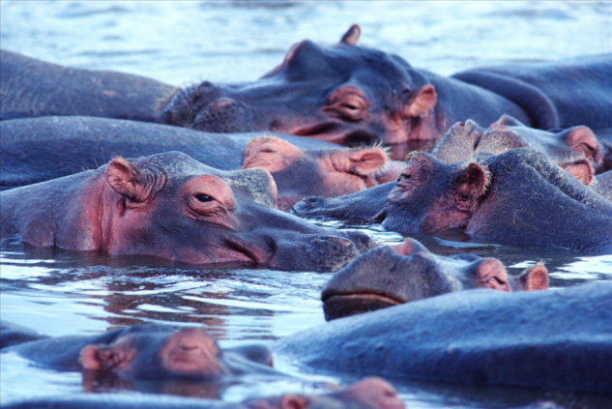
Rule #4: Most nouns that end in “-o” are made plural by adding “-s”.
Zoo zoos
Hippo hippos
Kangaroo kangaroos
Video videos
Studio studios

Slide 7

Other nouns that end in “-o” are made plural by adding “-es”.
Tomato tomatoes
Potato potatoes
Hero heroes
Volcano volcanoes

Slide 8
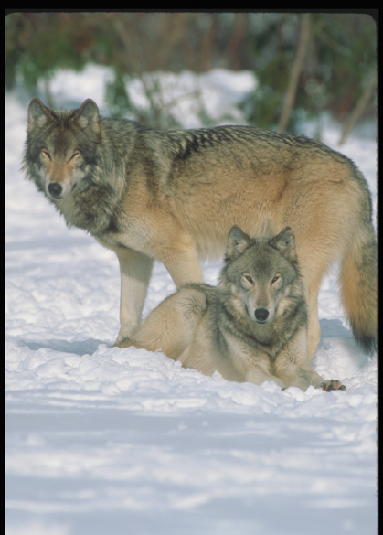
Rule #5: Nouns that end in “-f” are made plural by changing the “-f” to “-ves”.
Half halves
Leaf leaves
Shelf shelves
Wolf wolves
Thief thieves

Slide 9

Some nouns that end in “-f” are made plural simply by an added “-s”.
Chief chiefs
Roof roofs
Cliff cliffs
Puff puffs
Handkerchief handkerchiefs

Slide 10
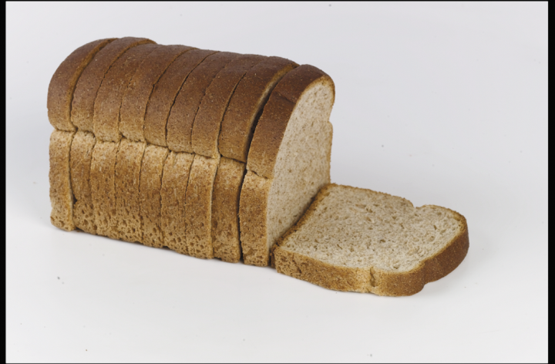
Most nouns that end in “-fe” or “-f” are made plural by changing the “-f” to “-v” and adding “-es”.
Knife knives
Wife wives
Life lives
Half halves
Loaf loaves

Slide 11
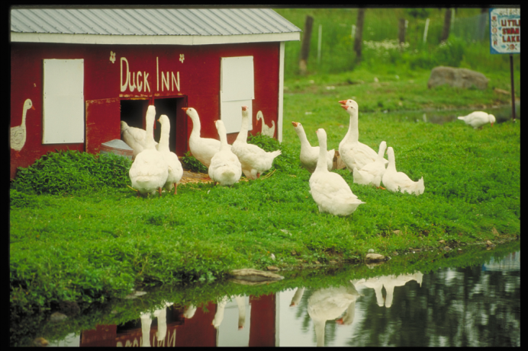
Some nouns change spelling from the singular form to the plural form.
Man men
Woman women
Child children
Person people
Mouse mice
Tooth teeth
Foot feet
Goose geese

Slide 12

Some words don't change when they become plural
Sheep
Deer
Fish
News
Offspring

Slide 13

Some nouns are always plural.
Trousers
Shorts
Jeans
Pants
Tights
Glasses
Scissors

Slide 14
Plural form of nouns

