Slide 1

Present Simple and Present Continuous

Slide 2
Present Simple
Present Continuous
Routines
Actions in progress now
Habits
Arranged future plans
Permanent situations
General truths

Slide 3
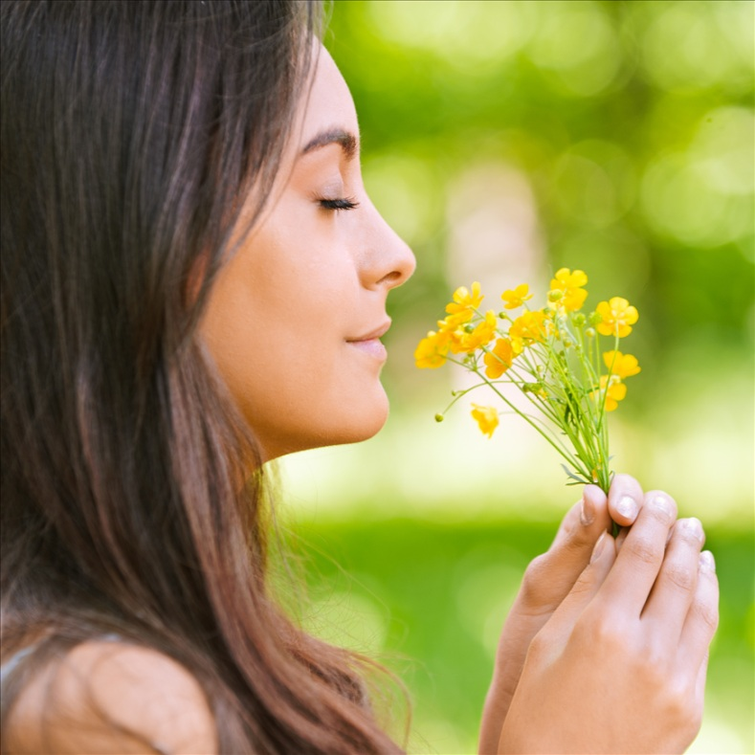
Stative verbs
There are some verbs that we do not usually use in the present continuous. These verbs are usually connected to the ideas of:
emotion: like, want, wish
mind: agree, believe, mean, know
appearance: look, like, resemble, seem
possession: belong, consist, contain, have, need, own
perception: see, hear, smell

Slide 4
Look at the sentences below.
In each pair one or both might be right.
☒
☑
☑
☑
☑
☒
1a. I watch football at the moment.
1b. I’m watching football at the moment.
2a. My brother lives in Paris.
2b. My brother is living in Paris.
3a. She’s the boss of the whole company.
3b. She’s being the boss of the whole company.

Slide 5
Look at the sentences below.
In each pair one or both might be right.
☑
☑
☑
☒
☒
☑
4a. John is really silly.
4b. John is being really silly.
5a. The Earth goes round the sun.
5b. The Earth is going round the sun.
6a. This week I study for my exams.
6b. This week I’m studying for my exams.

Slide 6
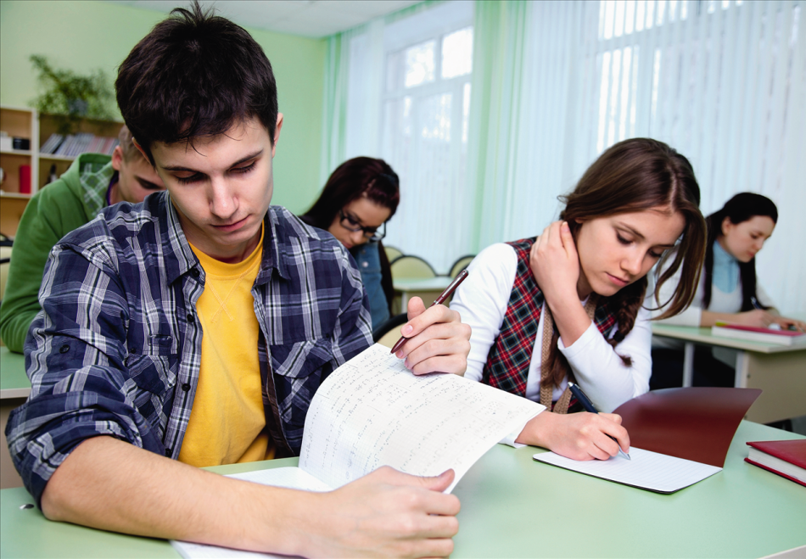
Look at the following sentences.
For each one choose between the
present simple or the present continuous.
Be careful, some verbs can change their meaning depending on the situation.

Slide 7
I’m not believing a word you say.
I don’t believe a word you say.
‘What are you thinking about?’ ‘My family.’
‘What do you think about?’ ‘My family.’
What do you think of Wayne’s new bike?
What are you thinking of Wayne’s new bike?
I’m seeing him. He’s coming through the gate.
I see him. He’s coming through the gate.
The doctor’s seeing Mr Jones at the moment.
The doctor sees Mr Jones at the moment.
Wait a minute. I’m tasting the soup.
Wait a minute. I taste the soup.

Slide 8
He’s earning a lot of money at the moment.
He earns a lot of money at the moment.
Warning: these cakes are containing nuts.
Warning: these cakes contain nuts.
I’m not understanding my girlfriend sometimes.
I don’t understand my girlfriend sometimes.
The money’s belonging to me, I earned it.
The money belongs to me, I earned it.
I’m sorry, I’m not knowing where he is.
I’m sorry, I don’t know where he is.
I hate smoked fish. It tastes horrible.
I hate smoked fish. It’s tasting horrible.

Slide 9
Choose the correct answer.
What do you do? I’m an architect. I’m designing a new factory. What are you doing? I’m a teacher. I’m trying to fix this toaster. | What’s Jimmy doing? He watches the match on TV. He’s watching the match on TV. Where do you come from? I’m Spanish. I’m coming from Kansas.
What’s the weather like today? It gets warmer. It’s getting warmer.

Slide 10
Choose the correct answer.
You’ve got paint in your hair. Yes, we paint the kitchen this week. Yes, we’re painting the kitchen this week. | What about your grandmother? Oh, she was born in Belfast. She still lives there. Oh, she was born in Belfast. She’s still living there.
Where’s Bill? He comes from York. Maybe his train’s late. He’s coming from York. Maybe his train’s late. | Why are you taking the bus? I take the bus because my wife has the car. I’m taking the bus because my wife has the car.

Slide 11
Complete the sentences with the correct forms of the verbs in brackets. Use the simple present or the present continuous tense.
My brother __________________________ (like) this CD very much.
He __________________________ (travel) to China this summer.
We __________________________ (go) to lunch now. Would you like to join us?
We always __________________________ (visit) Grandma on Sundays.

Slide 12
Complete the sentences with the correct forms of the verbs in brackets. Use the simple present or the present continuous tense.
In this photo, we __________________________ (play) volleyball on the beach.
I __________________________ (play) tennis every day.
My father can’t come to the phone now. He __________________________ (take) a shower.
My father __________________________ (work) as an accountant in a big company.

Slide 13
Complete the sentences with the correct forms of the verbs in brackets. Use the simple present or the present continuous tense.
I think this pen __________________________ (cost) $80.
I can’t play online games now. My brother ____________ (use) the computer to do his homework.
A: ______________ you ___________________ (do) your homework now?
B: Yes, I __________________________.

Slide 14
Complete the sentences with the correct forms of the verbs in brackets. Use the simple present or the present continuous tense.
This photo was taken when I was three. My father _____________ (carry) me on his shoulders.
People ______________ always ___________________ (buy) new mobile phones.
Can you see Anna? She ____________________ (stand) at the bus stop.

Slide 15
Present Simple and Present Continuous

