Slide 1


Reported Speech
Free Powerpoint Templates

Slide 2

Oh, my cuddly, fluffy teddy. You’re going to be my constant companion.
Garfield called his teddy cuddly and fluffy and said that he was going to be his constant companion.

Slide 3

Reported Speech
Use: To report what someone said.
We use reporting verbs such as:
- say - explain
- tell - suggest
- ask - reply
- promise - advise
- (...)

Slide 4
Form - verb changes
Direct Speech | Reported Speech
Present Simple Tom: “Dan eats too much chocolate.” | Past simple Tom said (that) Dan ate too much chocolate.
Present Continuous Tom: “Dan is eating some chocolate now.” | Past Continuous Tom said (that) Dan was eating some chocolate then.
Past Simple Tom: “Dan ate all the chocolate.” | Past Perfect Tom complained (that) Dan had eaten all the chocolate.

Slide 5
Form - verb changes
Direct Speech | Reported Speech
Present Perfect Tom: “Dan has eaten most of the chocolate.” | Past Perfect Tom revealed (that) Dan had eaten most of the chocolate.
Future – will Tom: “I know Dan will eat all the chocolate.” | Conditional Tom said he knew Dan would eat all the chocolate.
Imperative Tom: “Eat only your chocolate!” “Don’t eat my chocolate!” | Infinitive Tom asked Dan to eat only his chocolate. Tom asked Dan not to eat his chocolate.

Slide 6
Notice the changes to the imperative.
“Eat only your chocolate!”
Affirmative
Reported speech: TO + VERB
She ordered him to eat only his chocolate.
Negative
Reported speech: NOT + TO + VERB
She told/asked him not to eat her chocolate.
“Don’t eat my chocolate!”

Slide 7
Subject Change
Direct Speech | Reported Speech
I | he/she
you | he/she/I/they
he | he
she | she
we | they
they | they
Changes in pronouns and determiners
Direct Speech | Reported Speech
my | his/her
your | his/her/mine/their
his | his
her | her
our | your
their | their
your | yours
mine | his/hers

Slide 8
Other Changes
Direct Speech | Reported Speech
This | That
These | Those
Here | There
Now | Then
Today | That day
Yesterday | The day before/the previous day
Tomorrow | The next / The following day
Last year | The year before/the previous year
Ago | Before
Next | The following

Slide 9
Reported Speech questions
Whenever a question starts with an interrogative pronoun, this pronoun is repeated in the new reported speech sentence and is followed by the subject and then the verb.
Question interrogative pronoun + verb + subject
Reported
speech interrogative pronoun + subject + verb
e.g.
“How much chocolate did you eat?”
She asked me how much chocolate I had eaten.

Slide 10
Reported Speech questions
Whenever a question starts with a verb, we form the reported speech by adding if/whether followed by the subject and then the verb.
Question verb + subject
Reported
speech If/whether + subject + verb
e.g.
“Did you eat my chocolate?”
She asked me if/whether I had eaten her chocolate.

Slide 11
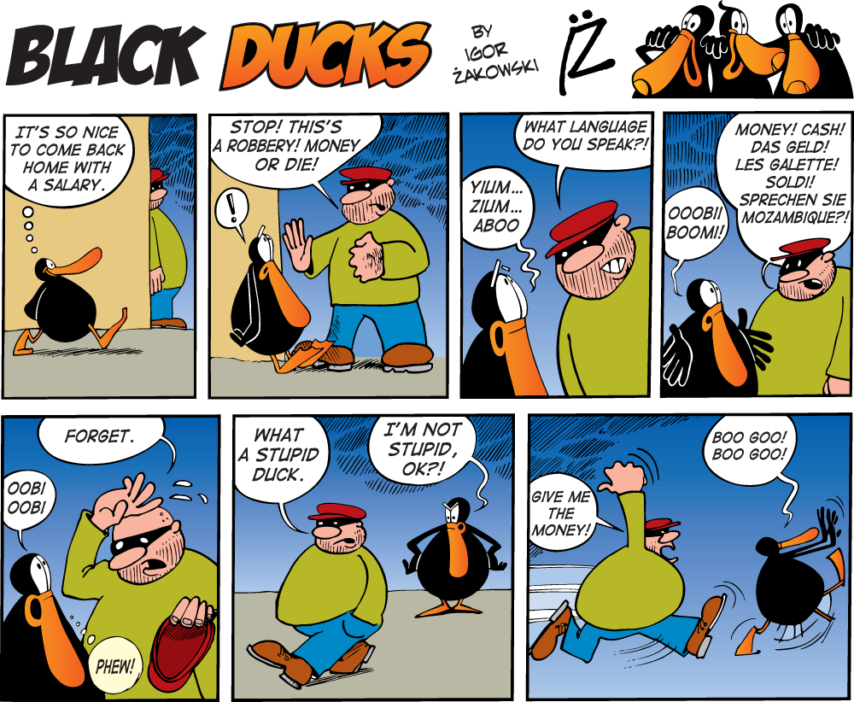
Rewrite the stories in the comic strips by using the reported speech.

Slide 12
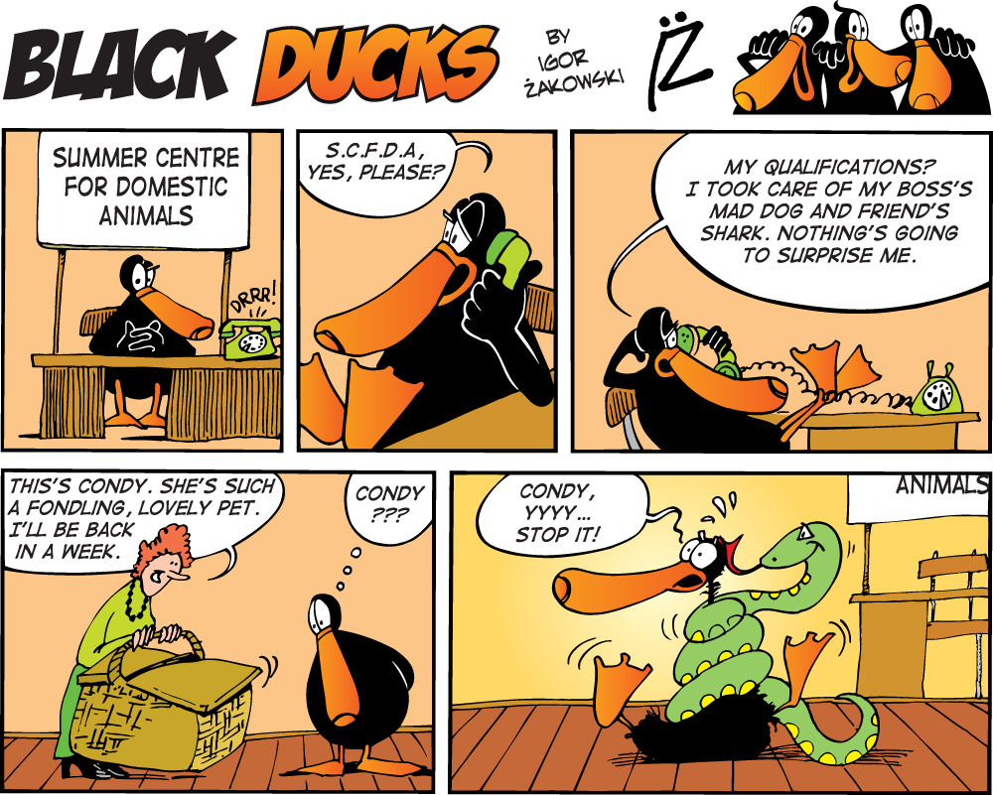
Rewrite the stories in the comic strips by using the reported speech.

Slide 13
Reported Speech
Free Powerpoint Templates

