Slide 1
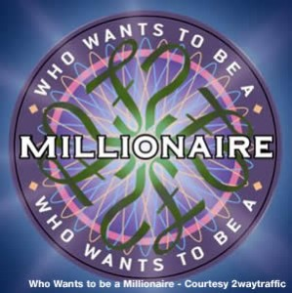

Tech ace

Slide 2
Solar power generates electricity from what source?
A: The moon
B: Machines
C: The sun
D: The wind

Slide 3
In what year did the first phone made by Steve Jobs’s company become available?
A: 2006
B: 2007
C: 2005
D: 2008

Slide 4
In terms of computing, what does CPU stand for?
A: Cellular Processing Unit
B: Central Process Unit
C: Central Promoting Unit
D: Central Processing Unit

Slide 5
The most famous Japanese video game company was first founded in…
A: 1990
B: 1889
C: 1988
D: 1991

Slide 6
The Hubble Space Telescope is named after which American astronomer?
A: Edward Hubble
B. Robert Hubble
C: Edwin Hubble
D: George Hubble

Slide 7
Firefox, Opera, Chrome, Safari and Explorer are types of what?
A: web machines
B: web browsers
C: web modems
D: web links

Slide 8
The technologically advanced humanoid robot ASIMO was made by which car company?
A: Mercedes
B: Renault
C: Honda
D: Ford

Slide 9
In terms of computing, what does ROM stand for?
A: Roll on memory
B: Read only memory
C: Right on memo
D: Reach only memory

Slide 10
What is the Earth’s primary source of energy?
A: The moon
B: The stars
C: The climate
D: The sun

Slide 11
IBM is a well known computer and information technology
company, what does IBM stand for?
A: International Bionic Matter
B: International Business Machines
C: International Binary Matter
D: International Binary Machine

Slide 12
Along with whom did Bill Gates found Microsoft?
A: Steve Jobs
B. Robert Zemakis
C: Paul Allen
D: George Randy

Slide 13
What science fiction writer wrote the three laws of robotics?
A: Edwin Abbot
B: Isaac Asimov
C: Kevin Anderson
D: Robert Adams

Slide 14
What does the abbreviation WWW stand for?
A: Wide World Web
B: Web World Wide
C: World Wide Web
D: Web Wide World

Slide 15
What does the abbreviation URL stand for?
A: Universal Router Launch
B: Uniform Resource Locator
C: Universal Recording Laptop
D: Uniform Reactivating Light

