Slide 1

WRITING A
NEWSPAPER ARTICLE

Slide 2
THE HEADLINE
Successful, eye-catching newspaper headlines should contain some of these elements:
Short phrases
Play on words
An element of intrigue

Slide 3
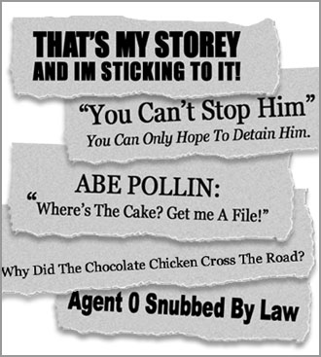
SOME EXAMPLES

Slide 4

You are now going to look at some other examples of newspaper headlines.
For each one,
think about:
what techniques the writer has
used to grab your attention;
what the article is about.

Slide 5

EXAMPLE 1
Splosh and Becks
Techniques used:
short phrase and play on words
This article is about:
The Beckhams cut short their £250,000 Christmas break in paradise in the Maldives - because it would not STOP RAINING.

Slide 6
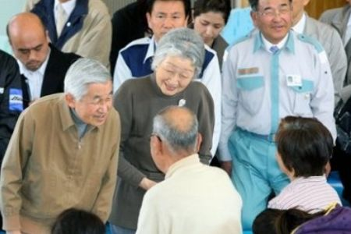
EXAMPLE 2
WE WEPT FOR WAVE ORPHANS
Techniques used:
Short phrases, alliteration –
repeating the “w” sound.
This article is about:
Royal family express their grief over the tsunami disaster.

Slide 7
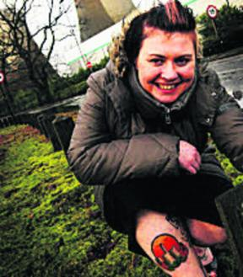
EXAMPLE 3
Power that’s so cool-ing
Techniques used:
Short phrase and play on words
This article is about:
WACKY Kelly Green loves her local power station so much she’s had its cooling towers and chimney tattooed on her leg.

Slide 8
Now you’re going to write an article...
First, you must identify the main point of your story before you write it.
The lead is what opens any piece of journalism. Other than the headline, the lead is the only chance to “catch” your reader’s attention.
The lead consists of 1 or 2 sentences in the opening paragraph that contain some of the most important parts of the story (who, what, where, when, why, how).
Readers spend only 3 seconds deciding whether to read your story based on your lead!

Slide 9

The lead
Who? | What?
Where? | When?
Why? | How?

Slide 10
Organising Your Story
Once you’ve written your lead, the time has come to develop the rest of your story, which includes the most interesting facts.
Choosing the correct structure to benefit your readers is critical to the success of your story.
There are 3 typical structures you will be using as a journalist:
      Inverted Pyramid
      Storytelling Pattern
      Chronological Order Pattern
Also, you might combine more than one
of these patterns in the same story.

Slide 11
Inverted Pyramid
LEAD
Who? – What? – Where?
When? – Why? – How?
Most important details
Less important details
Other general info

Slide 12
Storytelling Pattern
After a beginning, a middle and an ending, the writer includes a clincher or a kicker, which gives the reader something to remember without repeating previous information; a circle kicker returns back to the opening paragraph.

Slide 13
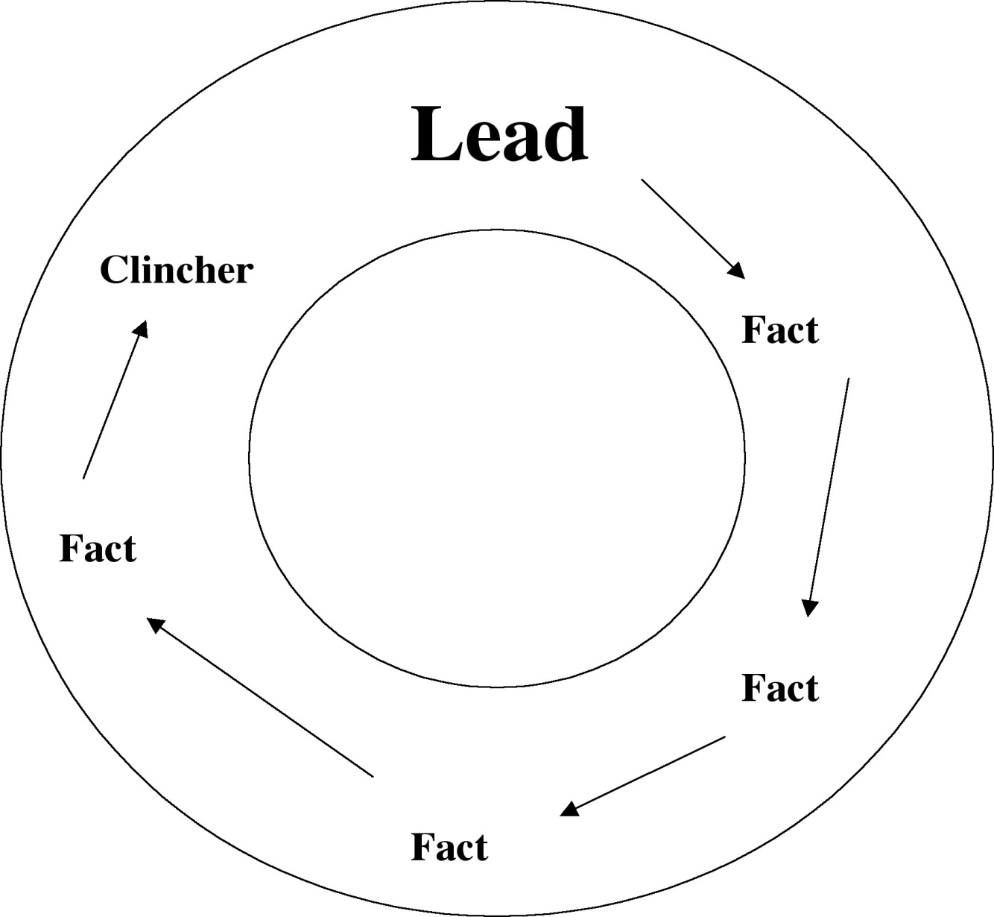

Slide 14
Chronological Pattern
LEAD
Foreshadowing
Chronological Storytelling
Climax at End

Slide 15
WRITING A
NEWSPAPER ARTICLE

