Slide 1
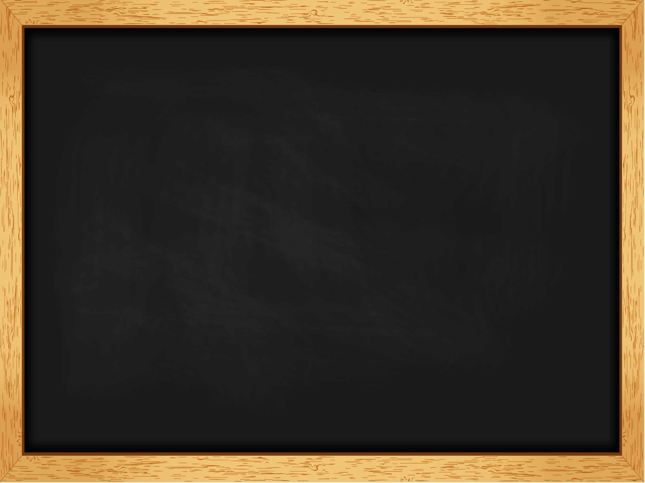
Test correction
Inglês 5º ano

Slide 2
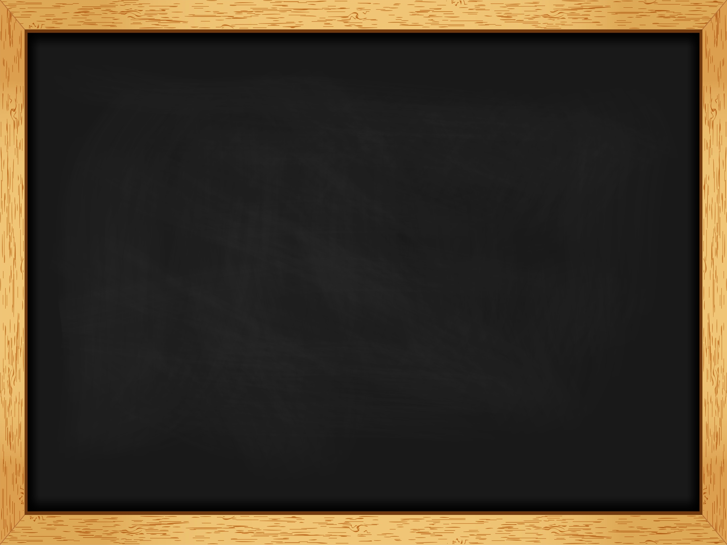

Test 2 (A)
A.
1. the United States of America
2. twenty-five (25)
3. beautiful
4. eight (8)
5. brown
B.
1. Ariana’s birthday / Her birthday is on 26th June.
2. No, she isn’t. She is medium height.
3. Her hair is brown.
4. Her favourite clothes are skirts, dresses and her favourite footwear are trainers.
5. Yes, she has.

Slide 3

C.
1. sweater
2. dress
3. shorts
4. shirt
5. gloves
6. t-shirt
7. socks
8. jeans
D.
1. have got
2. haven’t got
3. has got
4. hasn’t got
5. has got
E.
1. Has Ariana/she got long hair? Yes, she has.
2. Has she got ten dogs? No, she hasn’t.
3. Have Jessie and Leah / they got sweaters? No, they haven’t.
4. Have they got short hair? No, they haven’t.
5. Have they got books? Yes, they have.

Slide 4
F.
1. My friends have got nice caps.
My friends haven’t got nice caps.
Have my friends got nice caps?
2. Sam has got two sisters.
Sam hasn’t got two sisters.
Has Sam got two sisters?
3. Carol has got long legs.
Carol hasn’t got long legs.
Has Carol got long legs?
G.
1. It’s Rachel’s skirt.
2. It’s the students’ uniforms.
3. It’s Thomas’s raincoat.
4. They’re Andy and Peter’s gloves.

Slide 5
H.
1. Mine
2. yours
3. ours
4. hers
5. theirs
6. his
I.
1. My parents have got a modern house.
2. We are polite students.
3. Ted is a shy boy.
4. I have got a tall sister.
5. The teacher has got funny glasses.
J.
Personal answer.

Slide 6
Test 2 (B)
A.
1. the United States of America
2. twenty-five
3. beautiful
4. eight
5. brown
B.
1. c)
2. e)
3. a)
4. b)
5. d)
C.
1. sweater
2. dress
3. shorts
4. shirt
5. gloves
6. t-shirt
7. socks
8. jeans

Slide 7
D.
1. have got
2. haven’t got
3. has got
4. hasn’t got
5. has got
E.
1. b)
2. e)
3. a)
4. c)
5. d)
F.
1.
My friends haven’t got nice caps.
Have my friends got nice caps?
2.
Sam hasn’t got two sisters.
Has Sam got two sisters?
3.
Carol hasn’t got long legs.
Has Carol got long legs?

Slide 8
G.
1. Rachel’s
2. the students’
3. Thomas’s
4. Andy and Peter’s
H.
1. yours
2. ours
3. hers
4. theirs
5. his
I.
1. a) My parents have got a modern house.
2. b) We are polite students.
3. b) Ted is a shy boy.
4. a) I have got a tall sister.
5. a) The teacher has got funny glasses.
J. Personal answer.

Slide 9
Test 2 (C)
A.
1. sweater
2. dress
3. shorts
4. shirt
5. socks
6. jeans
B.
1. have got
2. haven’t got
3. has got
4. hasn’t got
C.
2. e)
3. a)
4. c)
5. d)

Slide 10
D.
1. Rachel’s
2. the students’
3. Thomas’s
4. Andy and Peter’s
E.
1. yours
2. ours
3. hers
4. theirs
F.
Personal answer.

