Slide 2

There was a Carnival
party at school.

Slide 3
There were a lot of people at the party.

Slide 4

Was there a mask contest?
No, there wasn’t a mask contest.

Slide 5
Were there any drinks?
No, there weren’t any drinks.
Was there any food?
No, there wasn’t any food.
No games, no food, no drinks… What a boring party!

Slide 6
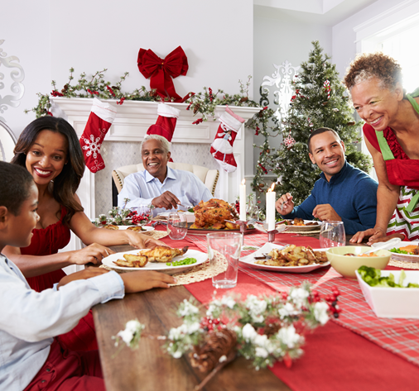
Exercises
Choose the right answer according to the picture.
At Christmas, __________ a lovely family dinner.
  there was
  there were

Slide 7
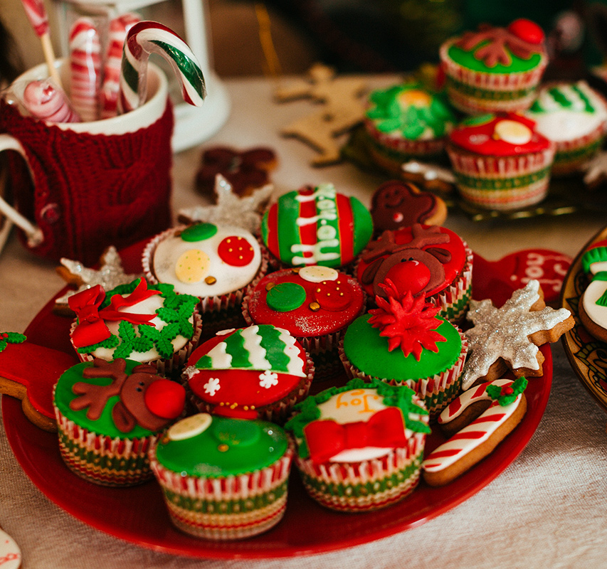
Exercises
Choose the right answer according to the picture.
__________ delicious cakes.
  There was
  There were

Slide 8

Exercises
Choose the right answer according to the picture.
__________ a Christmas tree, but
__________ a crib.
  There was / there wasn’t
  There wasn’t / there was

Slide 9
Exercises
Choose the right answer according to the picture.
__________ any Christmas lights, but
__________ some candles.
  There were / there weren’t
  There weren’t / there were

Slide 10
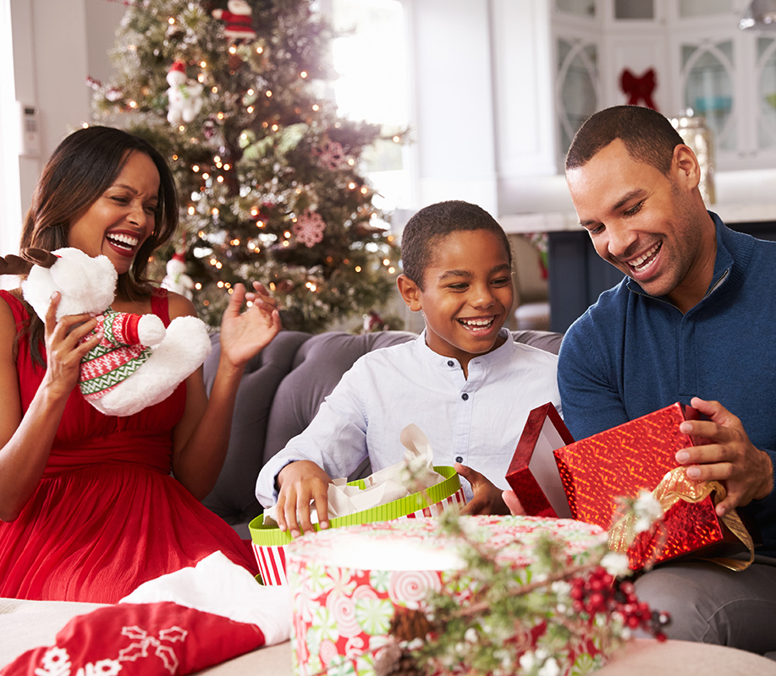
Exercises
Choose the right answer according to the picture.
And, of course, __________ lots of presents.
  there were
  there was

Slide 11
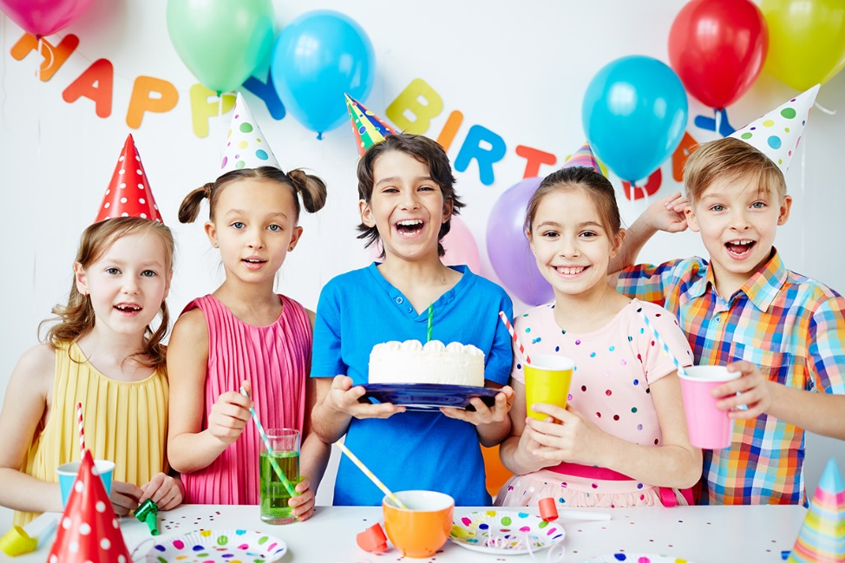
Exercises
In pairs, ask and answer about the picture. Use the past of there + to be. Follow the example.
1. a birthday party
Was there a birthday party? - Yes, there was.
2. many kids
3. a birthday cake
4. many balloons
5. lemon tea
6. a lot of food

Slide 12
Answers
Were there many kids? - Yes, there were.
Was there a birthday cake? - Yes, there was.
Were there any balloons? - Yes, there were.
Was there lemon tea? - No, there wasn’t.
Was there a lot of food? - Yes, there was.

