Slide 2
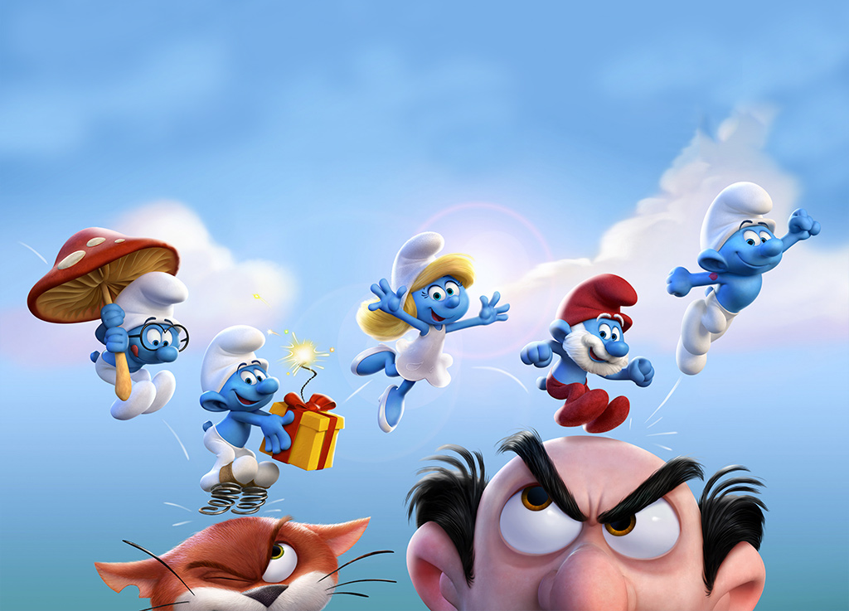


Slide 3

Some adjectives need a preposition.
For example:

Slide 4
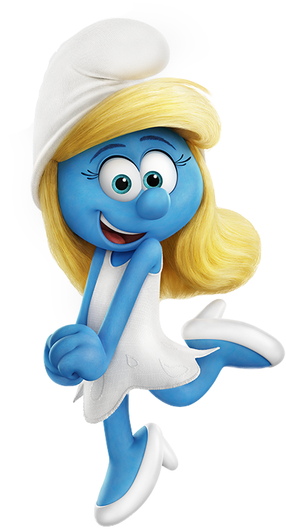
Hello! I’m Smurfette and all the Smurfs are interested in me.
I’m the only girl in the village…

Slide 5
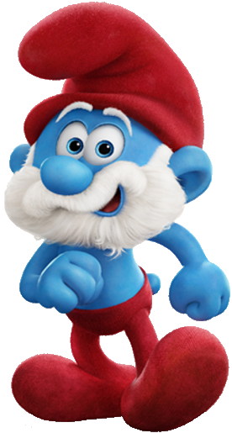
This is Papa Smurf.
He likes all the
Smurfs and is
kind to them.

Slide 6
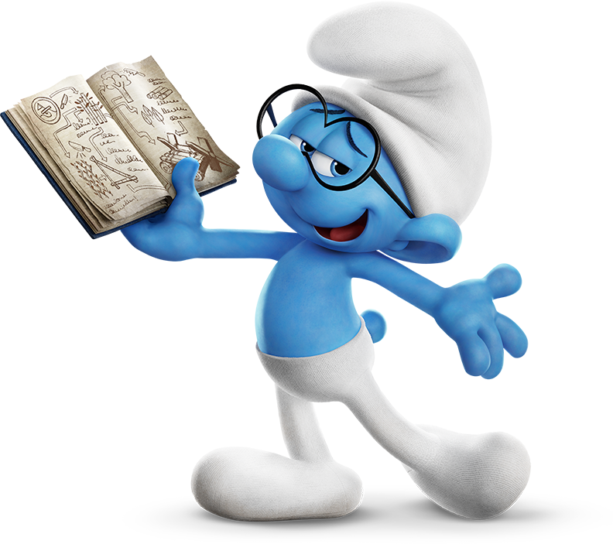
Brainy is intelligent and very good at science.

Slide 7
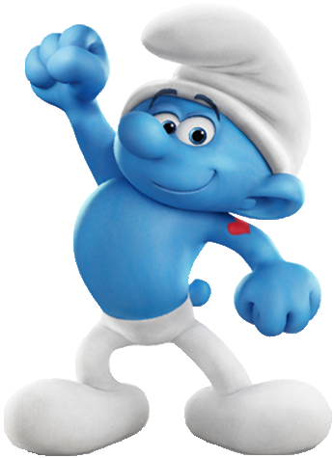
Hefty is never late for a fight...

Slide 8
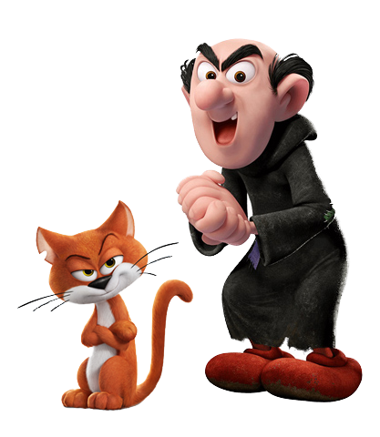
Be careful! Gargamel is a wizard
famous for his goal: to destroy the Smurfs.

Slide 9
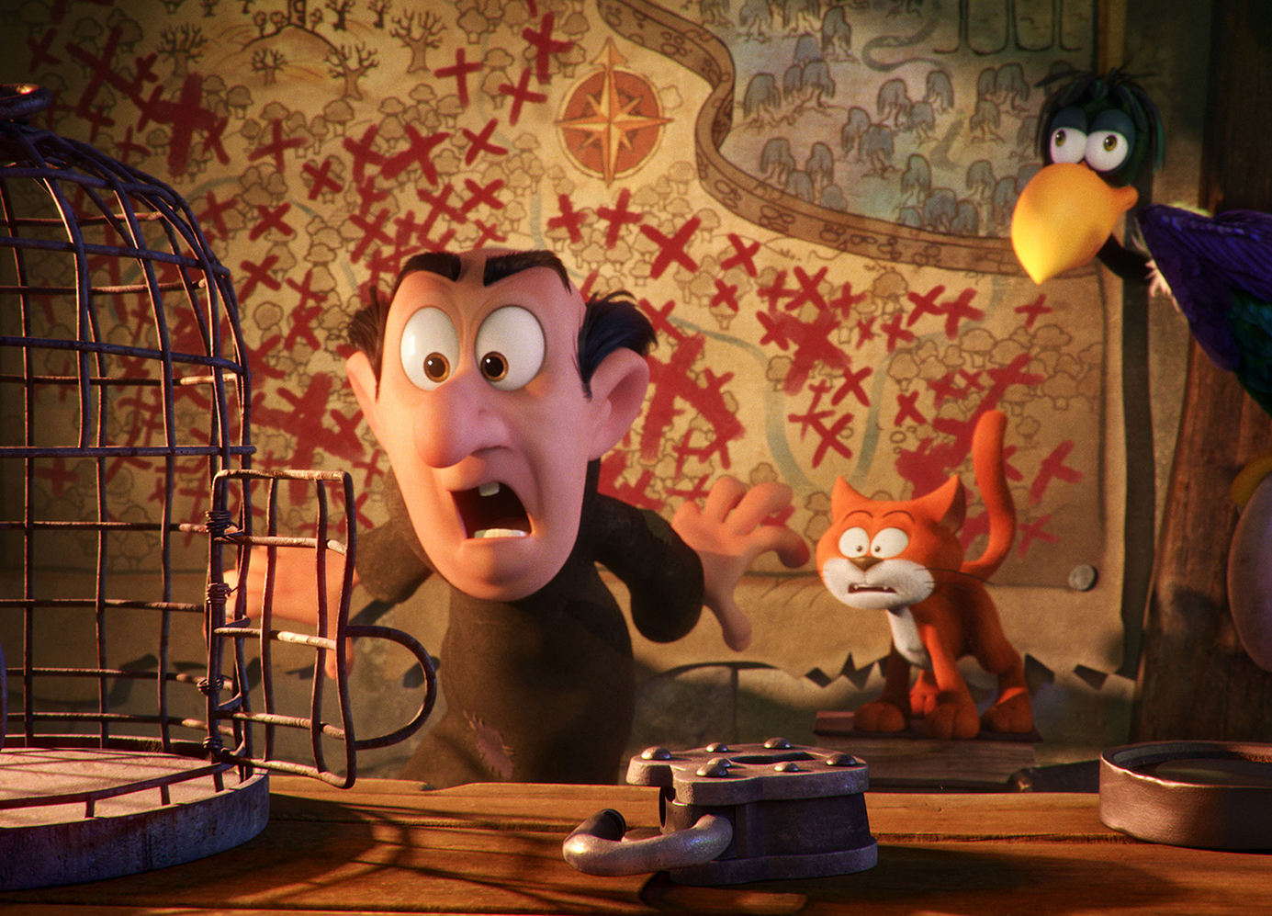
…but he is bad at catching them.

Slide 10
Complete the sentences with the correct preposition.

Slide 11
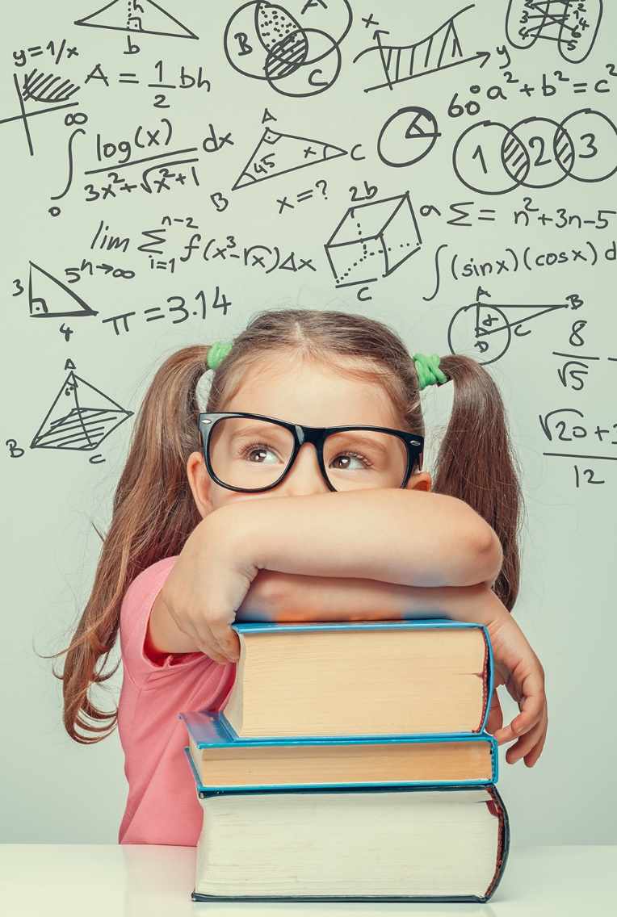
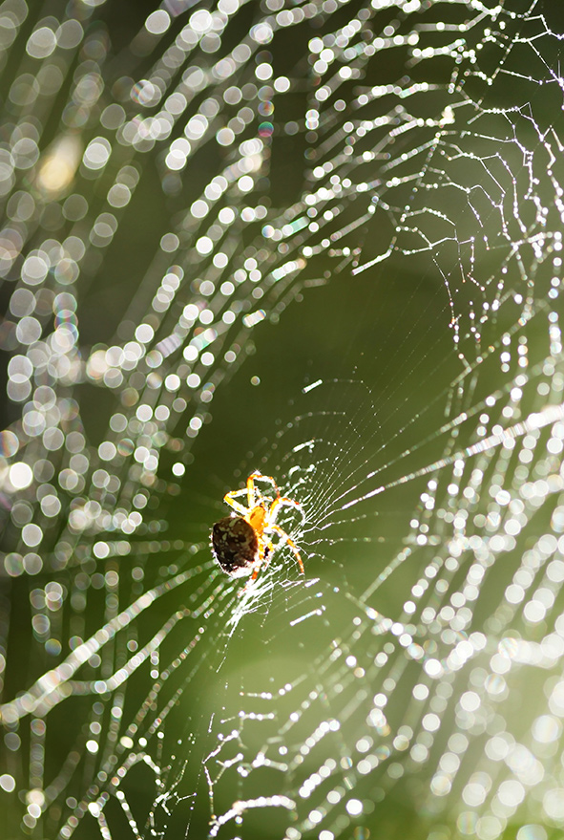
Kim is interested ____ maths.
of
She is afraid ____ spiders.
in

Slide 12
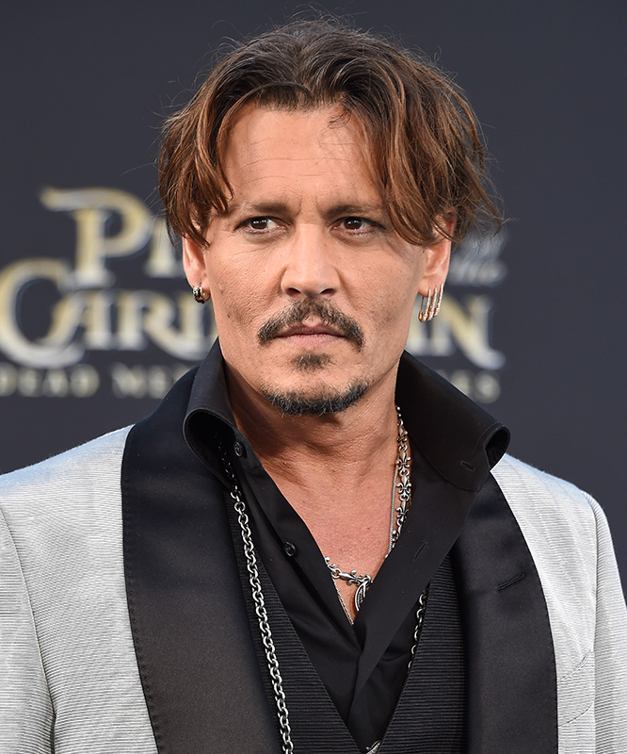
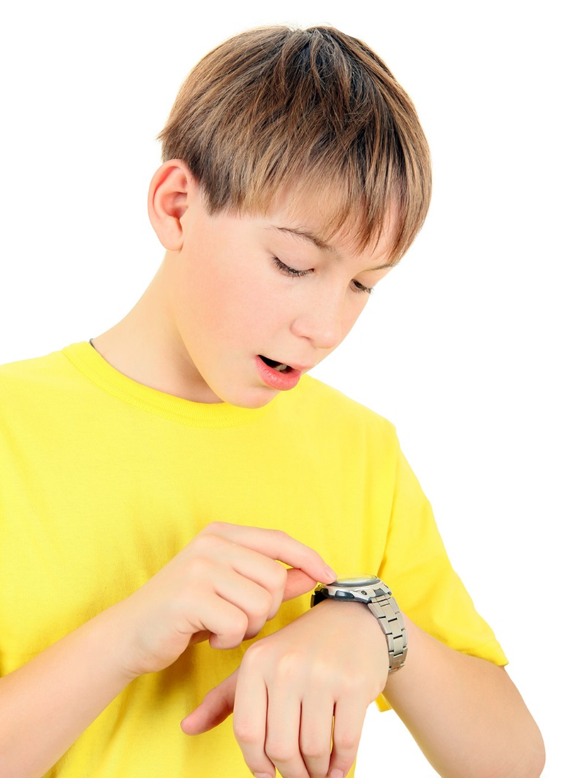
for
He is often late ____
school.
for
He is famous ____
his films.

Slide 13
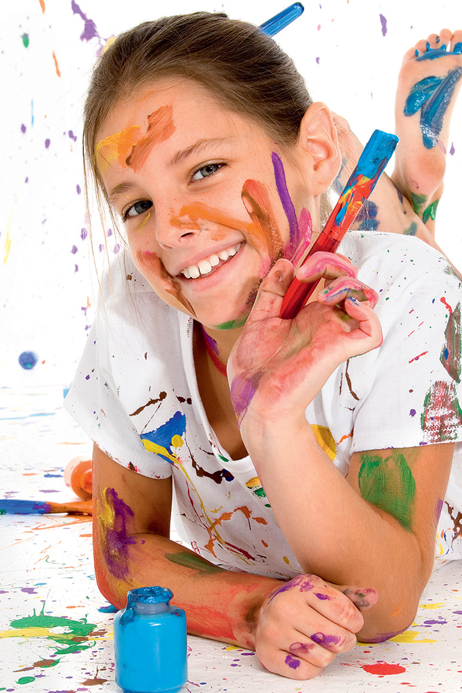
Chloe is good ___ painting.
at

Slide 14

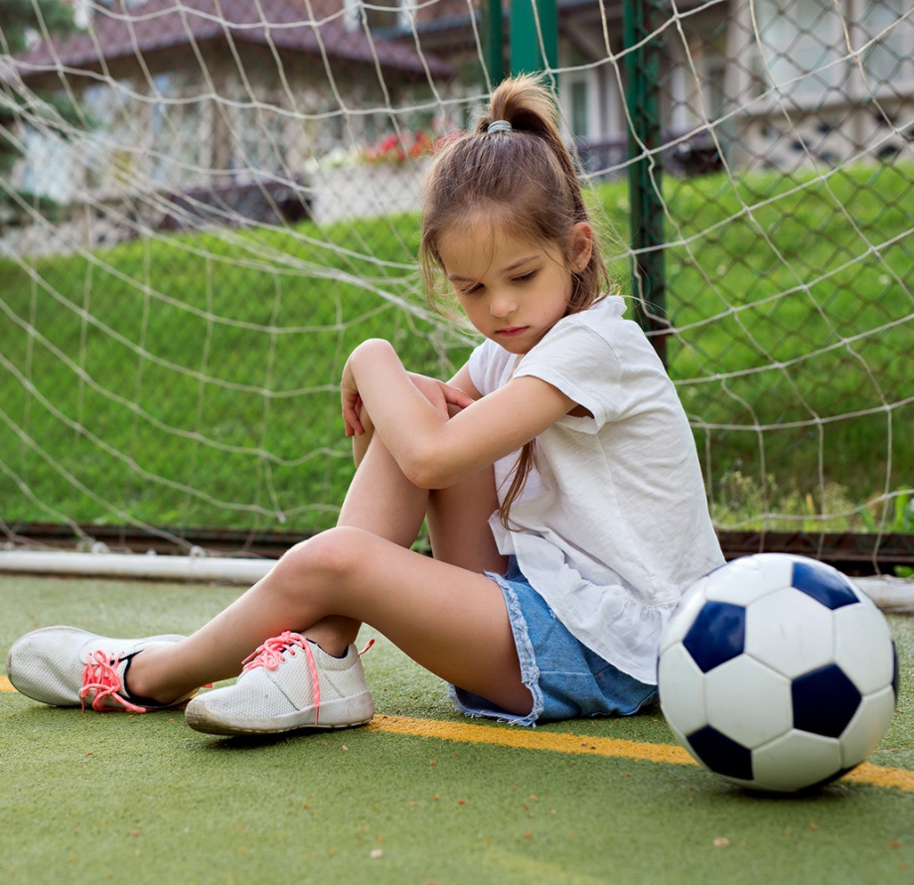
at
She is bad ____ football.
in
She is interested ____ reading.

Slide 15
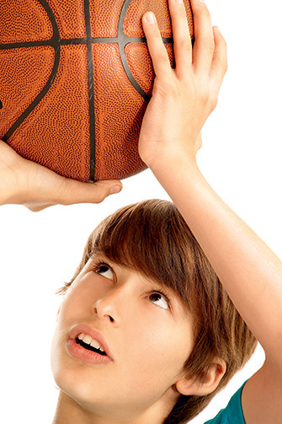
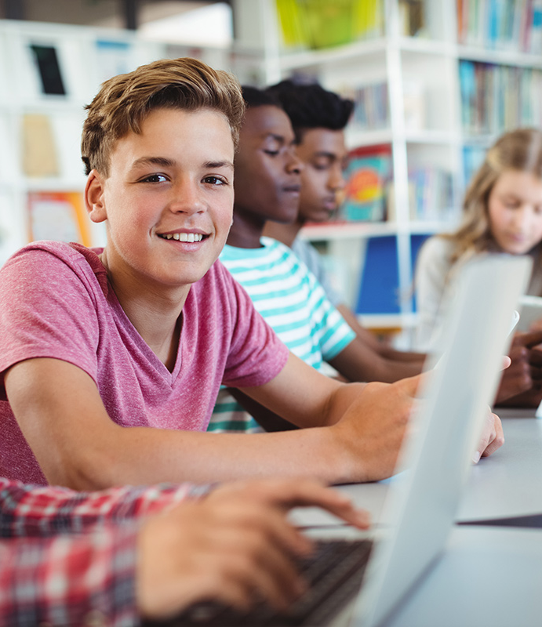
to
Tom is kind ____ his classmates.
at
He is good ____ basketball.

Slide 16
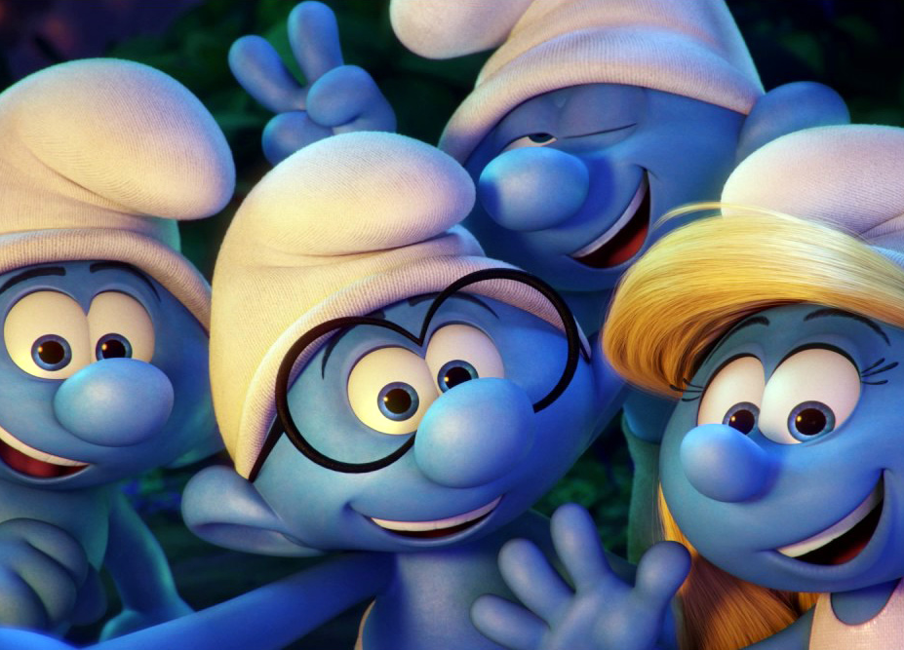
See? You’re good at English. Goodbye!

