Slide 2

Future be going to

Slide 3
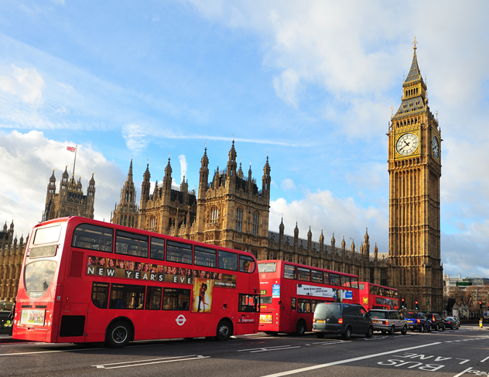
Future be going to
We use be going to to ask about or express a future plan or intention.
Where are you going to spend your summer holiday?
I am going to spend a week in London.

Slide 4
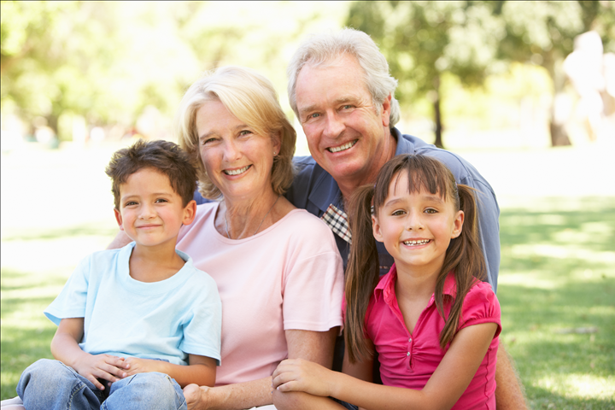
Future be going to
Do you know where I’m going to stay?
You are going to stay at your grandparents’ house.

Slide 5
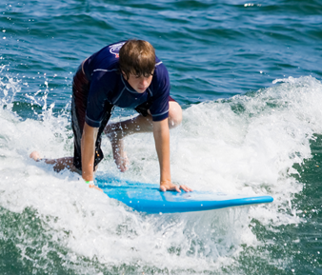
Future be going to
What’s Peter going to do?
He is going to practise surfing.

Slide 6
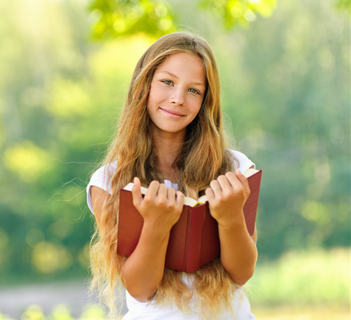
Future be going to
Is Caroline going to read school textbooks during the weekend?
No, she is going to read her favourite story books.

Slide 7
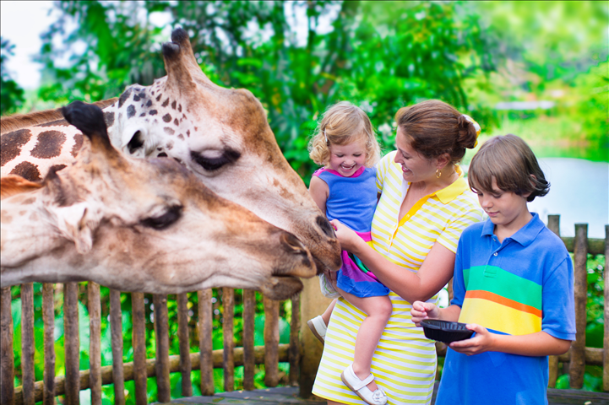
Future be going to
What are you going to do tomorrow?
We are going to visit the zoo.

Slide 8
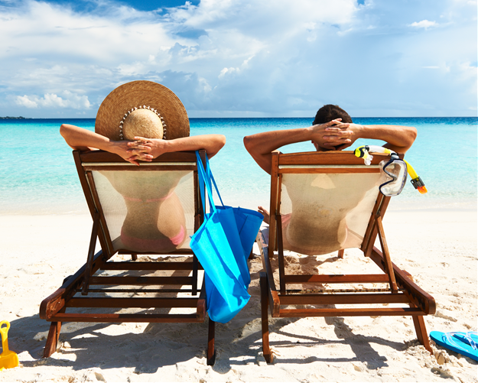
Future be going to
Am I going to the Caribbean to work?
No, you are going to relax on the beach!

Slide 9
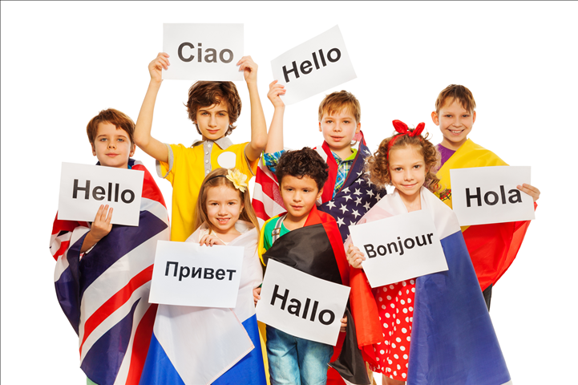
Future be going to
What are they going to do?
They are going to learn a new language.

Slide 10
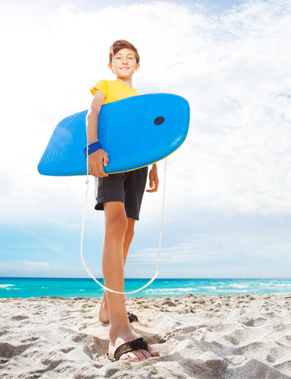
Future be going to
And you?
What are you going to do in your summer holidays?
Are you going to travel, stay at home, help your parents, get a holiday job, go to the seaside,
visit your grandparents…?
Think about it.

Slide 11
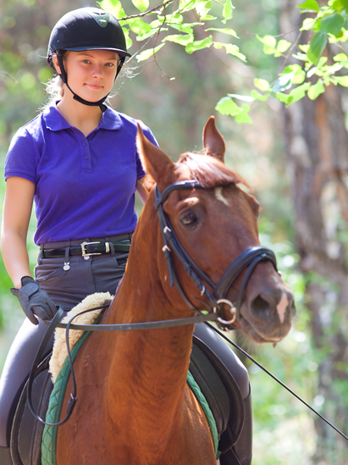
Future be going to
Exercises
Make sentences in the going to future.
Sophia / ride / a camel?
No, she / ride / her horse.
Is Sophia going to ride a camel?
No, she is going to ride her horse.

Slide 12
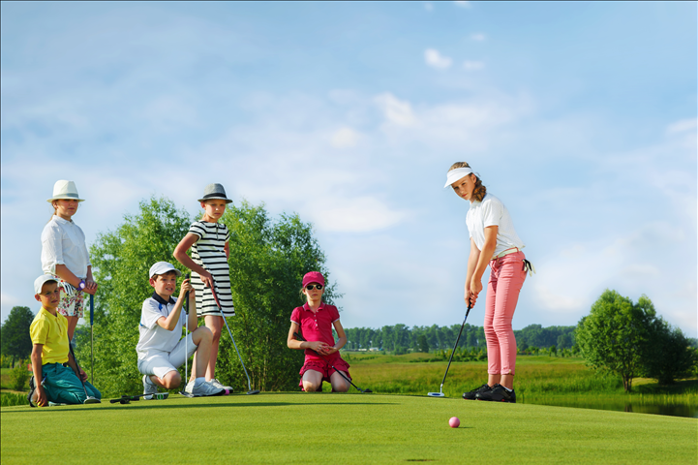
Future be going to
Exercises
3. What game / you / play /?
4. We/ play / golf.
What game are you going to play?
We are going to play golf.

Slide 13

Future be going to
Exercises
5. The Smiths / travel / by train?
6. No, they / travel / plane
Are the Smiths going to travel by train?
No, they’re going to travel by plane.

Slide 14
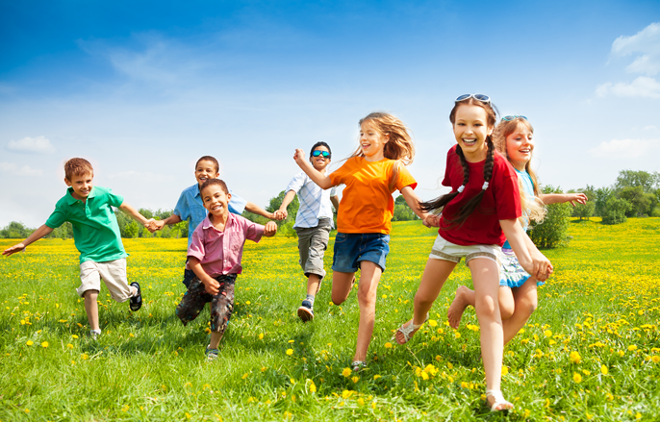
Future be going to
Exercises
7. What / you / do / in the park?
8. I / have / fun / with my friends.
What are you going to do in the park?
I am going to have fun with my friends.

