Slide 2


Comparatives

Slide 3
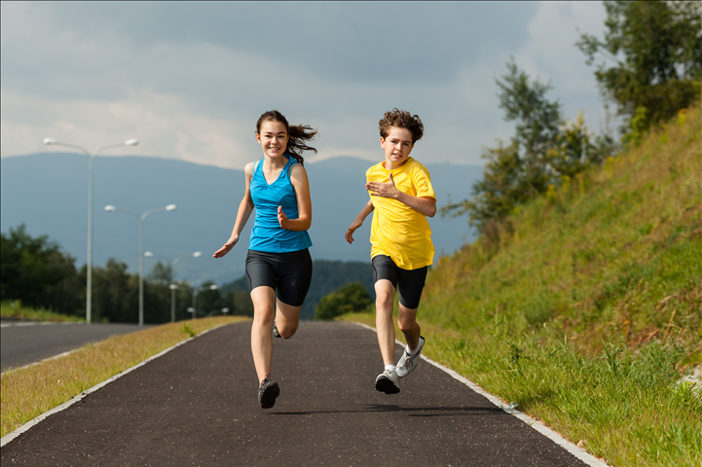
Comparatives
We use comparative adjectives to compare two people, things or places.

Slide 4
Comparative of superiority
+

Slide 5
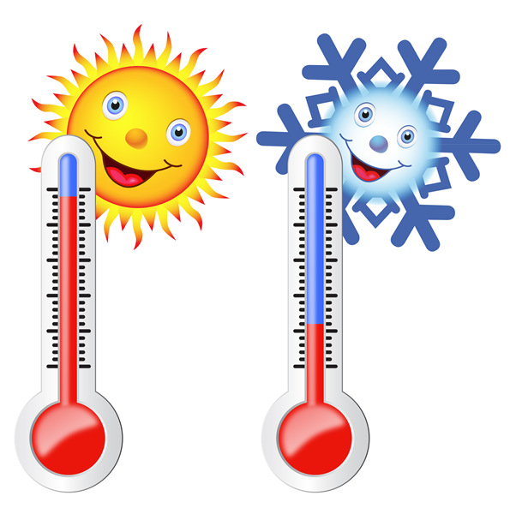
One syllable adjectives
fast
high
large
big
fat
hot
faster (than)
higher (than)
larger (than)
bigger (than)
fatter (than)
hotter (than)

Slide 6
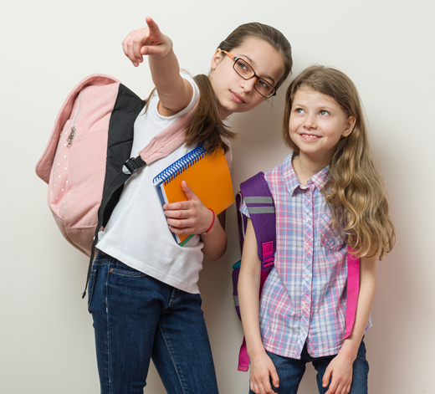
Two syllables ending in -y
easy
happy
hungry
pretty
easier (than)
happier (than)
hungrier (than)
prettier (than)

Slide 7
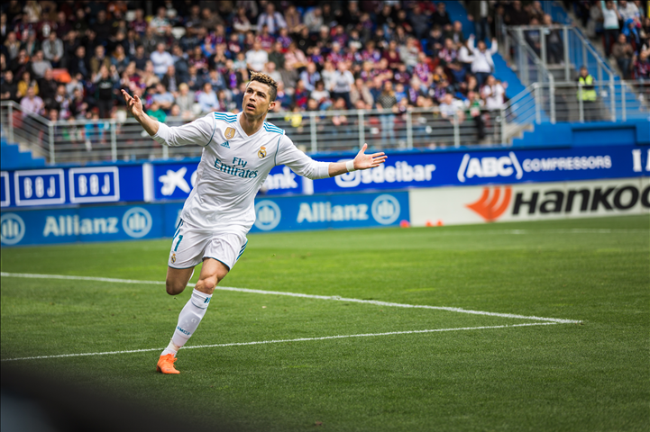
Two or more syllables
important
famous
popular
comfortable
more important (than)
more famous (than)
more popular (than)
more comfortable (than)

Slide 8
Comparative of equality
=

Slide 9
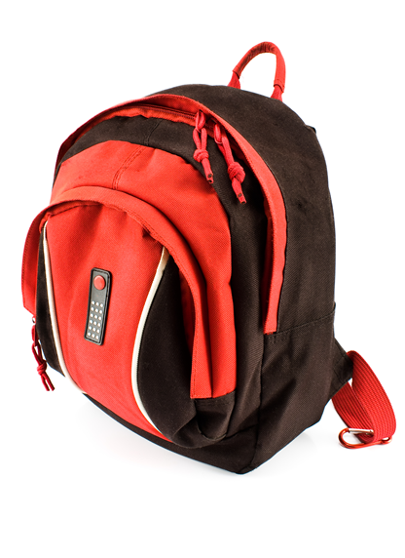

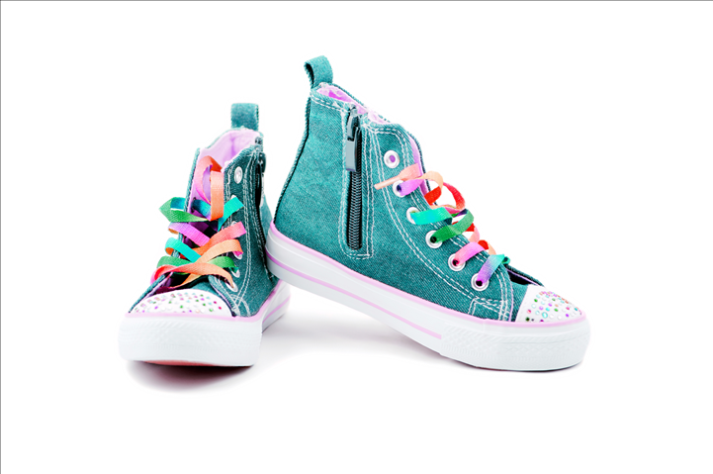

As … as
big
long
safe
intelligent
simple
expensive
as big as
as long as
as safe as
as intelligent as
as simple as
as expensive as
£40
£40

Slide 10
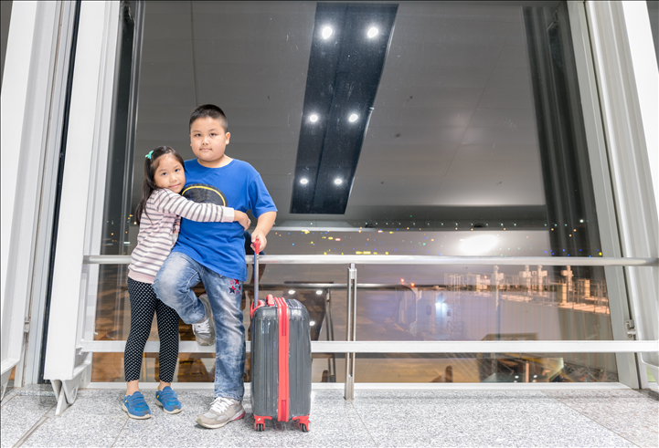
Exercises
Look at the picture and decide: true (T) or false (F).
Lin Chen
T
F
F
T
F
F
Lin is shorter than Chen.
Lin is fatter than Chen.
Lin is as slim as Chen.
Chen is taller than Lin.
Chen’s hair is curlier than Lin’s.
Lin eyes are bigger than Chen’s.

Slide 11
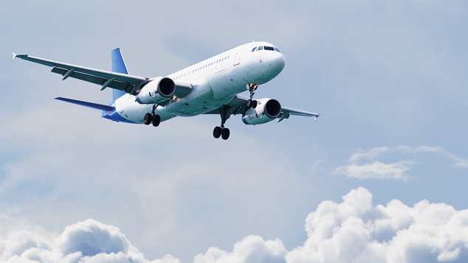
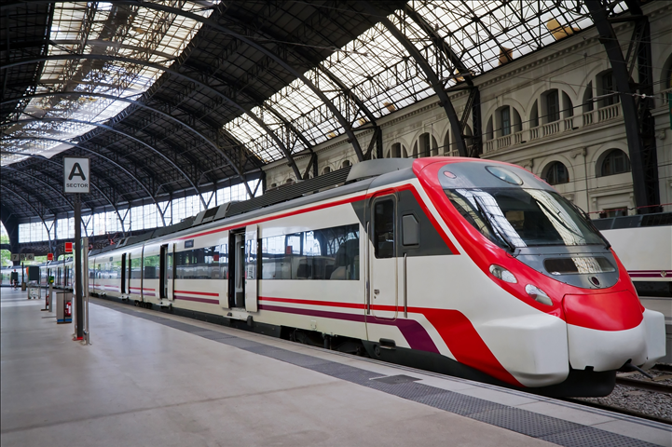
Exercises
Complete the sentences.
faster
The plane is _____________ than the train. (fast)

Slide 12
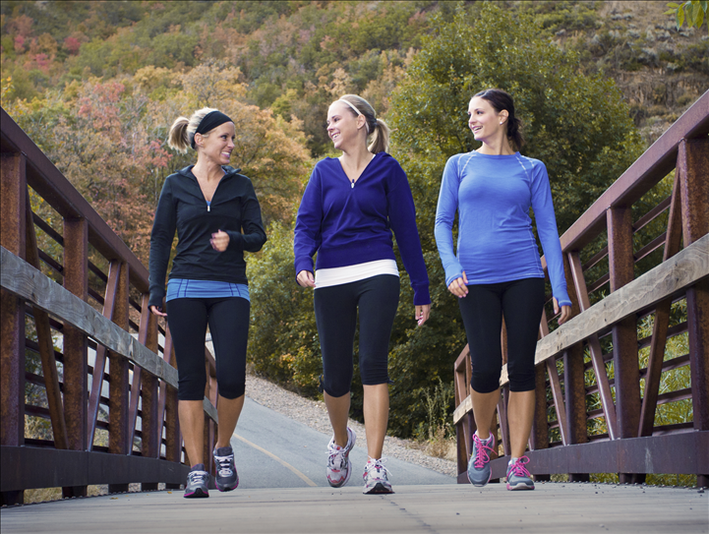
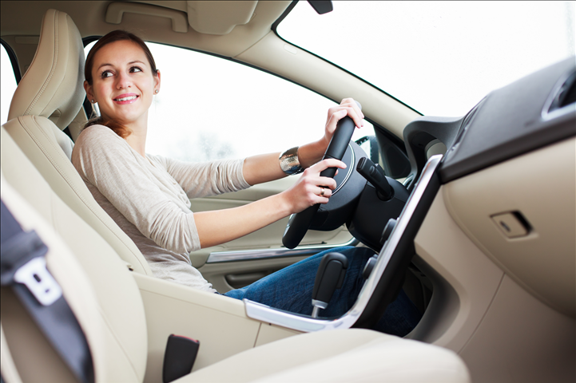
Exercises
healthier
Walking is ___________ than driving. (healthy)

Slide 13
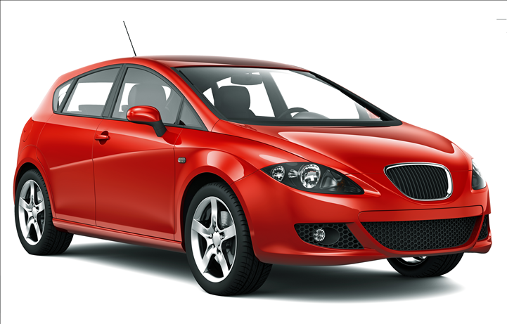
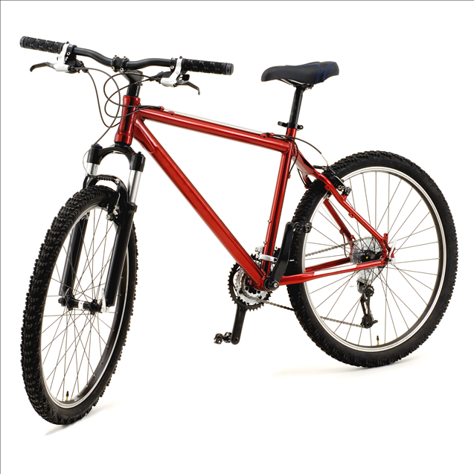
Exercises
more expensive
A car is _______________ than a bicycle. (expensive)

Slide 14
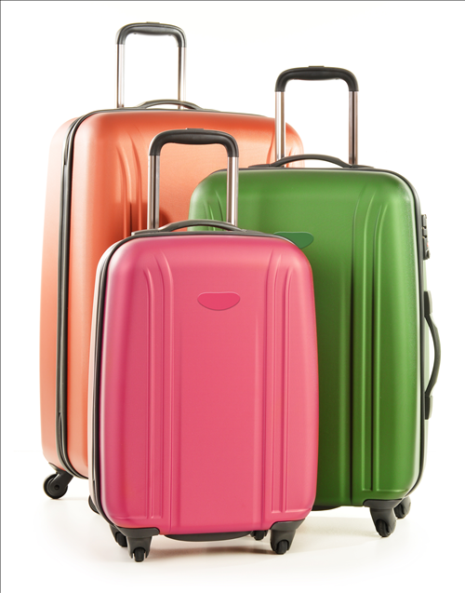
Exercises
My suitcase is __________ as yours. (big)
as big

Slide 15

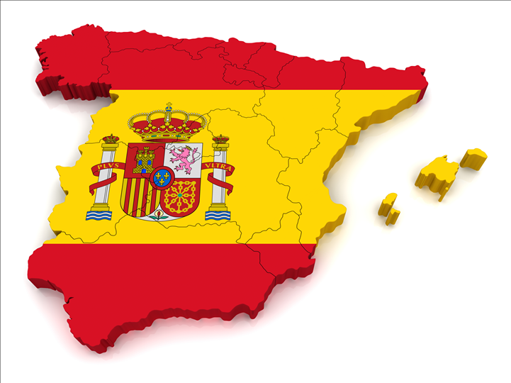
Exercises
smaller
Portugal is __________ than Spain. (small)

Slide 16
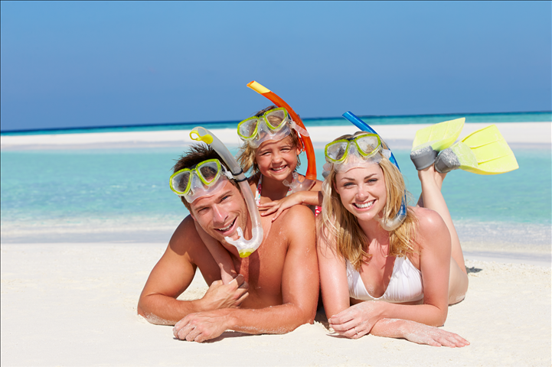
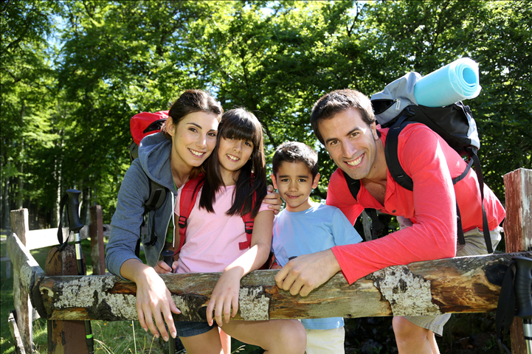
Exercises
Beach holidays are _______________ than mountain holidays. (popular)
more popular

Slide 17
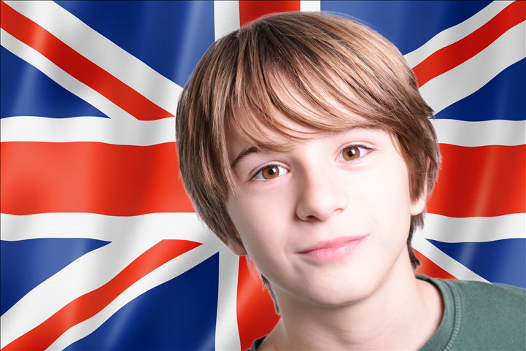
Congratulations!
Now your English is much better than it was last year!

