Slide 2
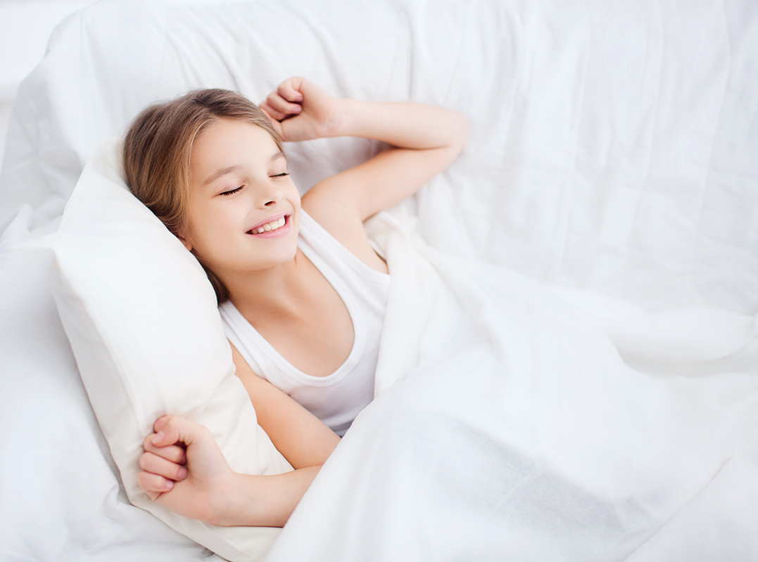
She usually gets up early.

Slide 3
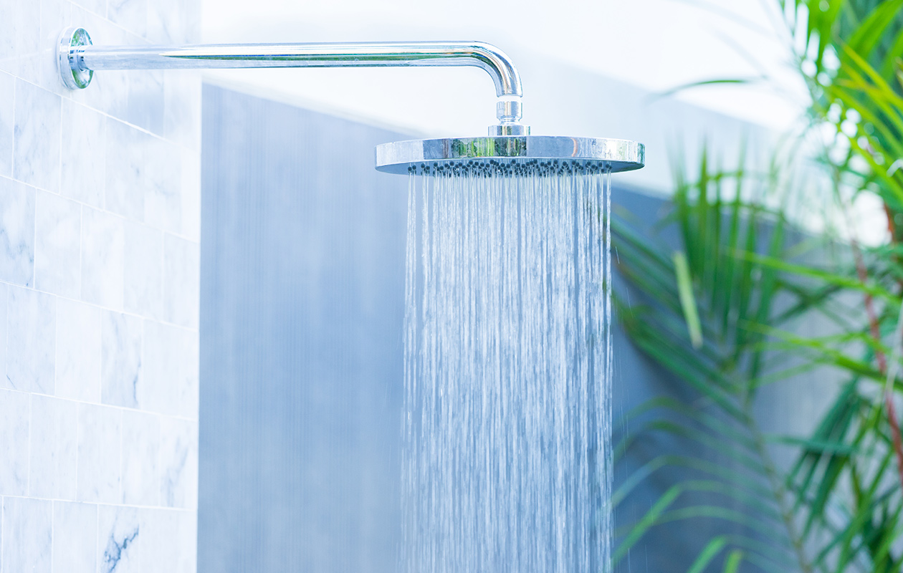
I always have a shower
in the morning.

Slide 4
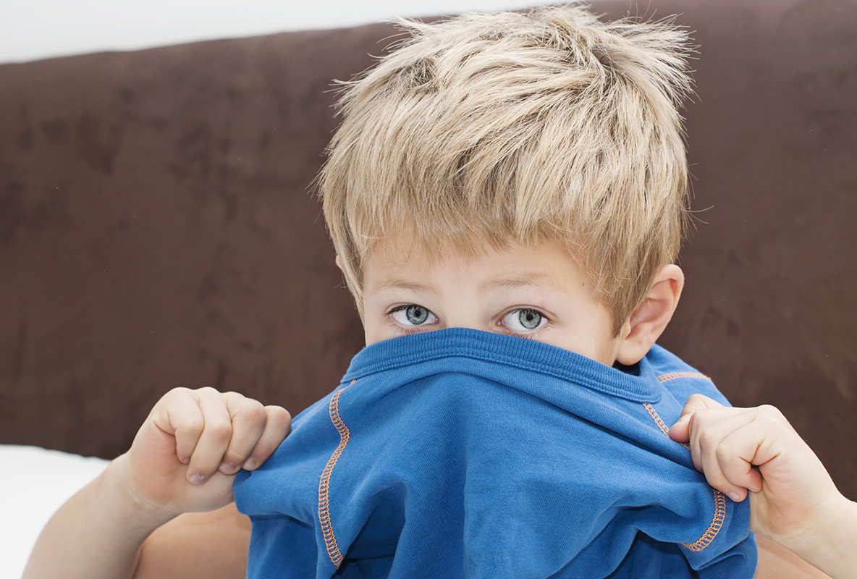
Then I get dressed.

Slide 5
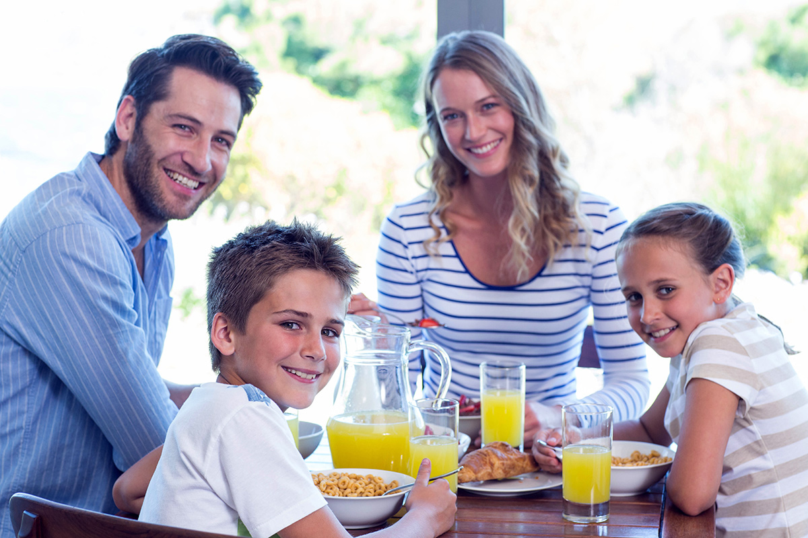
They always have
breakfast at home.

Slide 6
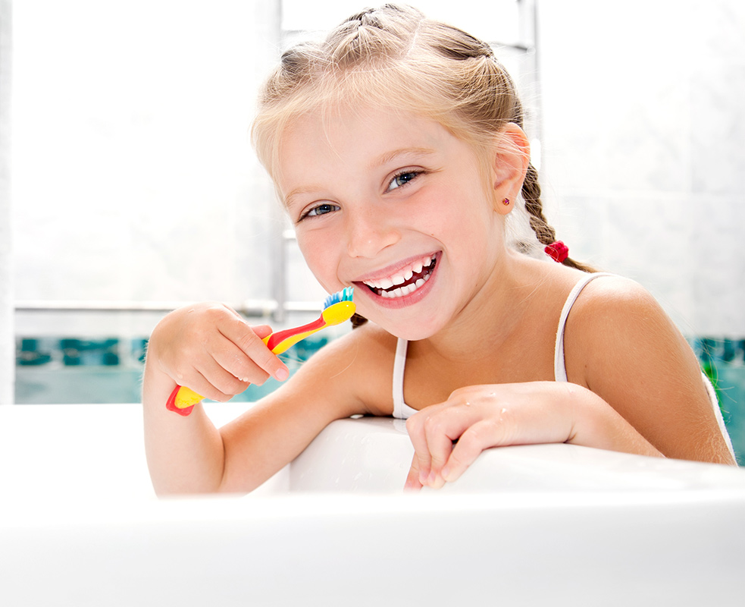
Mia brushes her teeth
every day.

Slide 7
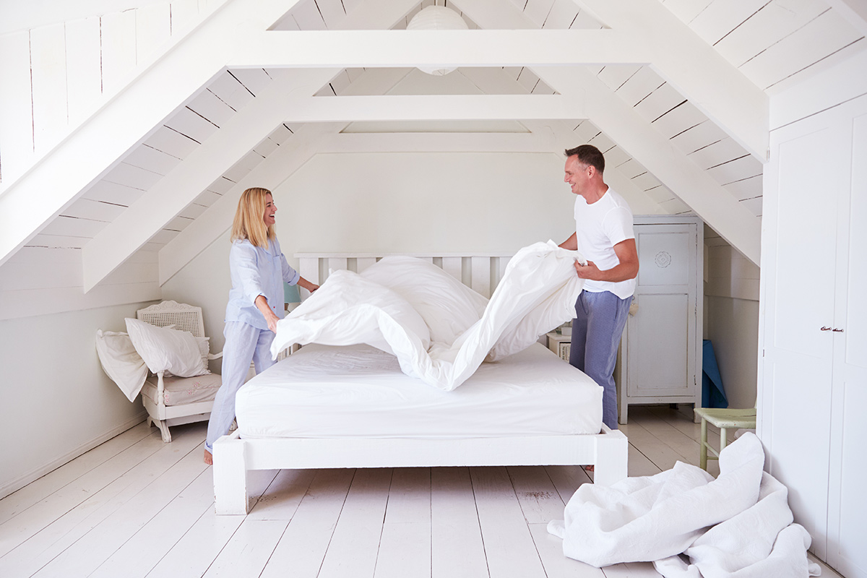
We make our bed
before going to work.

Slide 8
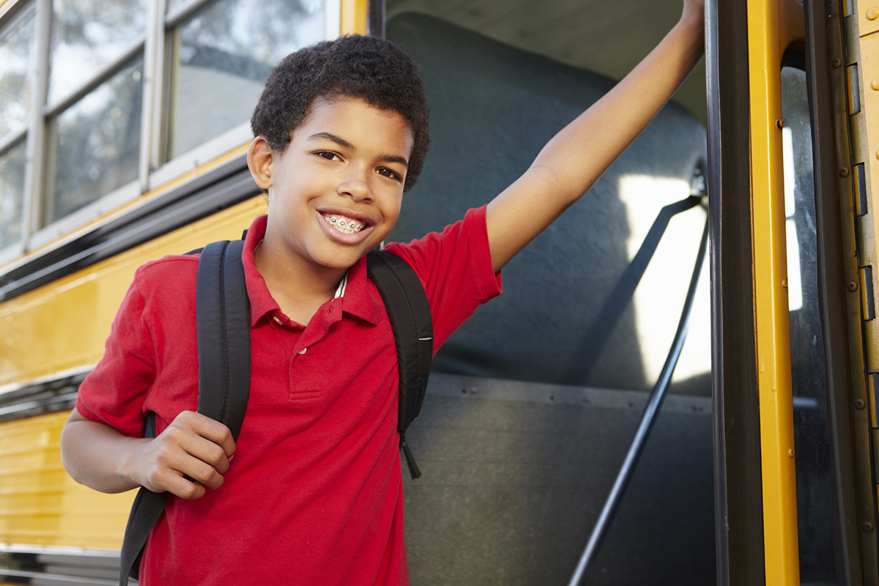
Tom goes to school
by bus.

Slide 9
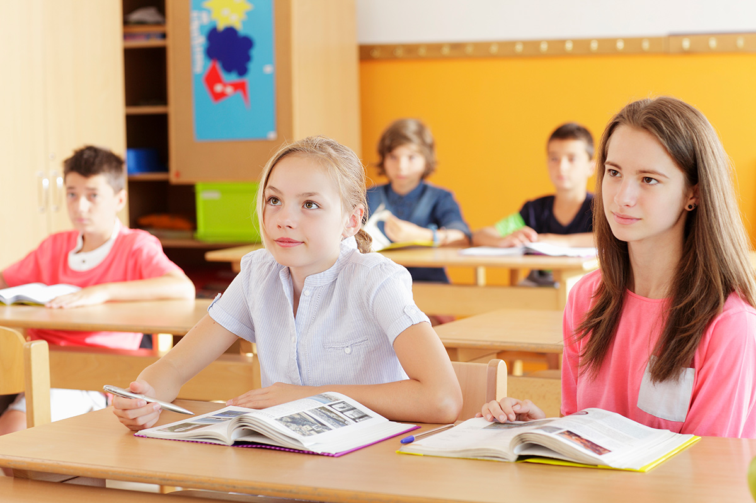
They have lessons
at 8.20.

Slide 10
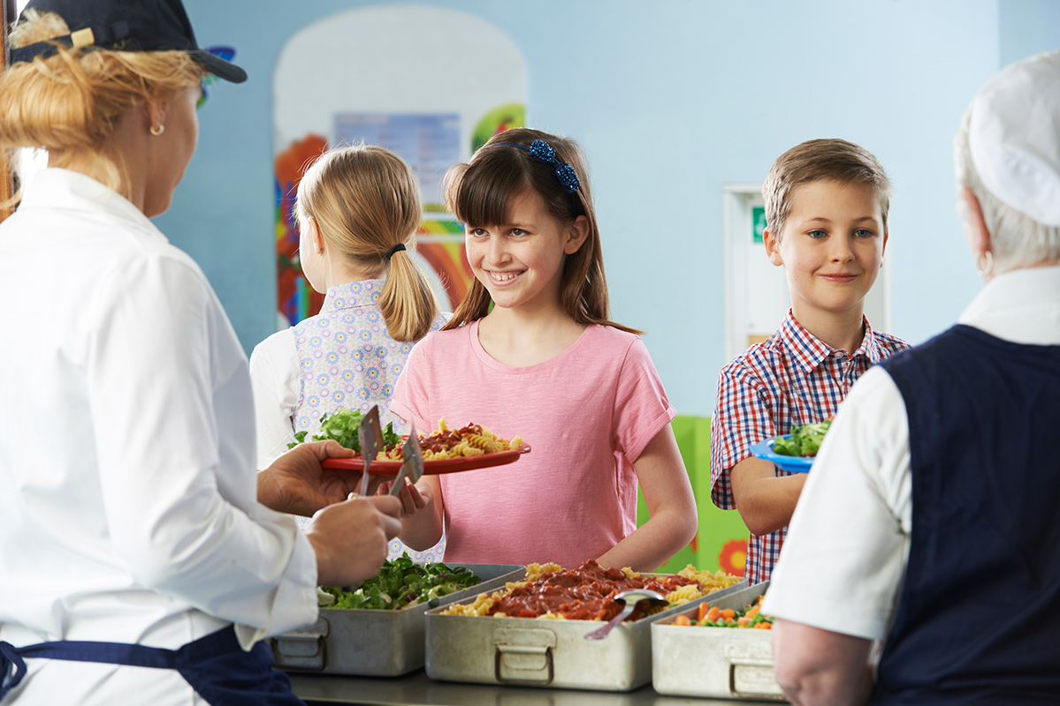
We have lunch
in the school canteen.

Slide 11
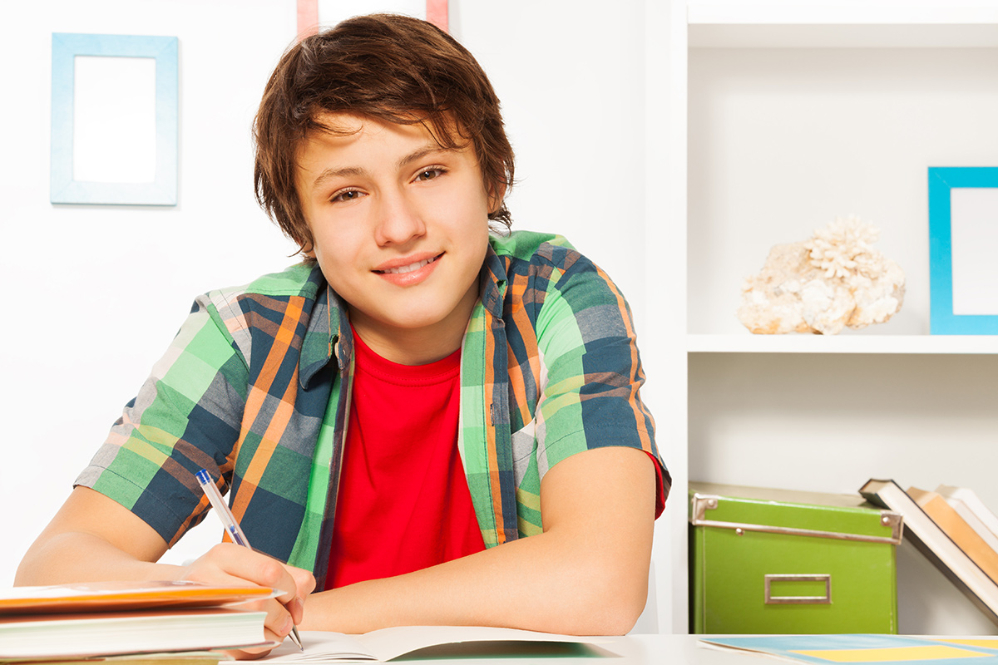
I always
do my homework.

Slide 12
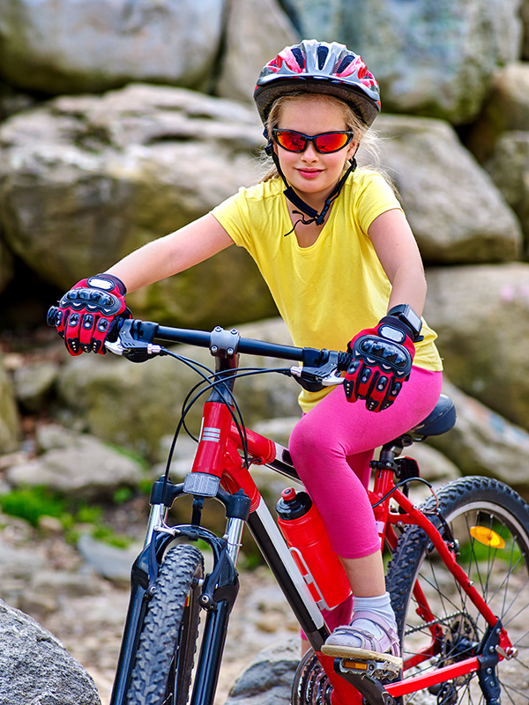
She usually
rides her bike.

Slide 13
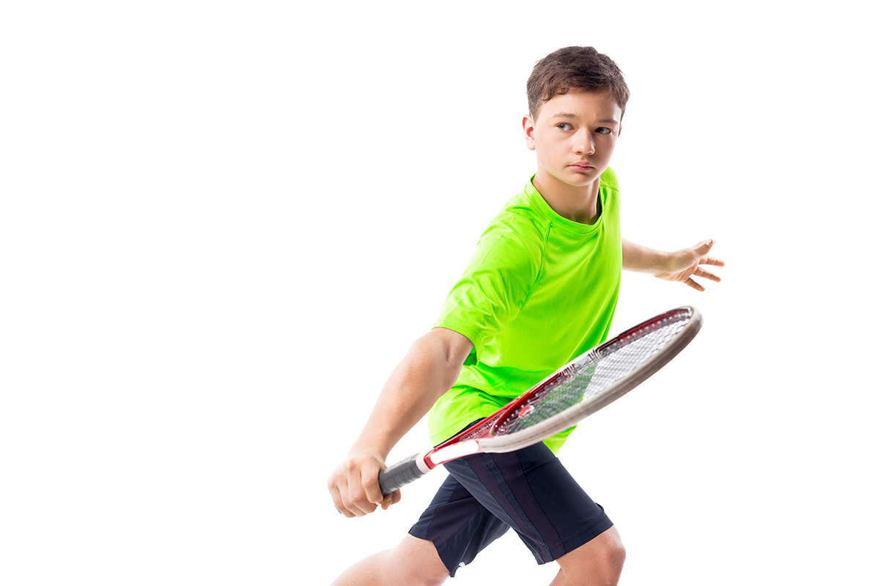
You sometimes
play tennis.

Slide 14
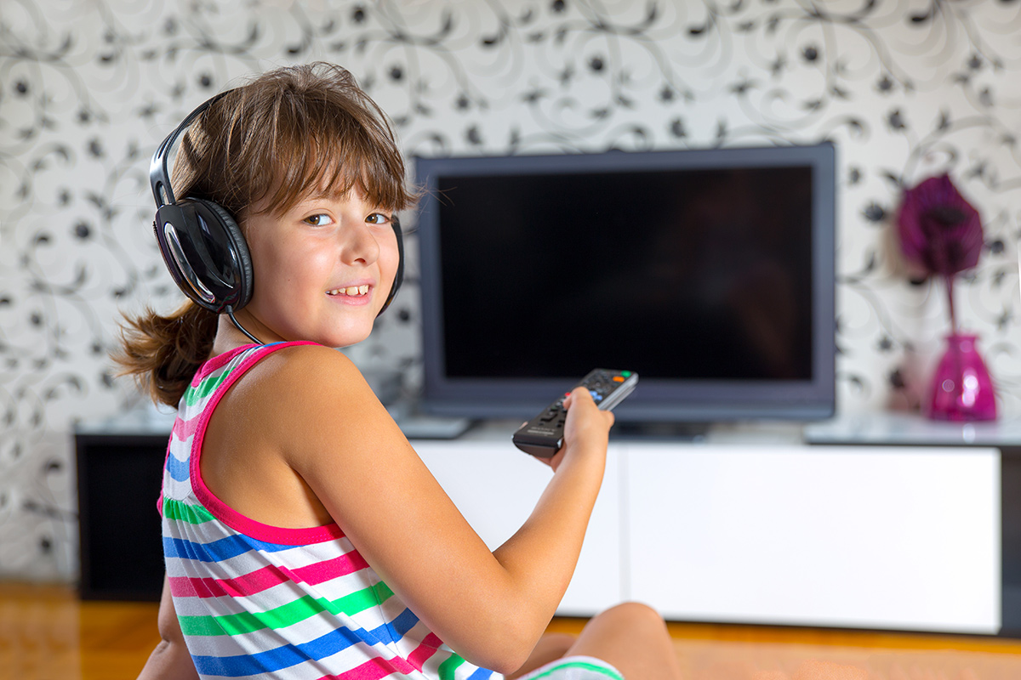
She watches TV
in the afternoon.

Slide 15
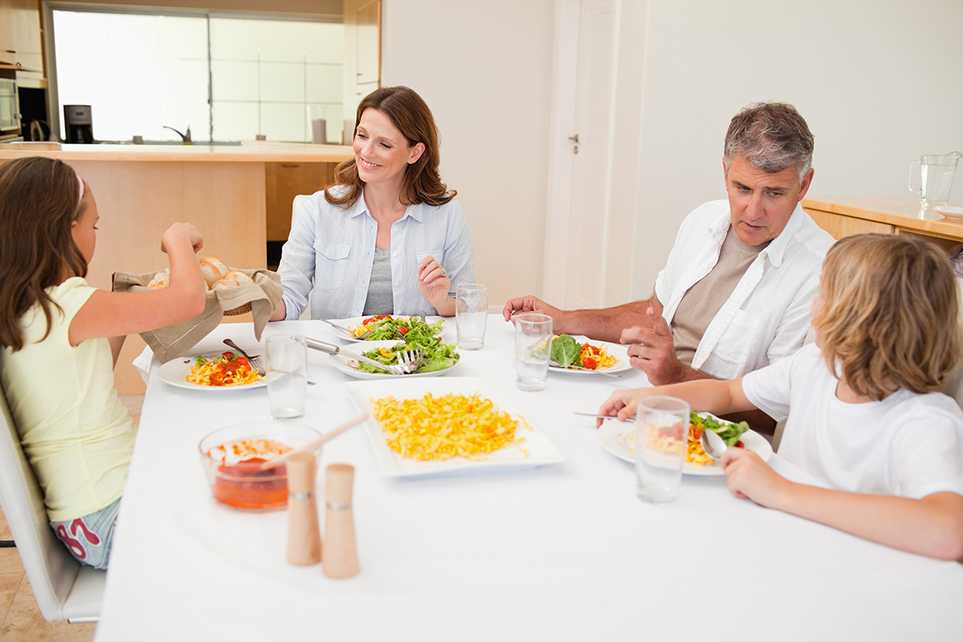
We have dinner
at 7 o’clock.

Slide 16
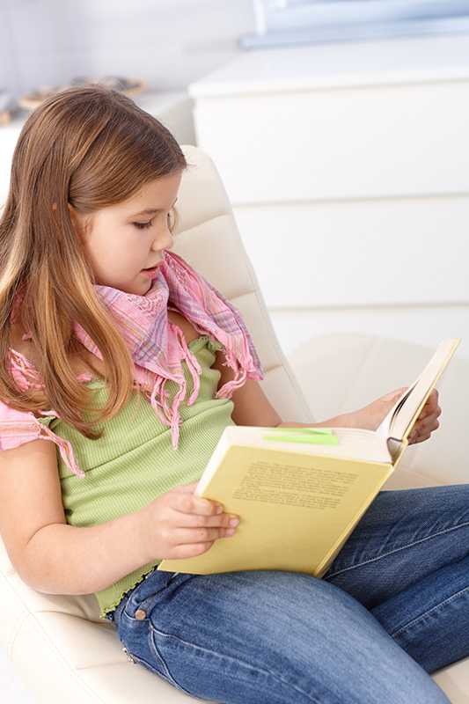
Mary reads a book
after dinner.

Slide 17
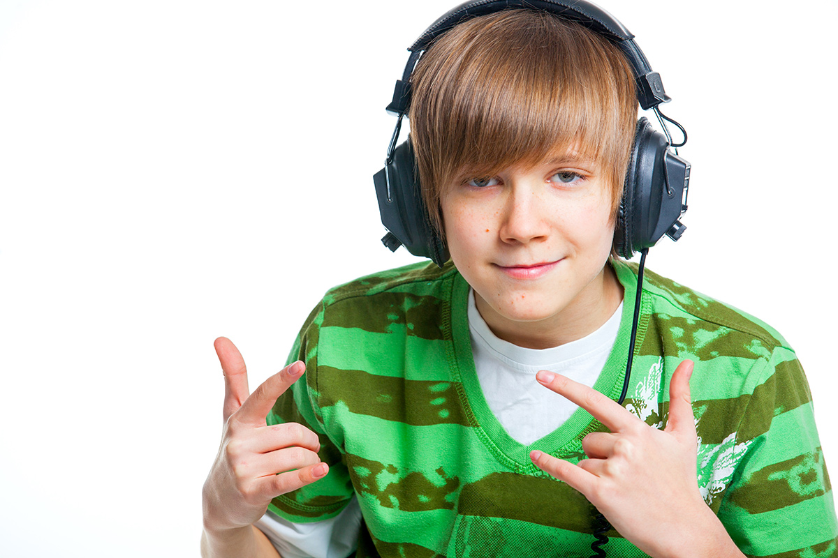
He often listens to music
before going to bed.

Slide 18
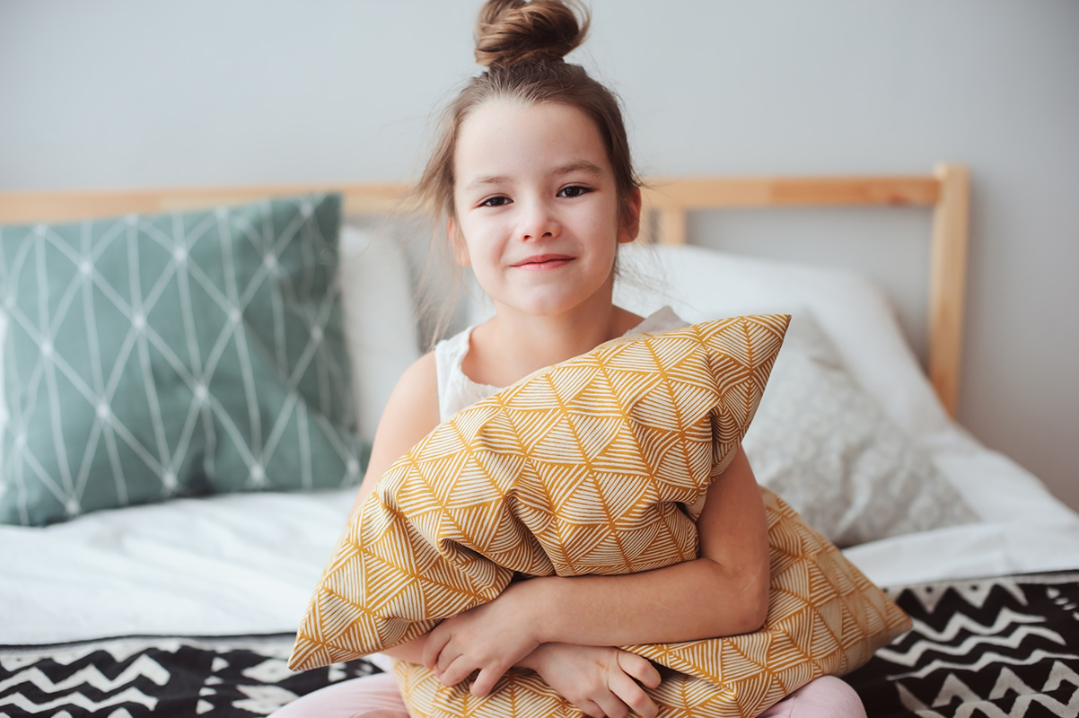
She never
goes to bed late.

