Slide 1
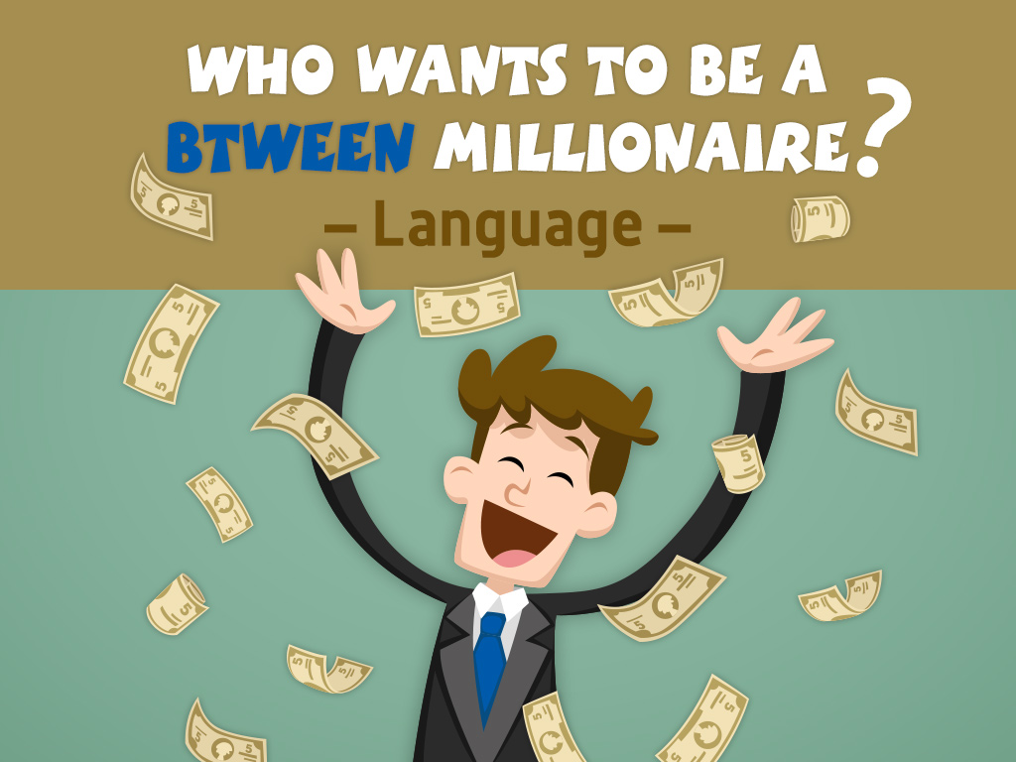

Slide 2
Question 1

Slide 3
You … ten years old.
is
have
are
has

Slide 4
You … ten years old.
is
have
are
has

Slide 5
£100

Slide 6
Question 2

Slide 7
… is she from?
Where
Who
What
When

Slide 8
… is she from?
Where
Who
What
When

Slide 9
£200

Slide 10
Question 3

Slide 11
Peter … blonde hair.
is
are
has got
have got

Slide 12
Peter … blonde hair.
is
are
has got
have got

Slide 13
£300

Slide 14
Question 4

Slide 15
Ann and I love Shakira.
… are her fans.
They
She
You
We

Slide 16
Ann and I love Shakira.
… are her fans.
They
She
You
We

Slide 17
£500

Slide 18
Question 5

Slide 19
Jane … to the gym every day.
go
goes
not go
plays

Slide 20
Jane … to the gym every day.
go
goes
not go
plays

Slide 21
£1,000

Slide 22
Question 6

Slide 23
She has guitar lessons … Mondays.
at
in
on
about

Slide 24
She has guitar lessons … Mondays.
at
in
on
about

Slide 25
£2,000

Slide 26
Question 7

Slide 27
Mark … now.
swims
swim
isn’t swim
is swimming

Slide 28
Mark … now.
swims
swim
isn’t swim
is swimming

Slide 29
£4,000

Slide 30
Question 8

Slide 31
John can sing … he can’t dance.
and
but
or
because

Slide 32
John can sing … he can’t dance.
and
but
or
because

Slide 33
£8,000

Slide 34
Question 9

Slide 35
Kim goes to the bathroom and …
gets up.
watches TV.
eats a snack.
washes her face.

Slide 36
Kim goes to the bathroom and …
gets up.
watches TV.
eats a snack.
washes her face.

Slide 37
£16,000

Slide 38
Question 10

Slide 39
… he ride his bike at the weekend?
Does
Is
Do
Has

Slide 40
… he ride his bike at the weekend?
Does
Is
Do
Has

Slide 41
£32,000

Slide 42
Question 11

Slide 43
They drink tea every day.
They… drink tea.
sometimes
usually
never
always

Slide 44
They drink tea every day.
They… drink tea.
sometimes
usually
never
always

Slide 45
£64,000

Slide 46
Question 12

Slide 47
I’m looking … a T-shirt.
for
after
at
to

Slide 48
I’m looking … a T-shirt.
for
after
at
to

Slide 49
£125,000

Slide 50
Question 13

Slide 51
Brad Pitt is a good actor.
I like …
he
it
her
him

Slide 52
Brad Pitt is a good actor.
I like …
he
it
her
him

Slide 53
£250,000

Slide 54
Question 14

Slide 55
Let’s … to the park!
go
going
goes
is going

Slide 56
Let’s … to the park!
go
going
goes
is going

Slide 57
£500,000

Slide 58
Question 15

Slide 59
Which is correct?
Jason doesn’t like read.
Jason doesn’t like reading.
Jason don’t like read.
Jason doesn’t likes reading.

Slide 60
Which is correct?
Jason doesn’t like read.
Jason doesn’t like reading.
Jason don’t like read.
Jason doesn’t likes reading.

Slide 61
£1,000,000

