Slide 2
PAST SIMPLE: IRREGULAR VERBS — AFFIRMATIVE
Past simple
Irregular verbs
do
drink
did
make
have
drank
made
had
eat
go
ate
went

Slide 3
PAST SIMPLE: IRREGULAR VERBS — AFFIRMATIVE
Past simple
It is used with finished actions in the past.
x
Past Present Future
Time expressions:
yesterday, last week/month/year, a year ago, in 2010
Example: He came here last week and went home yesterday.

Slide 4
PAST SIMPLE: IRREGULAR VERBS — AFFIRMATIVE
Irregular verbs
Unlike regular verbs, irregular verbs form their past in different ways. Sometimes the pronunciation does not correspond with the spelling. Occasionally there are two acceptable pronunciations even in standard forms of English.
read/read/ri:d/-/red/
write/wrote/raɪt/-/rǝʊt/
buy/bought/baɪ/-/bɔ:t/
sing/sang/sɪŋ/-/sæŋ/

Slide 5
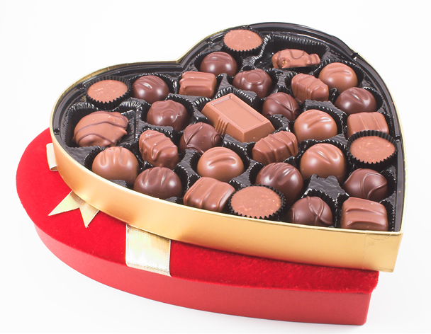
PAST SIMPLE: IRREGULAR VERBS — AFFIRMATIVE
Irregular verbs
It is the same for all the persons. Sometimes the pronunciation does not correspond with the spelling. Occasionally there are
two acceptable pronunciations even in standard forms of English.
I
You
He
She
It
We
You
They
ate all the chocolates.
Possible pronunciations: /et/, /eɪt/

Slide 6

PAST SIMPLE: IRREGULAR VERBS — AFFIRMATIVE
buy – bought sell – sold
Yesterday I bought a beautiful dress.
The shop sold it with 20% (twenty per cent) discount.

Slide 7
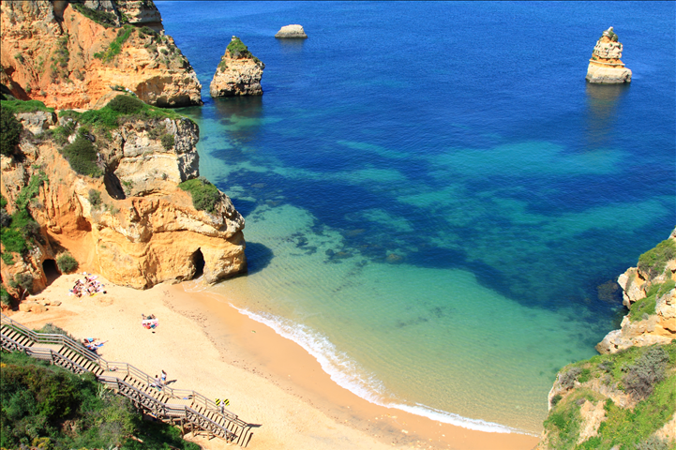
PAST SIMPLE: IRREGULAR VERBS — AFFIRMATIVE
go – went
Last summer, we went to the Algarve.

Slide 8
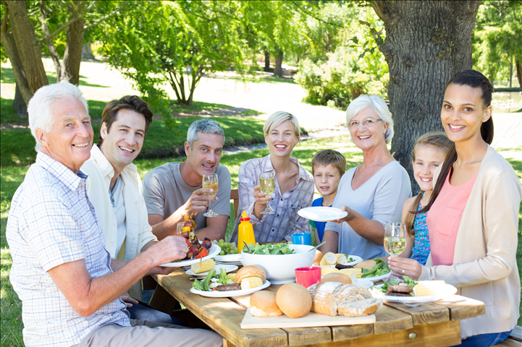
PAST SIMPLE: IRREGULAR VERBS — AFFIRMATIVE
have – had
Last Sunday, all the family had lunch together.

Slide 9
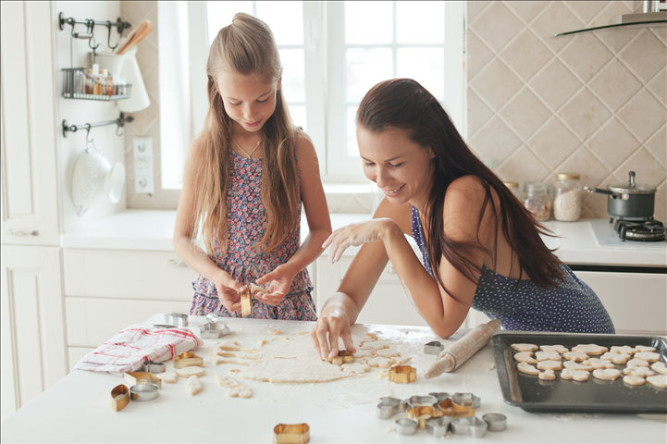
PAST SIMPLE: IRREGULAR VERBS — AFFIRMATIVE
make – made
Last weekend, my mother and I made some biscuits.

Slide 10
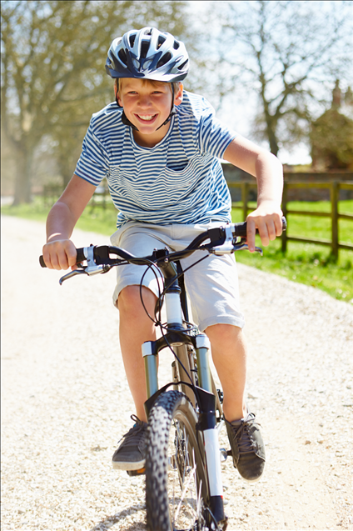
PAST SIMPLE: IRREGULAR VERBS — AFFIRMATIVE
ride – rode drive – drove
Last holiday, Peter rode his bike every day.
Sometimes, he drove his cousin’s electric jeep.

Slide 11
PAST SIMPLE: IRREGULAR VERBS — AFFIRMATIVE
Exercises
Order the dominoes.
bought
sang
made
eat
do
write
ate
went
did
sing
wrote
have
go
buy
got
had
drank
make
drink
get
NOTE: There’s a list of irregular verbs in Btween File, page 32, and in My Dictionary.

Slide 12
PAST SIMPLE: IRREGULAR VERBS — AFFIRMATIVE
Exercises
Order the dominoes.
bought
sang
made
eat
do
sang
ate
write
did
bought
do
sing
ate
went
go
eat
did
sing
wrote
have
went
wrote
go
buy
have
buy
got
had
drank
had
made
drank
got
make
drink
get
drink
write
get
make
NOTE: There’s a list of irregular verbs in Btween File, page 32 and My Dictionary.

Slide 13
PAST SIMPLE: IRREGULAR VERBS — AFFIRMATIVE
Write the sentences in the past.
He sings hip-hop.
I eat ice cream once a week.
My parents always read a book before going to bed.
This author writes good books.
Jane drives a car for the first time.
We drink a lot of water in the gym.

Slide 14
PAST SIMPLE: IRREGULAR VERBS — AFFIRMATIVE
Answers
He sang hip-hop.
I ate ice cream once a week.
My parents always read a book before going to bed.
This author wrote good books.
Jane drove a car for the first time.
We drank a lot of water in the gym.

