Slide 2
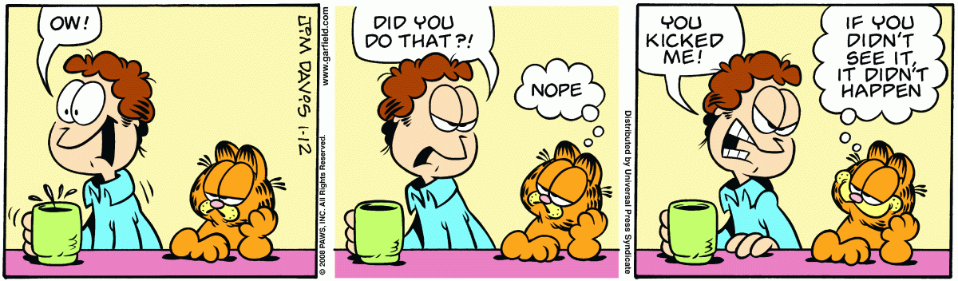
Past simple
Irregular verbs
Negative and Interrogative

Slide 3
Negative form
I
You
He
She
It
We
You
They
did not
(didn’t)
+
see
+

Slide 4
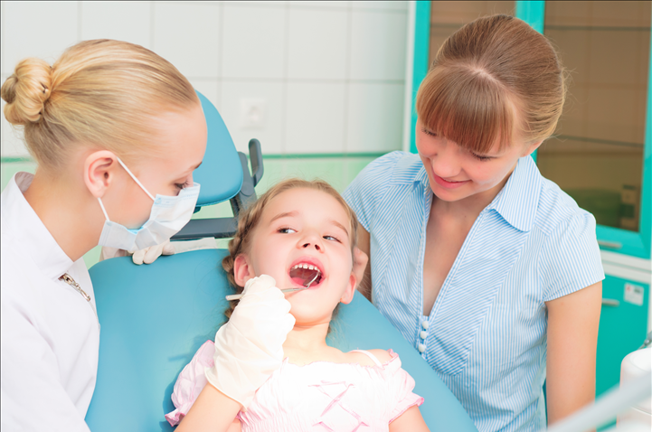
Negative form
Hello. I’m Cindy. Yesterday I didn’t go to school because I went to the dentist.

Slide 5

Negative form
My father didn’t read the newspaper, but he read the news online.

Slide 6
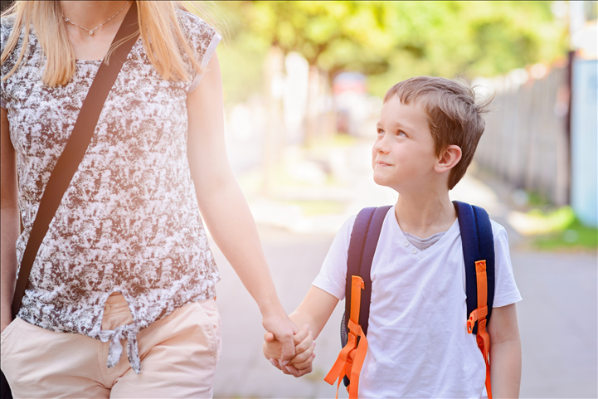
Negative form
My mother didn’t take me to school, but she took my younger brother.

Slide 7

Exercises
Look at the pictures and say what they did or didn’t do.
1. The girls __________ some clothes. They ____________ shoes. (buy)
bought
didn’t buy

Slide 8
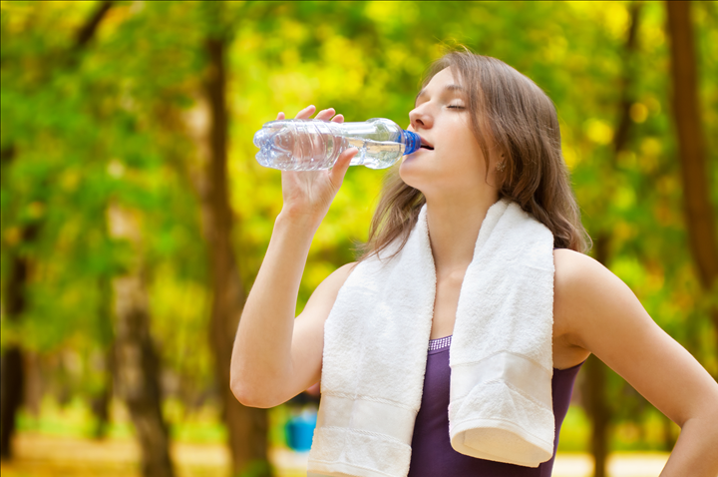
Exercises
2. After exercising, Drew __________ water.
She _____________ a soda*. (drink)
* American English for a sweet, fizzy drink.
drank
didn’t drink

Slide 9
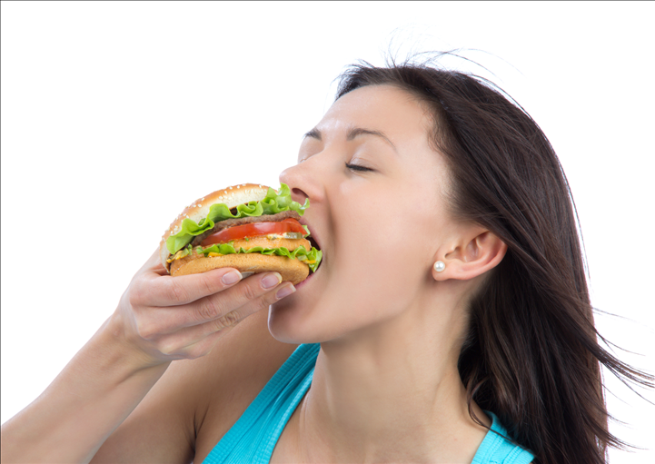
Exercises
ate
didn’t eat
3. Laura ________ a hamburger. She ____________ a cake. (eat)

Slide 10

Exercises
wrote
didn’t write
4. The secretary __________ an email. She ____________ a letter. (write)

Slide 11
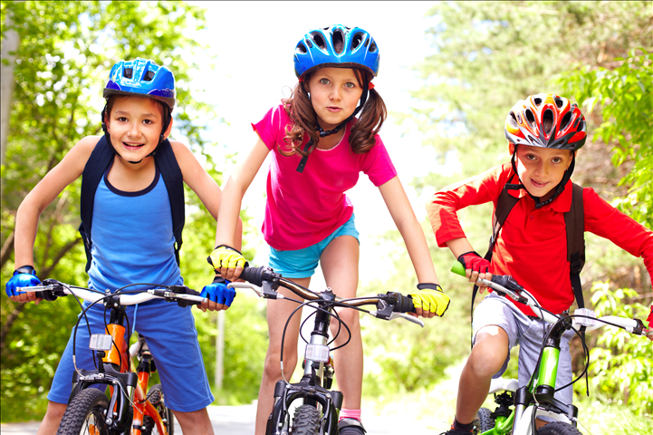
Exercises
rode
didn’t ride
5. My friends _________ their bikes. They ____________ horses. (ride)

Slide 12
Interrogative form
I
you
he
she
it
we
you
they
Did
see…?

Slide 13
Short answers
Yes, | I you he she it we you they | did.
No, |  | didn’t.

Slide 14
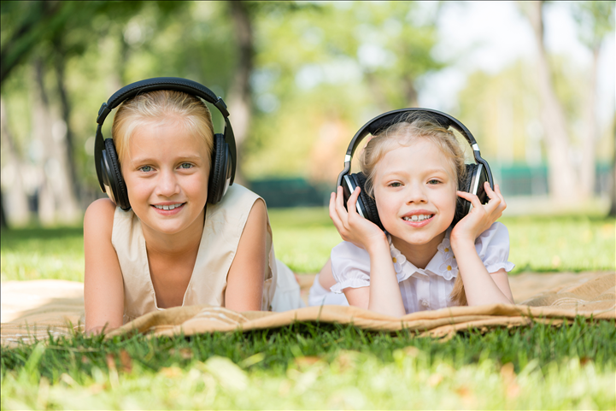
Interrogative form + short answers
Cindy, did you know this song?
No, I didn’t. (Or, ‘Yes, I did.’ Or, ‘Yes, I knew it.’ )

Slide 15
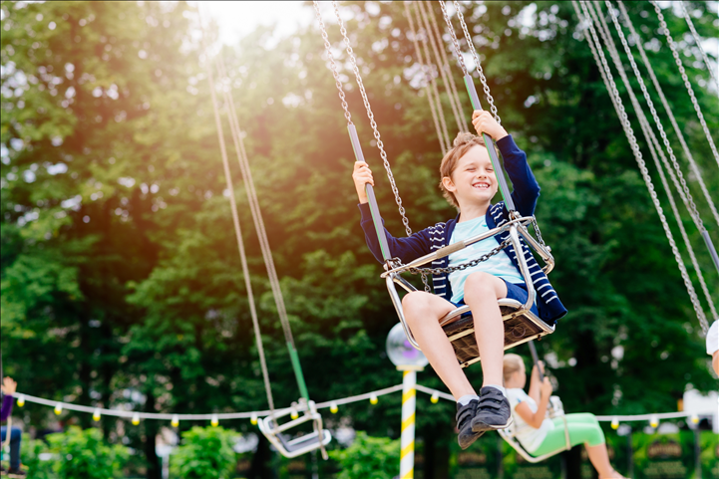
Exercises
Complete the sentences with did or didn’t.
______ your brother go to the funfair?
Yes, he ______. He went there.
Did
did

Slide 16
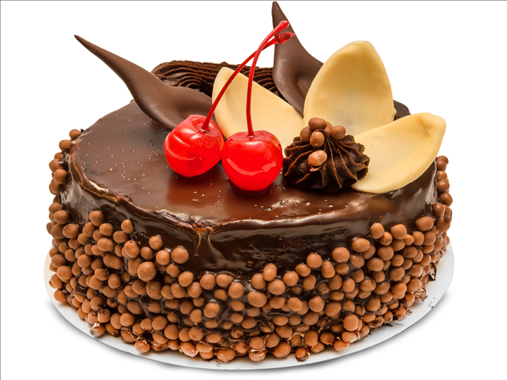
Exercises
_______ you and your mother make this cake?
No, we _______. The baker in the cake shop made it.
Did
didn’t

Slide 17

- ________ Mary do her homework yesterday?
- Yes, she _________. She did it quickly.
Exercises
Did
did

Slide 18
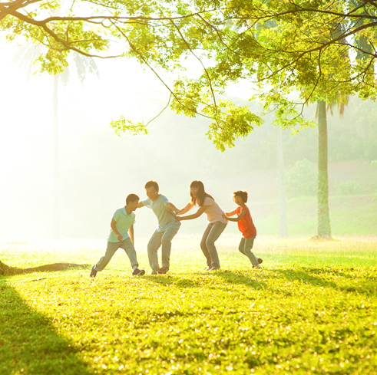
Exercises
________ the Smiths go to the beach last Saturday?
No, they _________. They went to the park.
Did
didn’t

