Slide 2

Let’s learn about the

Slide 3
Past simple
It is used with finished actions in the past.
x
Past Present Future
Time expressions:
yesterday, last week/month/year, a year ago, in 2010

Slide 4
Regular verbs
A regular verb forms its past tense by adding
-ed
to the infinitive (with some exceptions, of course).

Slide 5

Regular verbs
It is the same for all the persons.
I
You
He
She
It
We
You
They
liked the walk.

Slide 6

Regular verbs
Infinitive ending in consonant:
work – worked
listen – listened
help – helped
Yesterday I worked very hard.

Slide 7
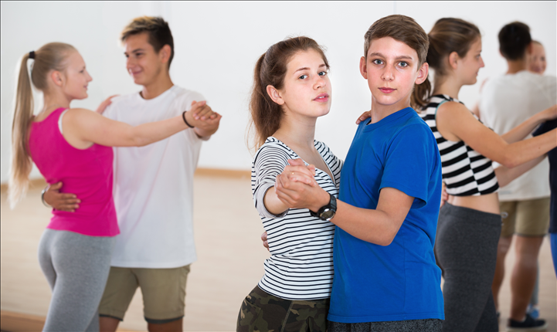
Regular verbs
Infinitive ending in -e:
dance – danced
like – liked
arrive – arrived
They danced all night at the party.

Slide 8

Regular verbs
Infinitive ending in vowel + -y:
play – played
stay – stayed
enjoy – enjoyed
John played his favourite video game.

Slide 9

Regular verbs
Infinitive ending in consonant + -y:
study – studied
tidy – tidied
marry – married
Last Saturday, Jill tidied her room.

Slide 10

Regular verbs
Infinitive with one syllable and ending in vowel + consonant:
stop – stopped
plan – planned
shop – shopped
The school bus stopped to pick up the pupils.

Slide 11
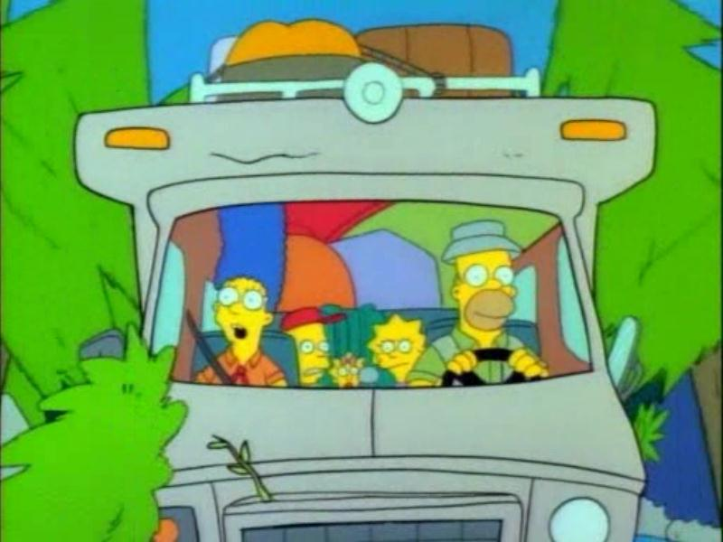
How were the the Simpsons’ holidays?
Complete the sentences with the verbs in brackets.
Last summer, the Simpsons __________ to go on holiday. (decide)
decided

Slide 12
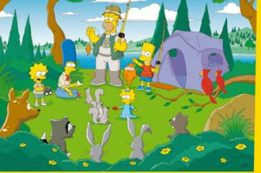
stayed
They ________ at a campsite near the river. (stay)

Slide 13
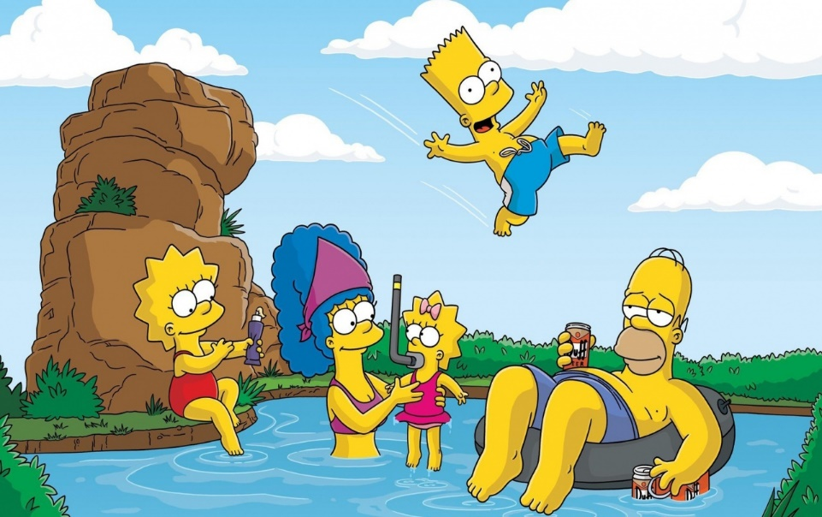
The parents ________ and the kids ________ in
the water. (relax/play)
relaxed
played

Slide 14
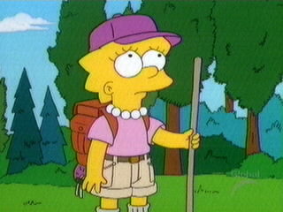
walked
They ________ through the woods. (walk)

Slide 15
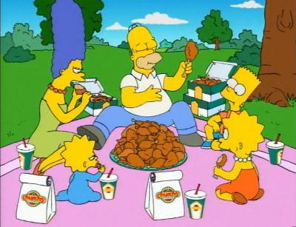
They __________ a picnic. (prepare)
prepared

Slide 16
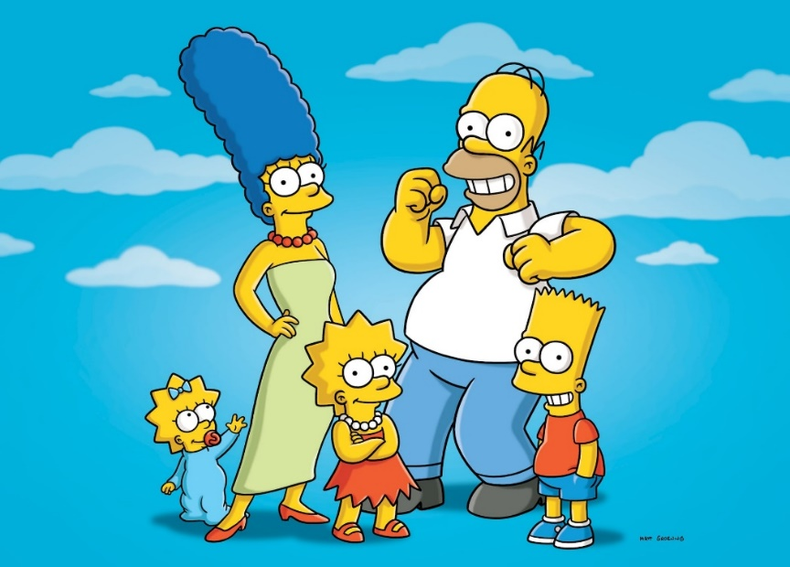
loved
Everybody ________ their holiday. (love)

Slide 17

QUIZ
Discoveries and inventions

Slide 18
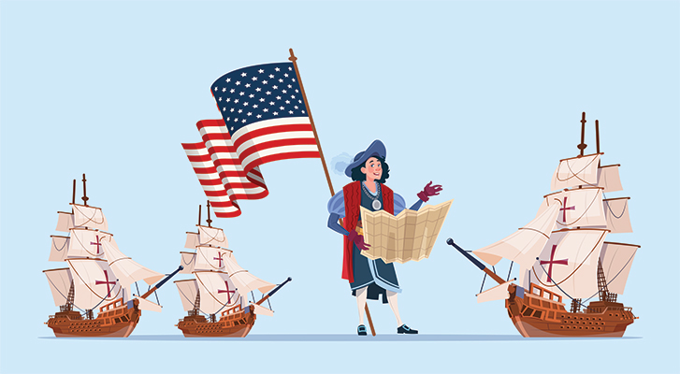
Who discovered America?
a) Christopher Colombus
b) Vasco da Gama

Slide 19
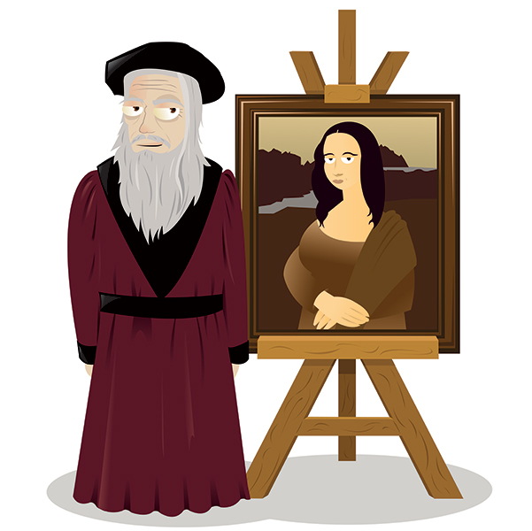
Who painted the Monalisa?
a) Leonardo Da Vinci
b) Pablo Picasso

Slide 20
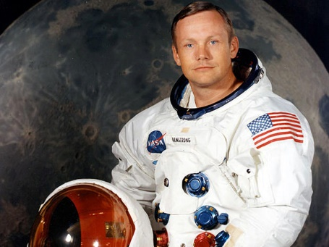
Who walked on the moon for the first time?
a) John Glenn
b) Neil Armstrong

Slide 21

Who invented Facebook?
a) Steve jobs
b) Mark Zuckerberg

Slide 22
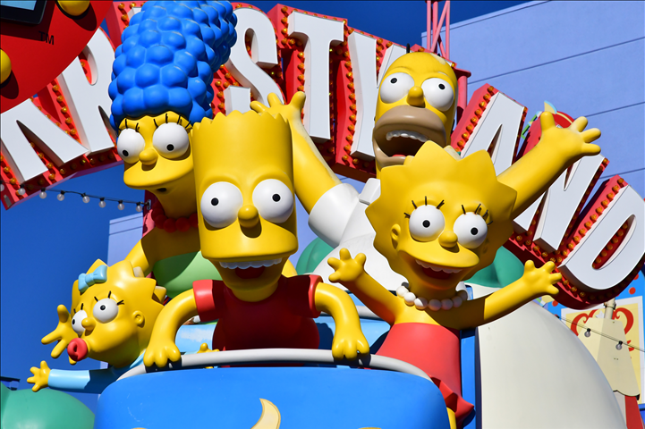
Who created the Simpsons?
a) Matt Groening
b) Walt Disney

