Slide 2
Interrogative form
I
you
he
Did she like… ?
it
we
you
they

Slide 3
Short answers
Yes, | I you he she it we you they | did.
No, |  | didn’t.

Slide 4
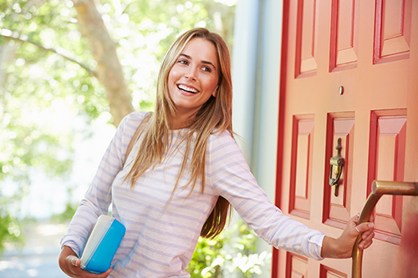
Short answers
- Did you close the door?
- Yes, I did.

Slide 5
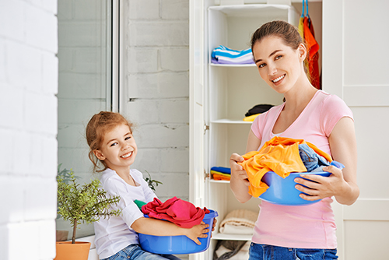
Short answers
- Did she help her mother with the household chores?
- Yes, she did.

Slide 6
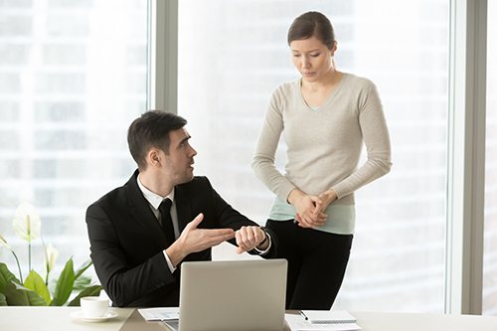
Short answers
- Did Janet arrive at work on time ?
- No, she didn’t.

Slide 7
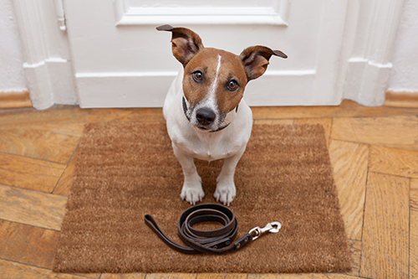
Short answers
- Did Gary walk the dog?
- No, he didn’t.

Slide 8
Exercises
A. Match the questions and the answers.
1. Did you study for the English test?
2. Did they tidy their room?
3. Did Tom play football yesterday?
4. Did your mother like the present?
5. Did the concert start at 9 p.m.?
a. Yes, they did.
b. No, it didn’t.
c. Yes, she did.
d. Yes, I did.
e. No, he didn’t.

Slide 9
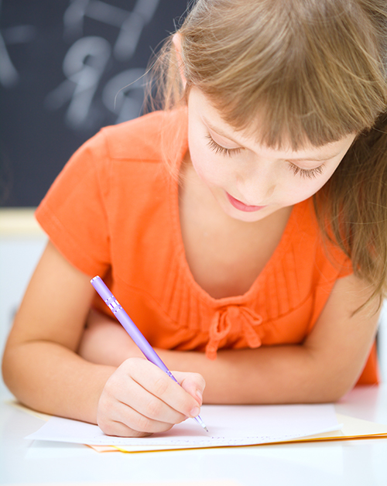
Exercises
B. Complete the questions about Anne’s birthday party.
1. Who _______________ invite to the party?
All her friends.
did Anne

Slide 10
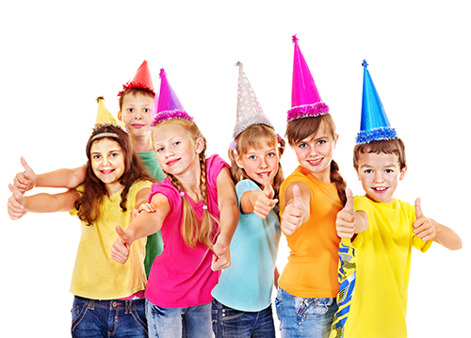
Exercises
2. What time ____________________ arrive?
At 3 p.m.
did they/the guests

Slide 11
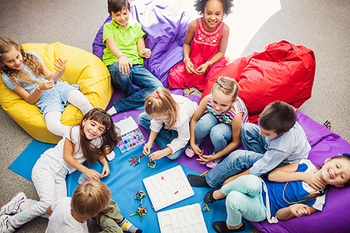
Exercises
3. How many games _______________ play?
Lots of games.
did they

Slide 12
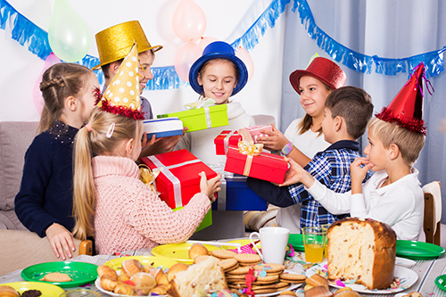
Exercises
4. _________________ receive many presents?
Yes, she did.
Did Anne / she

Slide 13
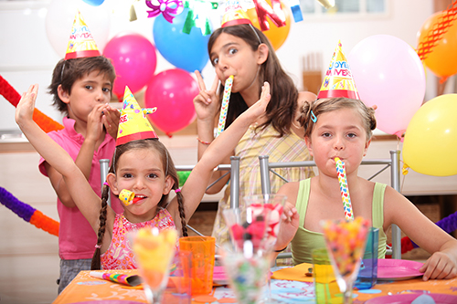
Exercises
5. ____________ like the birthday party?
Yes, they did.
Did they

Slide 14
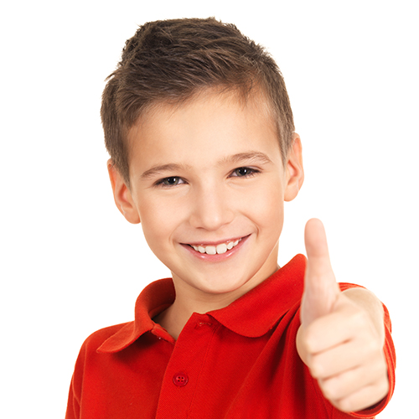
Did you enjoy doing the exercises?
Great!

