Slide 2
Negative form
I
You
He
She
It
We
You
They
+
did not
(didn’t)
+
play (infinitive)

Slide 3
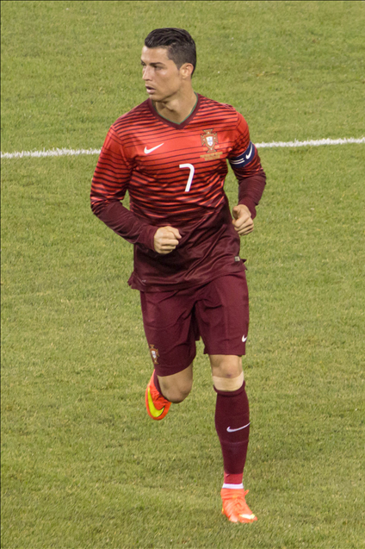
Negative form
Cristiano Ronaldo scored his first goal in the Portuguese League in 2002 and he didn’t stop. He is one of the best.

Slide 4
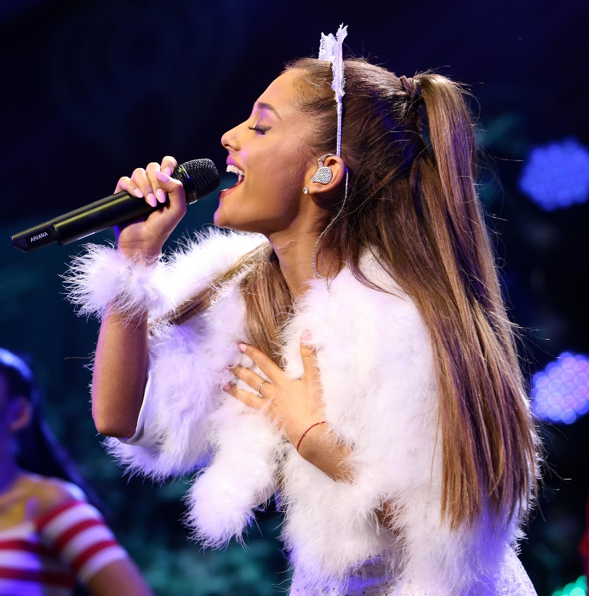
Negative form
Ariana Grande travelled the world on tour, but she didn’t travel to Mexico.

Slide 5
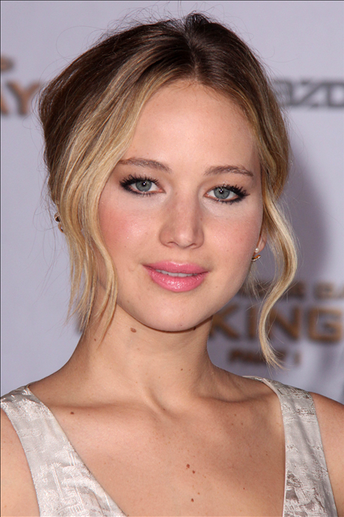
Negative form
Jennifer Lawrence acted very well in her last movie, but she didn’t receive the Oscar.

Slide 6
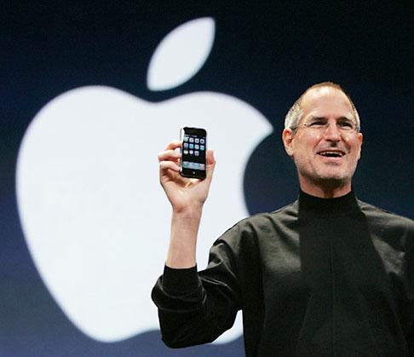
Negative form
Steve Jobs didn’t study at university, but was famous for his creative imagination and hard work.

Slide 7
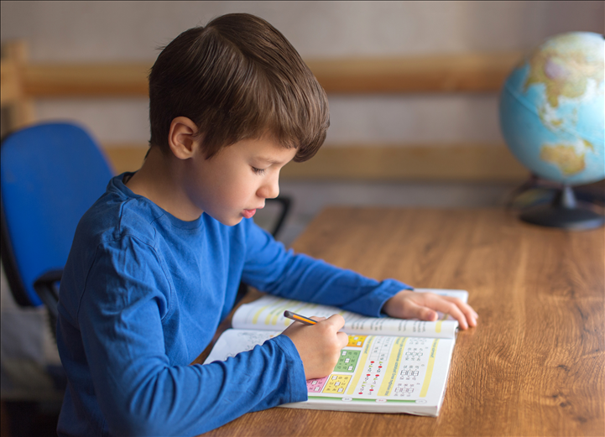
Exercises
Write the verbs in the negative.
1. Yesterday, Paul studied maths.
He ______________ history.
didn’t study

Slide 8
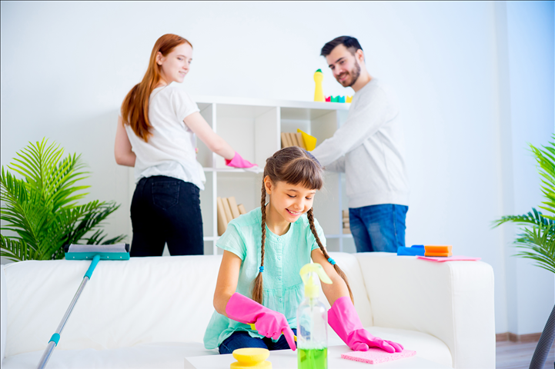
Exercises
2. Last weekend, my parents and I cleaned the house,
but we _____________ the garage.
didn’t clean

Slide 9
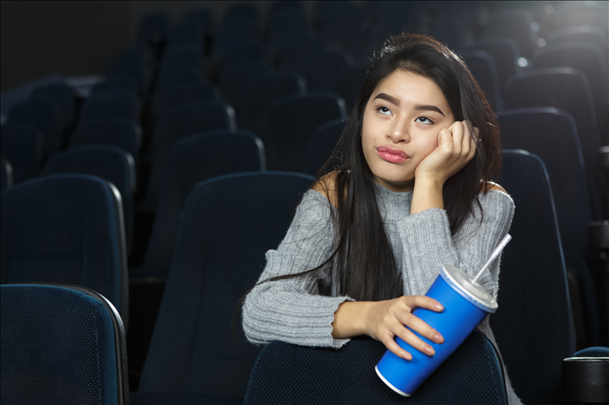
Exercises
didn’t like
3. I liked the movie, but I ___________ the end.

Slide 10
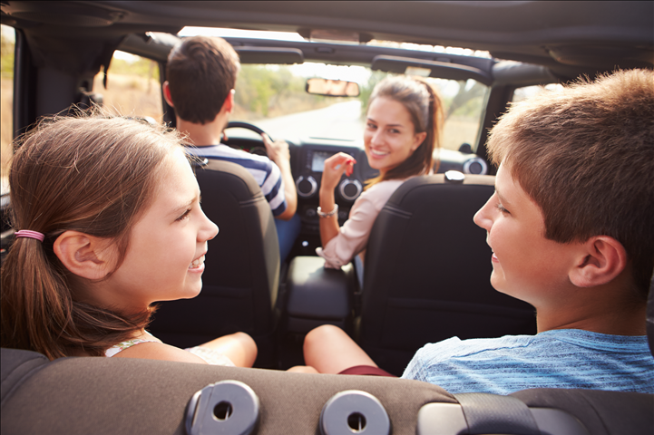
Exercises
4. Last summer holiday, they travelled by car.
They ______________ by plane.
didn’t travel

Slide 11
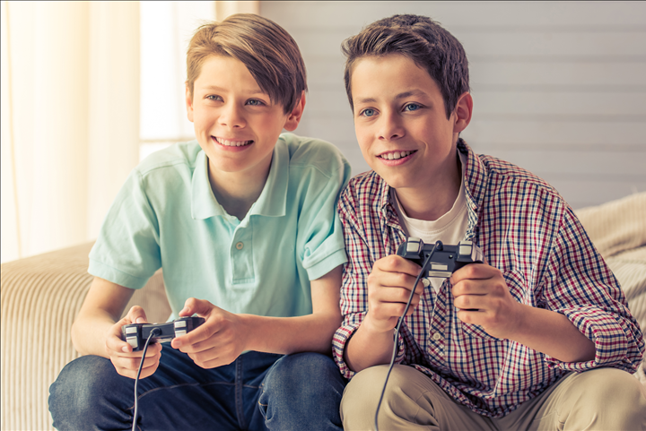
Exercises
didn’t play
5. The boys played a game, but they ____________ it all afternoon. They had a lot of homework to do.

