Slide 2
AFFIRMATIVE |  |  | NEGATIVE |  |  | INTERROGATIVE
I | was |  | I | was not (wasn’t) |  | Was | I | …?
You | were |  | You | were not (weren’t) |  | Were | you | …?
He | was |  | He | was not (wasn’t) |  | Was | he | …?
She |  |  | She |  |  |  | she
It |  |  | It |  |  |  | it
We | were |  | We | were not (weren’t) |  | Were | we | …?
You |  |  | You |  |  |  | you
They |  |  | They |  |  |  | they

Slide 3

Where were you yesterday?
Yesterday I was in the park. I wasn’t at home.

Slide 4

Where was I last week?
Last week you were in Paris. You weren’t in London.

Slide 5

Where was the teacher?
The teacher was in the library. She wasn’t in the classsroom.

Slide 6
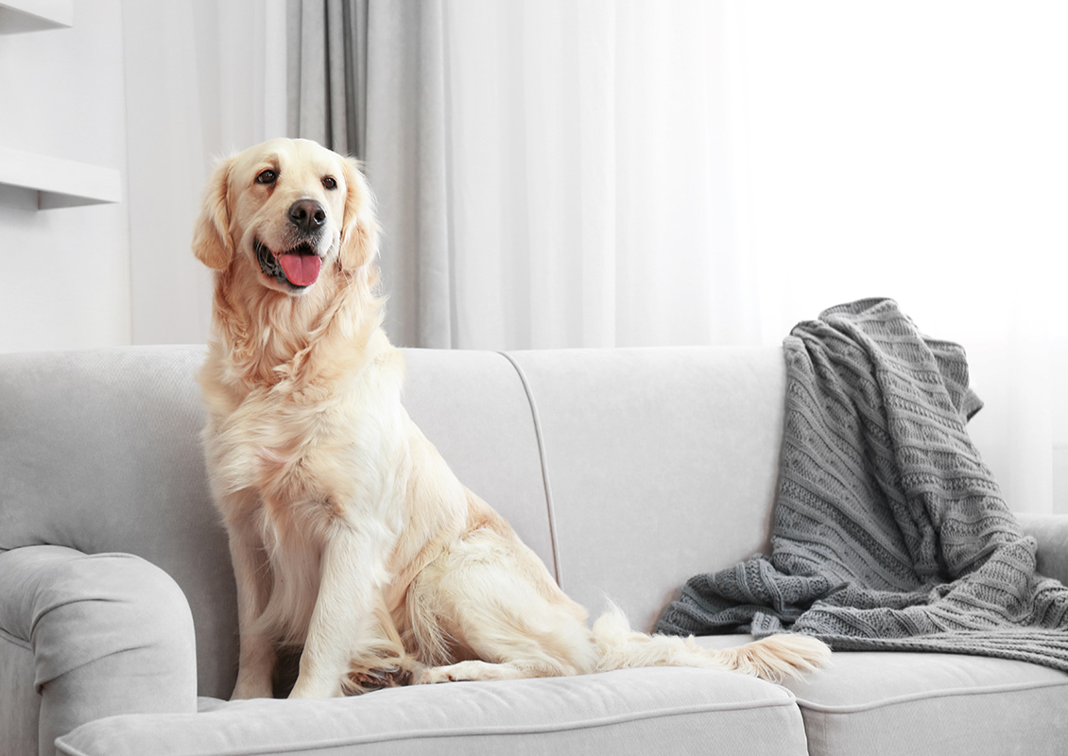
Where was the dog?
The dog was on the sofa. It wasn’t in its bed.

Slide 7

Were you bored in class?
No, we weren’t bored. We were happy.

Slide 8

When and where were we born?
You were born in the same year, but you weren’t born in the same country.

Slide 9
Where were the children last weekend?
The children were in the swimming pool. They weren’t on the beach.

Slide 10
Exercises
Match the names and ocupations to form sentences about famous British people.
Shakespeare | was were | a famous comic actor.
Charlie Chaplin |  | mathematicians and scientists.
The Beatles |  | a writer – a poet and dramatist.
Diana |  | an influential rock band.
Newton and Hawking |  | Princess of Wales.

Slide 11
Answers
Shakespeare was a writer – a poet and dramatist.
Charlie Chaplin was a famous comic actor.
The Beatles were an influential rock band.
Diana was Princess of Wales.
Newton and Hawking were mathematicians and scientists.

Slide 12

Exercises
Complete the dialogue with was, were, wasn’t or weren’t.
A: ______ you at school yesterday?
B: Yes, I ______. But my lessons ______
only in the morning. They _______ (not)
in the afternoon.
A: ______ you in the library?
B: No, I ______ (not). Why?
A: There ______ many new books. It ______
a gift from the Parents’ Association.
B: That’s great. They ______ very generous.
Were
was
were
weren’t
Were
wasn’t
were
was
were

