Slide 2
We use the present simple to talk about:
habits, routines or timetables.

Slide 3
Example:
Peter usually gets up
at 7 o’clock.
The film starts at 9.30.

Slide 4
Affirmative
I, you | play
He, she, it | plays
We, you, they | play

Slide 5
Third person singular: he, she, it
General rule | Verb + s ex. walk – walks
Verbs ending in: o, s, x, ch, sh | Verb + es ex. go – goes watch – watches
Vowel + y | Verb + s ex. buy – buys
Consonant + y | y ies ex. study – studies

Slide 6
What do these people do on Saturdays
?

Slide 7
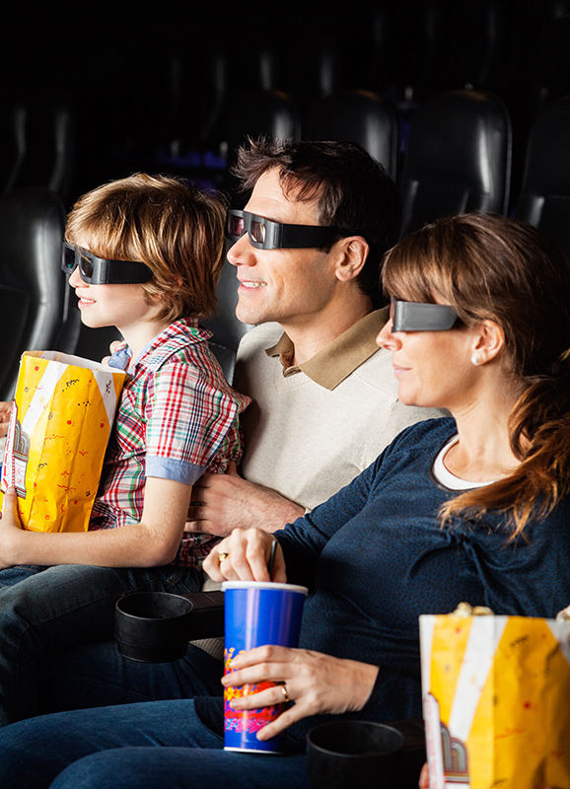
Peter usually to the cinema with his parents.
goes

Slide 8
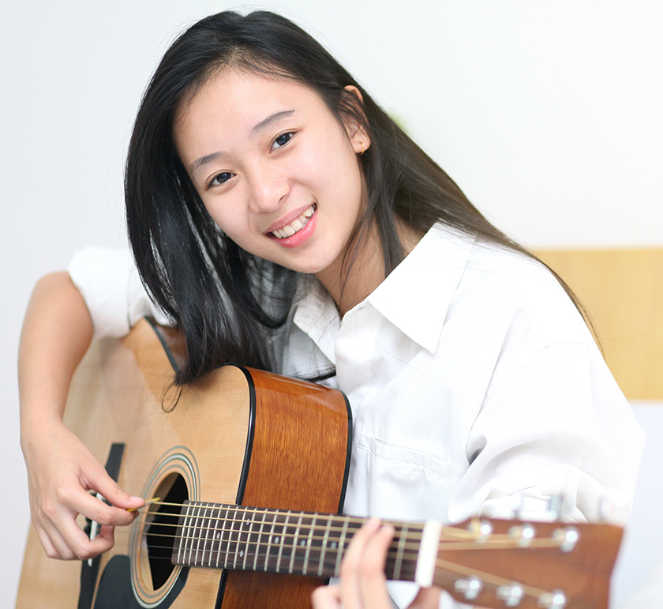
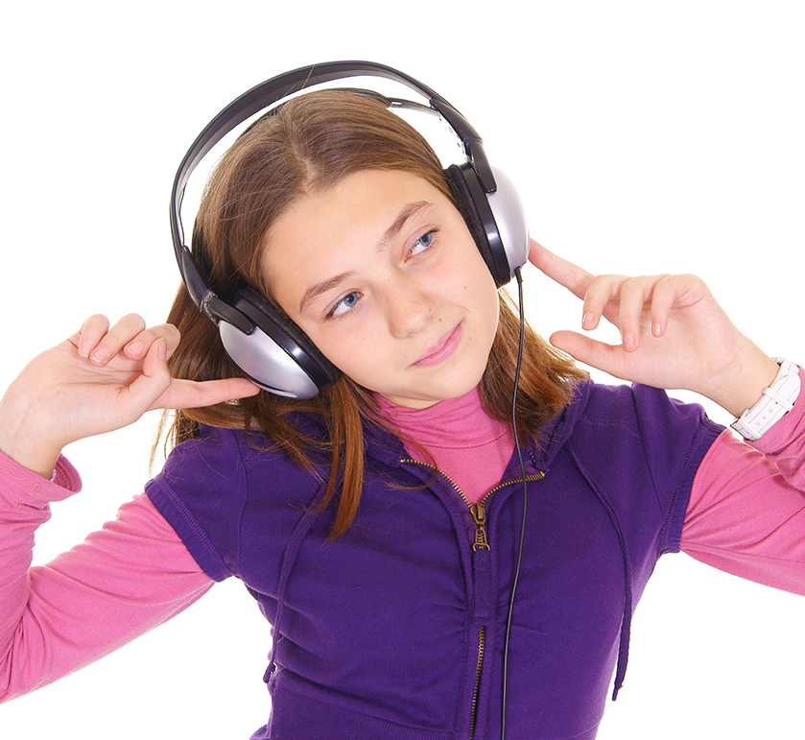
She to music.
listens
She the guitar.
plays

Slide 9
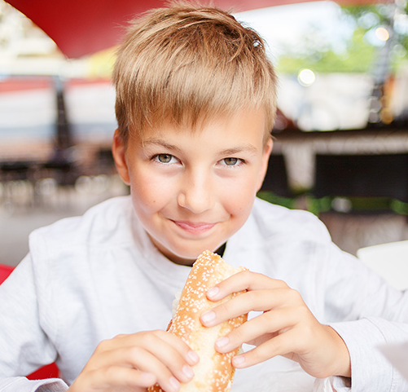
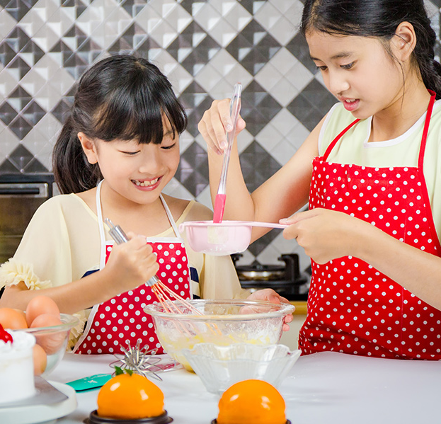
He _____ a sandwich.
eats
make
They a cake.

Slide 10
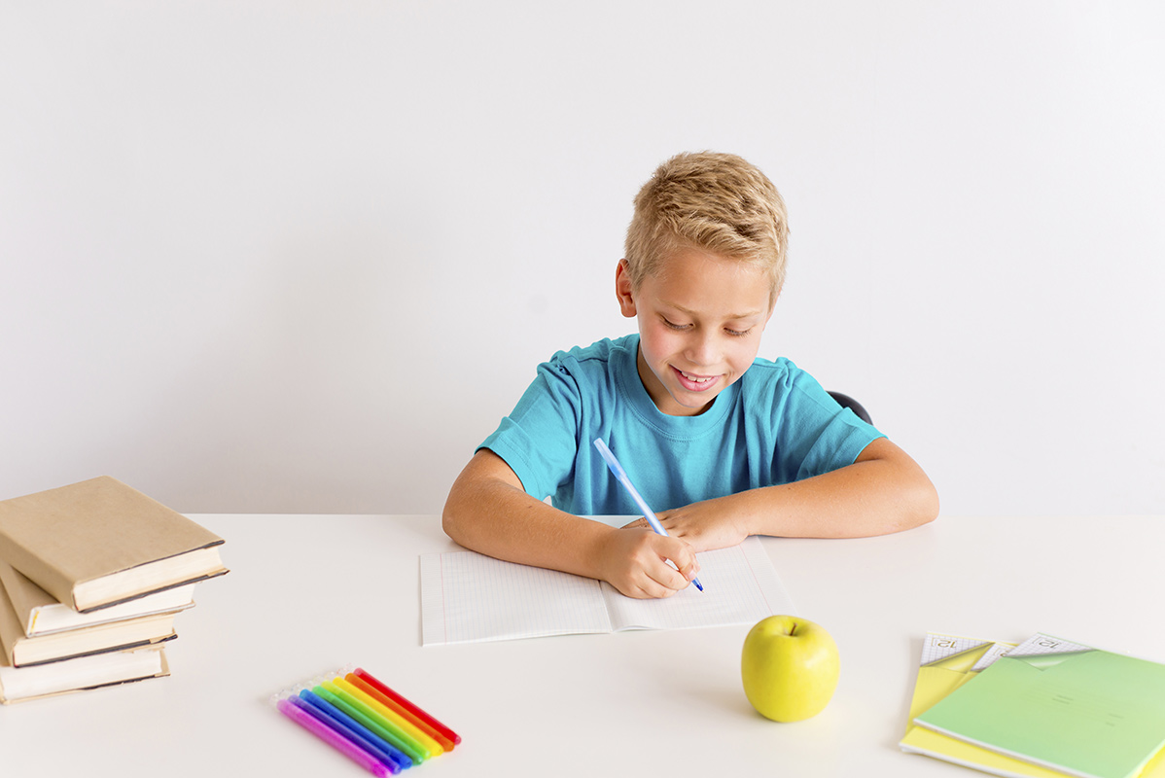
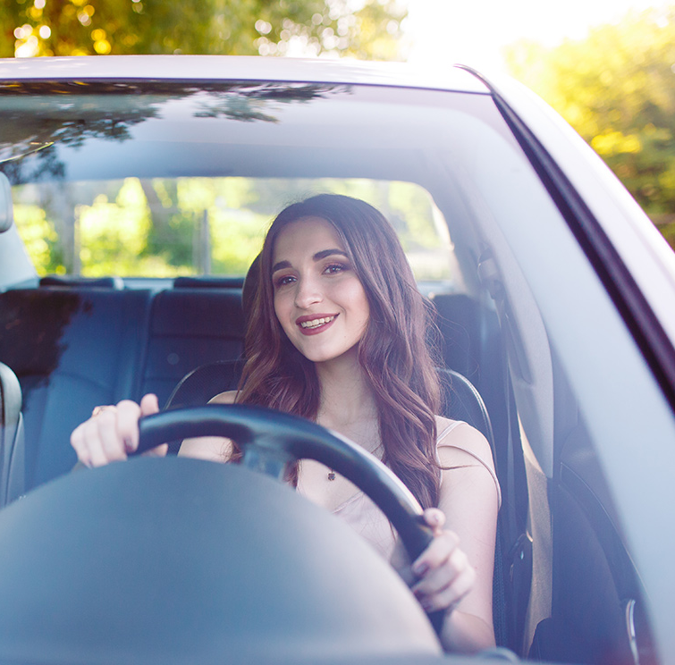
She her car.
drives
studies
He English.

Slide 11
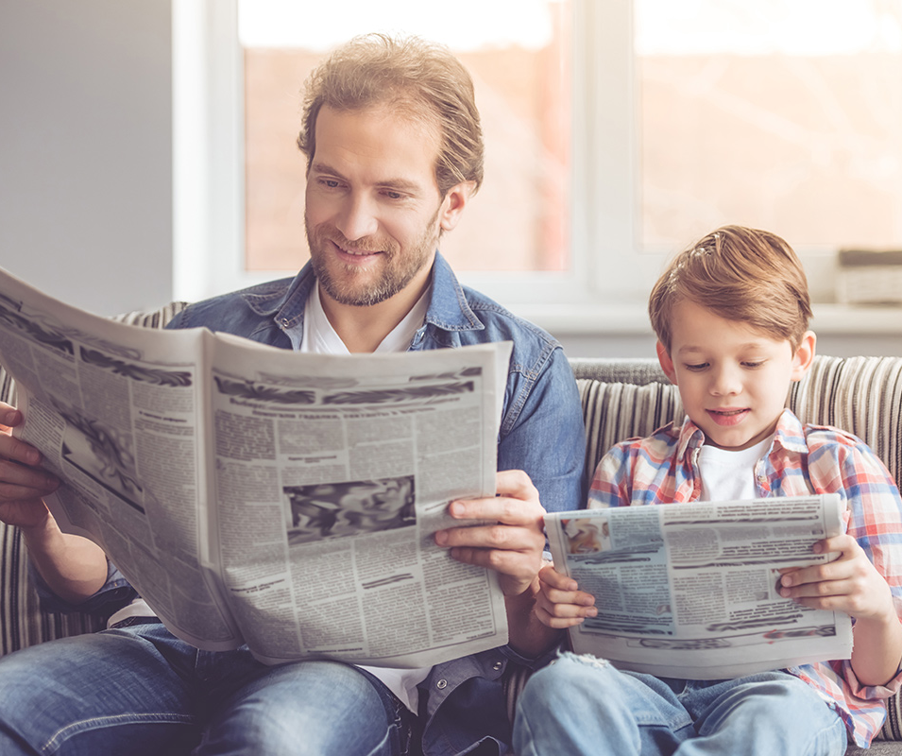
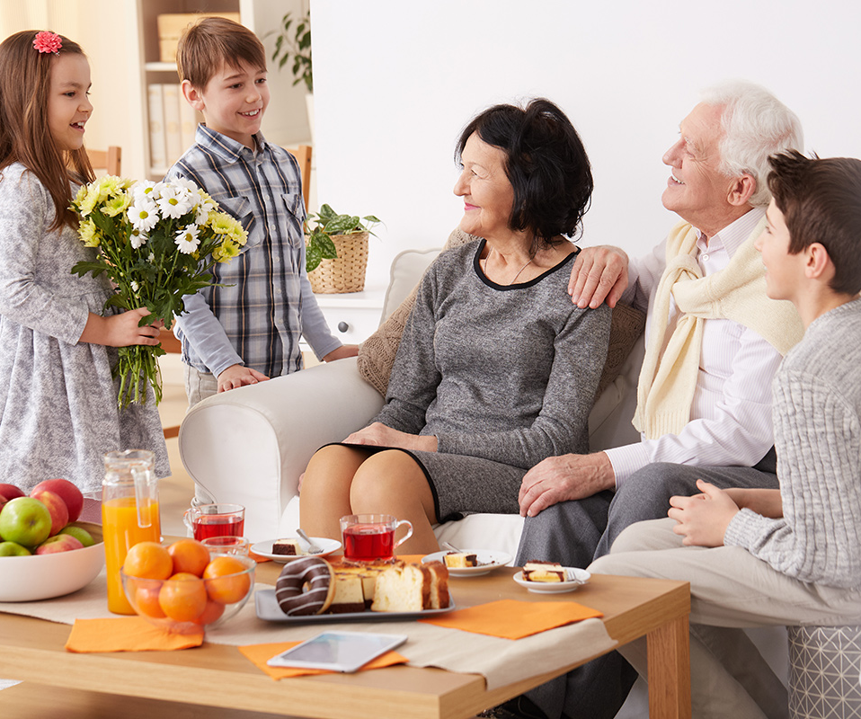
read
They the newspaper after lunch.
visit
They their grandparents.

Slide 12
Negative
I, you | don’t | play work watch
He, she, it | doesn’t
We, you, they | don’t

Slide 13


They __________
(not/go) home by car.
don't go
don’t play
We ___________ (not/play)
computer games every day.

Slide 14

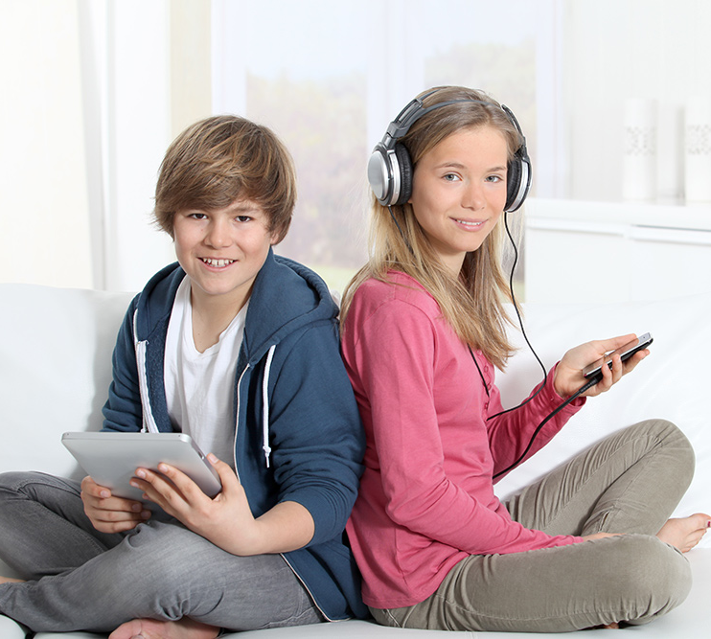
don’t like
They __________
(not/like) jazz.
doesn’t walk
She ______________
(not/walk) to school.

Slide 15
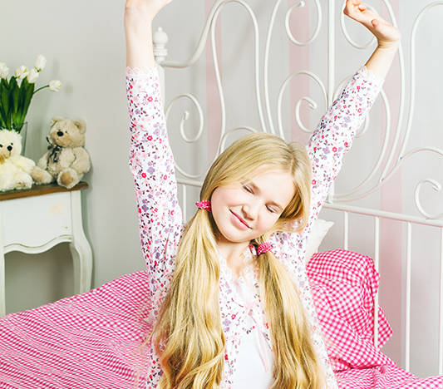
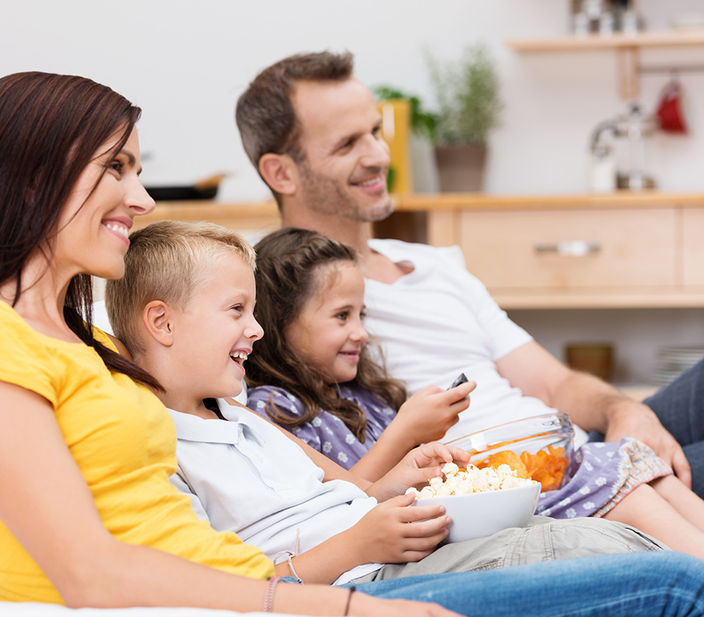
doesn't get up
She ________________ (not/get up) early on Sundays.
don’t watch
We _____________
(not/watch) TV in the morning.

