Slide 2
Interrogative
Do | I | play? work? like?
Does | he, she, it
Do | we, you, they

Slide 3
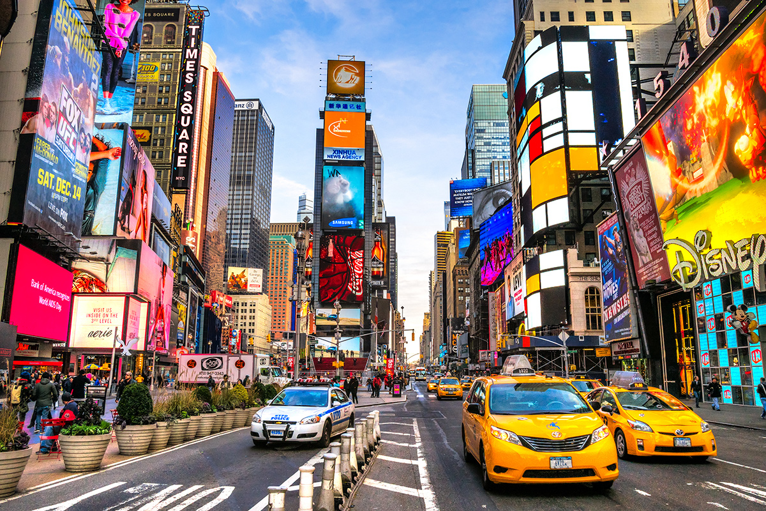
Do they live in New York?
Yes, they do.

Slide 4

Does she phone her friends every day? ()
Yes, she does.

Slide 5
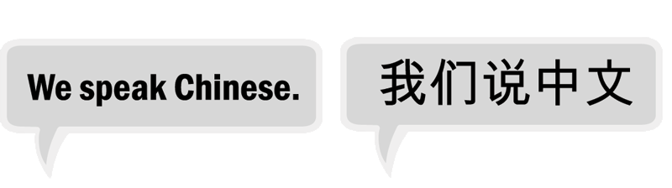


Does she drink coffee in the afternoon?
No, she doesn’t.
Do you speak Chinese? ()
No, I don’t.

Slide 6
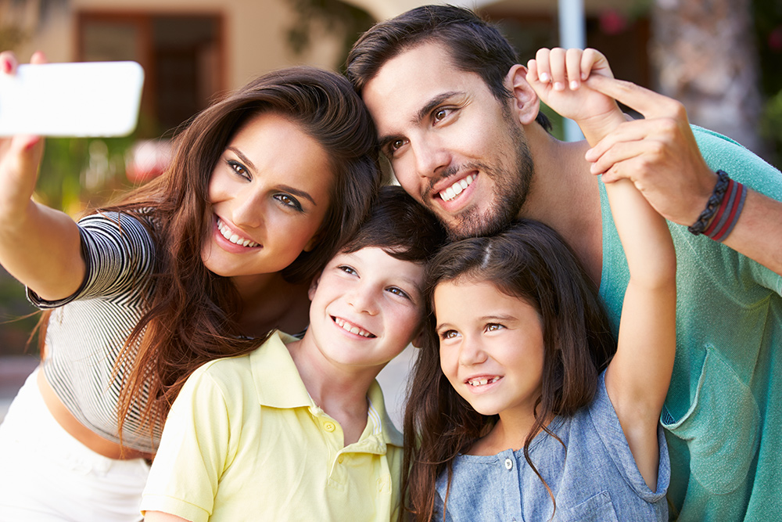
Do they like taking selfies? ()
Yes, they do.

Slide 7
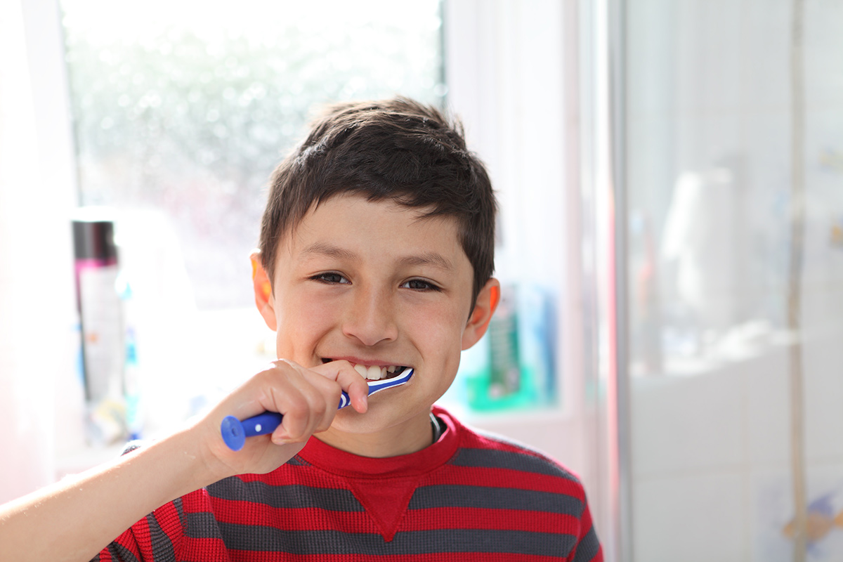
Does Tom brush his teeth every day? ()
Yes, he does.

Slide 8
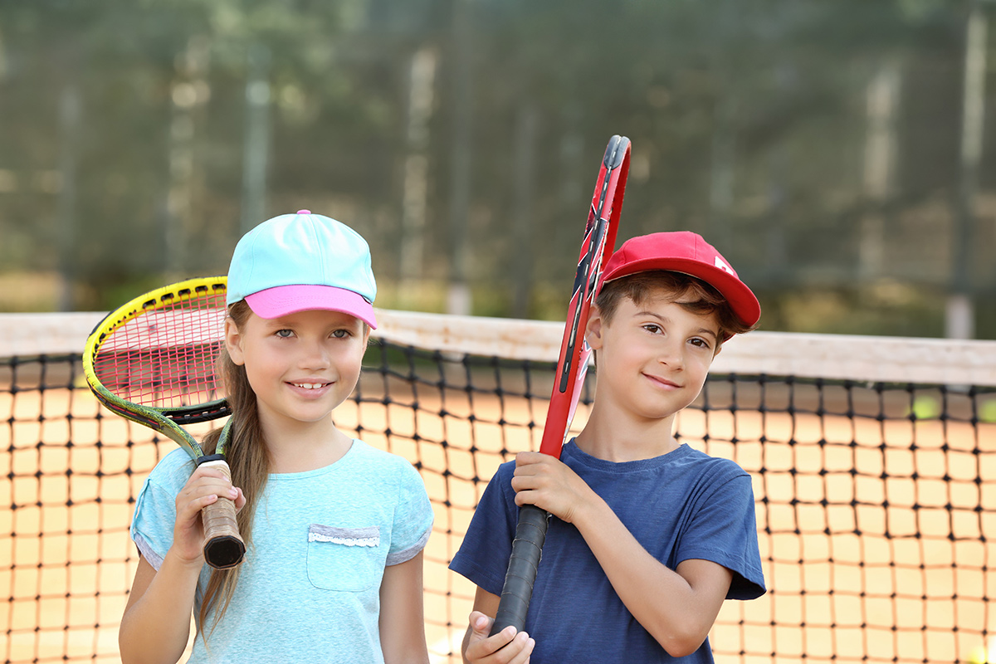
Do they play tennis every day? ()
No, they don’t.

Slide 9
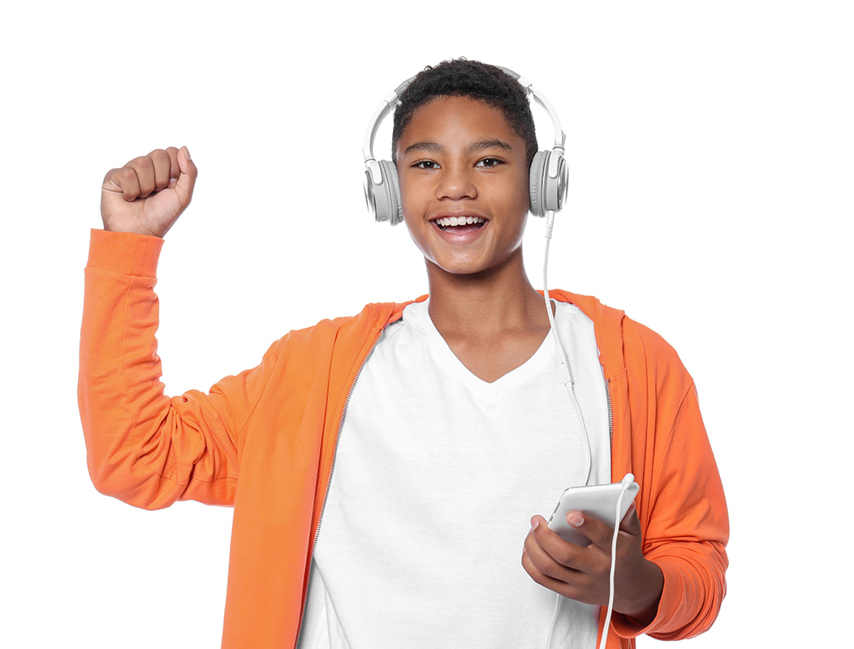
Does he listen to music every day? ()
Yes, he does.

