Slide 2

We use the present simple to talk about:
habits, routines or timetables.

Slide 3

Time expressions used with the present simple:
  always
  every… day / week / month / year
  sometimes
  often
  usually
  never
  (…)

Slide 4

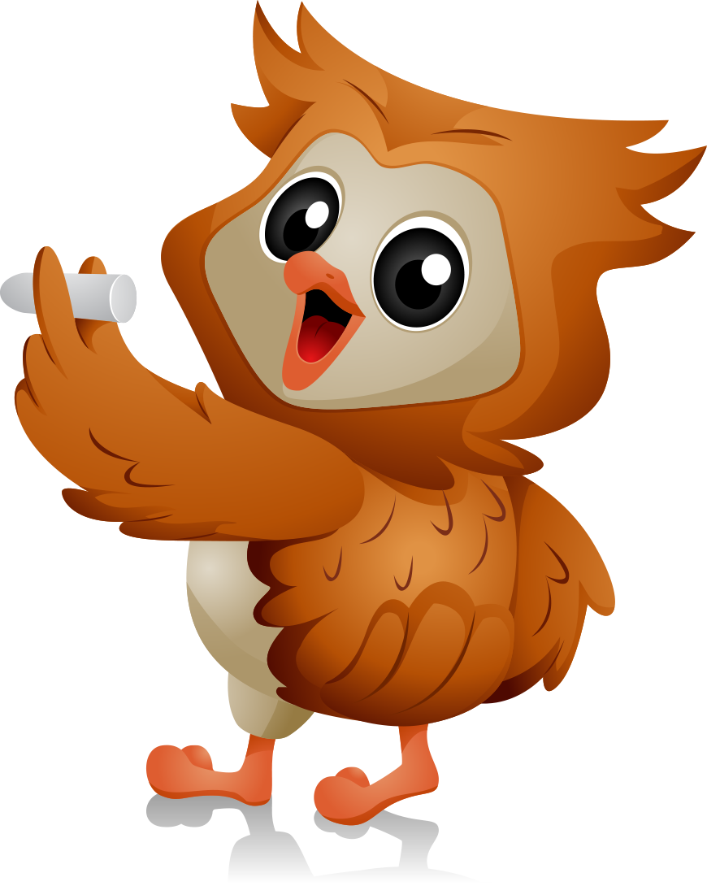
Affirmative
I / You | play
He /She / It | plays
We / You / They | play

Slide 5

Third person singular: he, she, it
General rule | Verb + s walk – walks
Verbs ending in: o, s, x, ch, sh | Verb + es go – goes watch – watches
Vowel + y | Verb + s buy – buys
Consonant + y | y ies study – studies

Slide 6
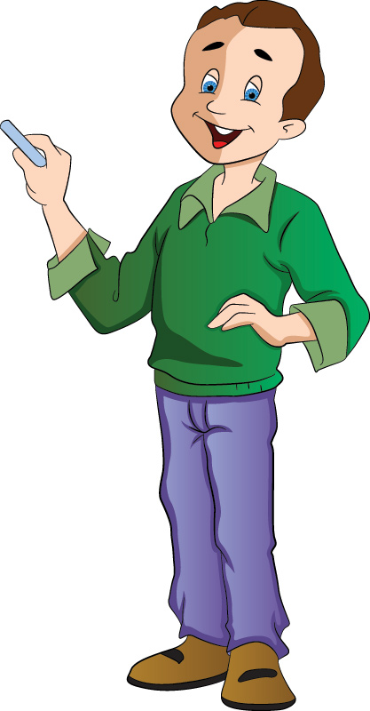
We use the present continuous to talk about actions happening now, at this moment, today.

Slide 7
Form:
am, is, are
+
main verb + ing

Slide 8
Affirmative
I | am | running dancing studying
You | are
He / She / It | is
We / You / They | are

Slide 9
Let’s do some exercises!

Slide 10
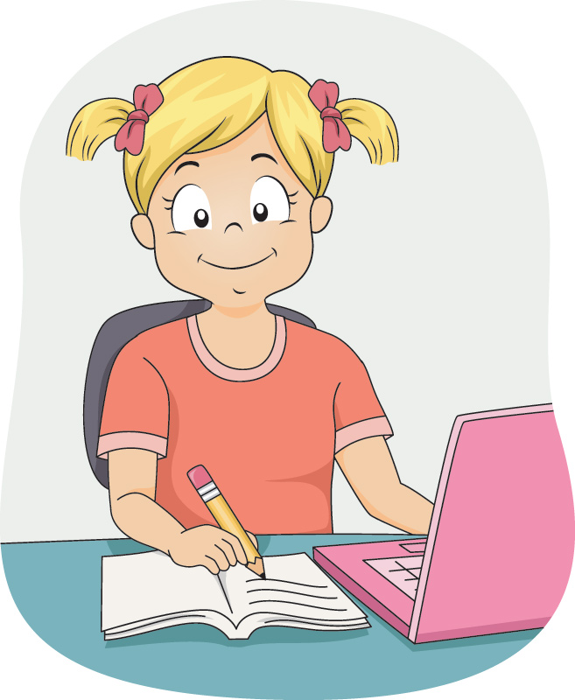
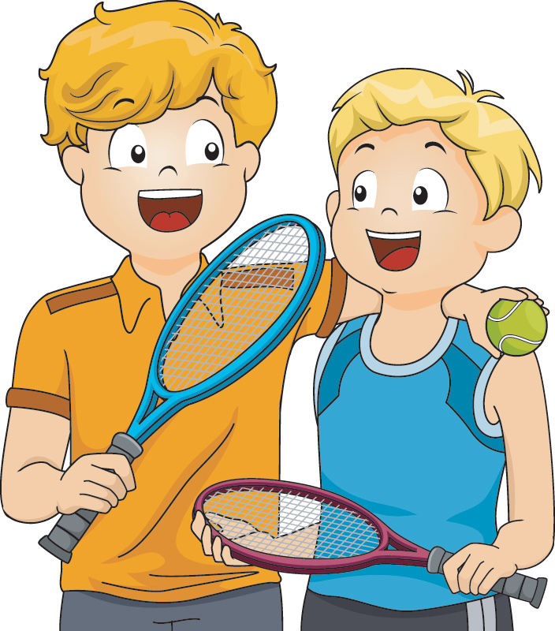
play
They usually (play) tennis twice a week.
Now she (do)
her homework.
is doing

Slide 11
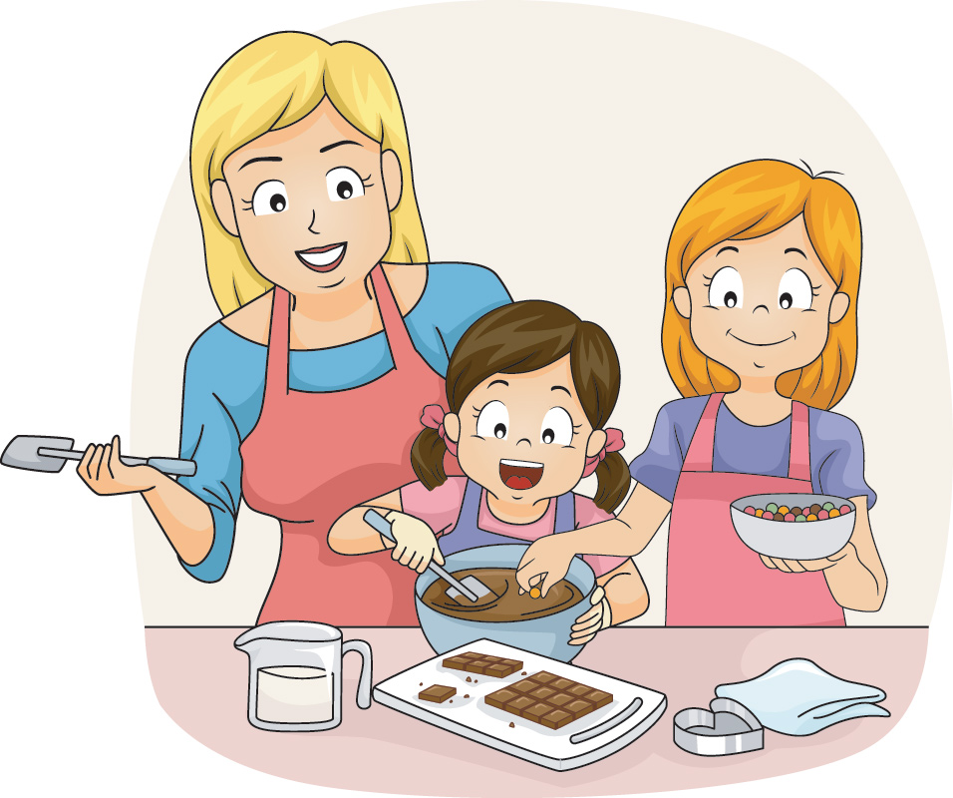
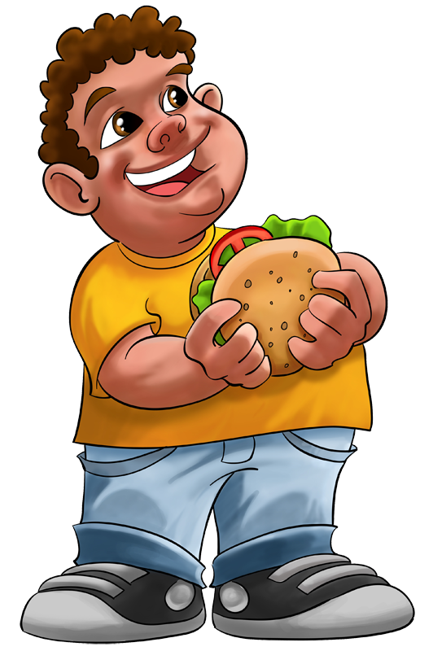
eats
He sometimes (eat)
a burger on Saturdays.
are making
They (make) a cake at the moment.

Slide 12
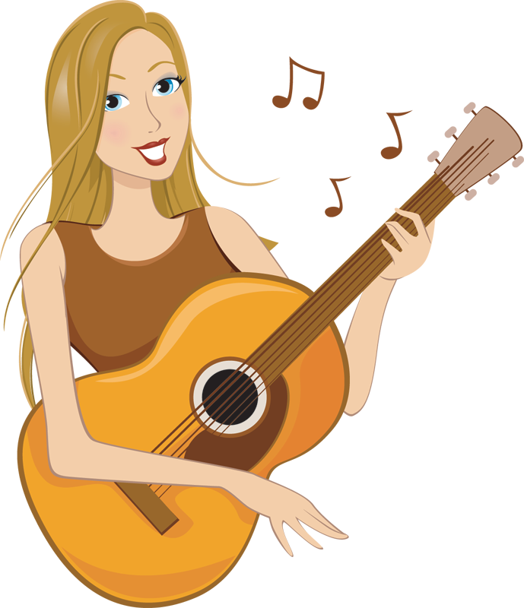

She (listen) to music every day.
listens
She ____ (play)
the guitar now.
is playing

Slide 13
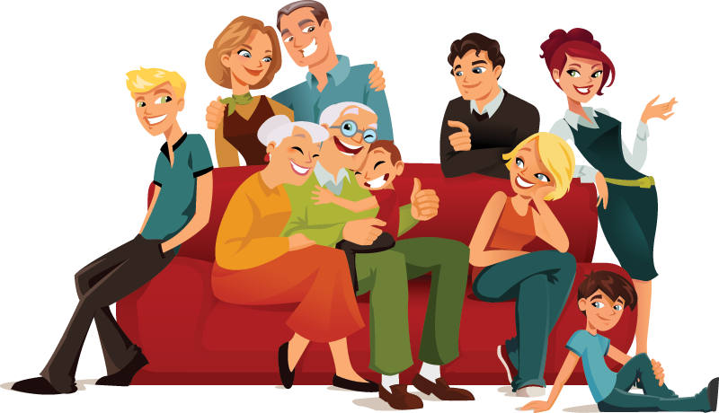

Look! They ____________ (read) the newspaper.
are reading
We ______ (visit) our grandparents at the weekend.
visit

Slide 14
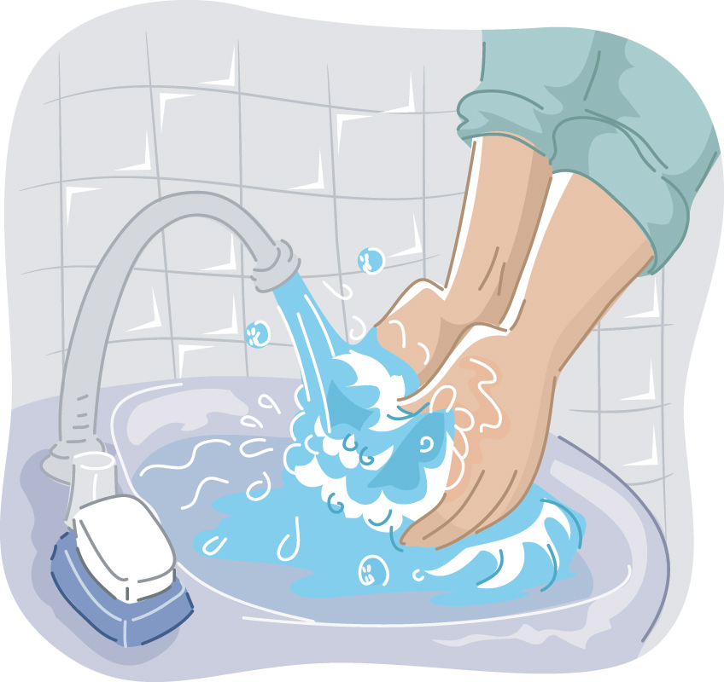
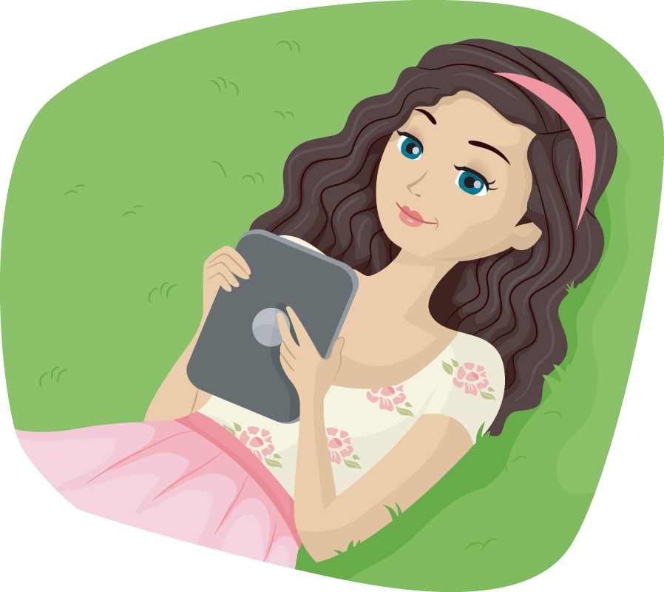
He always ________ (wash) his hands before eating.
washes
I ___________ (read) a book at the moment.
am reading

Slide 15
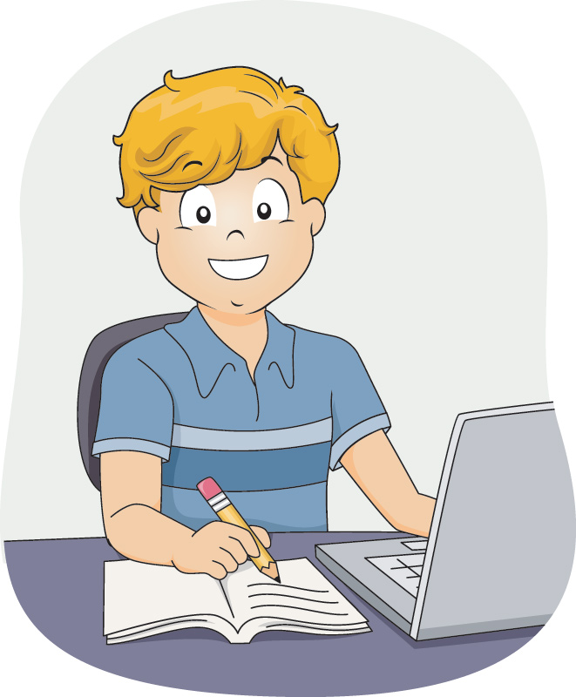
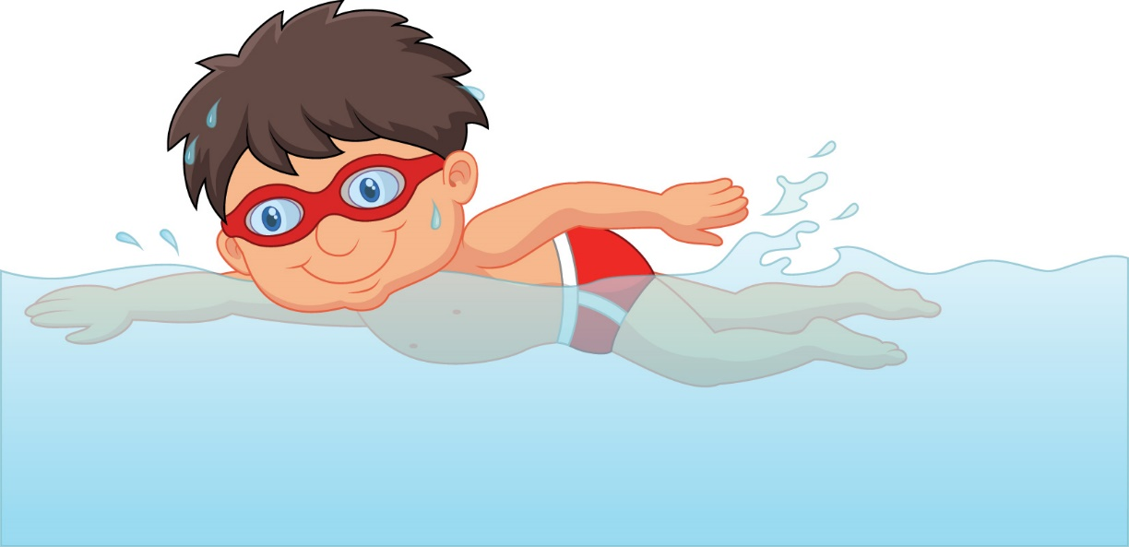
Today Michael
_____________ (swim).
is swimming
studies
Tom always ________
(study) hard.

Slide 16
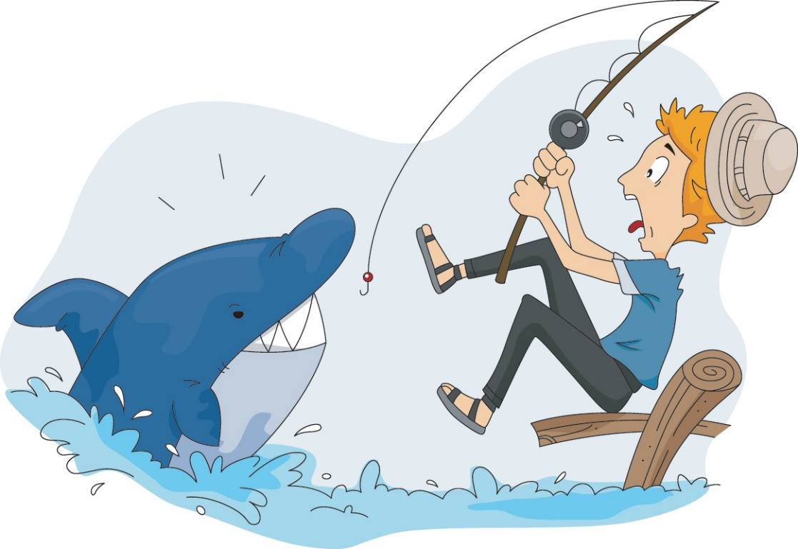
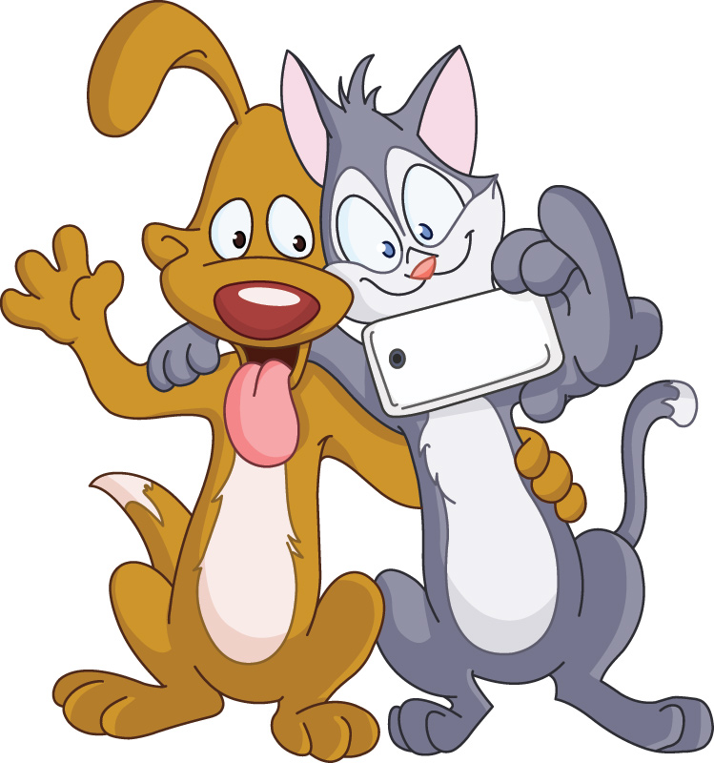
are taking
Look! They __________ (take) a selfie.
goes
He often ______ (go) fishing at the weekend.

