Slide 2

Reflexive pronouns

Slide 3
Reflexive pronouns
Reflexive pronouns
Singular | myself yourself himself herself itself
Plural | ourselves yourselves themselves

Slide 4
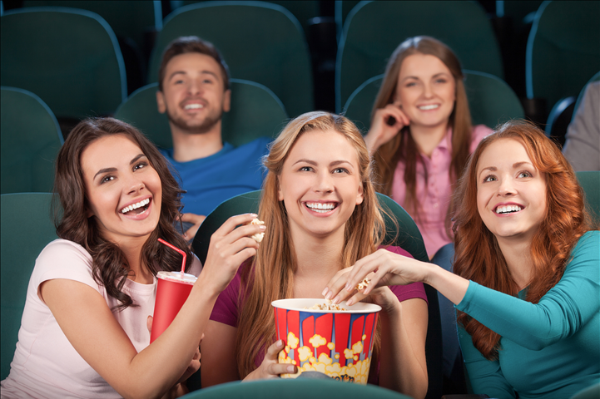
Reflexive pronouns
We use reflexive pronouns when the subject and the object of the sentence are the same.
They enjoyed themselves at the cinema.

Slide 5
Reflexive pronouns
We usually use them with the verbs that follow…

Slide 6
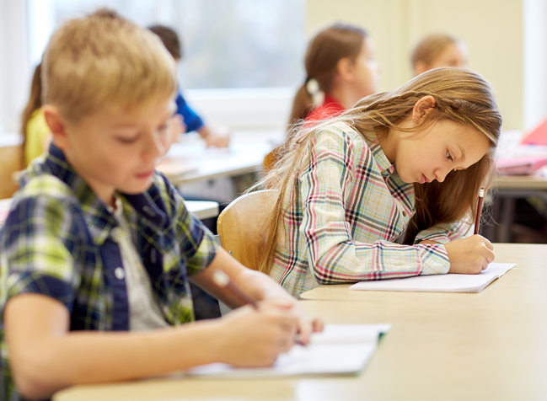
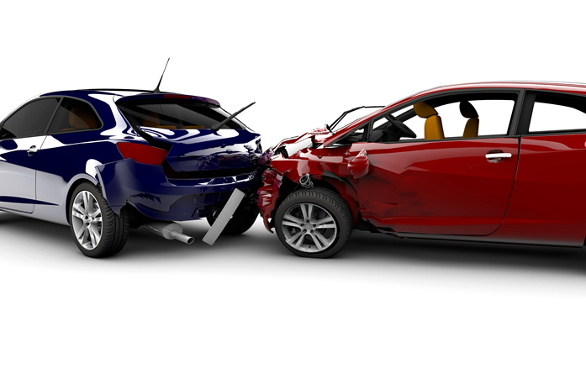
behave
Children, behave yourselves in class!
blame
He shouldn’t blame himself for the accident.

Slide 7
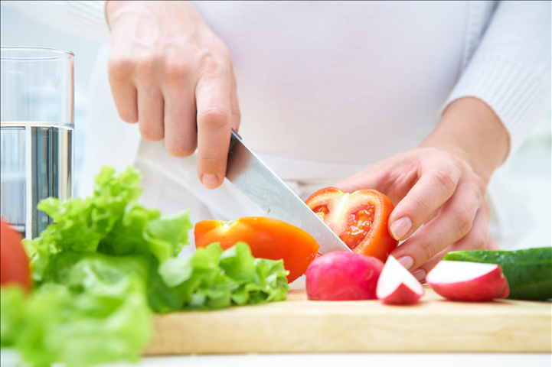
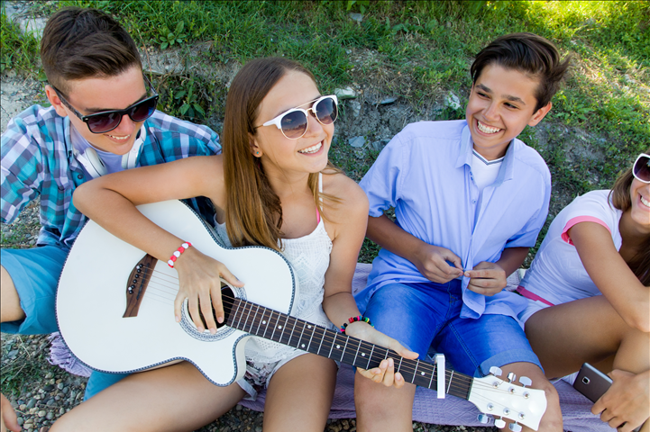
cut
She cut herself in the kitchen.
enjoy
We enjoy ourselves when we are together.

Slide 8
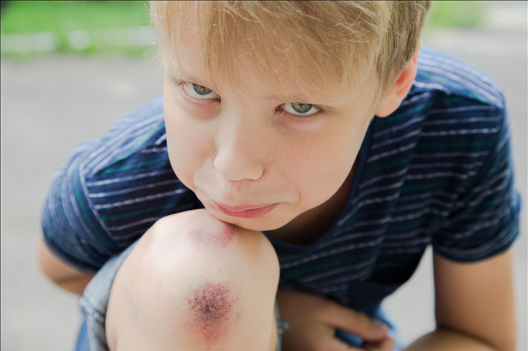
hurt
He fell and hurt himself.
introduce
They introduced themselves to the new teacher.

Slide 9
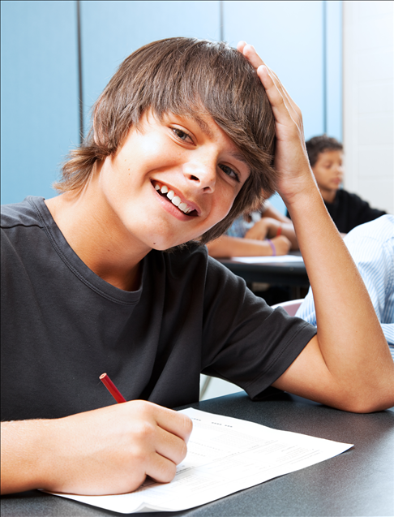
Exercises
Complete the sentences with the reflexive pronouns.
1. I behave __________ at school.
myself

Slide 10
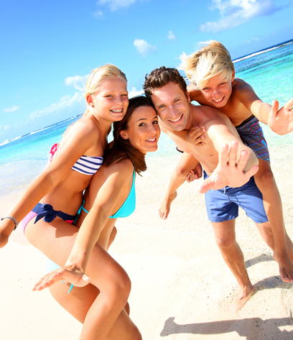
Exercises
ourselves
2. We enjoyed ___________ on the beach in the Algarve last summer.

Slide 11
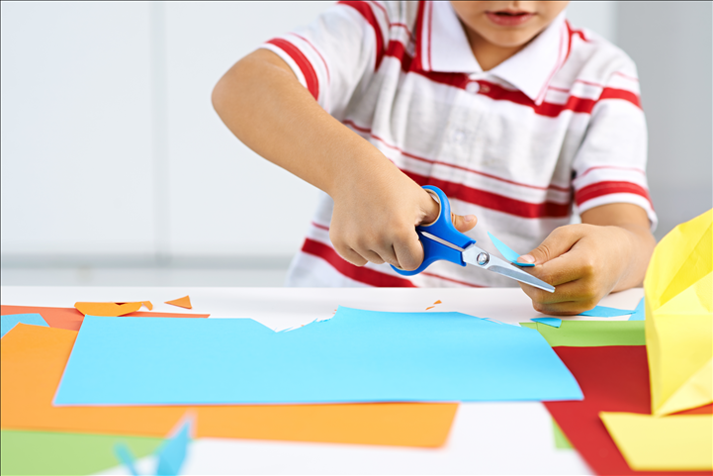
Exercises
yourself
3. Be careful! Don’t hurt __________!

Slide 12
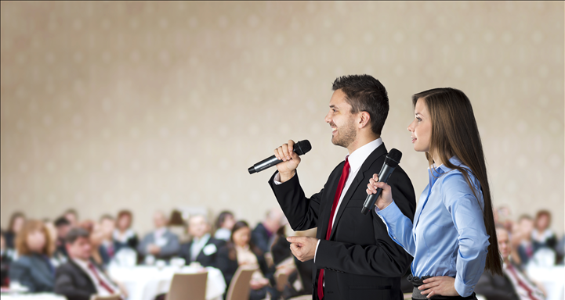
Exercises
themselves
4. They introduced _____________ to the audience.

Slide 13
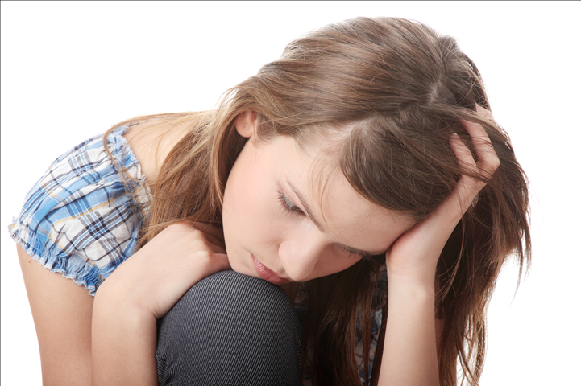
Exercises
herself
5. She shoudn’t blame __________ for what happened.

Slide 14
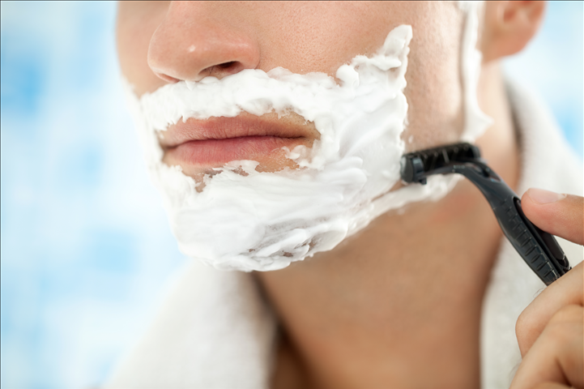
Exercises
himself
6. He cut __________ while shaving.

Slide 15
Exercises
In the hotel breakfast room.
Complete this notice with plural pronouns.
There is buffet service in the breakfast room.
The waitress does not serve the guests. Please serve ____________. Help _____________ to as much as you like. Enjoy your breakfast.
yourselves
yourselves

