Slide 2
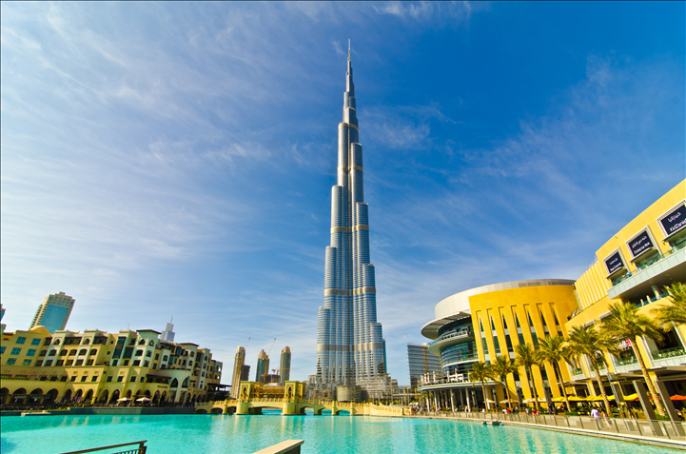
Superlatives

Slide 3
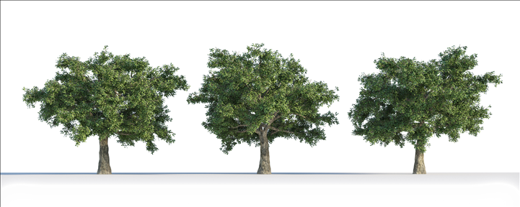
Superlatives
We use superlative adjectives to compare one person, thing or place to three or more.

Slide 4
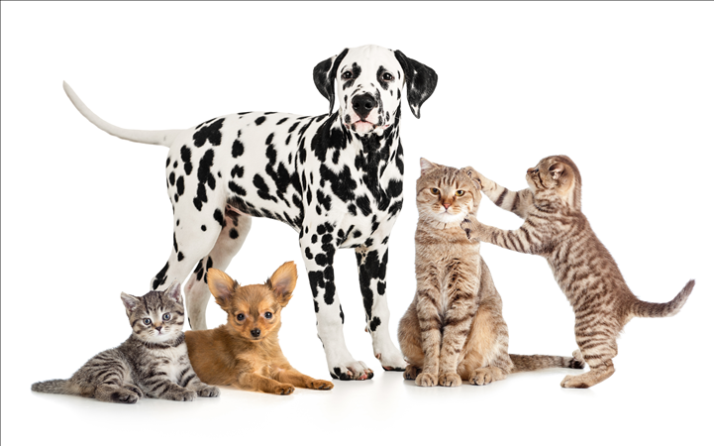
One syllable adjectives
small
long
large
fat
hot
big
the smallest
the longest
the largest
the fattest
the hottest
the biggest
It’s the biggest dog of all.

Slide 5
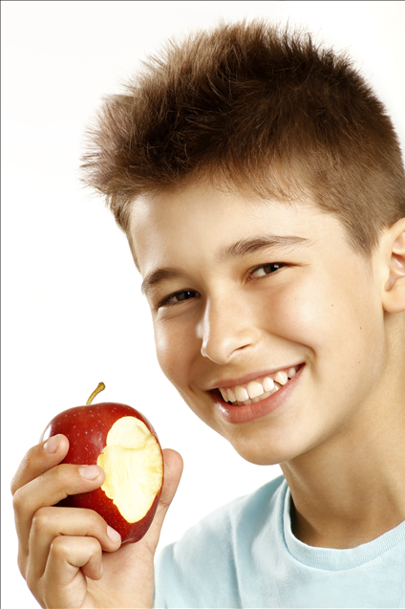
Two syllables ending in -y
easy
happy
hungry
healthy
the easiest
the happiest
the hungriest
the healthiest
He is the healthiest boy I know.

Slide 6
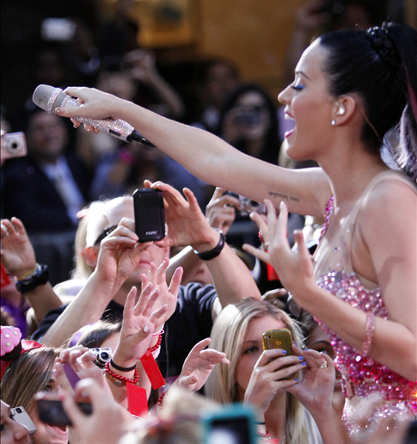
Two or more syllables
important
comfortable
popular
famous
the most important
the most comfortable
the most popular
the most famous
She is one of the most famous singers in the world.

Slide 7
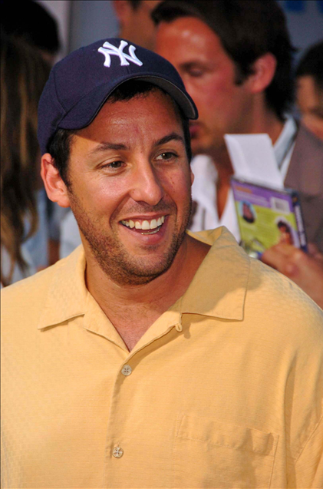
Exercises
Complete the sentences with the adjectives in the superlative
funniest
He is funny. He is the __________ actor I know.

Slide 8
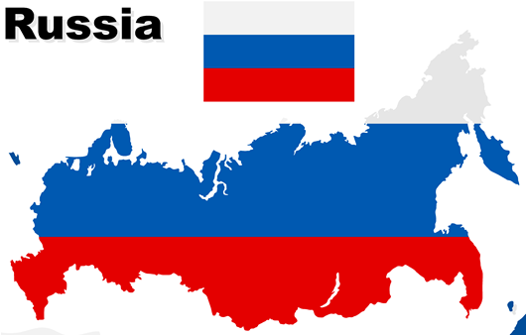
Exercises
Russia is a big country. In fact, it is the _________ country in the world.
biggest

Slide 9
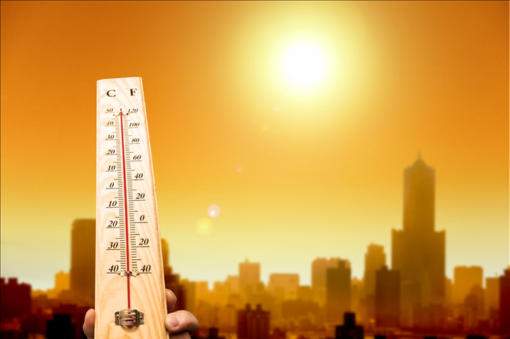
Exercises
Today is a hot day. I think it is the __________ day this year.
hottest

Slide 10
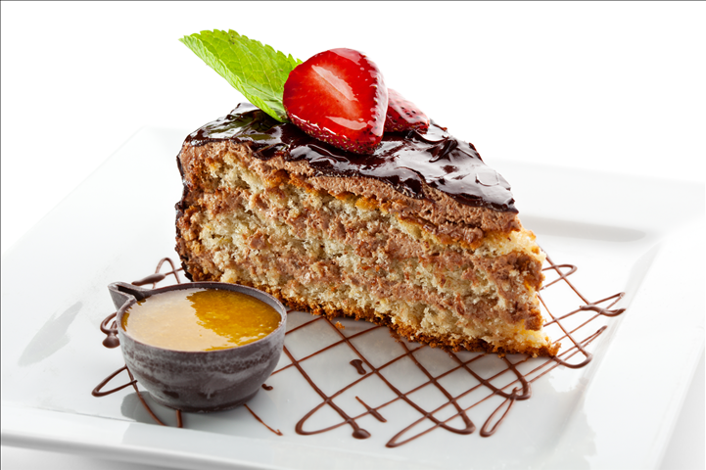
Exercises
best
This cake is good. It is the __________ in this restaurant.

Slide 11
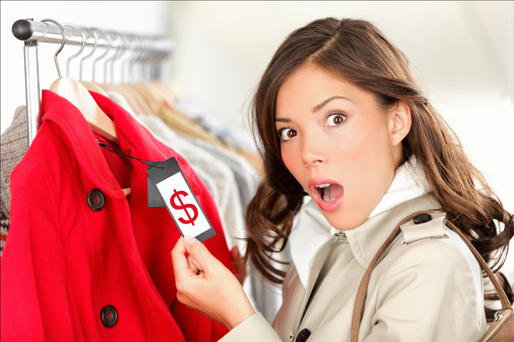
Exercises
This coat is lovely, but it is expensive. I think it is the ________________ in the shop.
most expensive

Slide 12
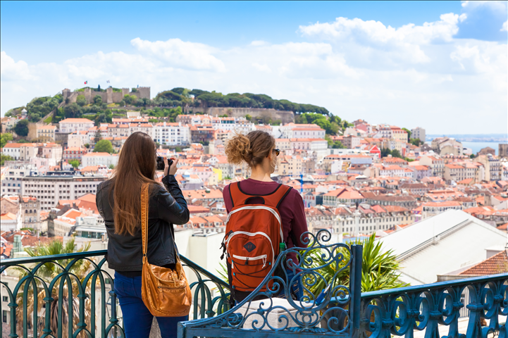
Exercises
Portugal is very popular. In fact, it is one of the _______________ tourist destinations.
most popular

Slide 13
Exercises
Comparative or superlative?
1. Emily and Margaret are__________ teachers I know.
a) better than b) the best
2. My Internet is _________ than yours.
a) faster b) the fastest
3. George is _________ boy in class.
a) the tallest b) taller than
4. The blue coat is __________ the green one.
a) more beautiful than b) the most beautiful

