Slide 1


Slide 2
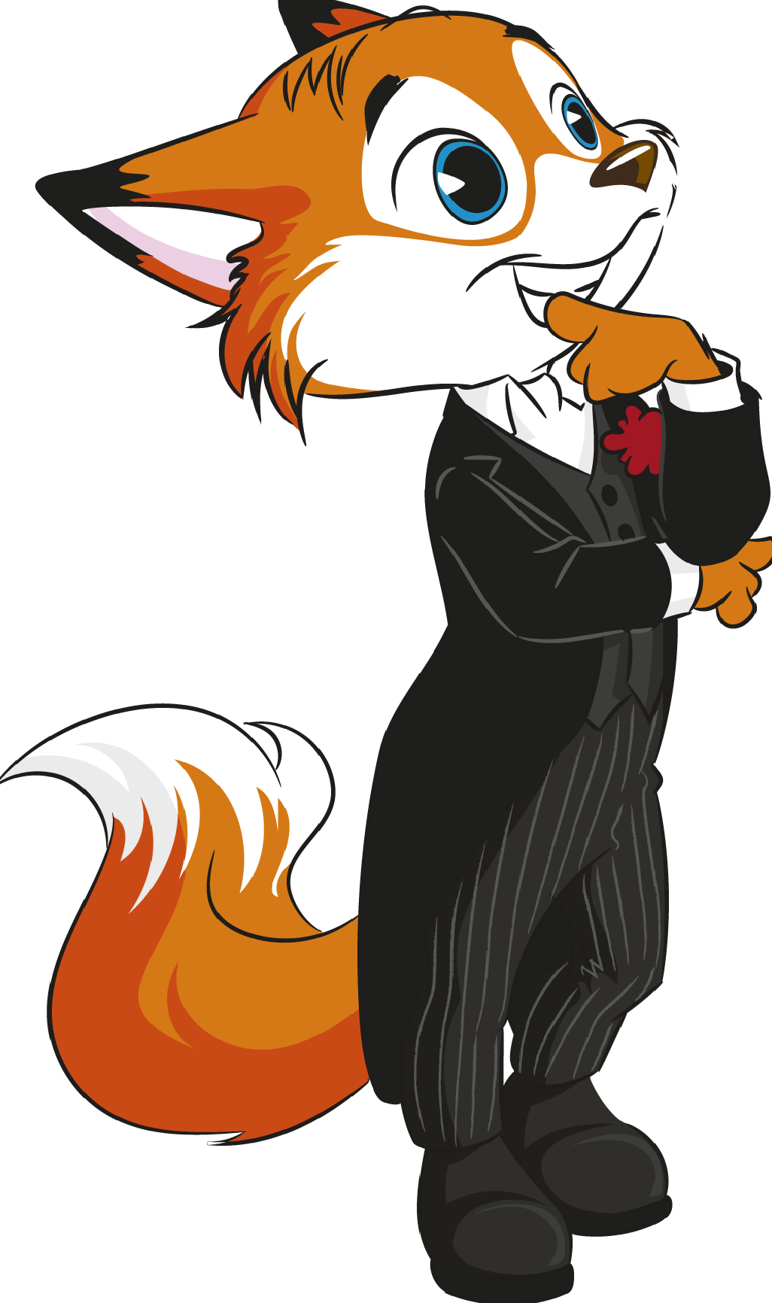
UNIT 4
CORRECTION OF THE TEST

Slide 3

LISTENING
Exercise 1: Listen and tick () the places that you hear in the city.
a. (theatre)
c. (hotel)
f. (post office)
g. (hospital)
h. (railway station)

Slide 4
LISTENING
Exercise 2: Look and match the people to their favourite means of transport.
a. Grace
b. Mike
c. Anna
d. Sally
e. Tom

Slide 5
READING
Exercise 1: Circle the correct option according to the text.
a. 3
b. 3
c. 2
d. 1
e. 1
f. 2

Slide 6
READING
Exercise 2: Answer the questions.
a. It is in the district of Leiria.
b. No, he didn’t. He travelled by car.
c. He stayed at a cool hotel.
d. It is a means of transport that is like a tram, but it has got a strong cable that pulls it up a mountain.

Slide 7
VOCABULARY AND GRAMMAR
Exercise 1: Read the sentences and write the names of the correct shops.
a. clothes shop
b. newsagent’s
c. corner shop
d. chemist’s
e. florist’s

Slide 8
VOCABULARY AND GRAMMAR
Exercise 2: Label the pictures of the buildings.
a. lighthouse
b. castle
c. farmhouse
d. factory
e. stadium

Slide 9
VOCABULARY AND GRAMMAR
Exercise 3: Complete the gaps with the directions to the theatre with the verbs in the box.
a. go
b. Take
c. go
d. turn
e. stop

Slide 10
VOCABULARY AND GRAMMAR
Exercise 4: Complete the gaps with a preposition of movement: onto, into, to, across or towards.
a. to
b. across
c. into
d. onto
e. towards

Slide 11
VOCABULARY AND GRAMMAR
Exercise 5: Complete the gaps with the Past Simple of the verbs in brackets.
a. bought
b. didn’t go
c. travelled
d. had
e. didn’t eat

Slide 12
VOCABULARY AND GRAMMAR
Exercise 6: Write sentences in the interrogative form. Use the Past Simple.
a. Did he watch the football match yesterday?
b. Did you use a map to find the restaurant?
c. What famous places did you see in Italy?
d. Where did you stay?
e. How many museums did you visit?

Slide 13
WRITING
Exercise 1: Answer the questions about you.
Personal answers:
a. My favourite place in town is…
b. Yes, I did. / No, I didn’t. I went to school by…
c. My favourite means of transport is…
d. Yes, there is. / No, there isn’t.
e. Yesterday I…

Slide 14
WRITING
Exercise 2: Write a postcard (25-35 words) of your imaginary trip to Los Angeles last summer.
Last summer I went to Los Angeles. I saw the famous Hollywood sign. I also visited the Warner Bros Studious, the La Brea Tar Pits and Museum and Hollywood Boulevard. Then, I walked along the beaches of Santa Monica. My trip was fantastic!

Slide 15


