Slide 1


Slide 2
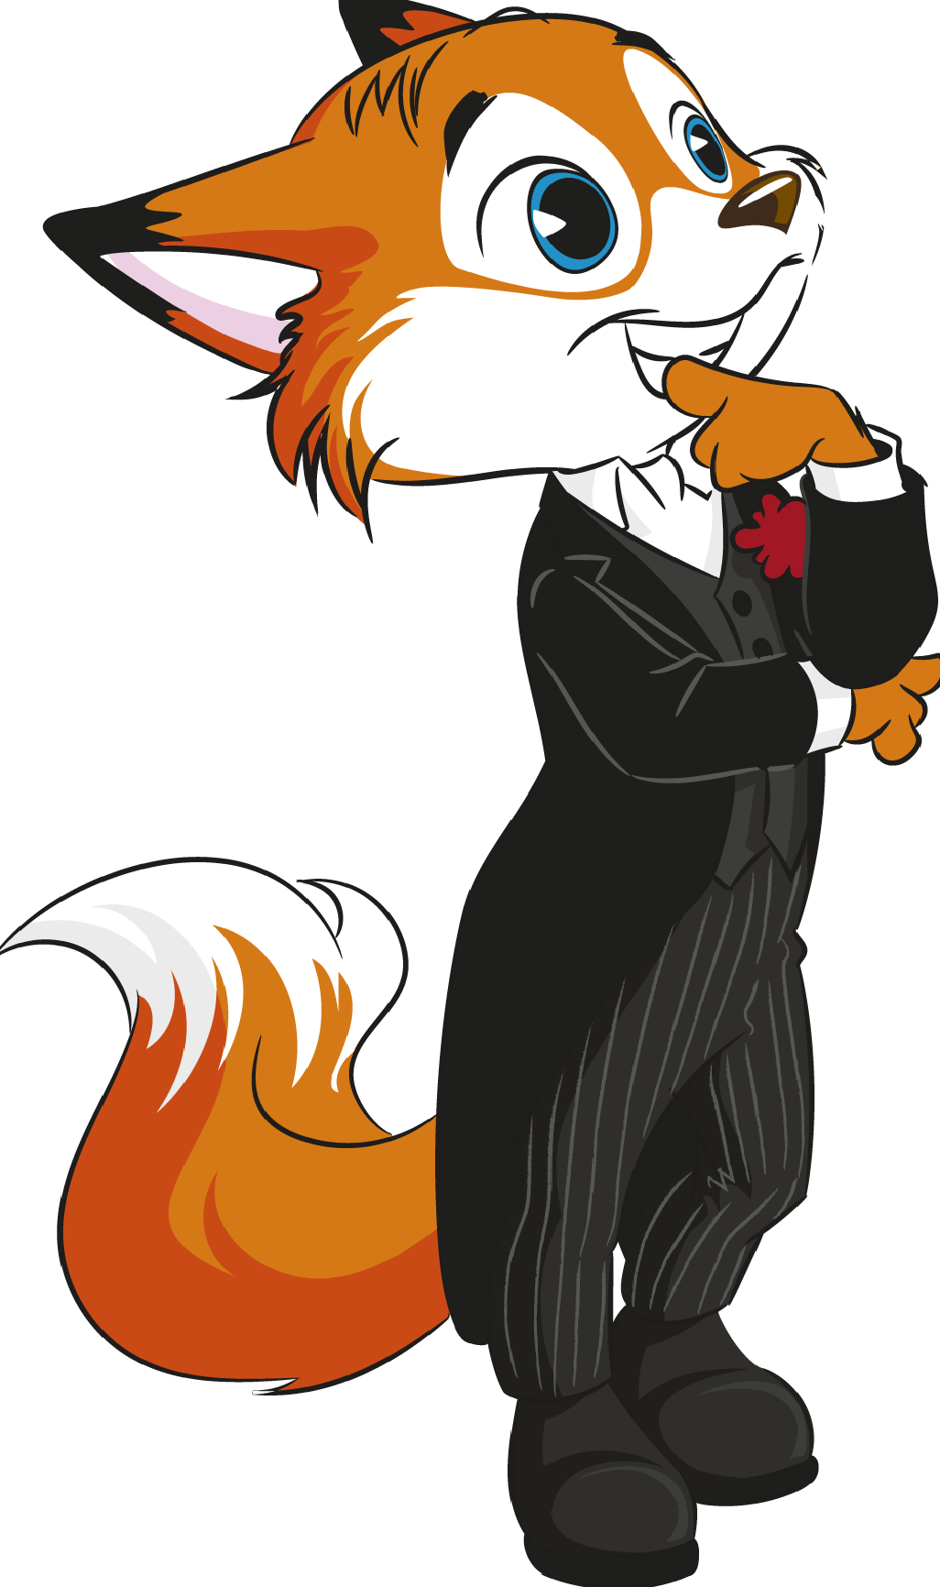
UNIT 2
CORRECTION OF THE TEST

Slide 3

LISTENING
Exercise 1: Listen and match the names to the school clubs.
a. Ken – robotics club
b. Sandy – photography club
c. Thomas – drama club
d. Anna – environmental club
e. Philip – choir

Slide 4
LISTENING
Exercise 2:Listen to the dialogue and Write TRUE (T) or FALSE (F).
a. False (F)
b. True (T)
c. True (T)
d. False (F)
e. True (T)

Slide 5
READING
Exercise 1: Complete the gaps with ONE word.
a. English
b. traditional
c. main
d. history
e. morning
f. basketball

Slide 6
READING
Exercise 2: Answer the questions.
a. Yes, it is.
b. There are around one thousand students at Jack’s school.
c. Jack is in the drama club.
d. He goes to bed at 11:00 p.m. every day.

Slide 7
VOCABULARY AND GRAMMAR
Exercise 1: Complete the gaps with a subject in the boxes below.
a. physical education
b. maths
c. art
d. history
e. IT

Slide 8
VOCABULARY AND GRAMMAR
Exercise 2: Label the places at school.
a. canteen
b. gym
c. art room
d. library
e. music room

Slide 9
VOCABULARY AND GRAMMAR
Exercise 3: Circle the correct answer.
a. are doing
b. Are (you) watching
c. is singing
d. isn’t writing
e. is studying

Slide 10
VOCABULARY AND GRAMMAR
Exercise 4: Complete the gaps with the Present Simple or the Present Continuous.
a. have
b. are eating
c. is not (isn’t) reading
d. go
e. are not (aren’t) playing

Slide 11
VOCABULARY AND GRAMMAR
Exercise 5: Write the correct prepositions at, in, on for each word or expression.
a. on
b. at
c. in
d. in
e. at

Slide 12
VOCABULARY AND GRAMMAR
Exercise 6: Complete the gaps with the comparative form of the adjectives in brackets.
a. nicer
b. more popular
c. busier

Slide 13
VOCABULARY AND GRAMMAR
Exercise 7: Complete the gaps with the superlative form of the adjectives in brackets.
a. the best
b. the easiest

Slide 14
WRITING
Exercise 1: Answer the questions about you.
Personal answers:
a. My favourite subject is…
b. Yes, there is. / No, there isn’t.
c. My favourite school club is…
d. …, … and… are easy for me.
e. Yes, I do. / No, I don’t.

Slide 15
WRITING
Exercise 2: Write about Kate Johnson(25-35 words). Use the information in the box to help you.
My name is Kate Johnson and I am 12 years old. My favourite subjects are history and science. I’m crazy about sports. My top school clubs are the sports club and the chess club. I love my school.

Slide 16


