Slide 1
Novo MSI6
Potências de expoente natural
Resolução de exercícios e problemas (Divisão de potências. Regras operatórias)

Slide 2


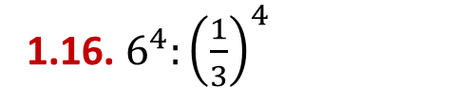





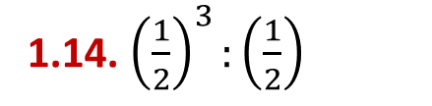
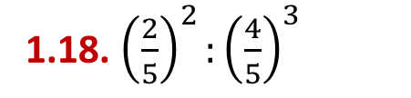





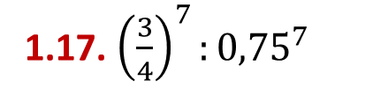



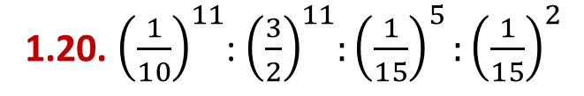
Vou Aplicar
Representa sob a forma de uma potência.
1.1. $9^{8}:9^{4}$
1.2. ${10}^{2}:5^{2}$
1.3. ${12}^{3}:4^{3}$
1.4.${ 5}^{3^{2}}:5^{2}$
1.5. ${\left(6^{2}\right)}^{4}:{\left(6^{4}\right)}^{2}$
1.6. ${35}^{3^{4}}:7^{9^{2}}$
1.7.${ 9}^{8}:9^{3}:9^{2}$
1.8. ${24}^{2}:4^{2}:3^{2}$
1.9. ${28}^{6}:7^{6}:4$
1.10. ${17}^{11}:{17}^{5}:17$
1.11. ${13}^{3^{2}}:{\left({13}^{3}\right)}^{2}$
1.12. ${\left(8^{5}\right)}^{2}:8^{2^{2}}:{\left(4^{3}\right)}^{2}$
1.14. ${\left(\frac{1}{2}\right)}^{3}:\left(\frac{1}{2}\right)$
1.15. $4^{3}:{\left(\frac{1}{4}\right)}^{3}$
1.13. ${\left({21}^{3}\right)}^{4}:21:7^{11}$
1.16. $6^{4}:{\left(\frac{1}{3}\right)}^{4}$
1.17. ${\left(\frac{3}{4}\right)}^{7}:{0,75}^{7}$
1.18. ${\left(\frac{2}{5}\right)}^{2}:{\left(\frac{4}{5}\right)}^{3}$
1.19. ${\left(\frac{2}{3}\right)}^{7}$: ${\left(\frac{5}{7}\right)}^{7}$
1.20. ${\left(\frac{1}{10}\right)}^{11}$:${ \left(\frac{3}{2}\right)}^{11}:{\left(\frac{1}{15}\right)}^{5}:{\left(\frac{1}{15}\right)}^{2}$
Novo MSI6

Slide 3





















Vou Aplicar
Resolução:
1.1. $9^{8}:9^{4}$
1.2. ${10}^{2}:5^{2}$
$$9^{8}:9^{4}=$$
$$9^{4}$$
$${10}^{2}:5^{2}=$$
$$2^{2}$$
1.3. ${12}^{3}:4^{3}$
1.4.${ 5}^{3^{2}}:5^{2}$
$${12}^{3}:4^{3}=$$
$$3^{3}$$
$${ 5}^{3^{2}}:5^{2}=$$
$${ 5}^{9}:5^{2}=$$
$${ 5}^{7}$$
1.5. ${\left(6^{2}\right)}^{4}:{\left(6^{4}\right)}^{2}$
1.6. ${35}^{3^{4}}:7^{9^{2}}$
$${\left(6^{2}\right)}^{4}:{\left(6^{4}\right)}^{2}=$$
$$6^{8}:6^{8}=$$
$$1$$
$${35}^{3^{4}}:7^{9^{2}}=$$
$${35}^{81}:7^{81}=$$
$$5^{81}$$
Novo MSI6

Slide 4

























Vou Aplicar
Resolução:
1.7.${ 9}^{8}:9^{3}:9^{2}$
1.8. ${24}^{2}:4^{2}:3^{2}$
$${ 9}^{8}:9^{3}:9^{2}=$$
$${ 9}^{5}:9^{2}=$$
$$9^{3}$$
$${24}^{2}:4^{2}:3^{2}=$$
$$6^{2}:3^{2}=$$
$$2^{2}$$
1.9. ${28}^{6}:7^{6}:4$
1.10. ${17}^{11}:{17}^{5}:17$
$${28}^{6}:7^{6}:4=$$
$$4^{6}:4=$$
$$4^{5}$$
$${17}^{11}:{17}^{5}:17=$$
$${ 17}^{6}:17=$$
$${ 17}^{5}$$
1.11. ${13}^{3^{2}}:{\left({13}^{3}\right)}^{2}$
1.12. ${\left(8^{5}\right)}^{2}:8^{2^{2}}:{\left(4^{3}\right)}^{2}$
$${13}^{3^{2}}:{\left({13}^{3}\right)}^{2}=$$
$${13}^{9}:{13}^{6}=$$
$${13}^{3}$$
$${\left(8^{5}\right)}^{2}:8^{2^{2}}:{\left(4^{3}\right)}^{2}=$$
$$8^{6}:4^{6}=$$
$$2^{6}$$
$${=8}^{10}:8^{4}:4^{6}=$$
Novo MSI6

Slide 5
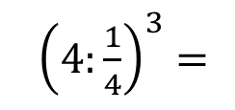

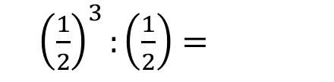

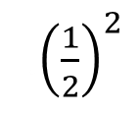
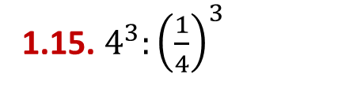
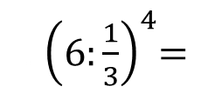




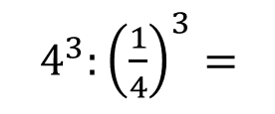


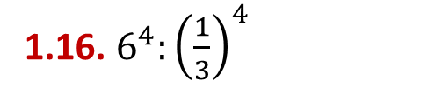

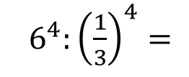

Vou Aplicar
Resolução:
1.14. ${\left(\frac{1}{2}\right)}^{3}:\left(\frac{1}{2}\right)$
1.13. ${\left({21}^{3}\right)}^{4}:21:7^{11}$
$${\left({21}^{3}\right)}^{4}:21:7^{11}=$$
$${ 21}^{12}:21:7^{11}=$$
.${\left(\frac{1}{2}\right)}^{2}$
. ${\left(\frac{1}{2}\right)}^{3}:\left(\frac{1}{2}\right)=$
$${21}^{11}:7^{11}=$$
$$3^{11}$$
1.15. $4^{3}:{\left(\frac{1}{4}\right)}^{3}$
1.16. $6^{4}:{\left(\frac{1}{3}\right)}^{4}$
.$4^{3}:{\left(\frac{1}{4}\right)}^{3}=$
.${\left(4:\frac{1}{4}\right)}^{3}=$
.$6^{4}:{\left(\frac{1}{3}\right)}^{4}=$
.${ \left(6:\frac{1}{3}\right)}^{4}=$
.${\left(4×4\right)}^{3}=$
$${=16}^{3}$$
.${=\left(6×3\right)}^{4}=$
$${ 18}^{4}$$
Novo MSI6

Slide 6
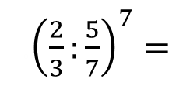
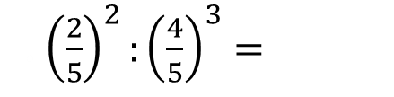

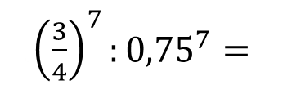


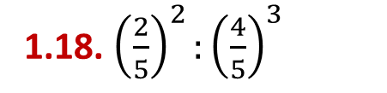
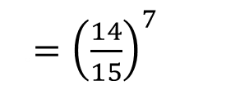

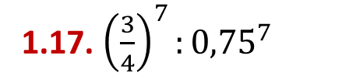
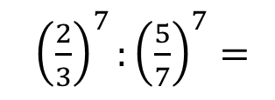
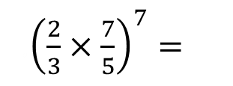
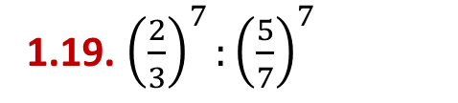
Vou Aplicar
Resolução:
1.17. ${\left(\frac{3}{4}\right)}^{7}:{0,75}^{7}$
1.18. ${\left(\frac{2}{5}\right)}^{2}:{\left(\frac{4}{5}\right)}^{3}$
.${\left(\frac{3}{4}\right)}^{7}:{0,75}^{7}=$
. ${\left(\frac{2}{5}\right)}^{2}:{\left(\frac{4}{5}\right)}^{3}=$
$$1$$
$\frac{4}{25}$ $:\frac{64}{125}=$
1.19. ${\left(\frac{2}{3}\right)}^{7}:{\left(\frac{5}{7}\right)}^{7}$
$\frac{4}{25}×$ $\frac{125}{64}=$
$\frac{5}{16}×$ $=$
.${\left(\frac{2}{3}\right)}^{7}:{\left(\frac{5}{7}\right)}^{7}=$
.${\left(\frac{2}{3}:\frac{5}{7}\right)}^{7}=$
.${\left(\frac{2}{3}×\frac{7}{5}\right)}^{7}=$
.$={\left(\frac{14}{15}\right)}^{7}$
Novo MSI6

Slide 7
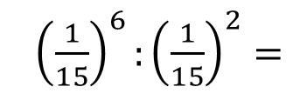
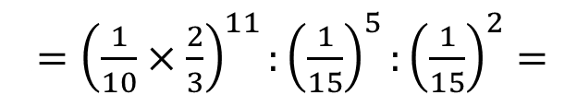
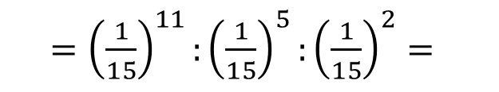
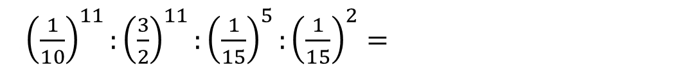
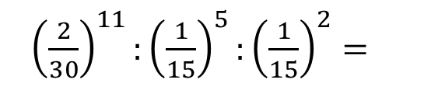
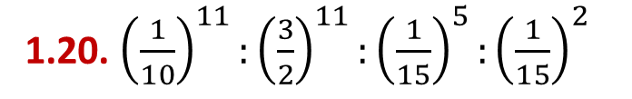
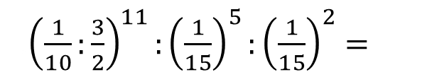

Vou Aplicar
Resolução:
1.20. ${\left(\frac{1}{10}\right)}^{11}:{\left(\frac{3}{2}\right)}^{11}:{\left(\frac{1}{15}\right)}^{5}:{\left(\frac{1}{15}\right)}^{2}$
.${\left(\frac{1}{10}\right)}^{11}:{\left(\frac{3}{2}\right)}^{11}:{\left(\frac{1}{15}\right)}^{5}:{\left(\frac{1}{15}\right)}^{2}=$
.${\left(\frac{1}{10}:\frac{3}{2}\right)}^{11}:{\left(\frac{1}{15}\right)}^{5}:{\left(\frac{1}{15}\right)}^{2}=$
.$={\left(\frac{1}{10}×\frac{2}{3}\right)}^{11}:{\left(\frac{1}{15}\right)}^{5}:{\left(\frac{1}{15}\right)}^{2}=$
.${\left(\frac{2}{30}\right)}^{11}:{\left(\frac{1}{15}\right)}^{5}:{\left(\frac{1}{15}\right)}^{2}=$
.=$={\left(\frac{1}{15}\right)}^{11}:{\left(\frac{1}{15}\right)}^{5}:{\left(\frac{1}{15}\right)}^{2}=$
.${\left(\frac{1}{15}\right)}^{6}:{\left(\frac{1}{15}\right)}^{2}=$
.${\left(\frac{1}{15}\right)}^{4}$
Novo MSI6

Slide 8
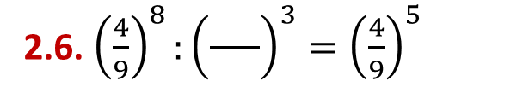


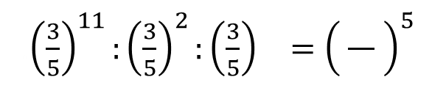




Vou Aplicar
Completa, em cada umas das expressões, os espaços em branco.
2
2.1. $9^{7}:9^{ }=9^{5}$
2.2. ${12}^{7}:{}^{ 7}=3^{7}$
4
2
14
2.3.${ 26}^{3}:{ }^{3}={13}^{3}$
2.4. ${14}^{11}:{ }^{6}={14}^{5}$
4
10
2.6. ${\left(\frac{4}{9}\right)}^{8}:{\left(\frac{ }{}\right)}^{3}={\left(\frac{4}{9}\right)}^{5}$
2.5.${ 25}^{} :{25}^{3}:{25}^{2}={25}^{5}$
9
4
.${\left(\frac{3}{5}\right)}^{11}:{\left(\frac{3}{5}\right)}^{2}:{\left(\frac{3}{5}\right)}^{}={\left( \frac{ }{ } \right)}^{5}$
2.7. ${15}^{3}:{\left(\frac{3}{4}\right)}^{3}={ }^{3}$
3
20
2.8.
5
Novo MSI6

Slide 9
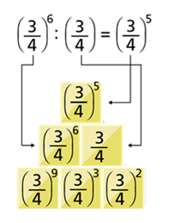
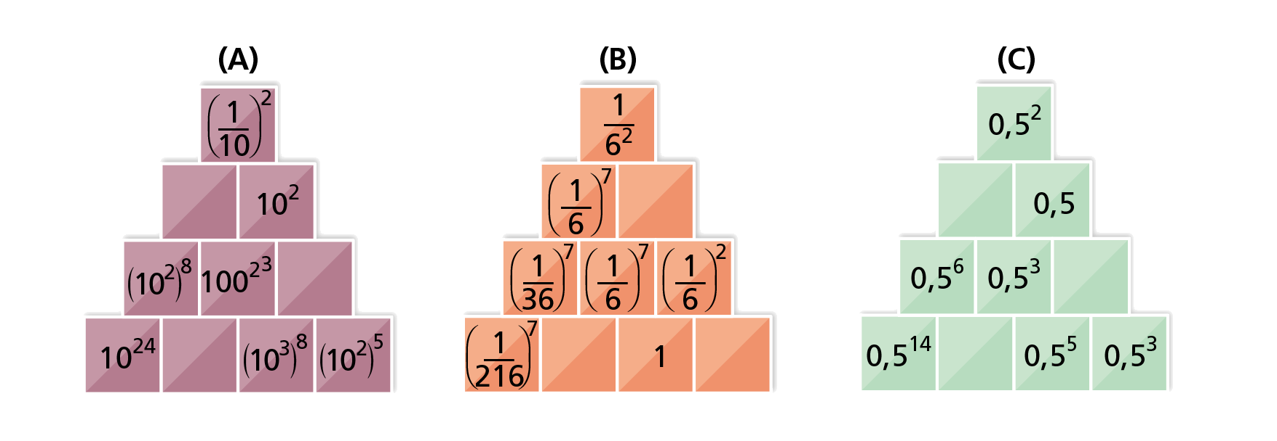
Vou Aplicar
Copia e completa de acordo com o exemplo.
Novo MSI6

Slide 10
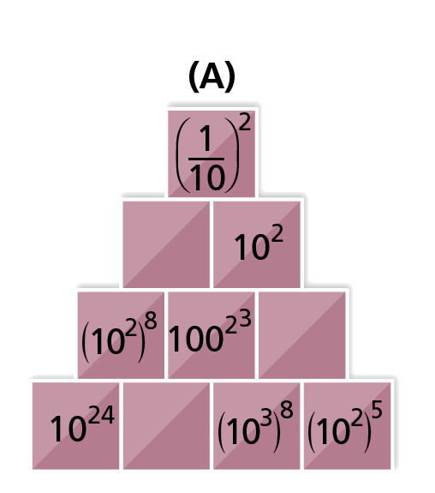
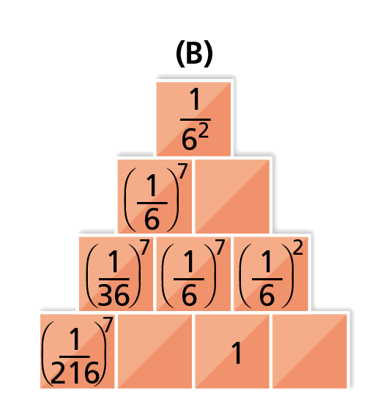

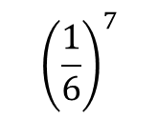



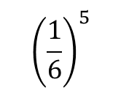
Vou Aplicar
Resolução:
$$1$$
$${\left(\frac{1}{6}\right)}^{5}$$
$${10}^{14}$$
$${\left(\frac{1}{6}\right)}^{7}$$
$${10}^{8}$$
$$6^{2}$$
Novo MSI6

Slide 11
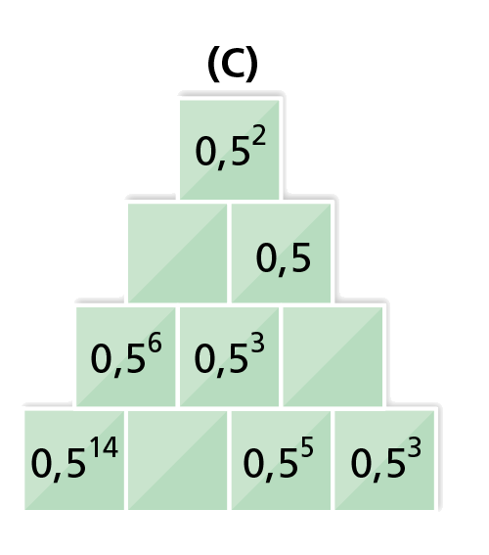



Vou Aplicar
Resolução:
$${0,5}^{4}$$
$${0,5}^{2}$$
$${0,5}^{8}$$
Novo MSI6

Slide 12

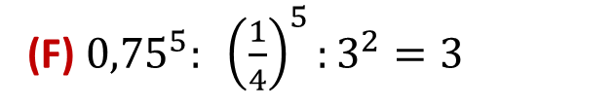

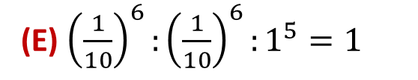


Vou Aplicar
Indica as afirmações falsas e corrige-as.
(A) ${\left(7^{4}\right)}^{5}:{\left(7^{5}\right)}^{4}=1$
(B) ${15}^{5}:15={15}^{2}$
(C)${ 12}^{3^{3}}:4^{27}:3={\left(3^{13}\right)}^{2}$
(D) $5^{2^{3}}:5=5^{5}$
(E) ${\left(\frac{1}{10}\right)}^{6}:{\left(\frac{1}{10}\right)}^{6}:1^{5}=1$
(F) ${0,75}^{5}: {\left(\frac{1}{4}\right)}^{5}:3^{2}=3$
Novo MSI6

Slide 13

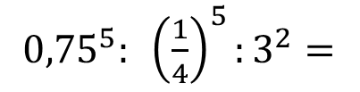


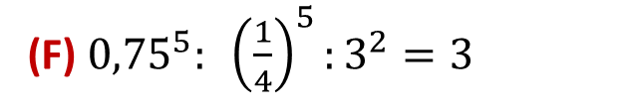








Vou Aplicar
Resolução:
V
F
(A) ${\left(7^{4}\right)}^{5}:{\left(7^{5}\right)}^{4}=1$
(B) ${15}^{5}:15={15}^{2}$
V
(C)${ 12}^{3^{3}}:4^{27}:3={\left(3^{13}\right)}^{2}$
${15}^{5}:15={15}^{4}$
(D) $5^{2^{3}}:5=5^{5}$
F
(E) ${\left(\frac{1}{10}\right)}^{6}:{\left(\frac{1}{10}\right)}^{6}:1^{5}=1$
V
$$5^{2^{3}}:5=$$
$$5^{8}:5=$$
$$5^{7}$$
(F) ${0,75}^{5}: {\left(\frac{1}{4}\right)}^{5}:3^{2}=3$
F
${0,75}^{5}: {\left(\frac{1}{4}\right)}^{5}:3^{2}=$
$$3^{5}:3^{2}=$$
$$3^{3}$$
Novo MSI6

Slide 14




Vou Aplicar
Representa sob a forma de potências de base 10.
5.1. ${\left({10}^{2}\right)}^{6}×{{10}^{3}×10}^{ }$
5.2. $2×5×2×5×100×\frac{1}{10}$
5.3.${\left({10}^{5}\right)}^{3}:{10}^{2^{2}}:{\left({10}^{3}\right)}^{2}$
5.4. $100×\frac{1}{{10}^{2}}×{10}^{4}$
Novo MSI6

Slide 15
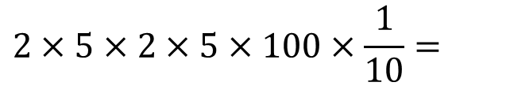





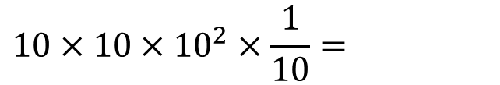


Vou Aplicar
Resolução:
5.1. ${\left({10}^{2}\right)}^{6}×{{10}^{3}×10}^{ }$
${\left({10}^{2}\right)}^{6}×{{10}^{3}×10=}^{ }$
$${10}^{12}×{{10}^{3}×10=}^{ }$$
$${10}^{15}×{10=}^{ }$$
$${=10}^{16}$$
5.2. $2×5×2×5×100×\frac{1}{10}$
$$2×5×2×5×100×\frac{1}{10}=$$
$$10×10×{10}^{2}×\frac{1}{10}=$$
$${=10}^{3}$$
Novo MSI6

Slide 16
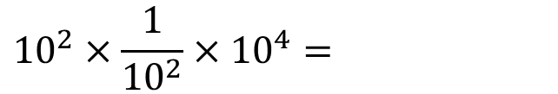



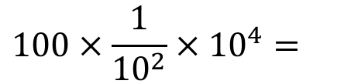




Vou Aplicar
Resolução:
5.3.${\left({10}^{5}\right)}^{3}:{10}^{2^{2}}:{\left({10}^{3}\right)}^{2}$
$${\left({10}^{5}\right)}^{3}:{10}^{2^{2}}:{\left({10}^{3}\right)}^{2}=$$
$${10}^{15}:{{10}^{4}:{10}^{6}=}^{ }$$
$${10}^{11}:{10}^{6}=$$
$$={10}^{5}$$
5.4. $100×\frac{1}{{10}^{2}}×{10}^{4}$
$$100×\frac{1}{{10}^{2}}×{10}^{4}=$$
$${10}^{2}×\frac{1}{{10}^{2}}×{10}^{4}=$$
$${=10}^{4}$$
Novo MSI6

