Slide 1

Appearance adjectives

Slide 2
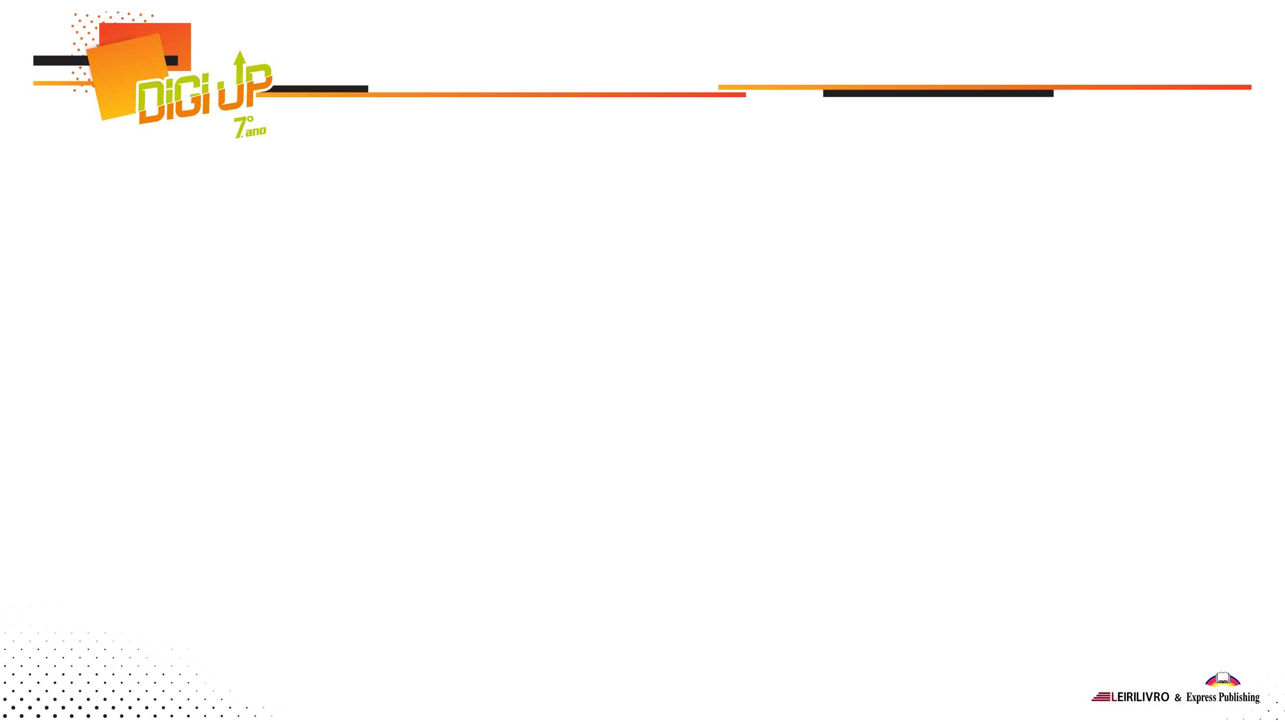

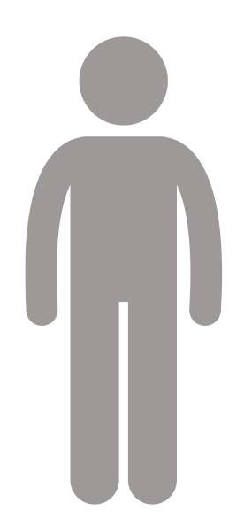
Appearance adjectives
Height
(altura)
≠
short
tall
baixo(a)
alto(a)

Slide 3
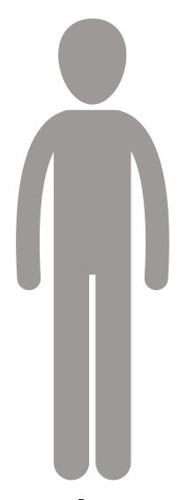
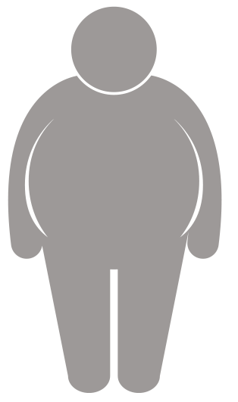
Appearance adjectives
Weight
(peso)
≠
thin
fat
magro(a)
gordo(a)

Slide 4
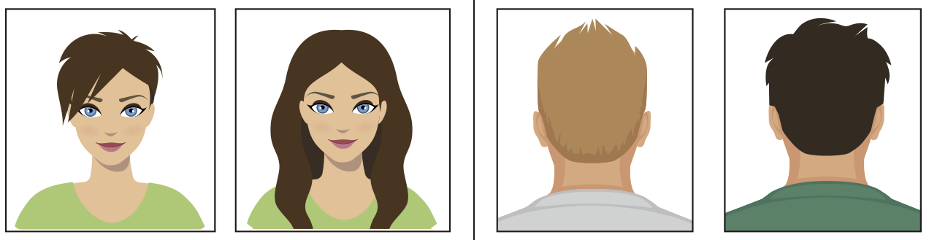
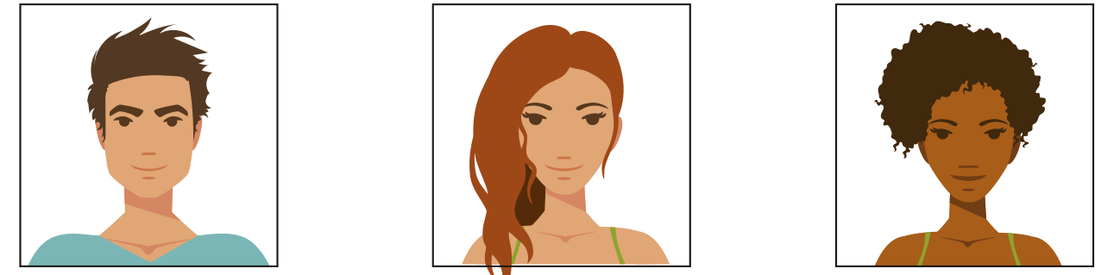
Appearance adjectives
Hair
(cabelo)
≠
≠
short
long
fair
dark
curto
comprido
claro
escuro
straight
wavy
curly
liso
ondulado
encaracolado

Slide 5
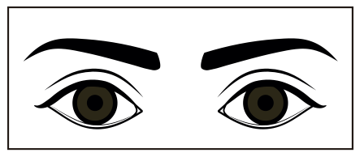
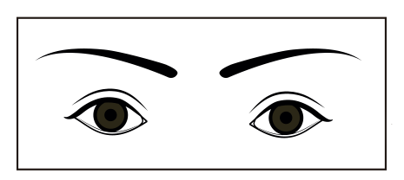
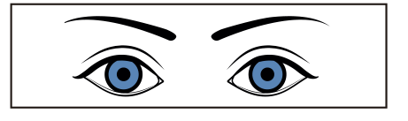
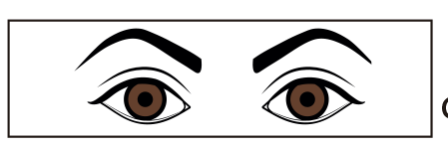
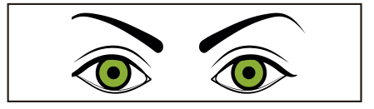
Appearance adjectives
Eyes
(olhos)
big
small
grandes
pequenos
blue
brown
green
azuis
castanhos
verdes

Slide 6
Appearance adjectives

