Slide 1
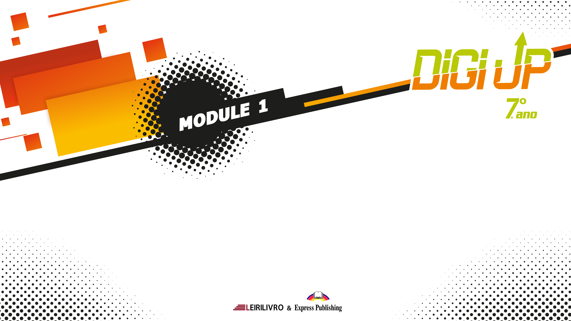
Present Simple
vs
Present Continuous

Slide 2

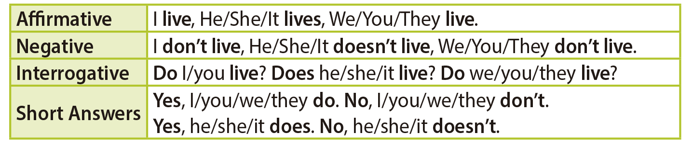
Present Simple vs Present Continuous
We use the present simple for:
• permanent states or situations.
My dad works at a hospital.
• daily routines, habits and repeated actions (especially with adverbs of frequency such as always, usually, etc).
I always have breakfast at 8 am.
• general truths and laws of nature.
The Moon moves around the Earth.

Slide 3
Present Simple vs Present Continuous
Spelling Rules
• Most verbs take -s in the third person singular.
I speak – he speaks, I eat – he eats
• Verbs ending in -ss, -sh, -ch, -x or -o take -es.
I pass – he passes,
I wash – he washes, I teach – he teaches, I fix – he fixes, I do – he does
• Verbs ending in a consonant + y drop the -y and take -ies.
I fly – he flies
• Verbs ending in a vowel + y take -s only.
I buy – he buys
Time words/phrases used with the present simple: every hour/day/week/month/summer/year, etc, usually, always, every morning/afternoon/evening/night, in the morning/afternoon/evening, at noon, at night, etc.

Slide 4
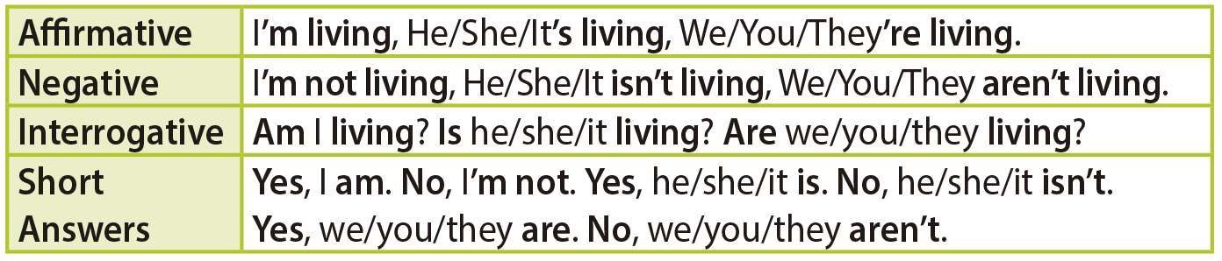
Present Simple vs Present Continuous
We use the present continuous for:
temporary actions, happening around the time of speaking.
My mum’s working in the USA until the end of the year.
actions happening now, at the moment of speaking.
I’m having breakfast at the moment.

Slide 5
Present Simple vs Present Continuous
Spelling
Most verbs take -ing after the base form of the main verb.
tell – telling, catch – catching, stay – staying
Verbs ending in -e drop the -e and take -ing.
write – writing, leave – leaving
Verbs ending in a vowel + a consonant double the consonant and take -ing.
get – getting, stop – stopping
Verbs ending in -ie change the -ie to -y and take -ing.
lie – lying
Verbs ending in -l, double the -l and take -ing.
travel – travelling
Time words/phrases used with the present continuous: now, at the moment, at present, these days, today, etc.

Slide 6
Present Simple
vs
Present Continuous

