Slide 1

Stative Verbs

Slide 2

Stative Verbs
Stative verbs describe a state rather than an action, and do not normally have continuous tenses.
I love my family.
(NOT: I’m loving my family.)
I believe you’re right.
(NOT: I’m believing you’re right.)

Slide 3
Stative Verbs
These verbs include:
verbs of perception: hear, see, smell, taste, feel, look, sound, etc.
You seem tired.
verbs which express thoughts & opinions: understand, believe, think (= believe), imagine, know, mean, suppose, forget, remember, etc.
I don’t know what you are talking about.
verbs which express feelings and emotions: like, dislike, love, hate, prefer, enjoy, etc.
Kim loves Geography.
some other verbs: have (= possess), belong to, own, consist, want, need, etc.
This schoolbag belongs to Claire.

Slide 4
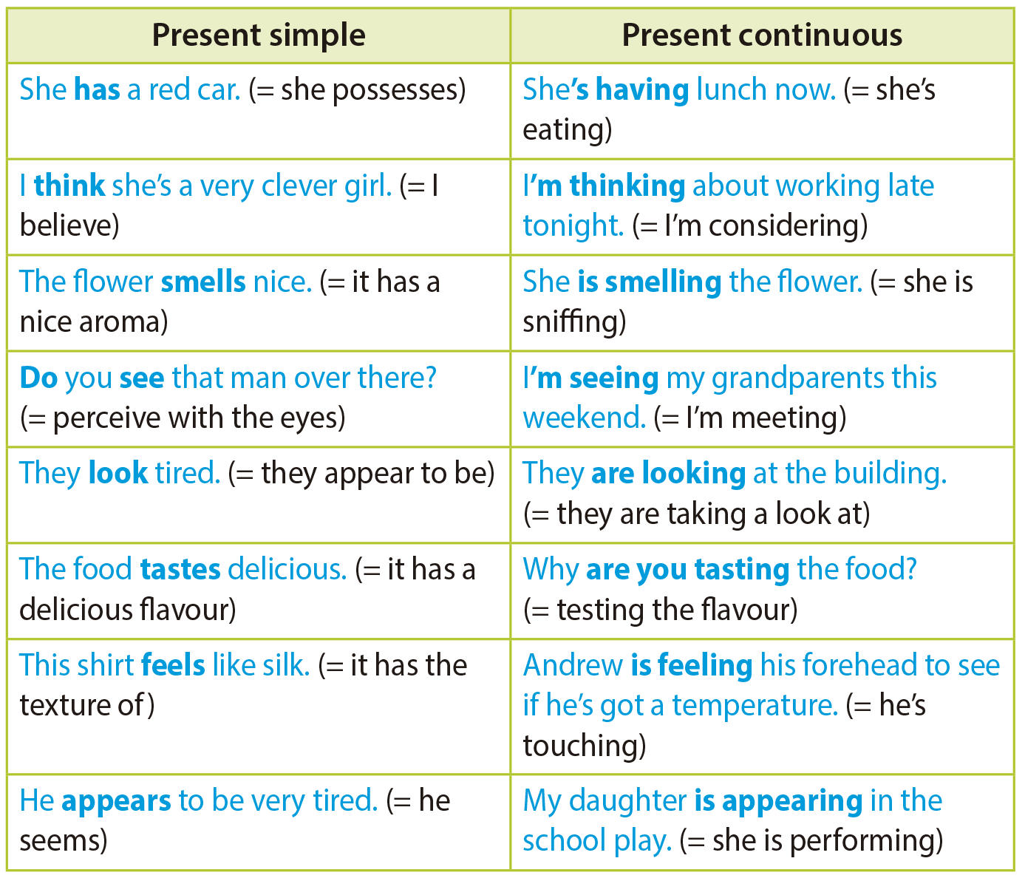
Stative Verbs
We can use some stative verbs in continuous tenses when they describe actions and not states, but there is a difference in meaning. Study the examples:

Slide 5
Stative Verbs

