Slide 1

Daily routines – Chores –
Free-time activities

Slide 2


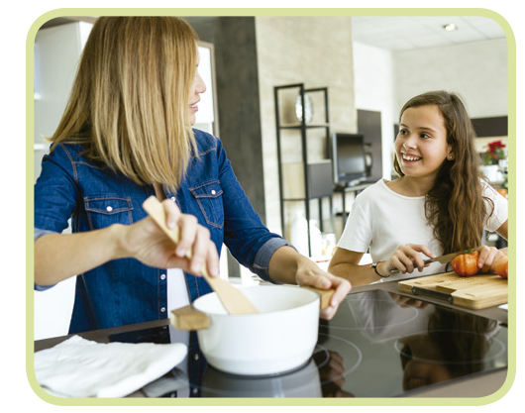
Daily routines – Chores – Free-time activities
Cook dinner
do homework

Slide 3
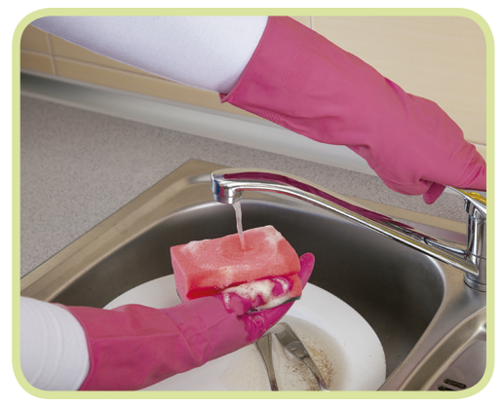

Daily routines – Chores – Free-time activities
do the washing-up
get up

Slide 4
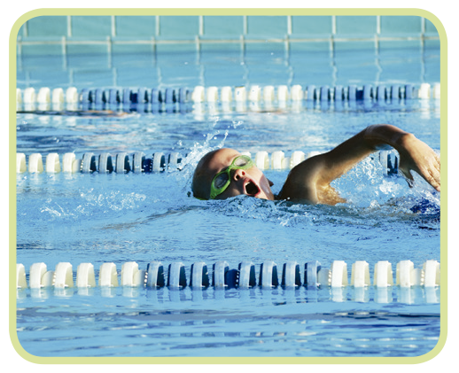
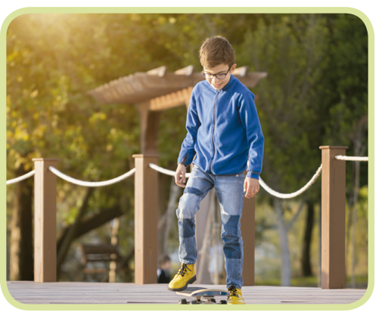
Daily routines – Chores – Free-time activities
go skateboarding
go swimming

Slide 5
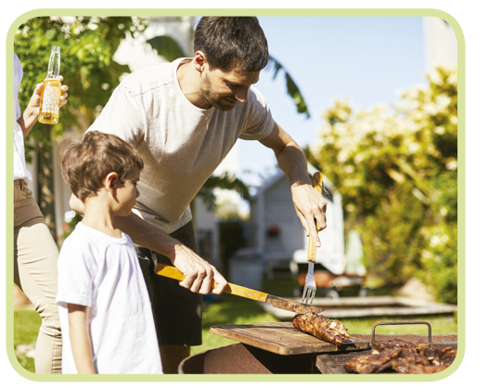

Daily routines – Chores – Free-time activities
go to bed
have a barbecue

Slide 6
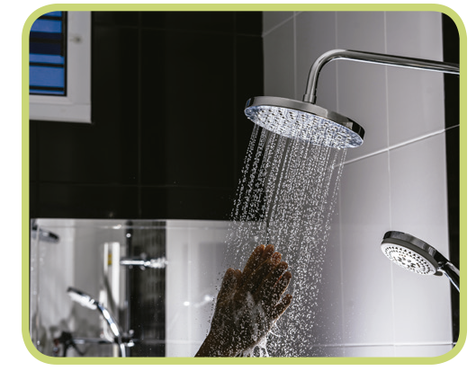

Daily routines – Chores – Free-time activities
have a shower
have lunch

Slide 7
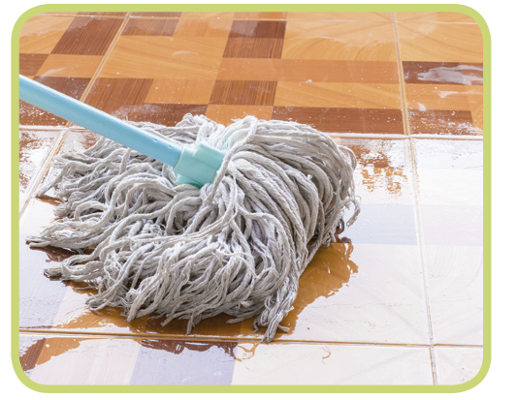
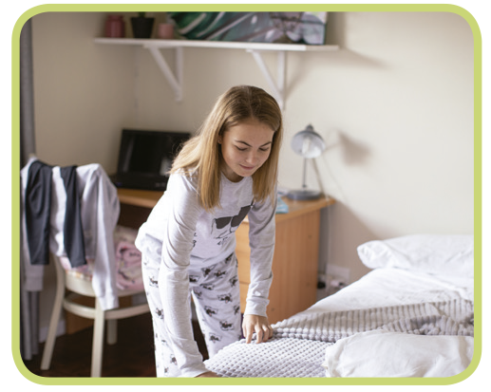
Daily routines – Chores – Free-time activities
make my bed
mop the floor

Slide 8
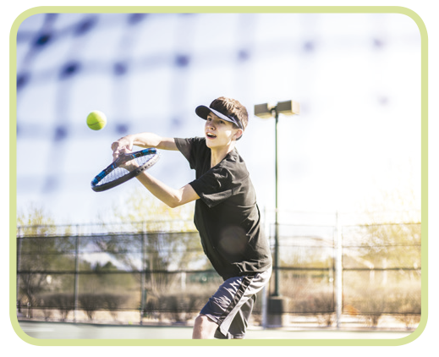
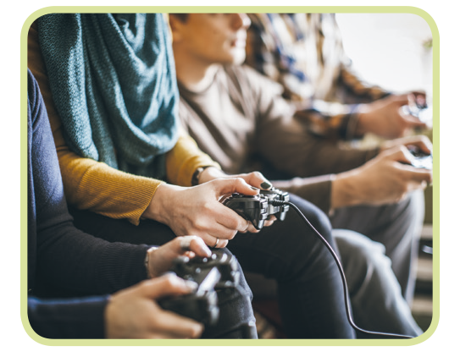
Daily routines – Chores – Free-time activities
play online games
play tennis

Slide 9
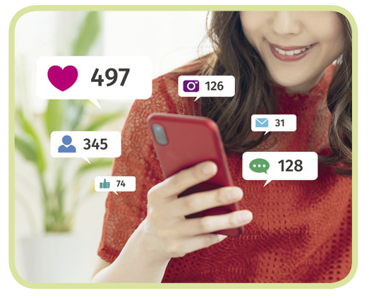
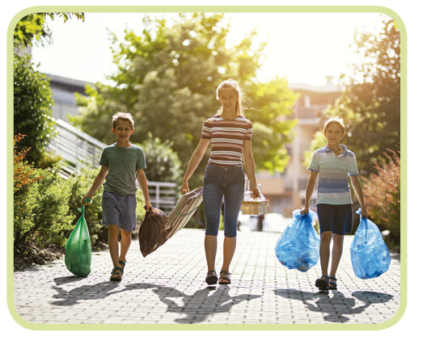
Daily routines – Chores – Free-time activities
post comments on social media
take out the rubbish

Slide 10
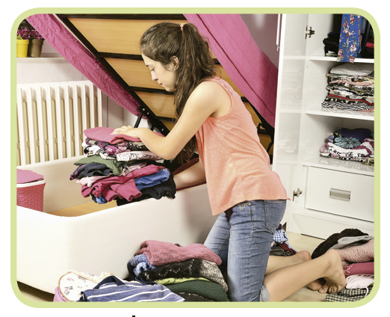
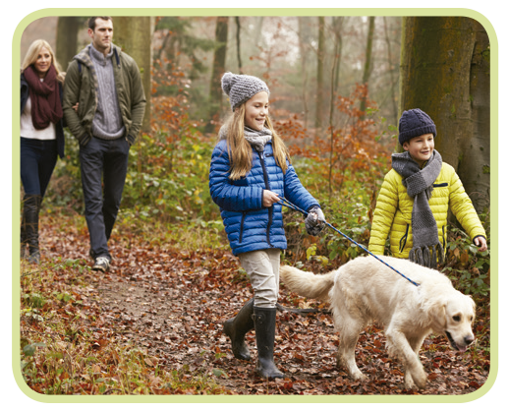
Daily routines – Chores – Free-time activities
tidy my room
walk the dog

Slide 11
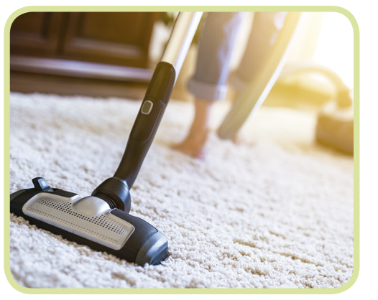

Daily routines – Chores – Free-time activities
watch (online) videos/shows/films
vacuum the carpet

Slide 12
Daily routines – Chores –
Free-time activities

