Slide 1

Family Members

Slide 2

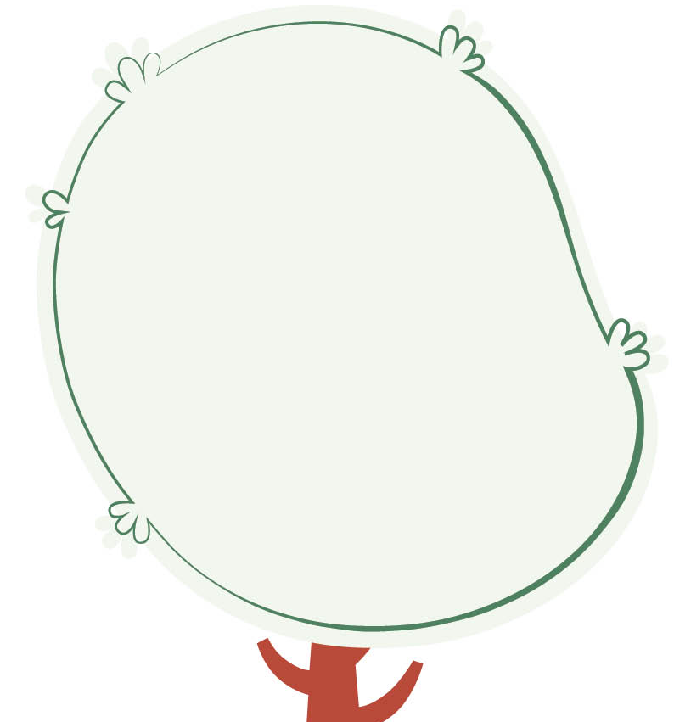
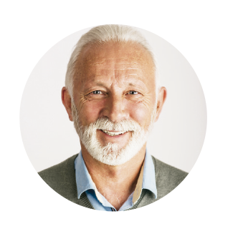
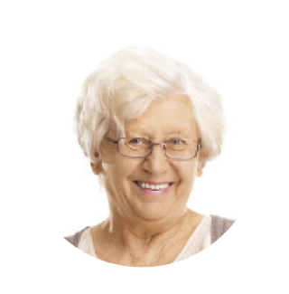

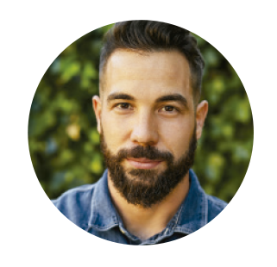



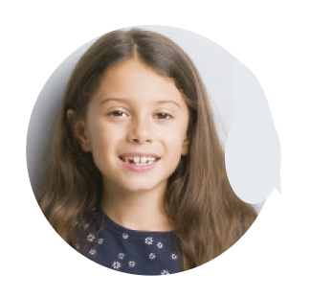
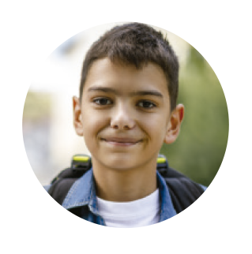
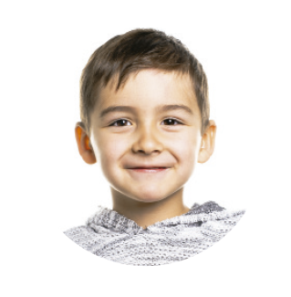
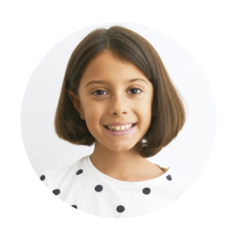
Family members
GRANDPARENTS
GRANDDAD
GRANDMA
SON
DAUGHTER
PARENTS
Wife-husband
MUM
DAD
AUNT
UNCLE
SISTER
ME
BROTHER
COUSIN
COUSIN

Slide 3
Family Members

