Slide 1

If clauses: types 0 and 1
7

Slide 2

It’s the title of a song.
Do you know who sings it?

Slide 3

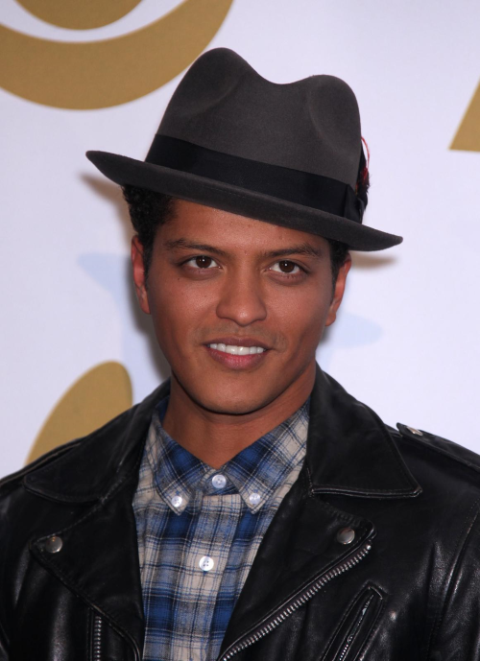
Listen to the song and fill in the gaps.

Slide 4
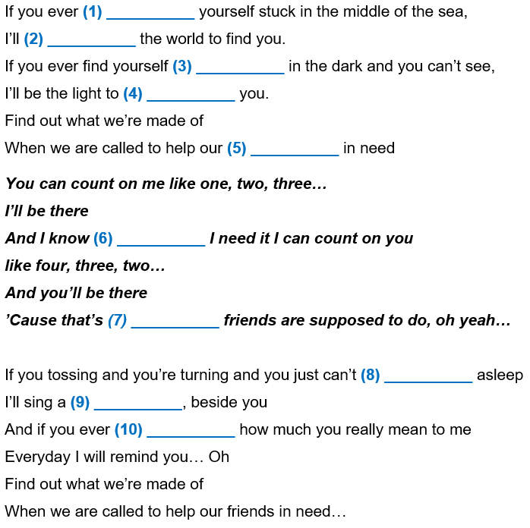
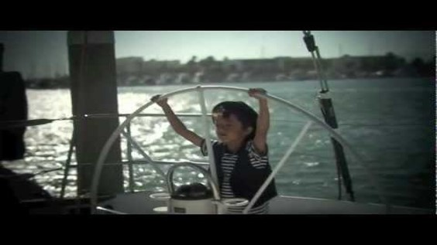
find
sail
lost
guide
friends
when
what
fall
song
forget

Slide 5
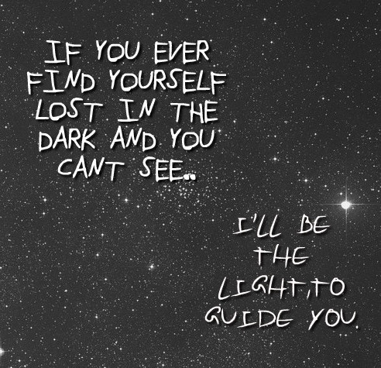
Notes:
Explore meaning of this part

Slide 6
It’s a CONDITION.
If you ever find yourself lost in the dark and you can’t see, I’ll be the light to guide you.
What kind of sentence is this?

Slide 7
If clauses
The sentence has two parts:
If you ever find yourself lost in the dark and you can’t see, I’ll be the light to guide you.
the condition
the result
The comma (,) separates the two parts of the sentence.

Slide 8
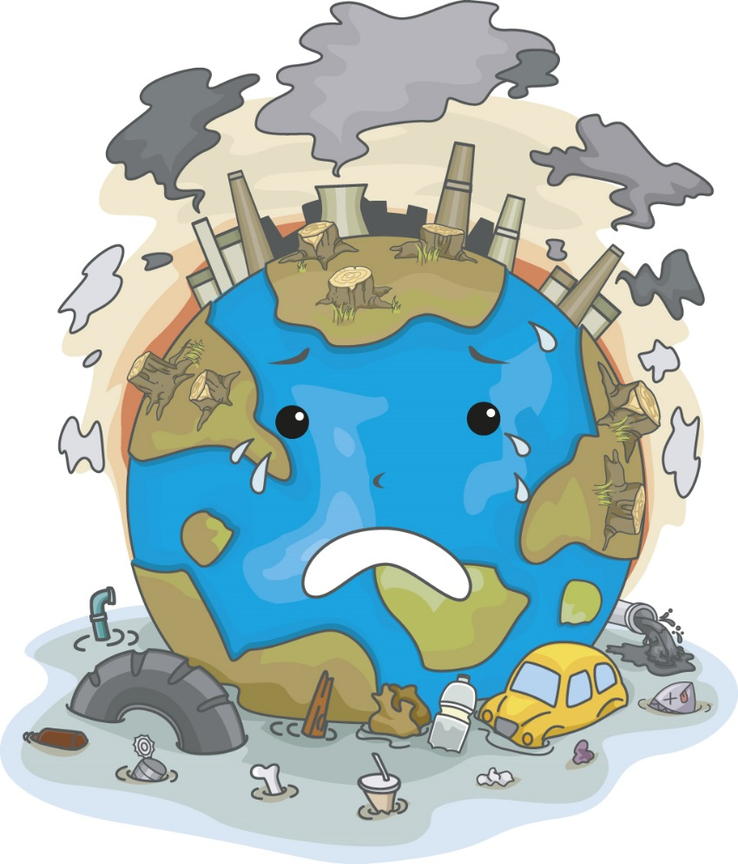
If clause – type 1
This is possible. It’s likely to happen.
If we pollute the planet,
we will all die.

Slide 9
If clause – type 1
If we pollute the planet ,
we will all die.
If
+
Present Simple
,
Future
(will + infinitive without ‘to’)

Slide 10
If clause – type 1
If we pollute the planet,
we will all die.

Slide 11
If clause – type 1
Note: let’s change the order of the clauses.
If we pollute the planet ,
will all die
we pollute the planet
we will all die.
We
if
.
NO comma (,) is necessary.
The IF separates both clauses.

Slide 12
you eat a lot of junk food,
If clause – type 1
If
you will be sick.
If you eat a lot of fruit, you’ll be healthy.
You will be healthy if you eat a lot of fruit.
If + Present Simple, + Future (will / won’t + bare infinitive)
Future (will / won’t + bare infinitive) + if + Present Simple

Slide 13

If clauses
There are different types of clauses.

Slide 14
If clause: type 1
- For real/probable present or future situations
If we pollute the planet, it will die.
If we don’t save water, we won’t have enough in the future.
if
+
Present Simple
Future Simple
(will / won’t + bare infinitive)

Slide 15
If clause: type 0
- For general truths (things which are always true)
If the sun shines, the snow melts.
If we mix blue and yellow, we get green.
if
+
Present Simple
Present Simple

Slide 16

Type 0
OR
Type 1?

Slide 17
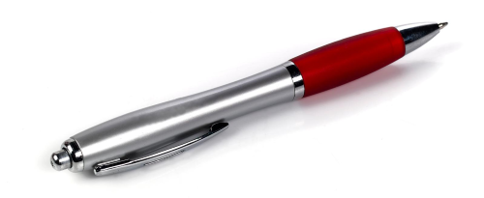
Decide if the clauses are type 0 or type 1.
1. If we all recycle, we’ll make a difference.
2. If you don’t help, you will regret it.
3. If the temperatures is below 0 ºC, water freezes.
4. If we protect endangered species, they will survive.
5. Plants die if they don’t get enough water.
6. If you donate your used clothes, you’ll feel good.
T1
T1
T0
T1
T0
T1

Slide 18
Complete the sentences with type 0.
1. If you ________ (freeze) water, it ________ (become) solid.
2. Plants ________ (die) if they ________ (not / get) enough water.
3. If my sister ________ (have) a cold, I usually ________ (catch) it.
4. If it ________ (rain), I usually ________ (stay) at home.
5. If you ________ (mix) yellow and blue, you ________ (get) green.
freeze
becomes
die
don’t get
has
catch
rains
stay
mix
get

Slide 19
Complete the sentences with type 1.
1. If we __________ (dump) all sorts of chemicals into rivers, we __________ (not / be) able to swim in them in the future.
2. If we __________ (not / stop) cutting down so many trees, we ___________ (endanger) our oxygen supply.
3. If the global temperature rises, sea levels ___________ (rise) too.
4. People ___________ (run out) of drinking water one day if they ___________ (not / use) it more rationally.
dump
won’t be
don’t stop
will endanger
will rise
will run out
don’t use

Slide 20
Complete the sentences with type 1.
5. If it __________ (be) sunny, I __________ (go) to the beach.
6. If you ___________ (not / phone) him, he __________ (not / come) to the party.
7. If you __________ (eat) too much, you __________ (be) overweight.
8. If we __________ (not / finish) our homework, our teacher __________ (be) angry.
is
will go
don’t phone
won’t come
eat
will be
don’t finish
will be

Slide 21
EXTRA PRACTICE: type 1.
If + Present Simple, + Future (will / won’t + bare infinitive)
If you __________ (study) hard, you __________ (pass) the exam.
If we __________ (not / protect) the elephant, it ___________ (become) extinct.
If it __________ (rain), we __________ (not / go) to the beach.
If I __________ (miss) the bus, I __________ (be) late for school.
If you __________ (not / go) to the dentist, the pain __________ (get) worse.
If the weather __________ (get) better, we __________ (go) swimming.
If he _________ (eat) too much, he __________ (have) a stomach ache.
study
will pass
don’t protect
will become
rains
won’t go
miss
will be
don’t go
will get
gets
will go
eats
will have

Slide 22

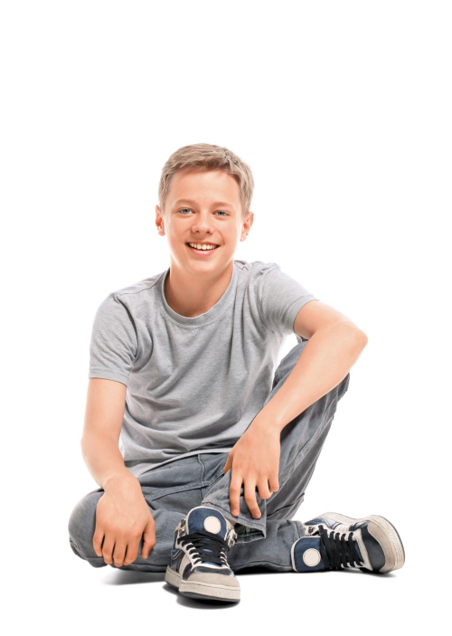
Look!
If not
=
Unless
If we don’t ask her, she won’t help us.
Unless we ask her, she won’t help us.

Slide 23
Let’s PRACTISE
Rewrite with
UNLESS

Slide 24
Rewrite the following sentences.
1. If you don’t save some money, you can’t buy a phone.
Unless _______________________________________
you save some money, you can’t buy a phone.
2. If you don’t wear a jacket, you will feel cold.
Unless ______________________________________
you wear a jacket, you will feel cold.

Slide 25
Rewrite the following sentences.
3. If there isn’t traffic, I’ll arrive at nine.
Unless _______________________________________
there is traffic, I’ll arrive at nine.
4. If you can’t speak English, it’s hard to find a job.
Unless ______________________________________
you speak English, it’s hard to find a job.

Slide 26

Chain – IF
Stand up in U (facing each other)
Make an if clause type 1 sentence
Other student starts with the other’s end
EXAMPLE
“If I’m sick, I’ll stay at home.”
“If I stay at home, I’ll study.”
“If I study, I’ll...”
Cláudia Regina Abreu Cidália Sousa

Slide 27

Chain – IF
“If it rains, …”
Cláudia Regina Abreu Cidália Sousa

