Slide 1

Bullying hurts

Slide 2
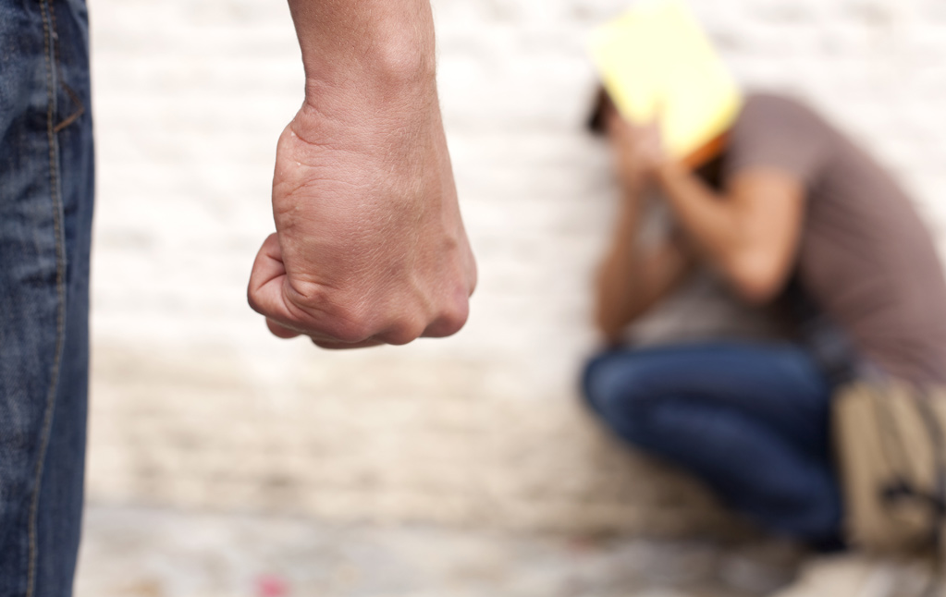
What is bullying?
Hitting, kicking, or pushing someone
Stealing, hiding, or ruining someone's things
Making someone do things he or she doesn't want to do

Slide 3

What is bullying?
Name-calling
Refusing to talk to someone
Excluding someone from groups or activities
Spreading lies or ‘rumours’ about someone

Slide 4
Bullying hurts
To be popular
Why do kids bully?
To escape their own problems
To feel powerful
Because they’re jealous of someone

Slide 5
If you are being bullied, remember:
Don’t blame yourself. It is not your fault. No matter what someone says or does, you should not be ashamed of who
you are or what you feel.
Avoid isolation. Make friends who will support you.
Stay calm and confident. Don't show the bully that you're sad, frightened or angry.
Ignore the bully and walk away. Fighting back can make bullying worse. But make sure he or she can’t attack you from behind.
Do not respond to cyber-bullying messages on phone or computer. If you don’t respond, the bully will get bored and stop.
Get help. Talk to your parents, a teacher, or other trusted adult.

Slide 6
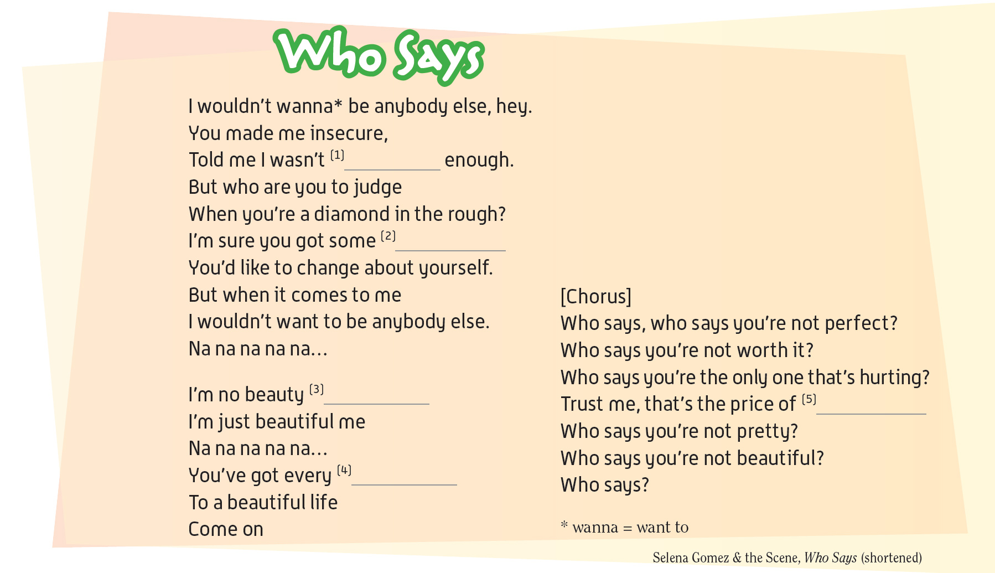


good
things
queen
beauty
right

Slide 7

Be cool
in Your school

