Slide 1


Countries
and
nationalities

Slide 2

?
Where are they from

Slide 3
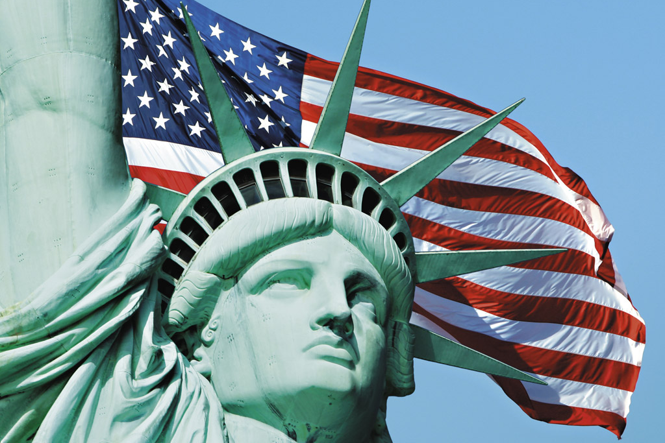
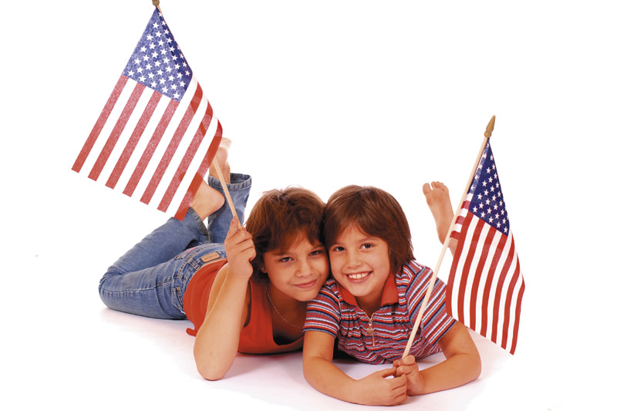
They are from...
They are...
The United States of America
American

Slide 4


They are from...
They are...
Canada
Canadian

Slide 5
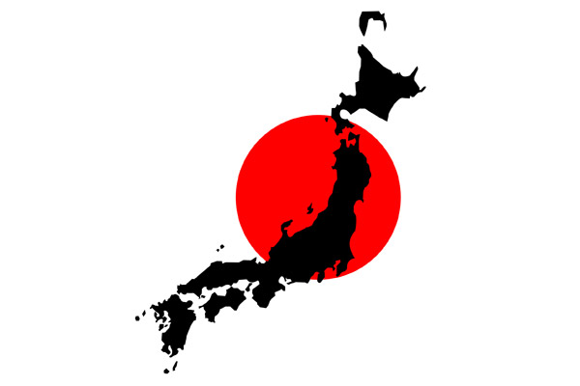

She is from...
She is...
Japan
Japanese

Slide 6


He is from...
He is...
Germany
German

Slide 7
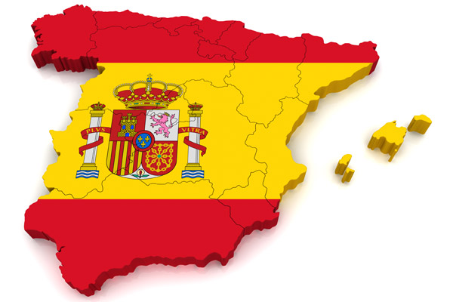
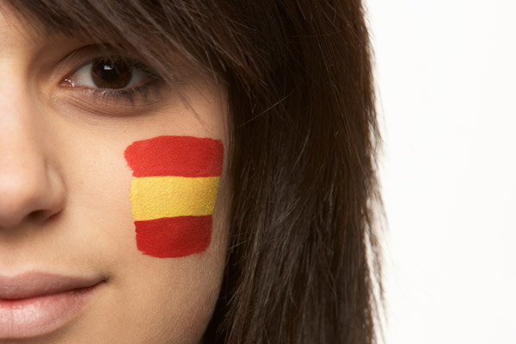
She is from...
She is...
Spain
Spanish

Slide 8

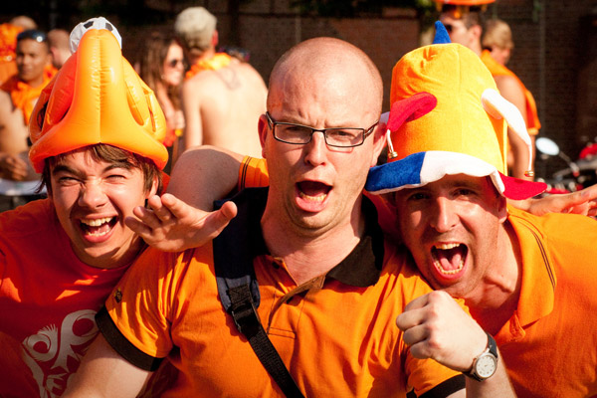
They are from...
They are...
The Netherlands
Dutch

Slide 9

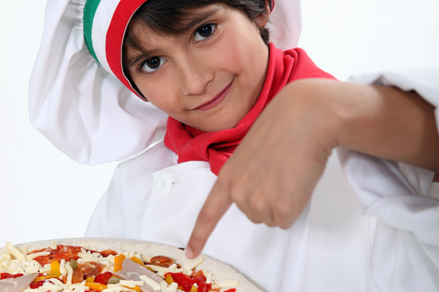
He is from...
He is...
Italy
Italian

Slide 10
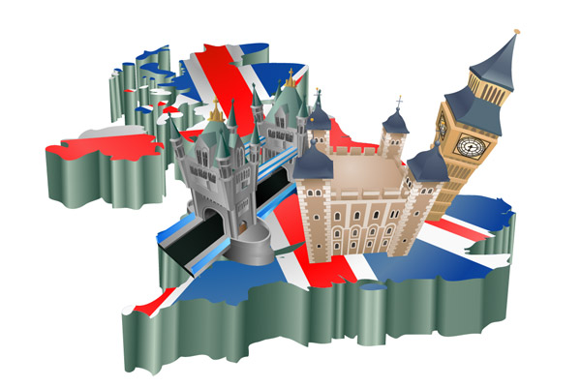

She is from...
She is...
The United Kingdom
British

Slide 11


He is from...
He is...
Greece
Greek

Slide 12


She is from...
She is...
France
French

Slide 13
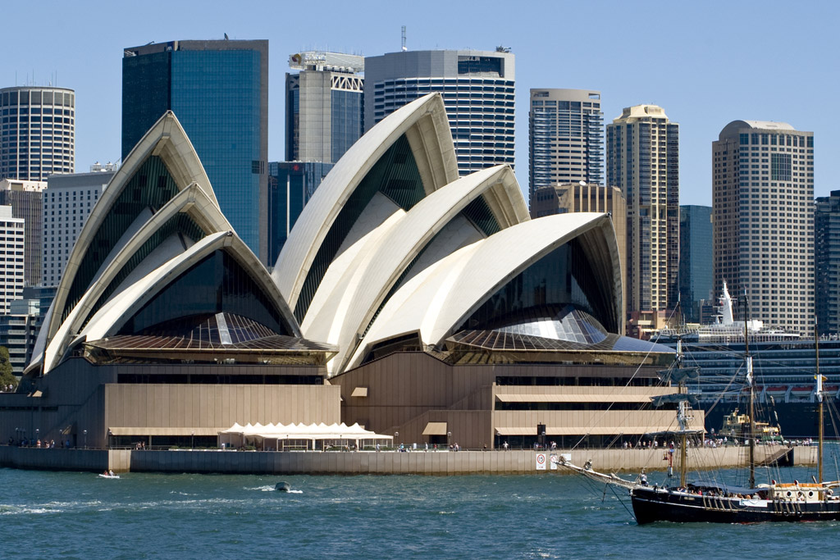
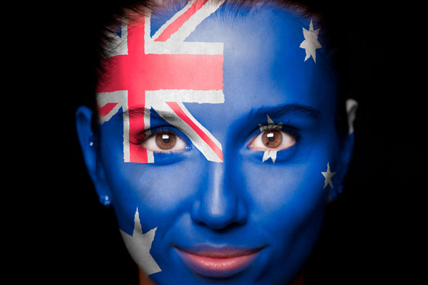
She is from...
She is...
Australia
Australian

