Slide 1



The future: Will

Slide 2
We use the future with ‘will’
for on-the-spot decisions;
to make a prediction based on what we think will happen;
to promise something.

Slide 3
Form:
will
+
infinitive

Slide 4
Affirmative
I | will | play dance study
He, she, it
We, you, they

Slide 5

I _______ (have) a cup of coffee.
will have

Slide 6
Interrogative
Will | I | play? travel? be?
Will | he, she, it
Will | we, you, they

Slide 7

Will I be famous?
Yes, you will.

Slide 8
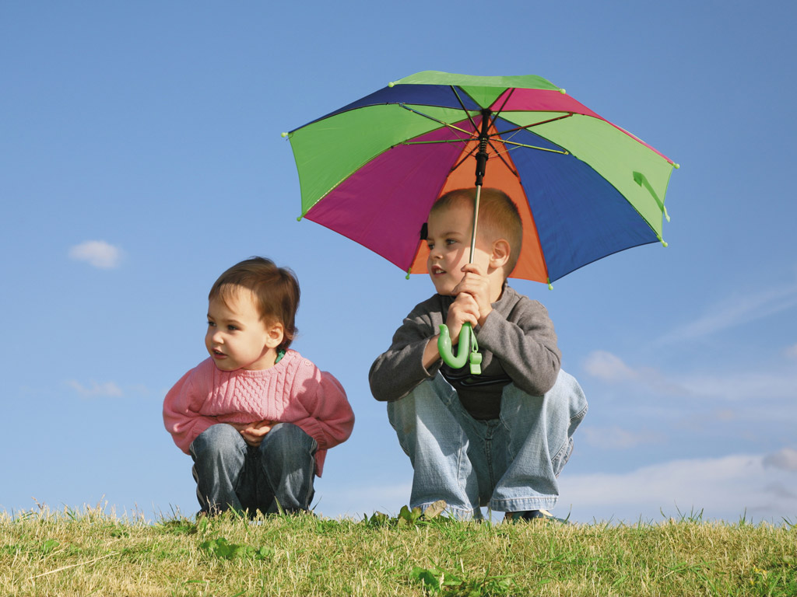
Will it rain?
No, it won’t.

Slide 9
Negative
I | won’t | play dance buy
He, she, it | won’t
We, you, they | won’t

Slide 10
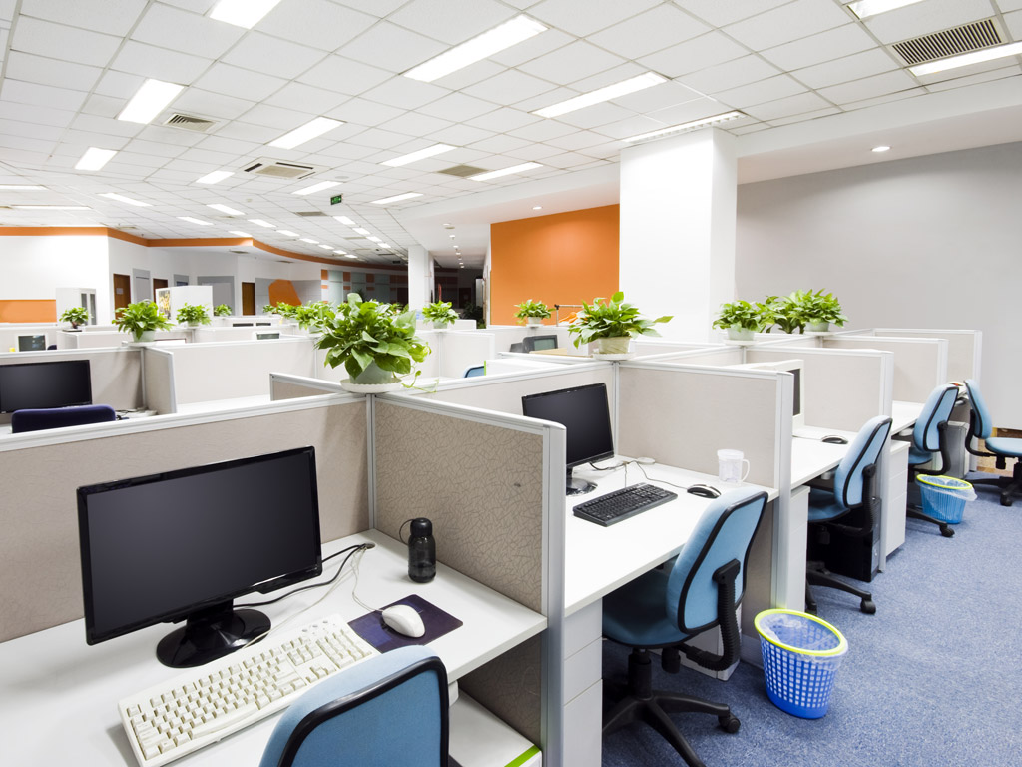
I _________ in an office.
won’t work

Slide 11
What will happen in the future?

Slide 12
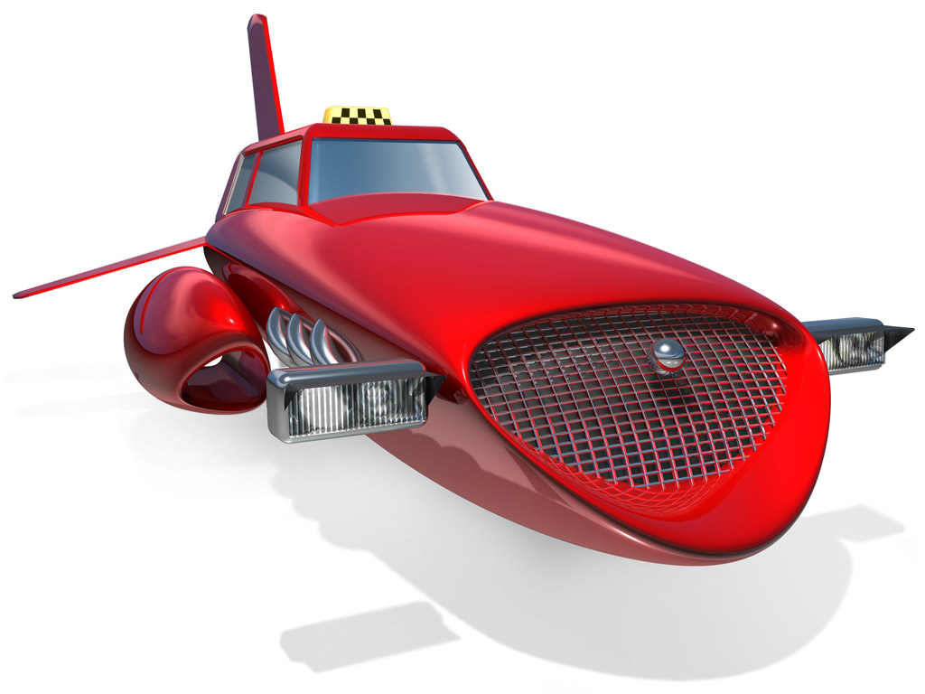
Cars ______ (fly).
will fly

Slide 13

They _______ (find) a good job.
will find

Slide 14

Daisy __________ (become) a teacher.
will become

Slide 15
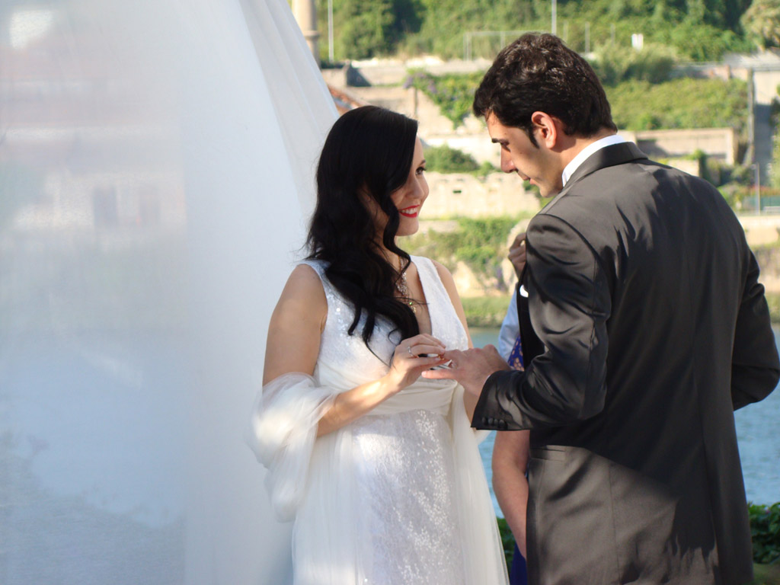
Arthur _________ (marry) a beautiful woman.
will marry

Slide 16
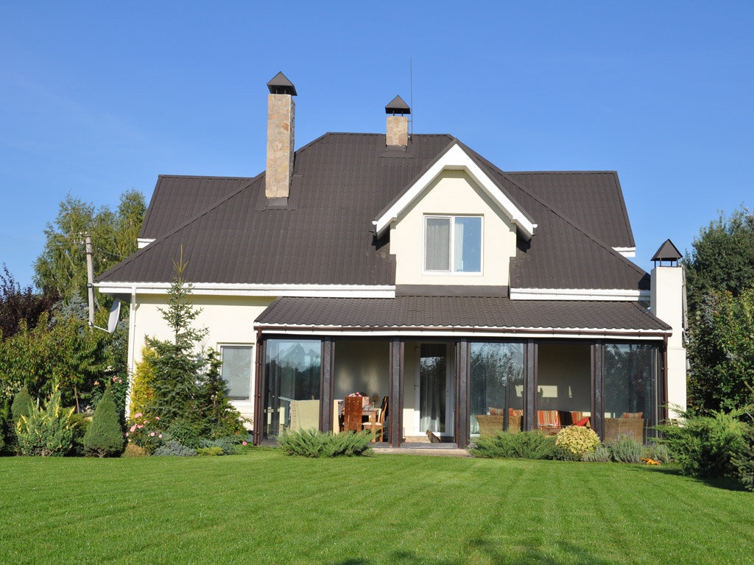
They _______ (buy) a house with a big garden.
will buy

Slide 17
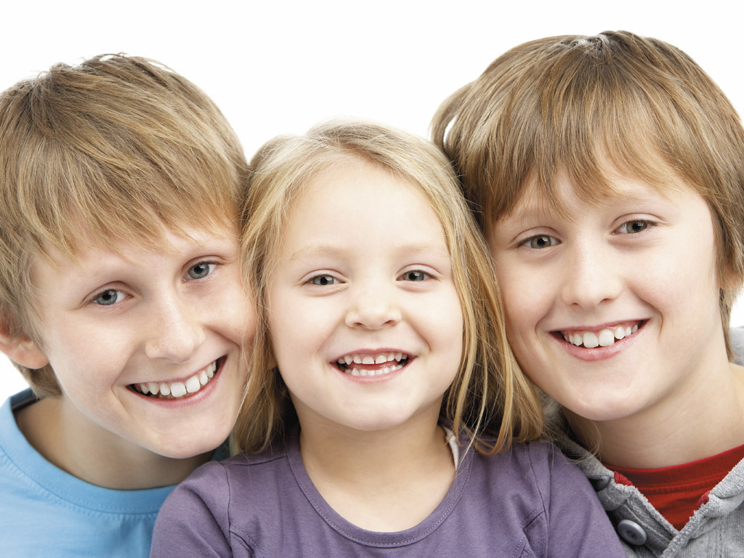
They ________ (have) three children.
will have

Slide 18

will win
Tom _______ (win) a medal.

Slide 19

We ________ (travel) around the world.
will travel

