Slide 1

No place like home
Rooms in a house

Slide 2
Identify the different rooms in the house and the objects you can find there.

Slide 3
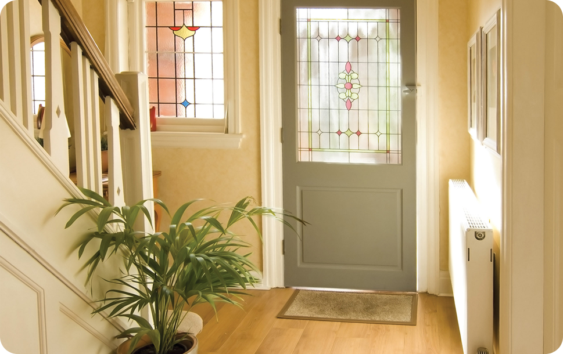
Hall
The area just inside the door of a house or building that leads to other rooms.

Slide 4
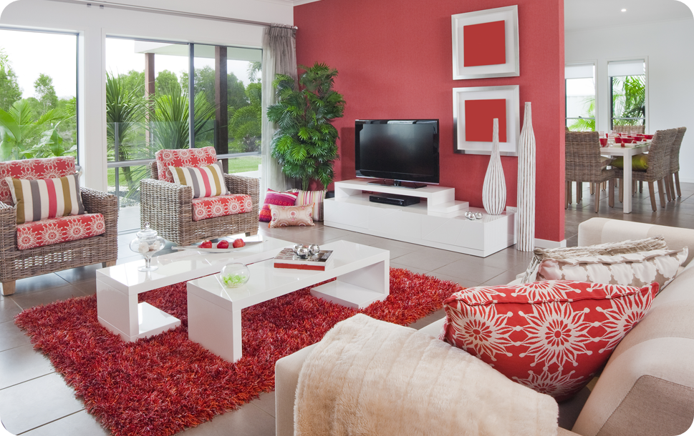
A room where people can sit, talk and relax.
Living room

Slide 5

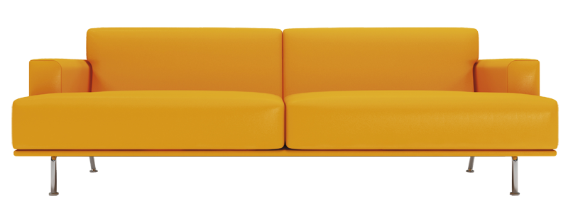
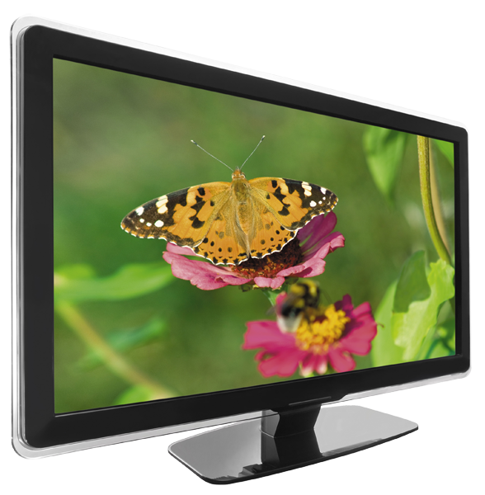
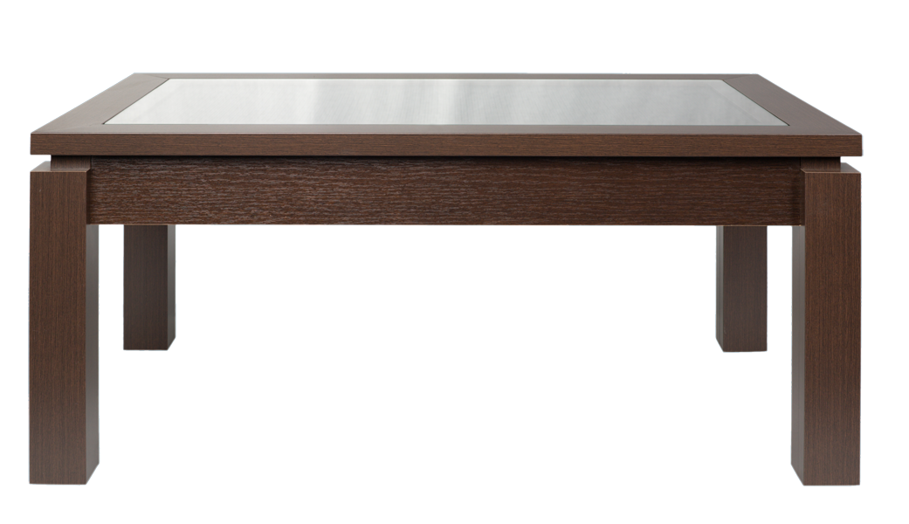
Living room
sofa
painting
coffee table
TV

Slide 6
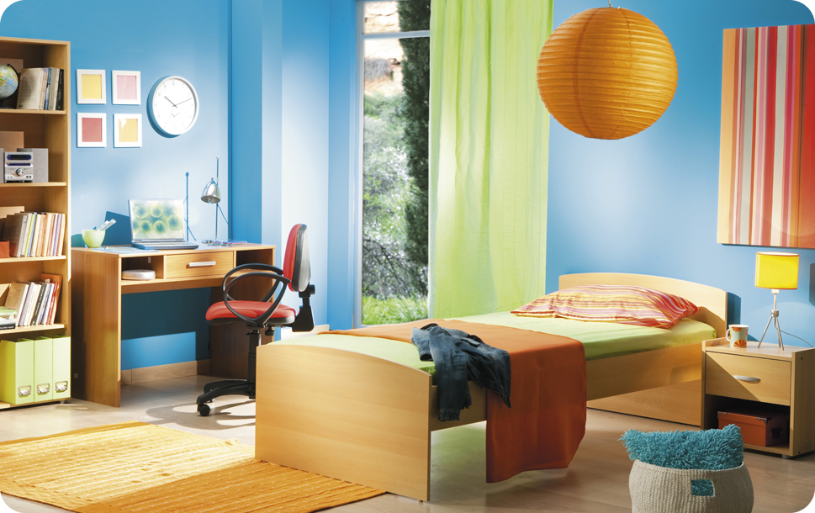
A room where you sleep.
Bedroom

Slide 7
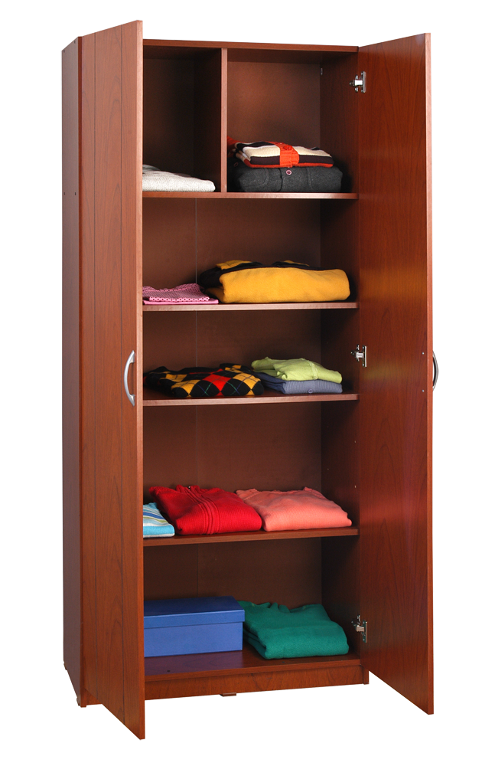
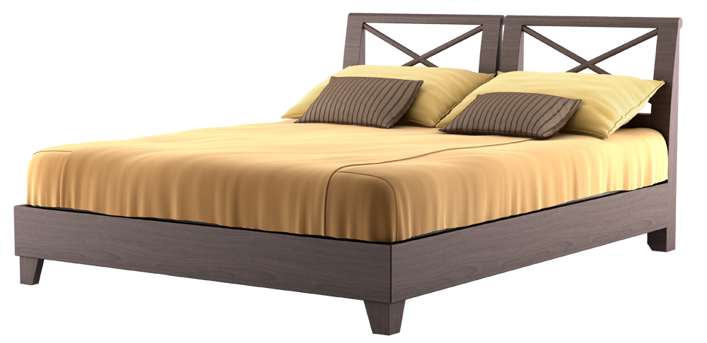
Bedroom
wardrobe
bed

Slide 8
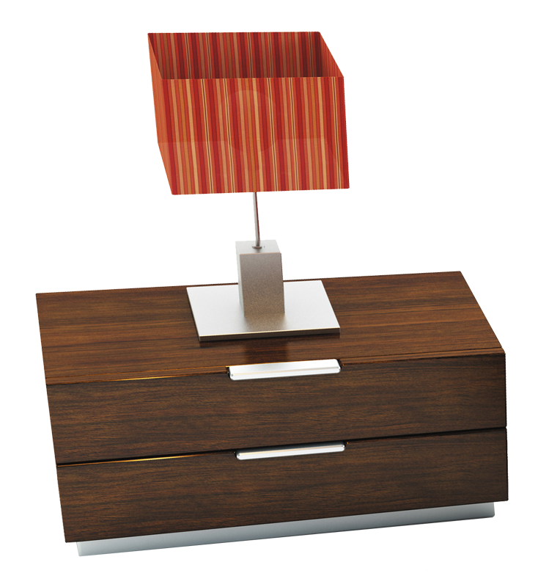

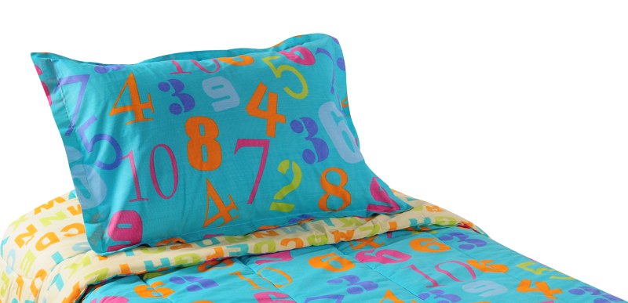
Bedroom
table lamp
alarm clock
bedside table
duvet

Slide 9
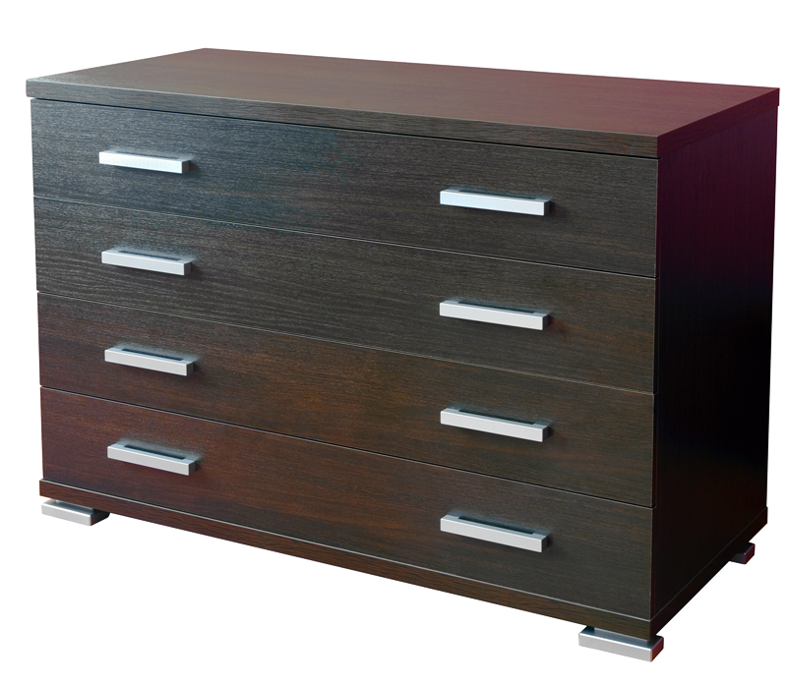

Bedroom
chest of drawers
pillow

Slide 10
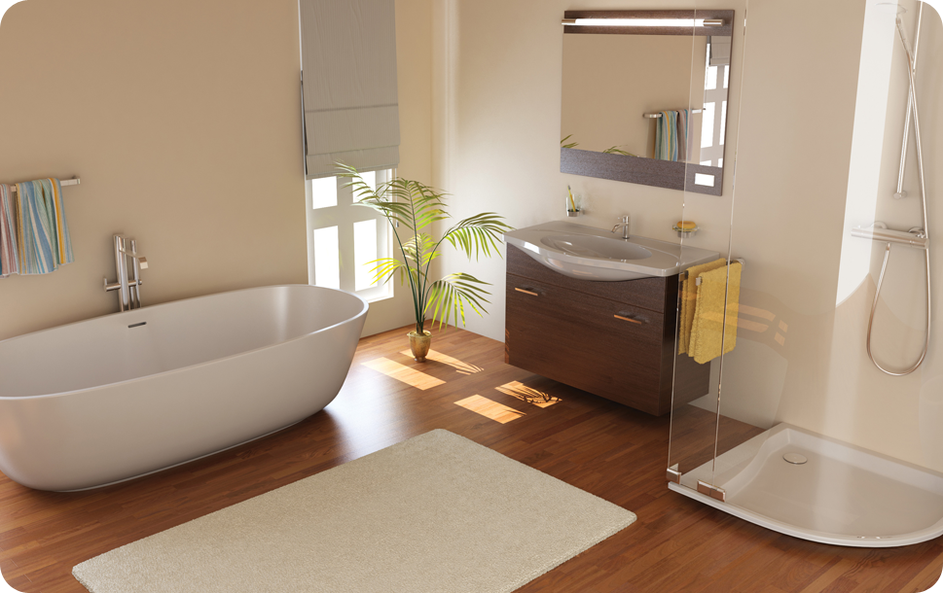
Bathroom
A room containing a bathtub or shower and usually a washbasin and toilet.

Slide 11
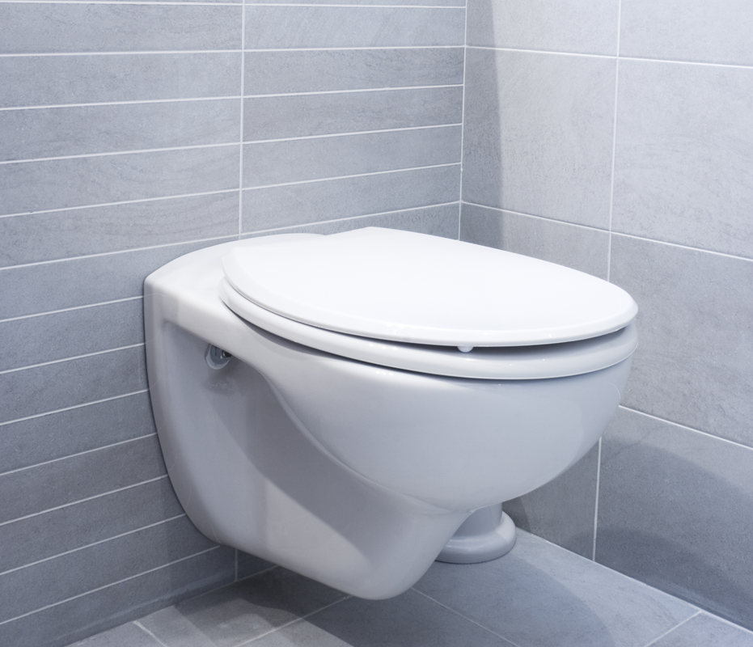
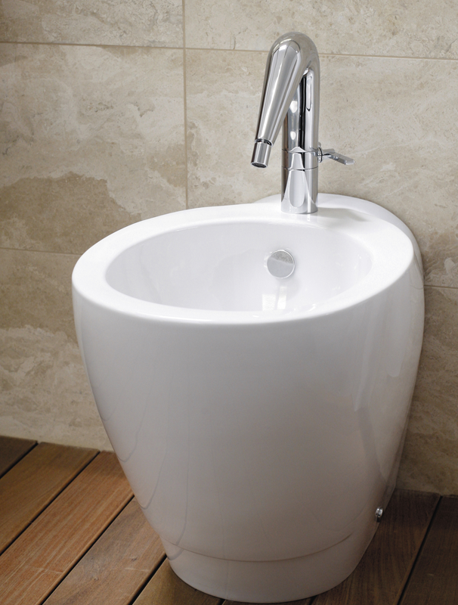
Bathroom
toilet
bidet

Slide 12
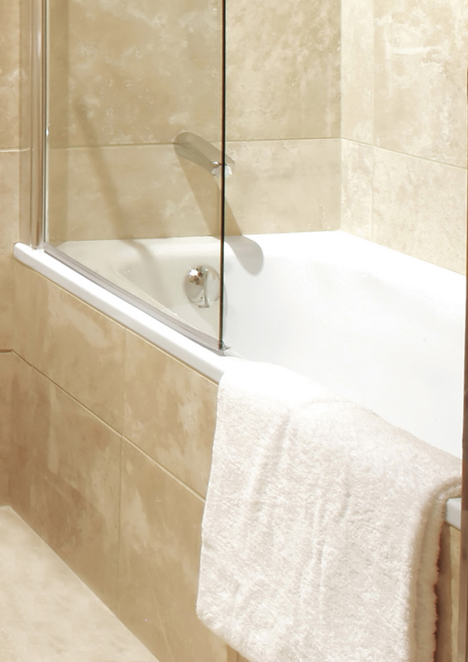
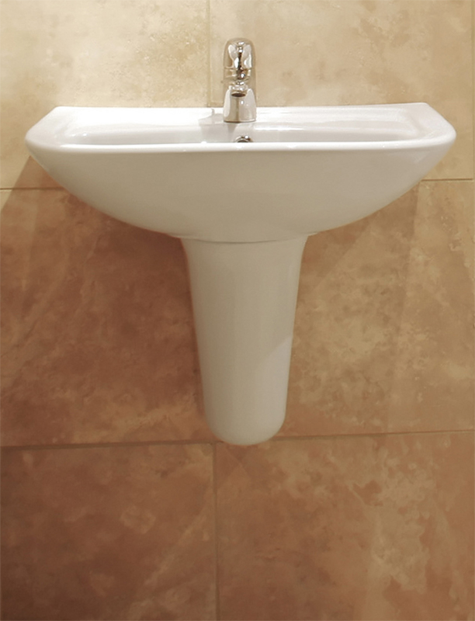
Bathroom
bathtub
washbasin

Slide 13
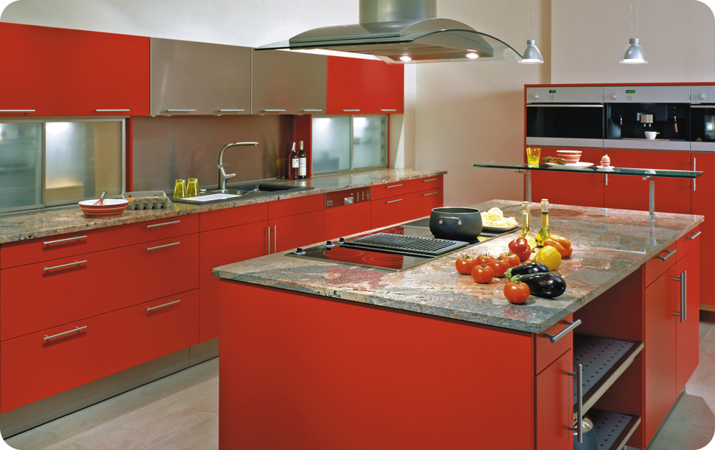
Kitchen
A room or an area equipped for preparing and cooking food.

Slide 14
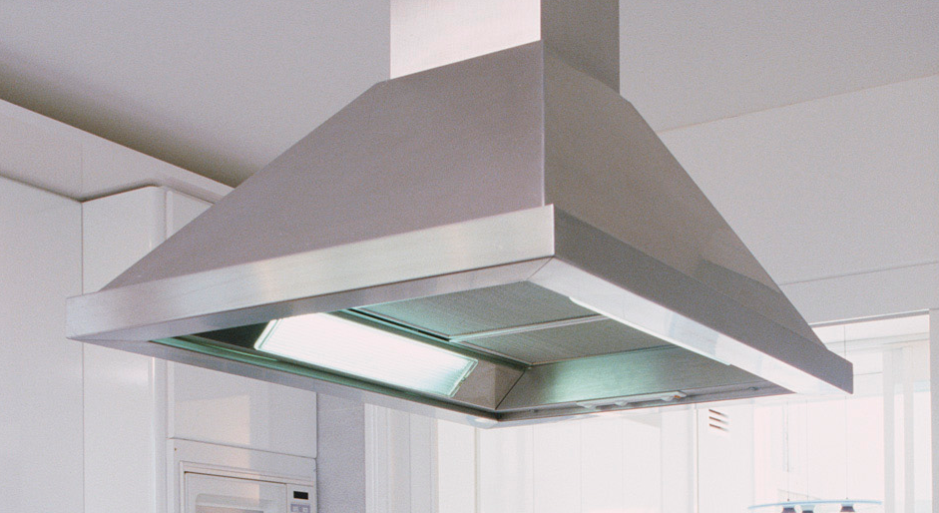
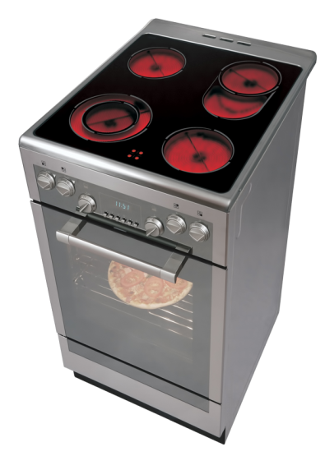
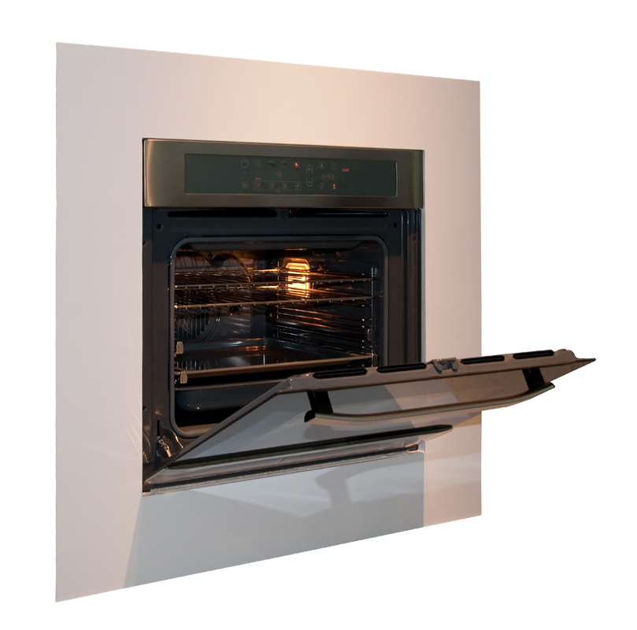
Kitchen
cooker hood
cooker
oven

Slide 15
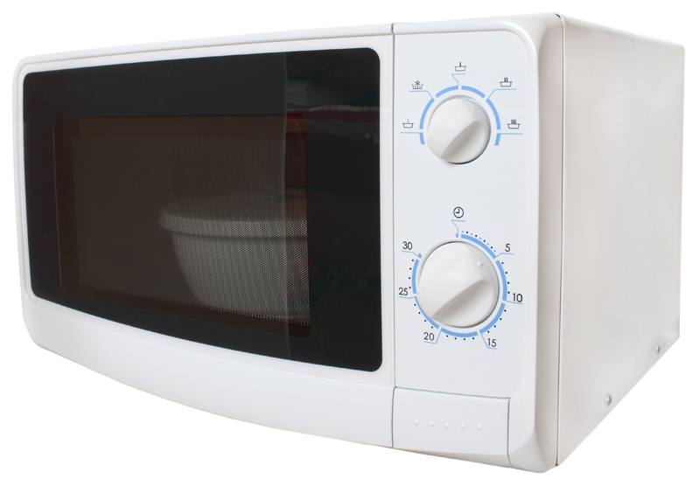
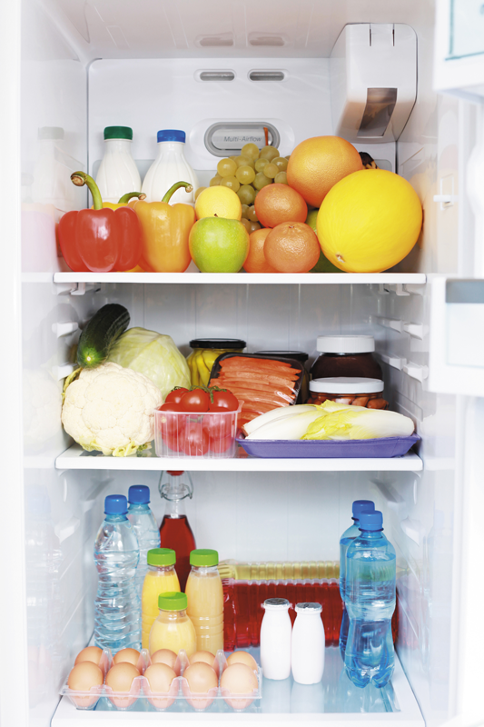
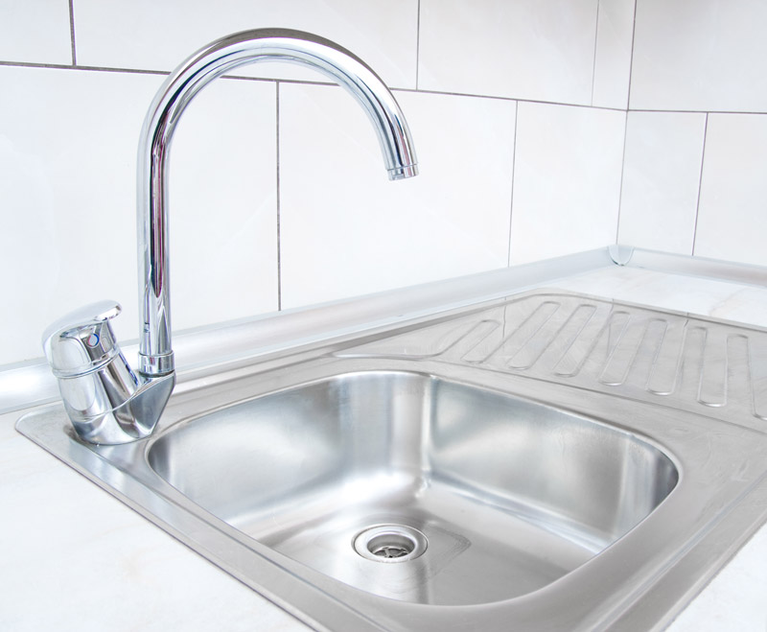
Kitchen
fridge
microwave oven
tap
sink

Slide 16
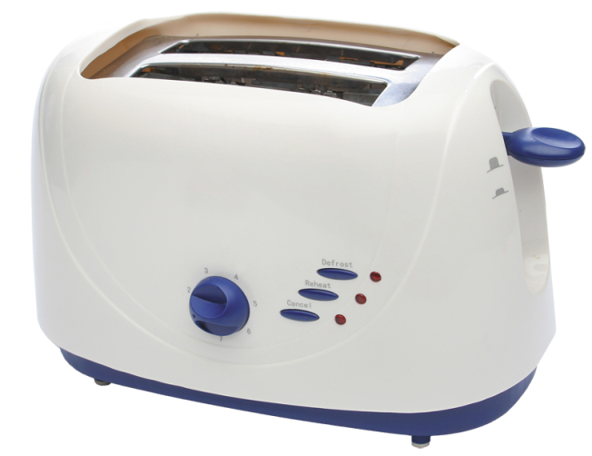
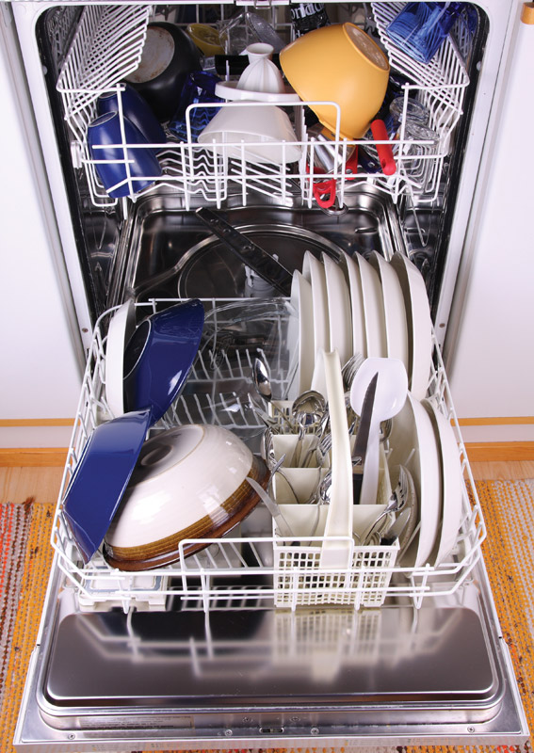

Kitchen
dishwasher
toaster
tablecloth

Slide 17
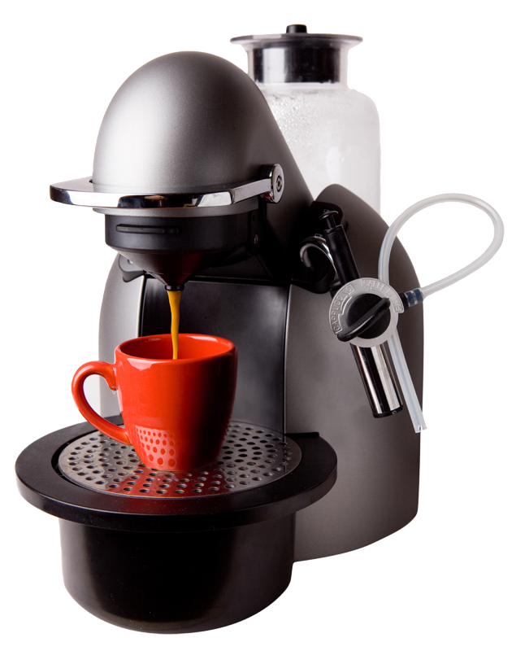
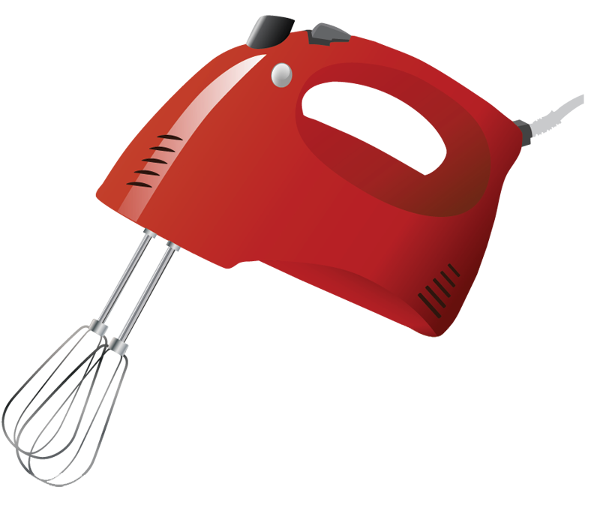
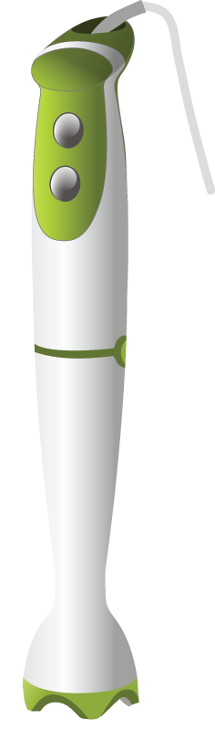
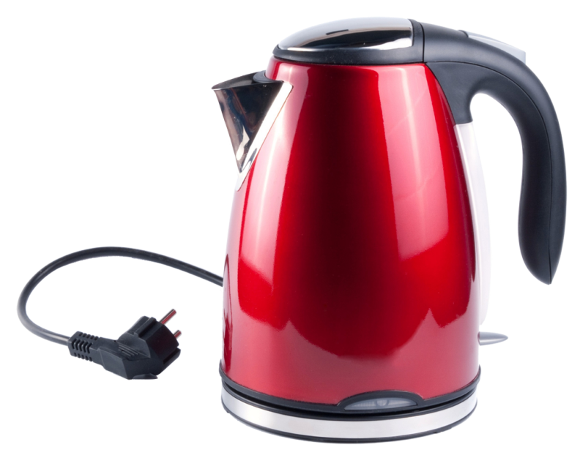
Kitchen
coffee maker machine
mixer
hand-held blender
electric kettle

Slide 18
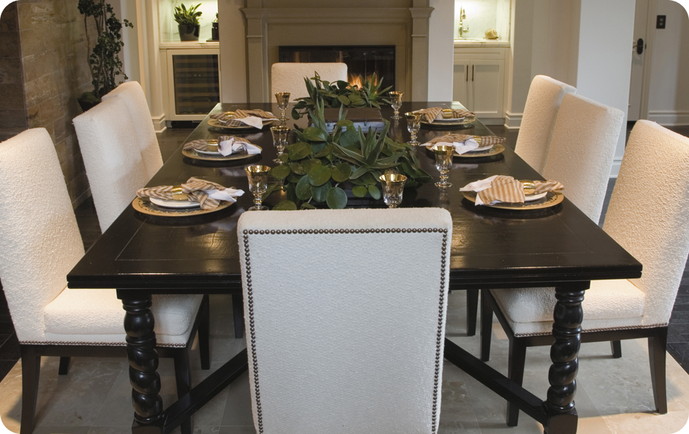
A room in which meals are eaten.
Dining room

Slide 19
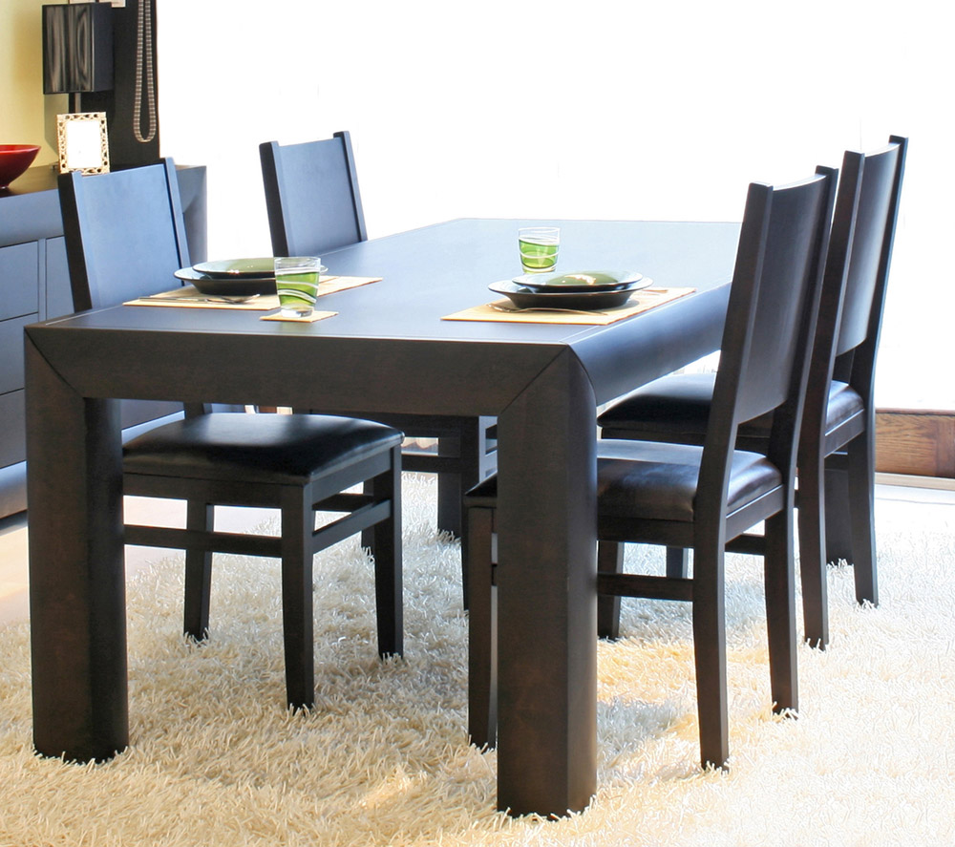
Dining room
dining table and chairs

Slide 20
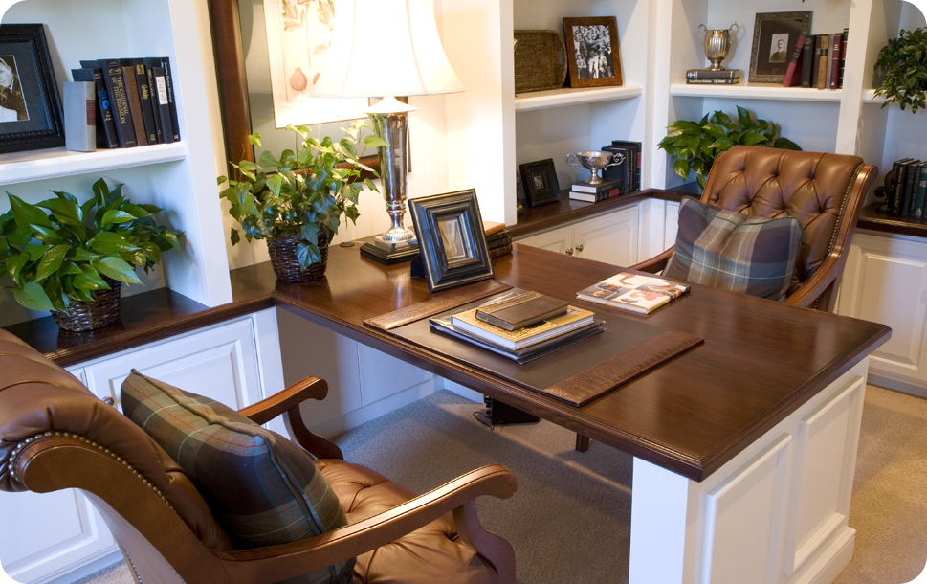
A room used for reading, writing, studying or working.
Study room

Slide 21
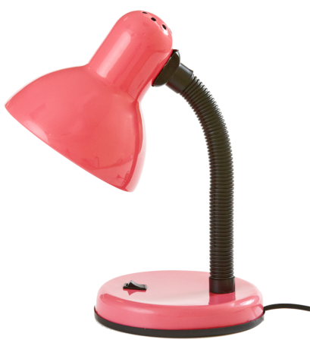
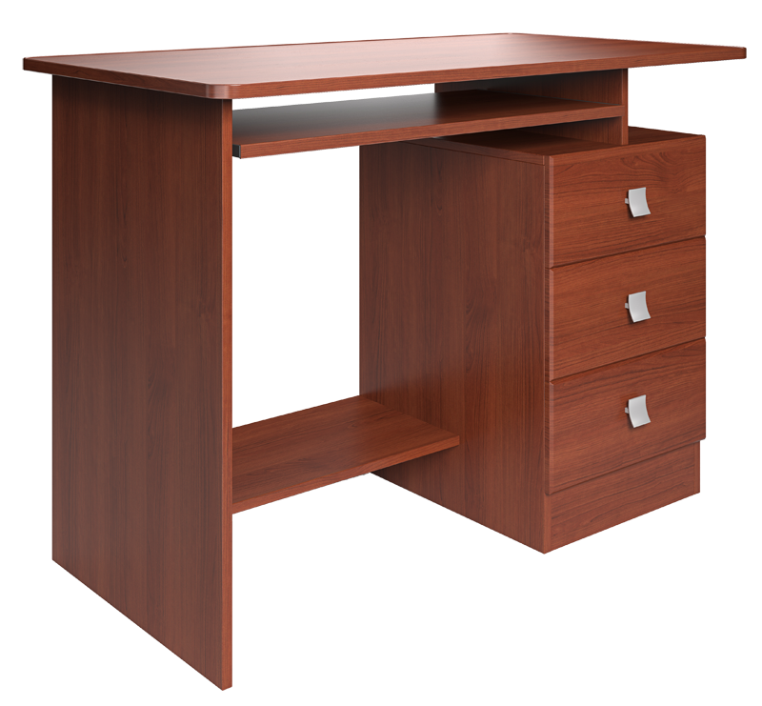

Study room
reading lamp
bookcase
desk

Slide 22
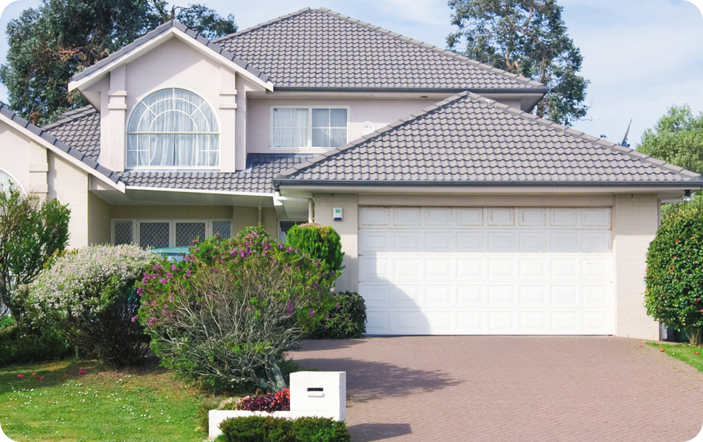
Garage
Part of a house/building used to park or keep a motor vehicle.

Slide 23
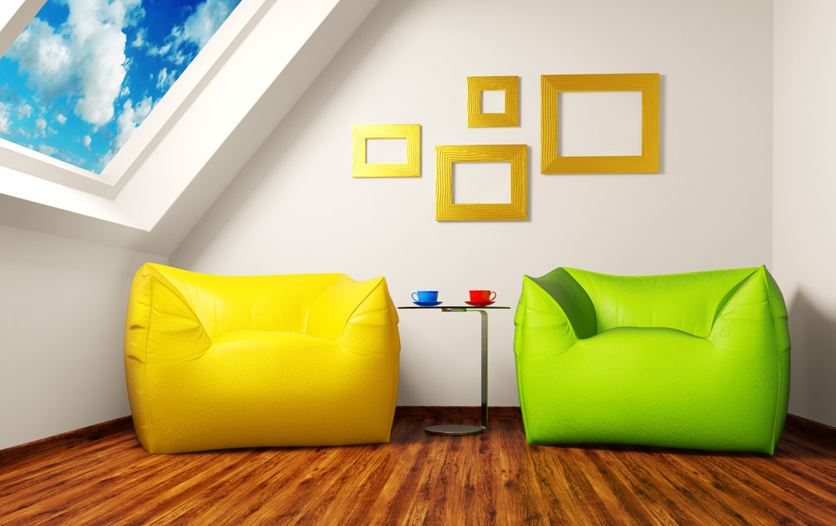
Attic
A room or open space at the top of a house just below the roof often used for storing things.

