Slide 1


Jobs and occupations

Slide 2
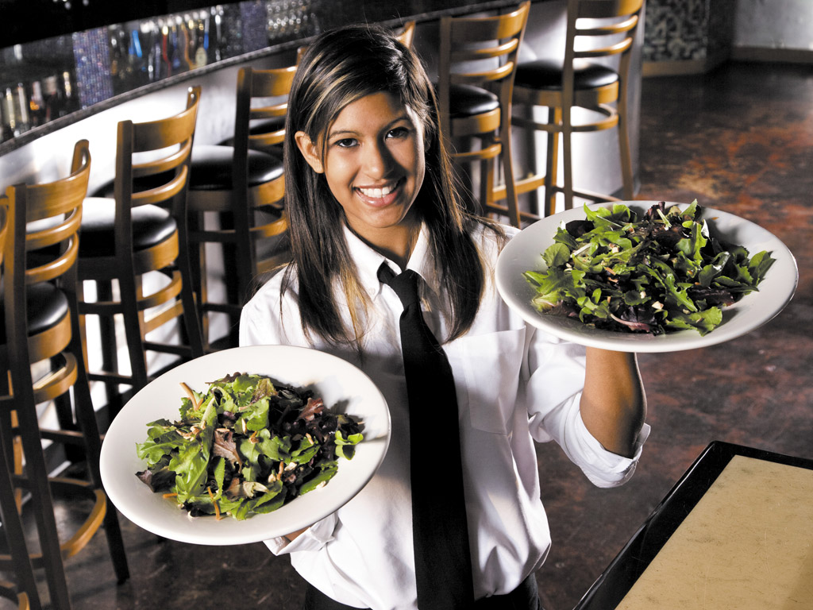
A person who serves customers at their tables in a restaurant or café.
waitress

Slide 3
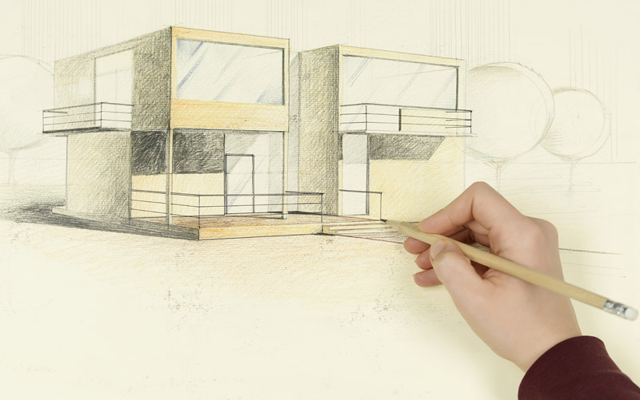
Someone who designs the construction of buildings or other large structures.
architect

Slide 4

Someone who works in gardens and enjoys growing flowers and plants.
gardener

Slide 5
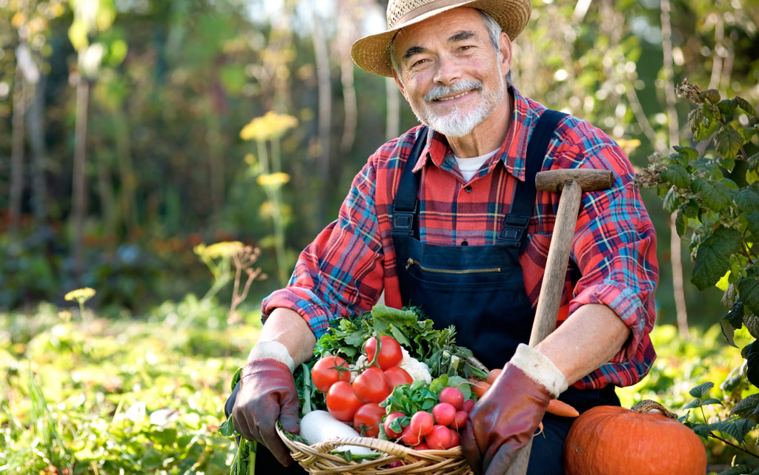
A person who works on a farm or cultivates land.
farmer

Slide 6
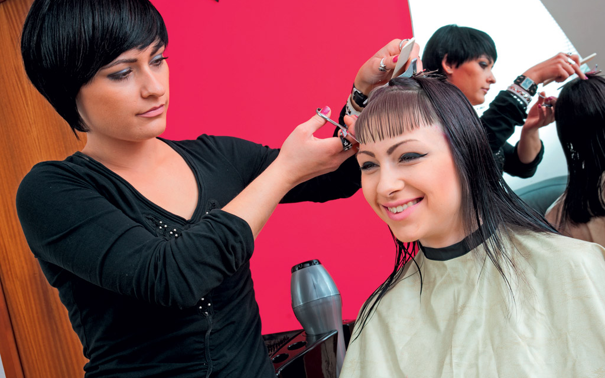
Someone who cuts, washes and arranges people’s hair.
hairdresser

Slide 7
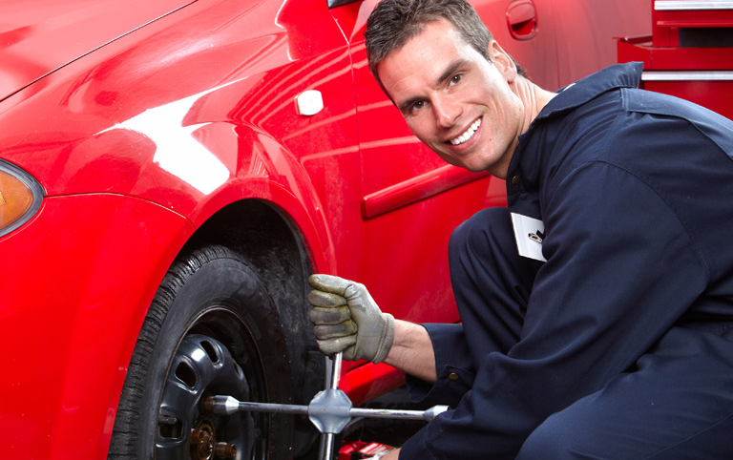
Someone whose occupation is repairing motor vehicles.
mechanic

Slide 8
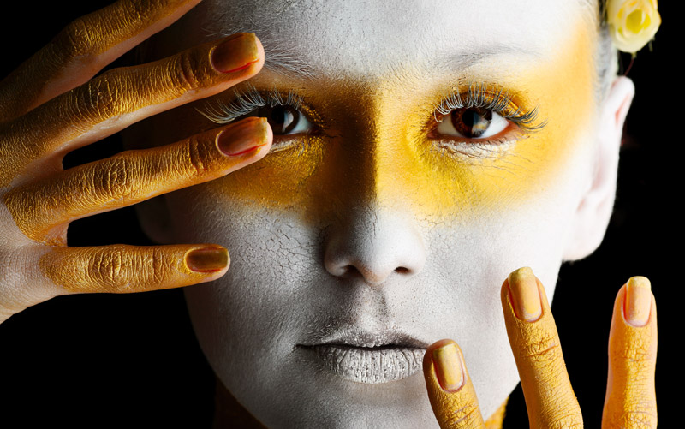
A person who acts in a play, film, etc.
actor/actress

Slide 9
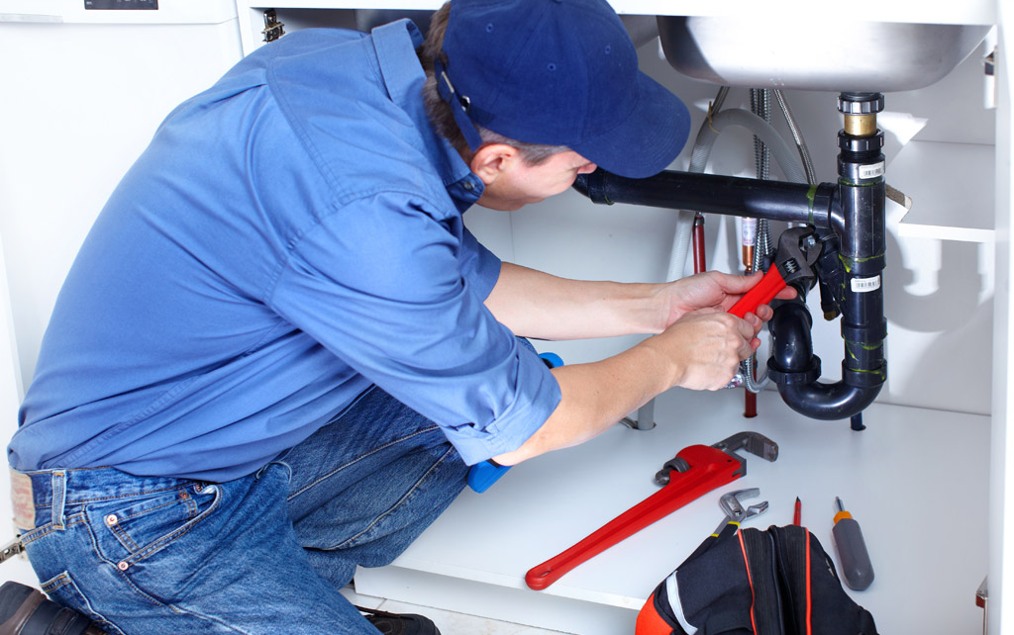
Someone whose job is to repair water pipes, sinks, baths, etc.
plumber

Slide 10
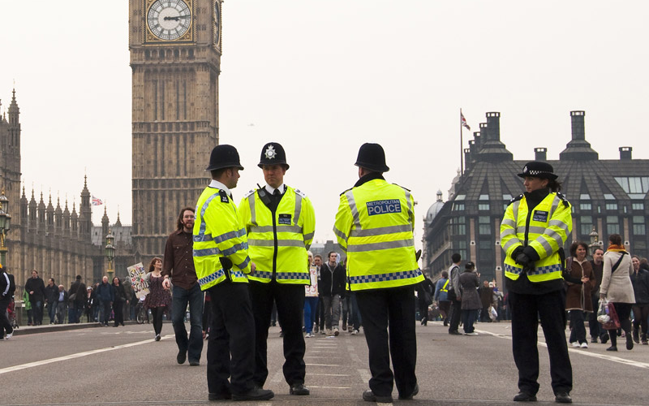
A member of a police force.
police officer

Slide 11

Someone who operates the controls of an airplane.
pilot

Slide 12

A person who gives medical care and treatment to animals.
vet

Slide 13
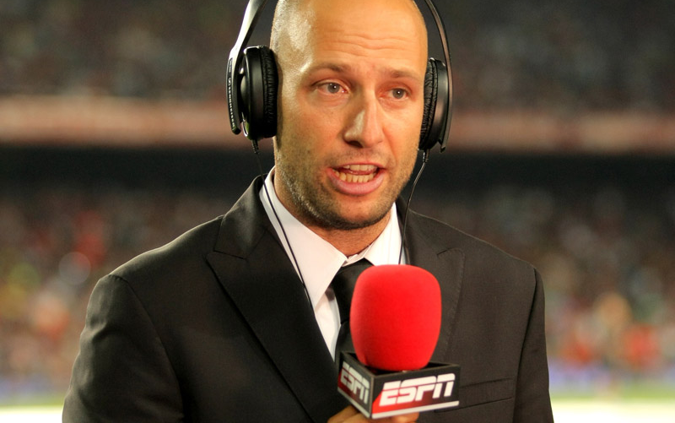
reporter
A person who collects and reports news for newspapers, radio or television.

Slide 14

doctor
Someone who treats people who are ill/sick.

Slide 15
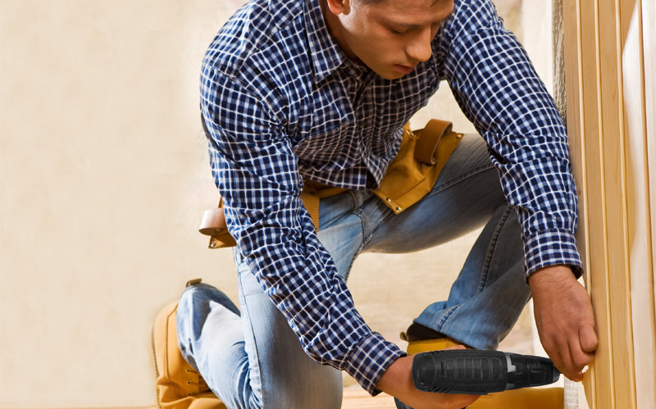
A worker who makes, finishes, and repairs wooden objects and structures.
carpenter

Slide 16

A person who teaches children and teens in a school.
teacher

Slide 17
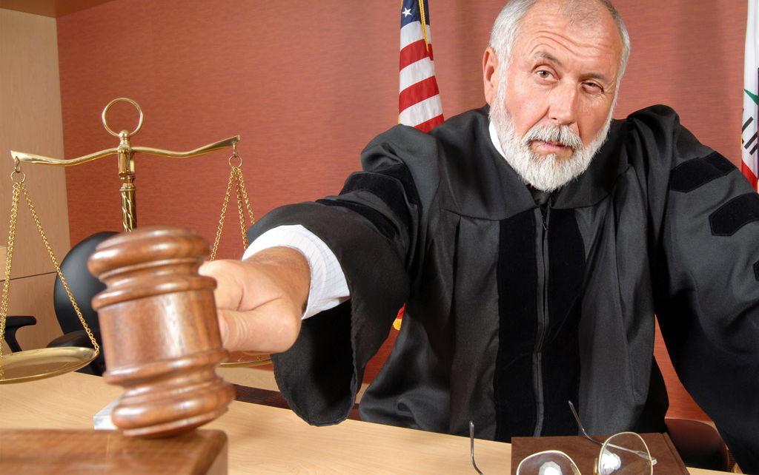
A person in a court who has the authority to punish criminals or make legal decisions.
judge

