Slide 1
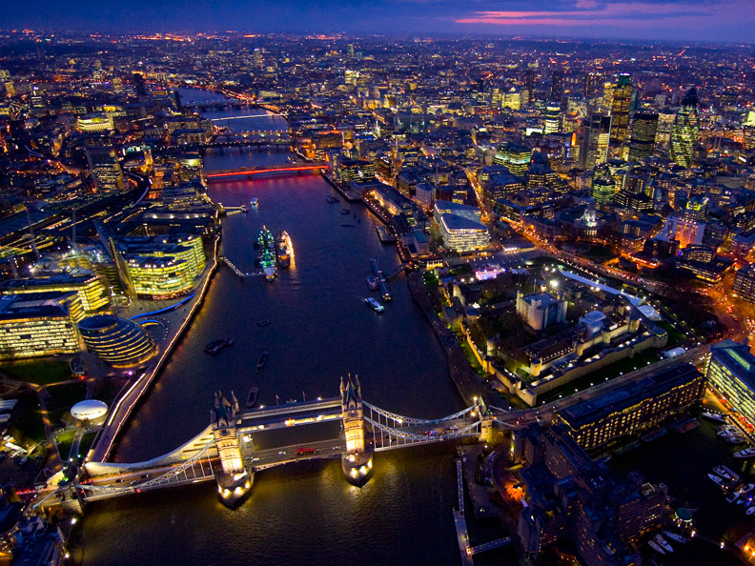
This is London!

Slide 2
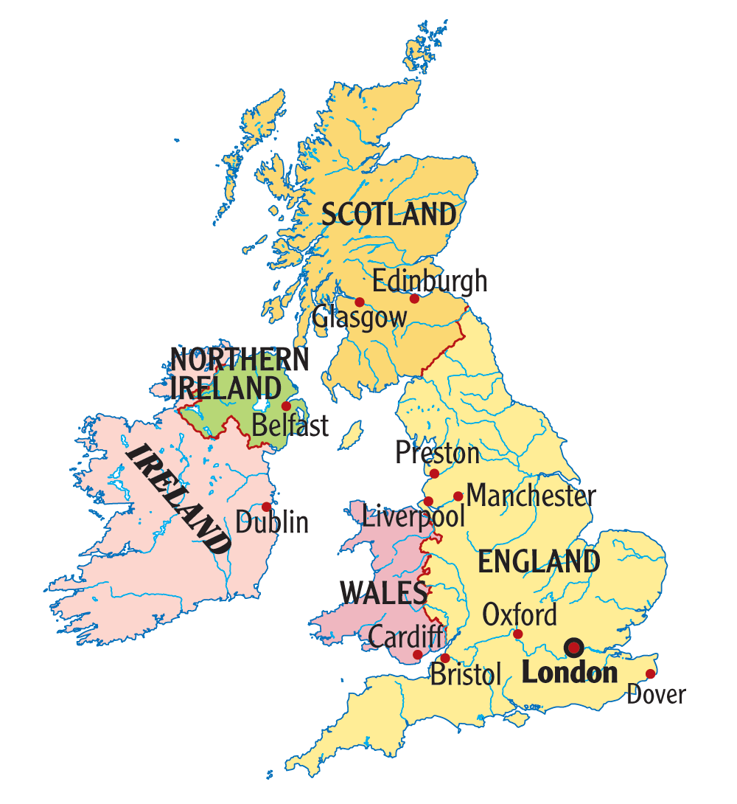
London is the capital city of England and the United Kingdom. It has a population of more than seven million people.

Slide 3
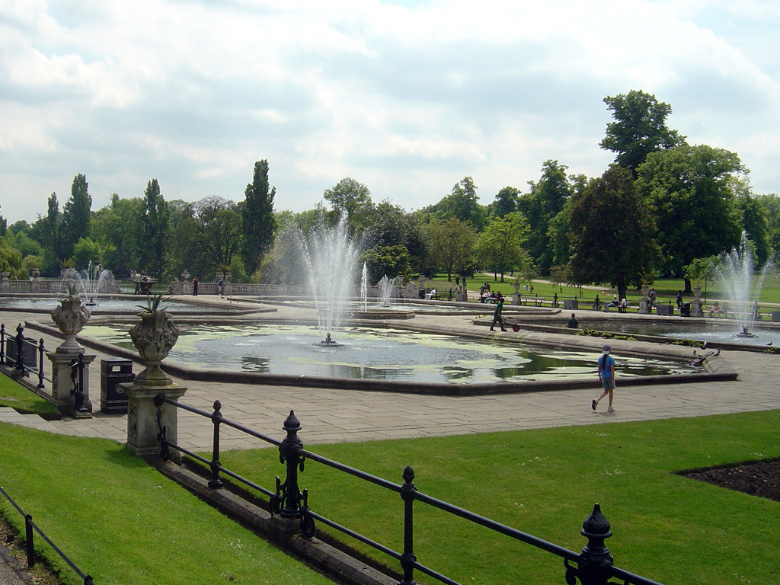
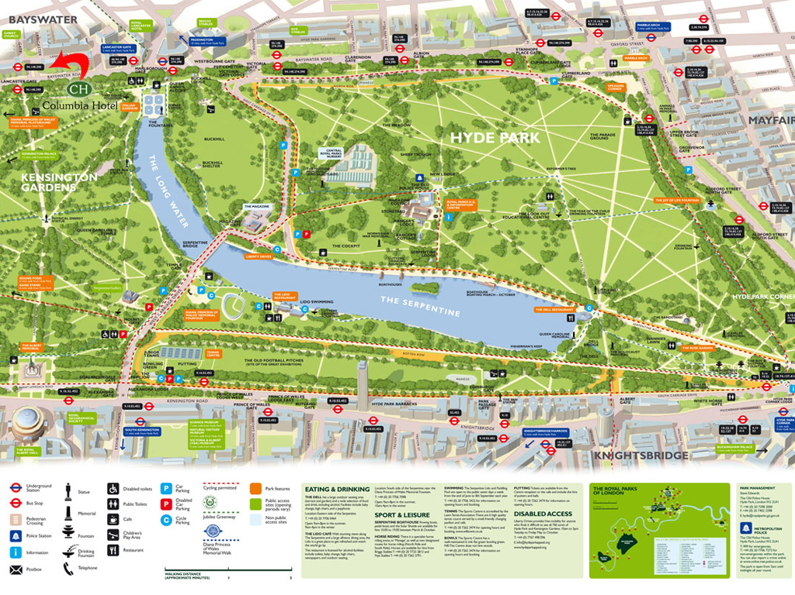
Hyde Park is one of the largest green spaces in Central London.

Slide 4
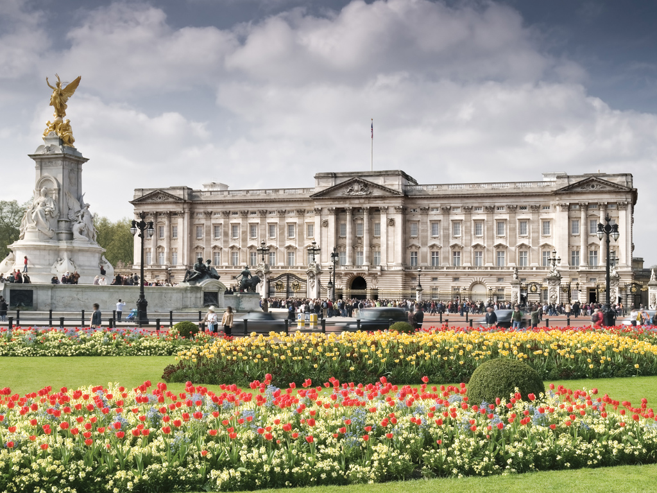
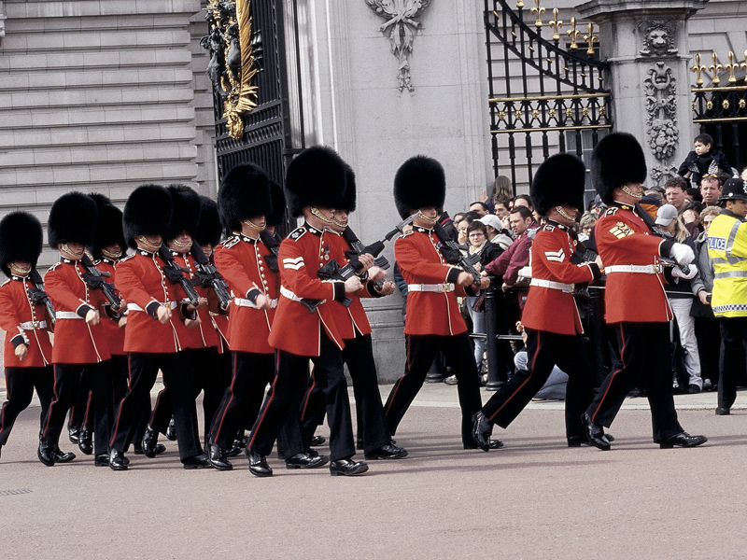
Buckingham Palace is the official London residence of the British monarch.
The Changing of the Guard takes place
at 11.30 every day. You can visit parts
of the palace in the summer.
http://www.youtube.com/...

Slide 5
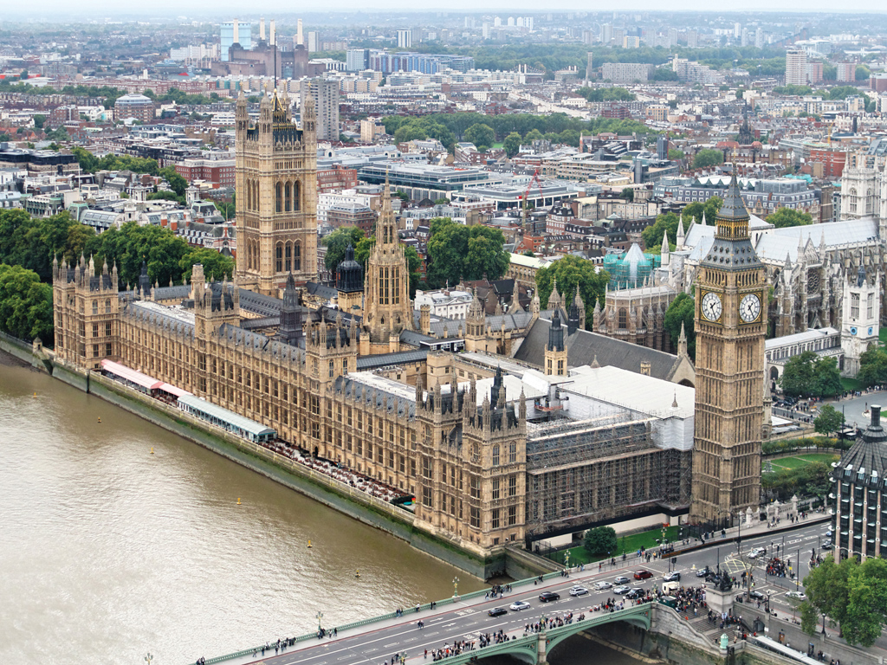
The Houses of Parliament, also known as the Palace of Westminster, are home to the House of Commons and the House of Lords.
The famous clock tower contains the massive bell called Big Ben.
The palace is a World Heritage Site and it is open to the public, so you can visit it at certain times.

Slide 6
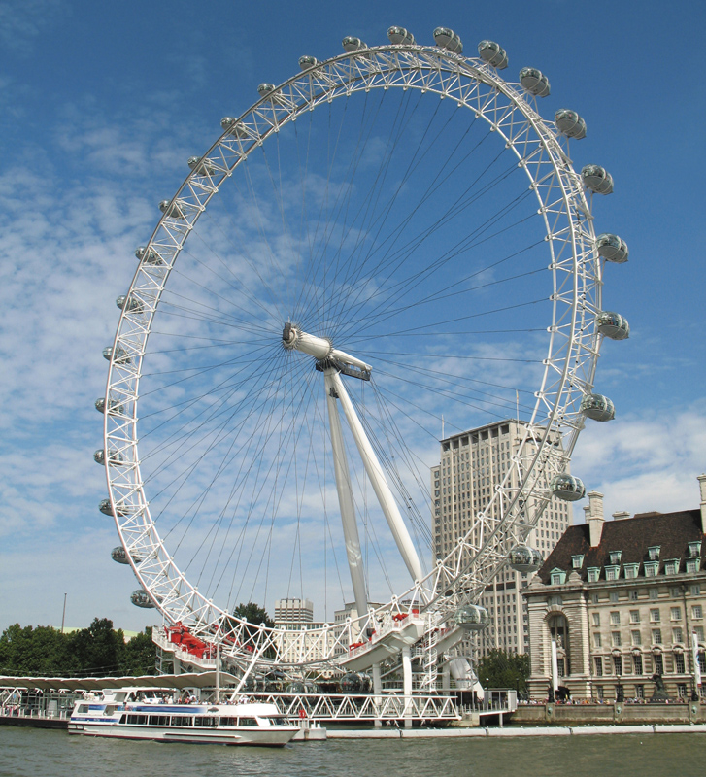
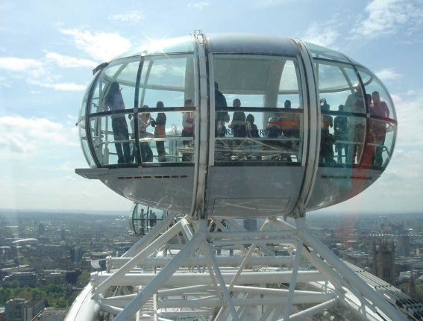
The London Eye is a giant observation Wheel (135 meters high).
The gradual ‘flight’ (one rotation) takes approximately 30 minutes and offers spectacular views of London and its famous landmarks.

Slide 7
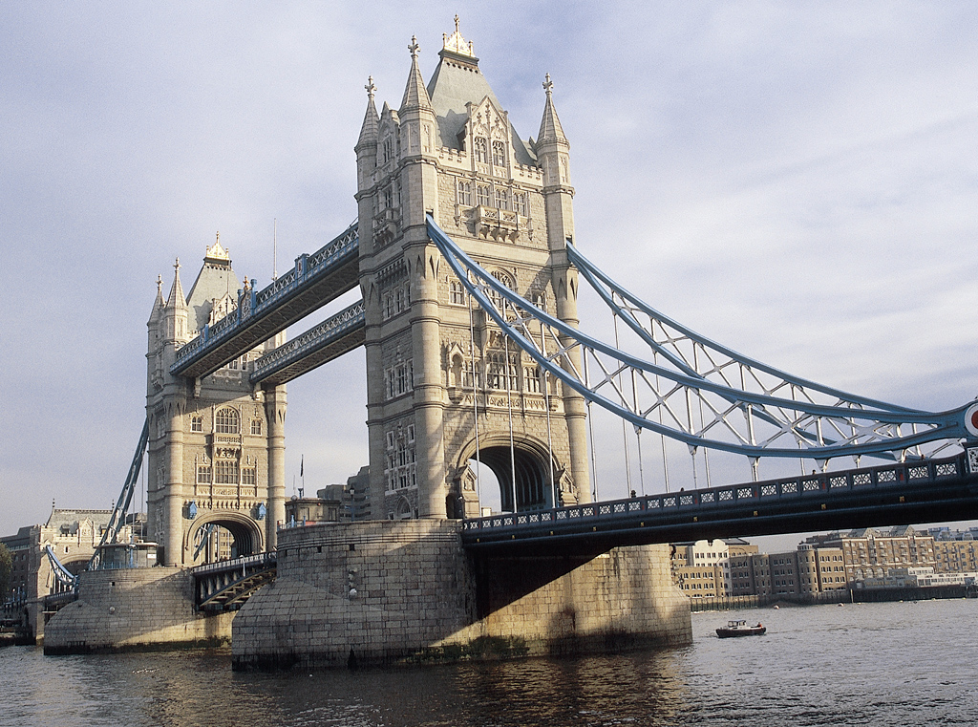
Tower Bridge
The bridge is supported by two towers over the River Thames. The central span can be raised to allow ships to pass through.

Slide 8
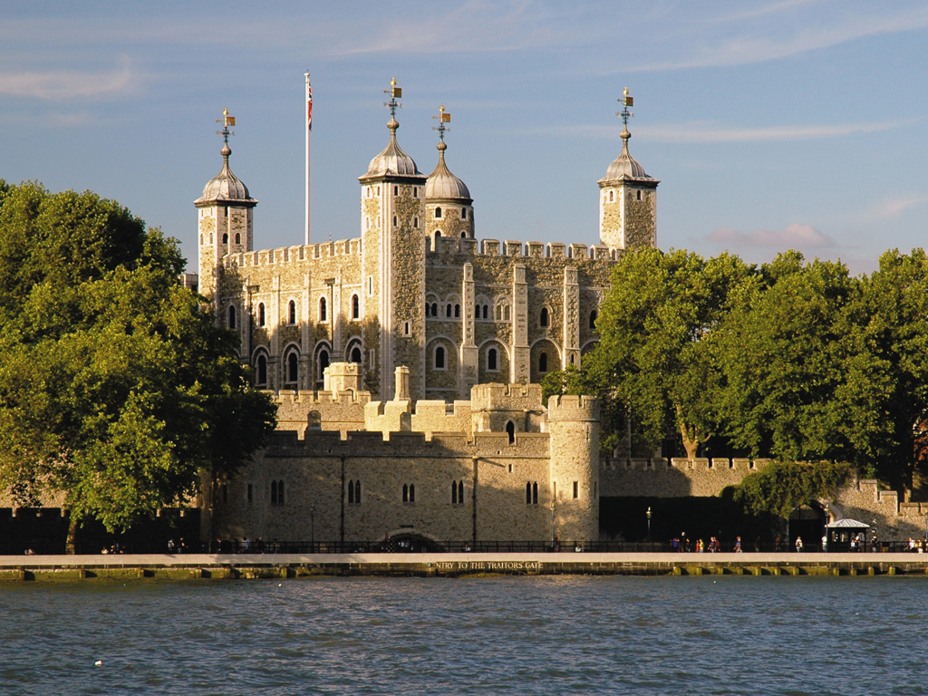
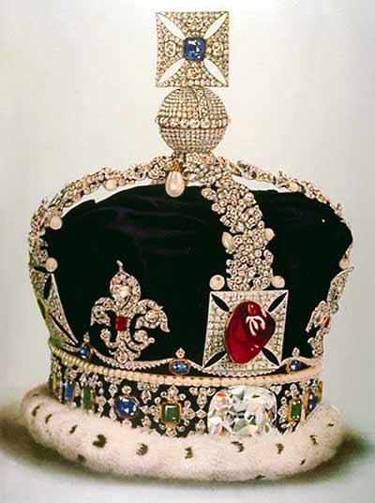
The Tower of London
– a World Heritage Site.
This fortress was used as a royal palace and prison. Now you can visit the Crown Jewels here.

Slide 9
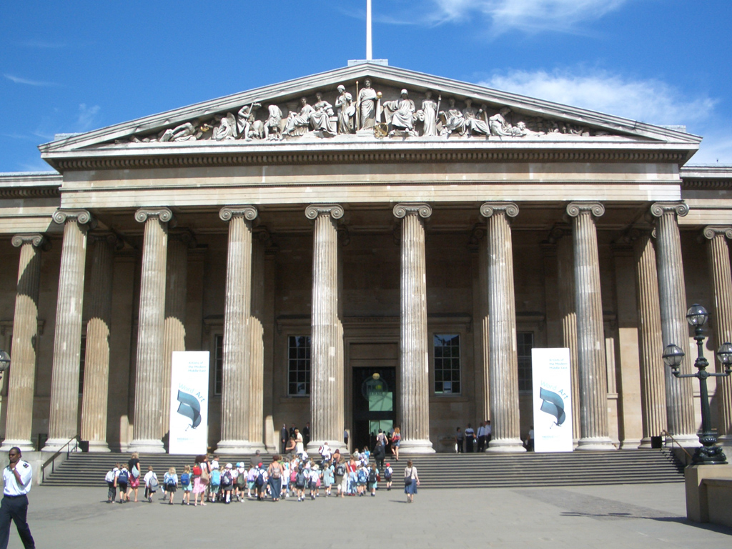
The British Museum
Its collections (more than seven million objects) illustrate human history and culture from its beginnings to the present.

Slide 10
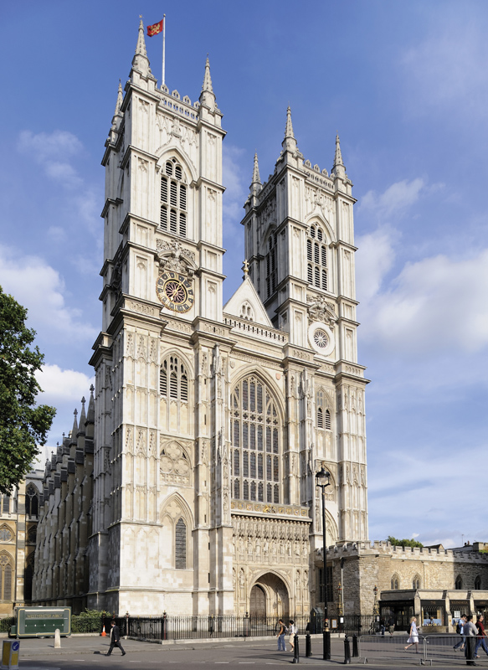
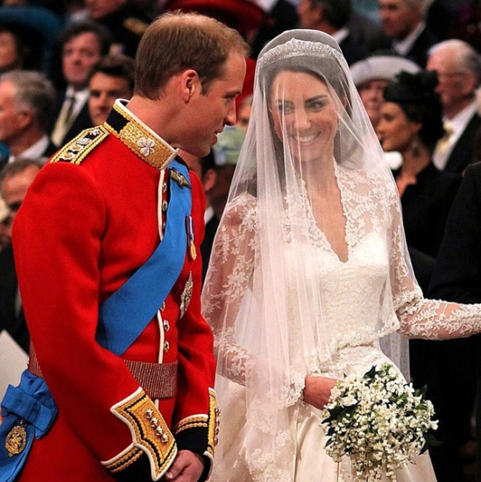
Prince William married Catherine Middleton, on 29th April 2011 at Westminster Abbey, which is a World Heritage Site.
The coronation of Kings and Queens has taken place here since 1066.

Slide 11
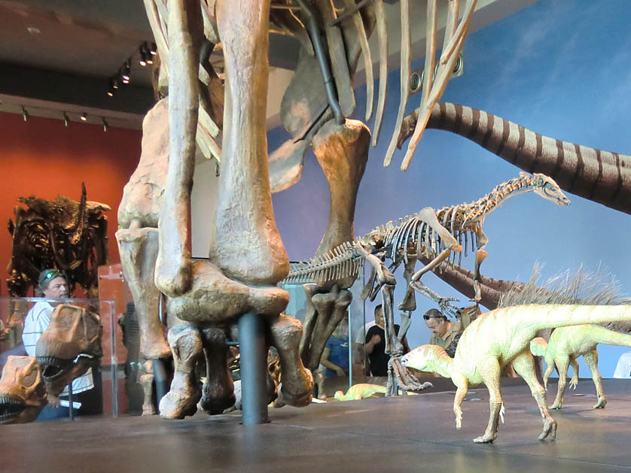
The Natural History Museum
Here you can experience the age of dinosaurs, discover amazing facts about life and learn a lot about the history of our planet.

Slide 12
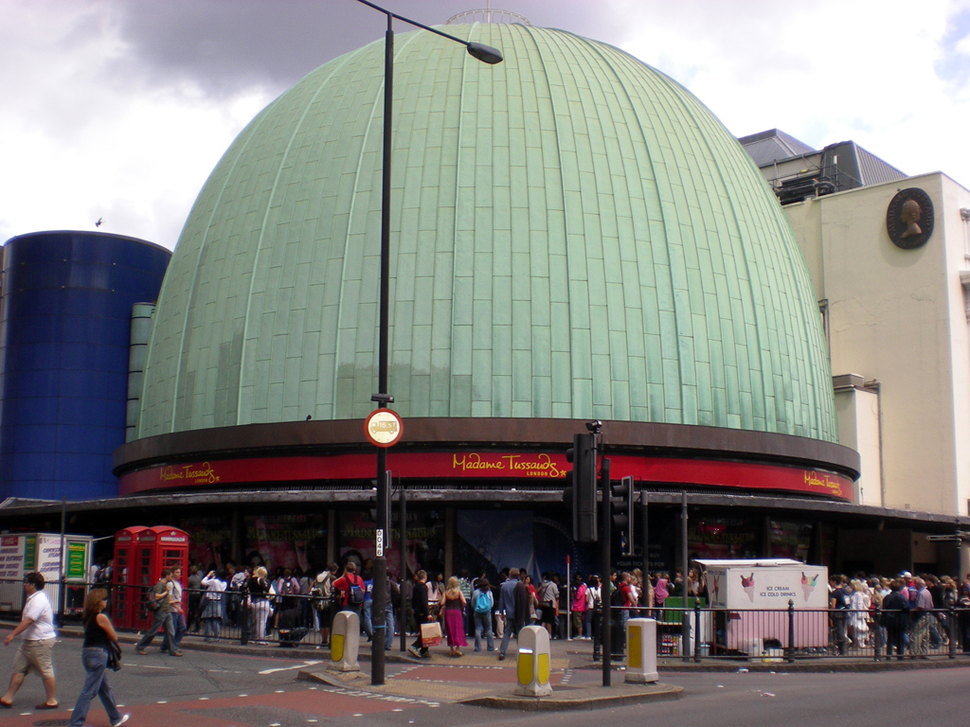

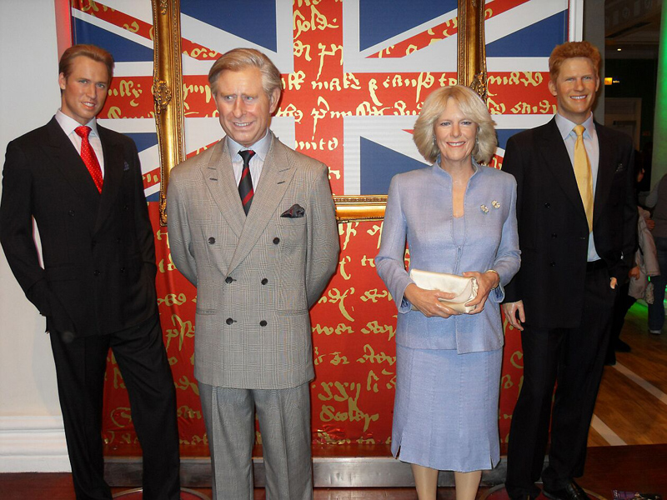

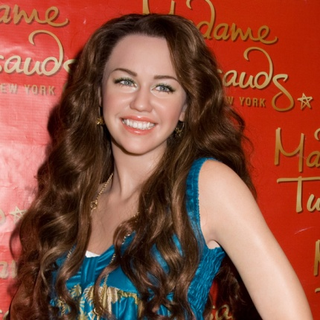
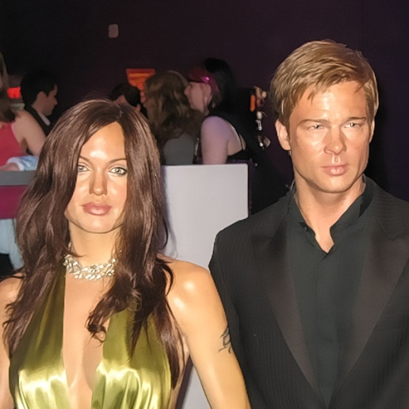
Madame Tussaud’s is a famous wax museum. Here you can see famous people from the past and present. You can take a picture next to historical and royal figures, film stars, singers, sports stars...
http://www.youtube.com/...

Slide 13
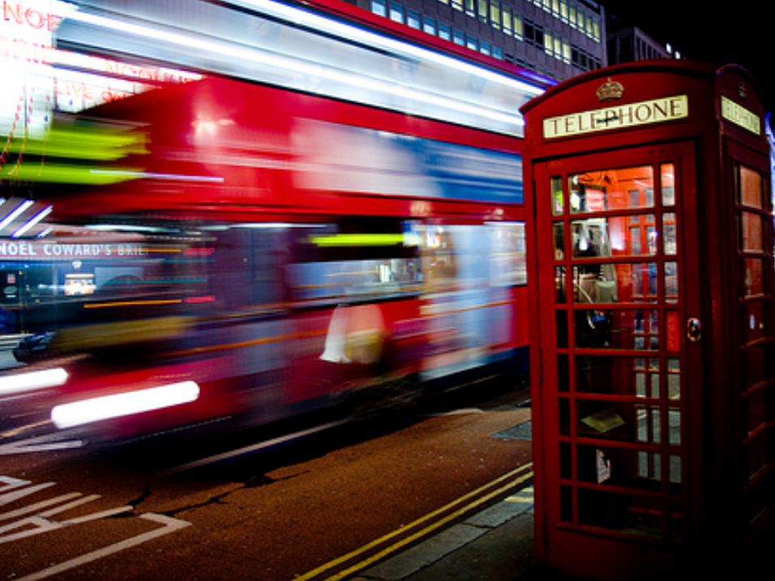
As you can see, there are lots of things to see and do in London.
London is an amazing city!

Slide 14
This is London!

